Slide 1
1. frontend
Download node.js
npm install
npm start

Slide 2
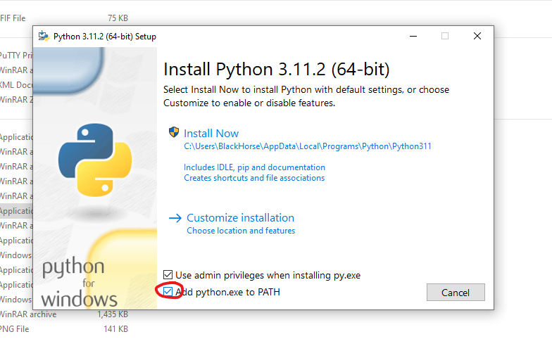
2. backend
Download python
Intall python (check second option)

Slide 3
pip install virtualenv
virtualenv venv
Run venv/Scripts/activate.bat
pip install –r requirements.txt
pip install langchain
pip install pinecone-client
uvicorn main:app --reload

