Slide 1
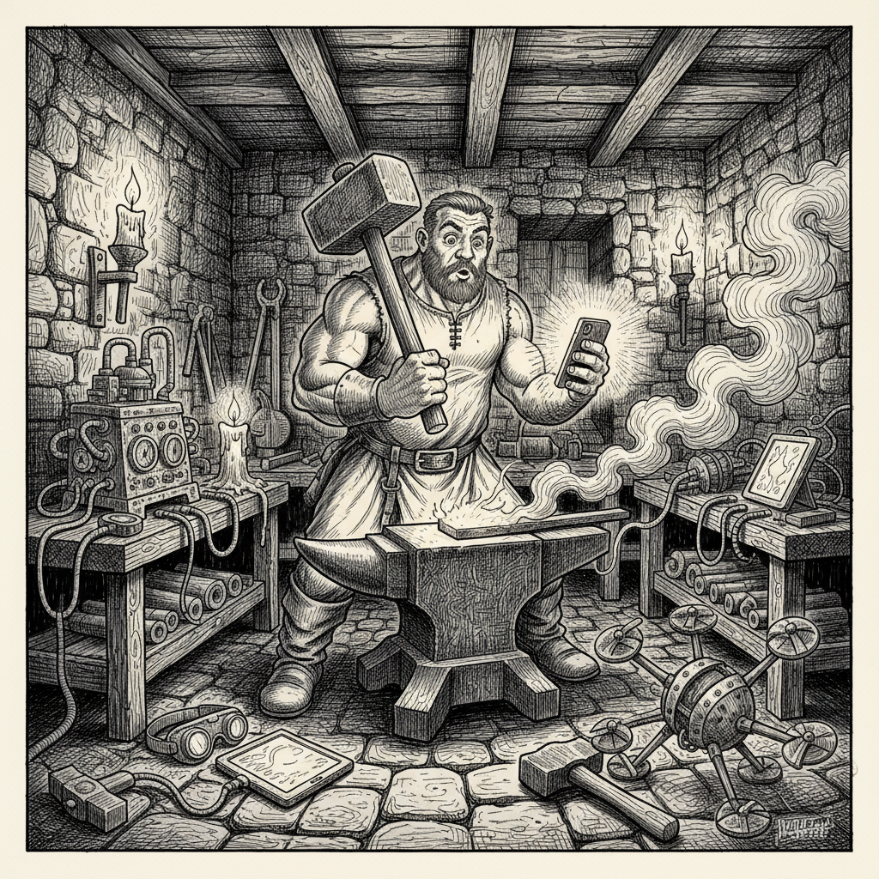
From Anvils to APIs
Two Transitions, One Pattern
WCCCE 2026
WCCCE 2026

Slide 2
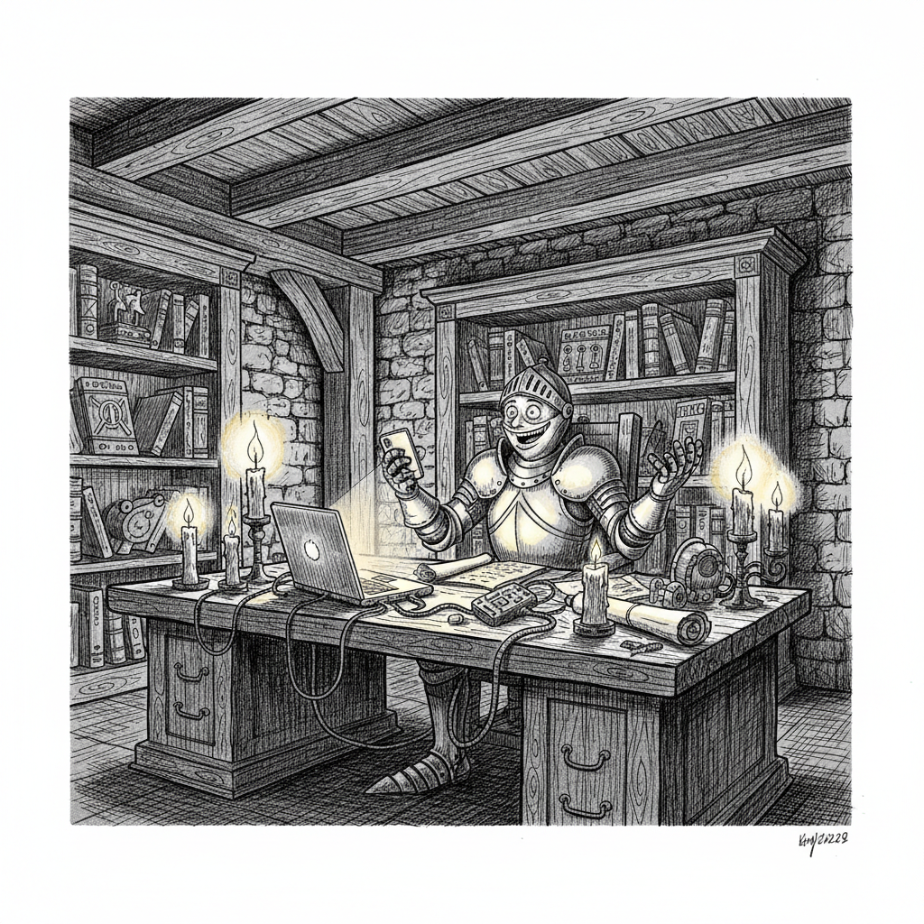
Why Computer Science?
So we can build things that delight customers — real people with real problems, who should leave glad we existed.
Everything else is in service of that.
WCCCE 2026

Slide 3
Where We Drifted
We began to treat incantations — syntax, rituals, the canon — as if they were the degree.
We forgot (or stopped saying out loud) that the mission was teaching students to build.
Knowing the spells is not the same as shipping something that matters.
cd36d50a-9f6
WCCCE 2026

Slide 4
What We Taught Was Incantations
Computers demanded precise spells before anything useful happened: source → machine language — hence the compiler and toolchain.
Year one: semicolons, tabs, initialization — if you're lucky, what happens to data in memory.
We rarely started from the problem we were solving.
a60de312-1f4
WCCCE 2026

Slide 5
The Ladder Goes Up
Algorithms, Big-O — domain incantations. You learn the classics; previous magicians wrote them.
Databases / SQL — store data so you can reach it fast and ask questions. The spells get closer to English: select… where…
7de99796-eaf
WCCCE 2026

Slide 6
The Pinnacle — and the Trap
Then the big magic: low-level to machine-level — compilers, translation — often the crown of the undergrad program.
We digest the book; you give it back looking like our template. Grades reward mimicry.
By year three, many students still haven't built anything except proof they echoed the spellbook.
8837e721-79a
WCCCE 2026

Slide 7
Counselors Know the Gap
They push final-year courses where you finally ship something the world might want — as if the first three years were rehearsal.
The job market still asks for people who delight customers — not only people who ace the canon.
856f468e-0e7
WCCCE 2026

Slide 8
CS Was Never Only About Coding
We taught it that way when we weren't builders.
You know the incantations. So does every LLM.
The job is no longer teaching incantations. It's teaching how to build.
f90edc1e-651
WCCCE 2026

Slide 9
I've Always Been a Builder
What follows isn't random biography. It's the same instinct over and over: make something that changes what happens next.
Institutions kept foregrounding incantations. I kept reaching for builds — games, workarounds, tools for real work.
9143c156-07b
WCCCE 2026

Slide 10
Grade 2 — Multiplication Tables
The teacher kept the tables on her desk. I went home and taught myself to read upside down.
My mother asked why. I said: she's showing me the answers — I'll read upside down so I don't have to drill the tables.
I still read upside down. I never really memorized the tables. It hasn't hurt my career.
4033e7f3-d9e
WCCCE 2026

Slide 11
My First "ChatGPT"
It wasn't magic — it was figuring out the prompt: what to learn, how to position myself, to get the data I needed.
d90c793a-85b
WCCCE 2026

Slide 12
1977 — A Game on a Casio
Programmable calculator. A random target on a 100×100 grid. You type x and y; it answers with distance to the ship. You close in until you hit it.
Crude Minesweeper-style deduction — tight memory, tiny screen — and fun to play.
f663552b-2fb
WCCCE 2026

Slide 13
"That Isn't a Real Computer"
University of Windsor — I wanted to do coursework on my Z-80 instead of the lab IBM 360.
A professor said I didn't have a real machine: if it wasn't 32-bit, it didn't count.
Part of my training, he said, was punch cards — because that's how you drove the IBM 360.
2c78bc0a-a3b
WCCCE 2026

Slide 14
A Better Machine — Same Ritual
Year three: Computing Services bought a DEC VAX 780 — better than the 360, a room of terminals.
The same professor had the VAX wired as a line-editor front end to the 360: edit like punch cards, batch to the 360, pick up printouts at the IOL window.
The VAX still wasn't "real." The 360 stayed the center of gravity.
8d293112-31c
WCCCE 2026

Slide 15
The Pattern Didn't Stop
IDEs: some faculty banned them — unless you used vi and make, it wasn't "real CS."
Tab completion: a senior engineer wanted it off for juniors — too easy to tell who had memorized the library incantations.
Same mistake: confusing ritual with skill — difficulty as a proxy for merit.
0a182380-5fc
WCCCE 2026

Slide 16
A Colleague, Early in My Career
I asked why he didn't program anymore.
"I don't need to practice. I already know it."
In his model, teaching CS was teaching incantations — A's meant you'd learned them — so you were a computer scientist. Done.
a59301cc-586
WCCCE 2026

Slide 17
Magicians and Wizards
The world doesn't want magicians who repeat the old magic.
It wants wizards who see problems, build solutions, and leave people glad.
0c0001e2-be2
WCCCE 2026

Slide 18
That Summer — Lead–Acid Batteries
My uncle broke down forklift batteries for recycling. We weighed cells (50–160 kg), counted cells, tallied, billed the plant.
I was the tally. I wrote BASIC on a TRS-80 Model I — end-of-day totals, saved, auditable if we mistyped.
eec49a0c-db9
WCCCE 2026

Slide 19
First Time I Delighted a "Customer"
Me — less pain doing the books. My uncle — faster, more accurate billing.
The machine the professor said wasn't for real CS was for real work — checkable, useful, human.
e82aae96-dff
WCCCE 2026

Slide 20
A Morning in 1905
A blacksmith didn't wake up one morning to find horses gone and Model Ts parked outside his shop.
The change crept in.
First it was a neighbor asking if he could straighten a bent axle.
Then it was fabricating a bracket that didn't exist yet because no parts catalog did either.
c0575c2a-000
WCCCE 2026

Slide 21
Running example: a real person with a real problem
Summer job — my uncle’s shop. Forklift batteries in for recycling.
The actual work: weigh each unit on the scale, record how many cells, tally everything for the day, submit the bill to the recycling plant — and deal with the fact that people mistype and still need the books to close.
Not a programming problem on day one. A human losing time and trust to arithmetic and paperwork.
ebc9d04f-8b4
WCCCE 2026

Slide 22
Understand the problem
What does done look like? Faster tally, fewer errors, and numbers you can defend if the plant or your own crew asks “where did this come from?”
What are the constraints? Who runs it, on what machine, with what patience — no IT department, no appetite for cleverness that only the author understands.
You don’t open an editor yet. You interview the work until the success criteria are boringly clear.
441e6936-9a9
WCCCE 2026

Slide 23
Understand how to automate it — that creates sub-problems
Automation isn’t one miracle button. It’s decomposition.
Typical threads: capture weights and counts safely → accumulate totals correctly → end-of-day report the business trusts → persist / correct enough to back out a bad entry without replaying everything.
Each thread is a small bet you can test against reality before you pretend you’re “done.”
139069e7-6af
WCCCE 2026

Slide 24
For each sub-problem: code. Then put the pieces together.
Ship the smallest proof per piece (input loop, running totals, printable tally, save or “fix last line” — tune to your story on stage).
Integration is the product: shared data, clear handoffs, and one error shouldn’t corrupt the whole day.
Goal: something they can run — and defend to the plant — not a program only you understand.
14b3512e-164
WCCCE 2026

Slide 25
Happy customer
My uncle wasn’t grading my style. He wanted the day closed clean: less time reconciling, numbers that held up.
First time I felt what this work is for — a delighted customer (even when the customer was family).
That’s the bar we skip when we teach incantations instead of building for someone.
b9851894-a1b
WCCCE 2026

Slide 26
The Part We Get Wrong
The horseshoe was a known problem — heat, shape, nail it on.
The automobile was something else: combustion, drivetrain, electrical systems, tolerances the smith had never seen.
0f53ccd7-313
WCCCE 2026

Slide 27
The Thing Being Built Got Harder
The complexity forced the transition — not the mere arrival of a new machine.
Understanding metal and stress didn't become less important. It became more — the automobile demanded a deeper version of the same insight.
7249bc9f-2ed
WCCCE 2026

Slide 28
Tools That Match the Problem
The pneumatic press. The torque wrench. The diagnostic gauge.
They didn't replace expertise. They were necessary because the problem outgrew the hammer and anvil.
44fdbee4-d5e
WCCCE 2026

Slide 29
The Blacksmith Who Thrived
Not the one who kept shoeing horses from stubbornness.
Not the one who panicked and threw away what he knew.
The one who saw the real skill was how metal behaves under force — carried into a harder problem with new tools.
f61beadc-a08
WCCCE 2026

Slide 30
We're living through that same kind of morning right now.
3937ffc1-ba8
WCCCE 2026

Slide 31
The Developer in 2026
An LLM can emit a function from a prompt — that doesn't make the work simple.
What we're asked to build is more ambitious: distributed, integrated, cross-platform, always on.
eef7a4df-18e
WCCCE 2026

Slide 32
The Pattern Repeats
LLM tooling can make you faster.
The artifact still demands deeper understanding — not shallower.
New tools because the problem got harder — and the tools require more judgment, not less.
05e7bc73-813
WCCCE 2026

Slide 33
Mistake the tool for the skill → build fast, debug forever.
Refuse the tool entirely → build carefully, ship never.
dea4ad64-11a
WCCCE 2026

Slide 34
Who Will Thrive
Not those who think typing syntax was the job.
Not those who think prompting replaces knowing what the system does.
The skill was always decomposing problems, seeing systems, knowing what correct looks like.
902f21b1-d1c
WCCCE 2026

Slide 35
The Garage
The shop became a garage. It didn't need fewer skills — it needed different ones, same foundation, harder brief.
Same for every IDE with an AI tab next to the terminal.
b472172b-2d0
WCCCE 2026

Slide 36
The question isn't only "how do we teach when students have AI?"
It's how we prepare them for work that is fundamentally more complex than a decade ago.
5a1b8aab-beb
WCCCE 2026

Slide 37
Reframing
Not: How do we teach when students have AI?
But: How do we teach building for problems that won't fit last decade's homework shapes?
The transition is deeper understanding — with tools that match the real problem.
That's the transition. That's always been the transition.
6813fcfd-95d
WCCCE 2026

