Slide 1


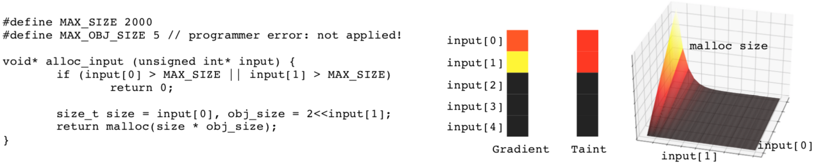
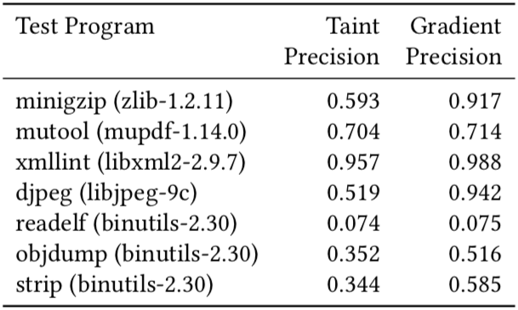
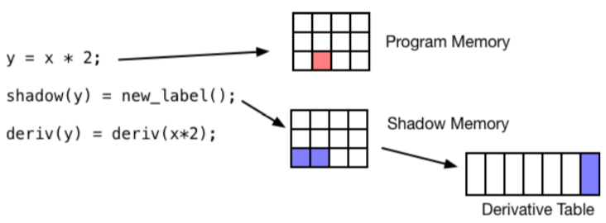
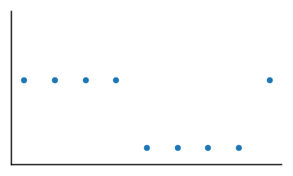

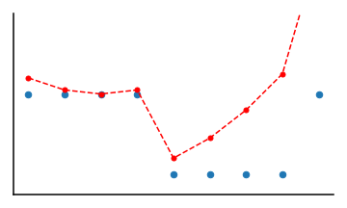
Proximal Gradient Analysis for Systems Security
Gabriel Ryan¹, Abhishek Shah¹, Dongdong She¹, Koustubha Bhat², Suman Jana¹
¹Columbia University ²Vrije Universiteit
gabe@cs.columia.edu, as5258@columbia.edu, ds3619@columbia.edu, k.bhat@vu.nl, suman@cs.columia.edu
Is it possible to trigger the error?
Gradient identifies important
parts of sample input and guides testing.
If gradients can be computed over programs, they can be used to analyze
program behavior and identify potential security vulnerabilities.
Implementation:
- Implemented as LLVM Sanitizer, based on DataFlowSanitizer
- Each address has associated shadow memory with label
- Each operation is instrumented to propagate gradient
- Gradients are stored in table indexed by labels
Evaluation:
- Achieved 34% better dataflow precision than previous
state of the art method (Taint Analysis) on 7 programs.
- Overhead is comparable to Taint Analysis on average and
20% worse in the worst case.
- Example analysis: identifying how input bytes are used in
decoding a gzipped file.
Problem: Programs are not Differentiable
Solution: Nonsmooth Optimization
Local gradient is flat!
int f(int x) {
return x & 4;
}
x=6
Gradient Analysis identifies which input bytes are used to look up each Huffman decoding index in gzip decompression.
Programs contain nonsmooth operations like Bitwise And,
making it impossible to compute gradients normally.
input byte
Proximal Minimization
Proximal Gradient
decoding byte
x=6
x=6
References:
[1] LeCun, Yann, Yoshua Bengio, and Geoffrey Hinton. "Deep learning." nature 521.7553 (2015): 436.
[2] Selvaraju, Ramprasaath R., et al. "Grad-cam: Visual explanations from deep networks via gradient-based localization." Proceedings of the IEEE International Conference on Computer Vision. 2017.
[3] Parikh, Neal, and Stephen Boyd. "Proximal algorithms." Foundations and Trends® in Optimization 1.3 (2014): 127-239.
Proximal Operator finds nearby minimum
Proximal Gradient is computed from nearby minimum
Proximal Gradients are an application of nonsmooth
optimization methods that base the gradient on the local
minimum of a function.³

