Slide 1
WEEK 06
Trees & Binary Search Trees
Hierarchies, Recursion, and Logarithmic Search
A University-Grade Lecture in Data Structures & Algorithms
Course · CSC: Data Structures & Algorithms
Module · Week 06 of 12
Format · Lecture · Demonstration · Practical Lab

Slide 2
Lecture Outline
From flat lists to branching hierarchies
▸ 1. From linear to hierarchical. Why we need trees.
▸ 2. Tree terminology. Root, parent, child, leaf, depth, height.
▸ 3. Binary Trees. At most two children — and what that buys us.
▸ 4. Binary Search Trees. The ordering invariant that enables O(log N) lookup.
▸ 5. Insertion & Search. Walking the tree under the BST property.
▸ 6. DFS Traversals. Pre-order, In-order, Post-order — and what each is for.
▸ 7. BFS / Level-order. Visiting tier by tier with a queue.
▸ 8. Lowest Common Ancestor. A canonical interview question.
▸ 9. Balanced vs Degenerate. Why a sorted insert ruins your tree.
▸ 10. Pitfalls, applications, and the lab.
Data Structures & Algorithms · Week 06 · Trees & BSTs
Slide 2 / 22

Slide 3
Learning Outcomes
By the end of this lecture you will be able to…
▸ Define the canonical tree vocabulary and identify each component on a diagram.
▸ Implement a TreeNode and a Binary Search Tree with iterative insertion.
▸ State the BST invariant and explain why it implies O(log N) search on balanced inputs.
▸ Implement Pre-, In-, and Post-order DFS traversals recursively and reason about which to use when.
▸ Describe Level-order (BFS) traversal and implement it with a queue.
▸ Use the BST property to compute the Lowest Common Ancestor of two nodes in O(h).
▸ Recognise degenerate trees and describe the motivation for self-balancing variants (AVL, Red-Black).
Data Structures & Algorithms · Week 06 · Trees & BSTs
Slide 3 / 22

Slide 4
1. From Linear to Hierarchical
Where a single chain stops being enough
Linked lists are 1-D chains.
====================================================================== OPENV-GFSS FINAL (strict GFSS, n_runs=5) ====================================================================== Average base mIoU : 77.39% Average novel mIoU : 80.34% Harmonic mean : 78.84% ======================================================================
A small tree
But the world is hierarchical: a filesystem is folders inside folders; an HTML page is elements inside elements; a chess engine reasons about moves that branch into more moves. Whenever an item logically owns several other items, you have a tree.
10
5
15
2
7
12
20
Why the shape matters
▸ A chain of N items is searched in O(N).
▸ A balanced tree of N items is searched in O(log N).
▸ log₂(1,000,000) ≈ 20 — twenty steps to find one in a million.
Same data — but ordered for O(log N) search.
Data Structures & Algorithms · Week 06 · Trees & BSTs
Slide 4 / 22

Slide 5
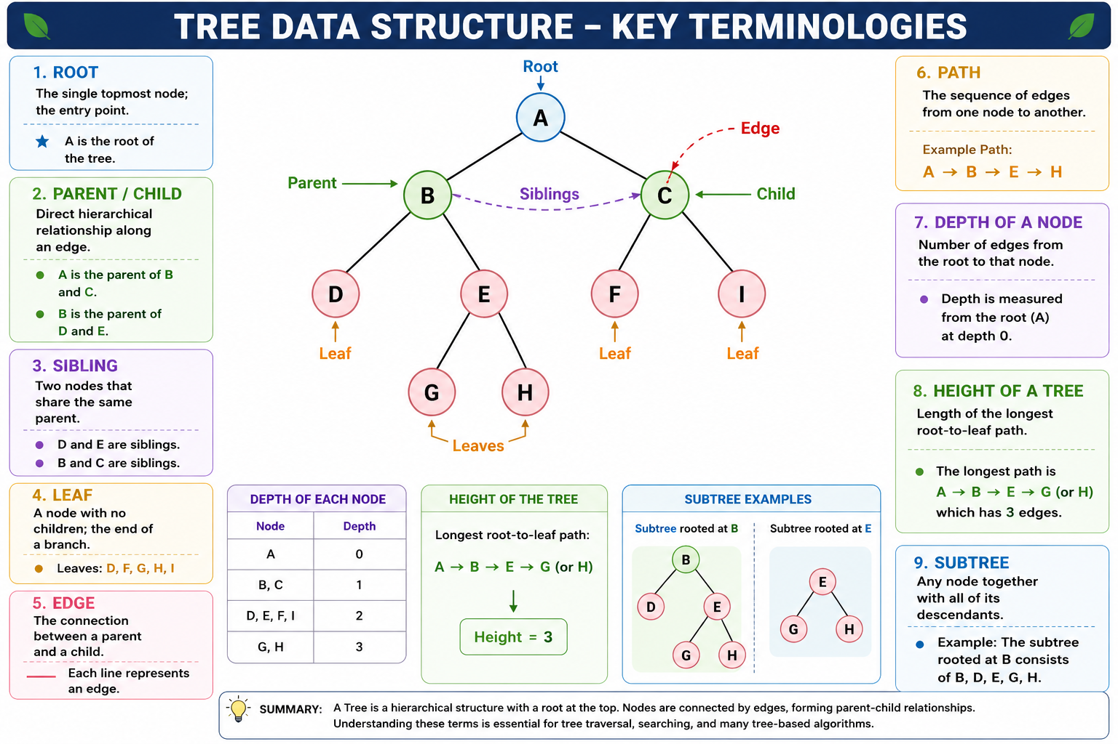

Slide 6
2. Tree Terminology
The vocabulary of every tree question you will ever face
▸ Root. The single topmost node; the entry point.
▸ Parent / Child. Direct hierarchical relationship along an edge.
▸ Sibling. Two nodes that share a parent.
▸ Leaf. A node with no children; the end of a branch.
▸ Edge. The connection between a parent and a child.
▸ Path. The sequence of edges from one node to another.
▸ Depth of a node. Number of edges from the root to that node.
▸ Height of a tree. Length of the longest root-to-leaf path.
▸ Subtree. Any node together with all of its descendants.
ROOT A / \ / \ edge / \ edge / \ B --------- C / \ \ / \ \ D E F / \ G H ROOT
A
/ \
/ \
edge / \ edge
/ \
B --------- C
/ \ \
/ \ \
D E F
/ \
G H ROOT
A
/ \
/ \
edge / \ edge
/ \
B --------- C
/ \ \
/ \ \
D E F
/ \
G H ROOT
A
/ \
/ \
edge / \ edge
/ \
B --------- C
/ \ \
/ \ \
D E F
/ \
G H
A
← Root
B
C
Parent of F
Edge→
D
E
F
G
Leaf →
Height of this tree = 3 (longest path A→B→E→G)
Data Structures & Algorithms · Week 06 · Trees & BSTs
Slide 5 / 22

Slide 7
3. Binary Trees
Each node has at most two children — left and right
Definition
The atom — TreeNode
A binary tree is a tree where every node has zero, one, or two children, distinguished as left and right. Binary trees are the workhorse of CS: BSTs, heaps, expression trees, Huffman codes, and decision trees are all binary.
class TreeNode:
"""A single node of a binary tree."""
__slots__ = ("val", "left", "right")
def __init__(self, val=0):
self.val = val
self.left = None
self.right = None
Special shapes
▸ Full. Every node has either 0 or 2 children.
▸ Complete. Every level full except possibly the last, filled left-to-right.
▸ Perfect. All internal nodes have 2 children, all leaves at the same depth.
▸ Balanced. Heights of left and right subtrees differ by at most a constant.
Mini binary tree
R
L
Rt
Data Structures & Algorithms · Week 06 · Trees & BSTs
Slide 6 / 22

Slide 8
4. Binary Search Trees
The invariant that turns a tree into a sorted index
The BST invariant
Example
10
For every node N: • every value in the left subtree of N < N.val • every value in the right subtree of N > N.val
5
15
2
7
12
20
Why this matters
▸ Searching halves the candidate set at every step.
▸ An in-order DFS yields the values in sorted order — for free.
▸ Insertion preserves the invariant by always going one side.
▸ When balanced, height = ⌈log₂ N⌉ + 1 — hence O(log N) operations.
Each left subtree is < parent. Each right subtree is > parent.
Data Structures & Algorithms · Week 06 · Trees & BSTs
Slide 7 / 22

Slide 9
5. Why O(log N)?
Each comparison eliminates half the remaining tree
Searching for 7 in the BST below — only 3 comparisons.
10
5
15
2
7
12
20
Step-by-step
1) 7 < 10 → go left. 2) 7 > 5 → go right. 3) Match: return node 7. Three steps, not seven.
Data Structures & Algorithms · Week 06 · Trees & BSTs
Slide 8 / 22

Slide 10
6. BST Insertion — Walkthrough
Insert 8 into the tree below
Step 1 — Start at root. 8 < 10 → go left.
10
10
5
15
5
15
2
7
12
20
2
7
12
20
Step 2 — At 5: 8 > 5 → go right. Step 3 — At 7: 8 > 7 and 7.right is None → insert.
8
Each comparison decides one direction. Insertion cost = path length = O(h).
Data Structures & Algorithms · Week 06 · Trees & BSTs
Slide 9 / 22

Slide 11
7. BST Insertion — Code
Iterative insertion is robust and stack-safe
class BST:
def __init__(self):
self.root = None
def insert(self, val):
if self.root is None:
self.root = TreeNode(val)
return
current = self.root
while True:
if val < current.val:
if current.left is None:
current.left = TreeNode(val)
return
current = current.left
else:
if current.right is None:
current.right = TreeNode(val)
return
current = current.right
Notes
▸ Iterative form avoids recursion depth limits on large trees.
▸ Empty-tree branch creates the root and returns immediately.
▸ Equal values go right by convention — choose and document.
▸ Time O(h); for balanced trees O(log N); worst-case O(N).
Data Structures & Algorithms · Week 06 · Trees & BSTs
Slide 10 / 22

Slide 12
8. Tree Traversals — Overview
Two strategies, four orders, one tree
Pre-Order (DFS)
In-Order (DFS)
▸ Visit Node → Left → Right.
▸ Use: deep-copy a tree; serialise structure.
▸ Implemented with recursion or an explicit stack.
▸ Visit Left → Node → Right.
▸ On a BST: produces values in sorted ascending order.
▸ Use: validate a BST; output sorted view.
Post-Order (DFS)
Level-Order (BFS)
▸ Visit Left → Right → Node.
▸ Use: free / delete a tree; evaluate expression trees.
▸ Children are processed before their parent.
▸ Visit tier by tier from the root downward.
▸ Implemented with a FIFO queue, not recursion.
▸ Use: shortest path in unweighted trees, level summaries.
Data Structures & Algorithms · Week 06 · Trees & BSTs
Slide 11 / 22

Slide 13
9. Same Tree, Four Outputs
What each traversal actually produces
10
Pre-Order (Node, Left, Right)
10 · 5 · 2 · 7 · 15 · 12 · 20
5
15
In-Order (Left, Node, Right)
2 · 5 · 7 · 10 · 12 · 15 · 20 ← sorted!
2
7
12
20
Post-Order (Left, Right, Node)
2 · 7 · 5 · 12 · 20 · 15 · 10
Level-Order (BFS)
10 · 5 · 15 · 2 · 7 · 12 · 20
In-order on a BST is the cheapest sort you'll ever write.
Data Structures & Algorithms · Week 06 · Trees & BSTs
Slide 12 / 22

Slide 14
10. Traversal Implementations
Three lines change between Pre-, In-, and Post-order
def inorder_traversal(root):
res = []
def dfs(node):
if node is None: return
dfs(node.left)
res.append(node.val) # ← position decides the order
dfs(node.right)
dfs(root)
return res
def preorder_traversal(root):
res = []
def dfs(node):
if node is None: return
res.append(node.val) # node first
dfs(node.left)
dfs(node.right)
dfs(root)
return res
Level-order (BFS)
from collections import deque
def level_order(root):
if root is None: return []
res, q = [], deque([root])
while q:
n = q.popleft()
res.append(n.val)
if n.left: q.append(n.left)
if n.right: q.append(n.right)
return res
Data Structures & Algorithms · Week 06 · Trees & BSTs
Slide 13 / 22

Slide 15
11. Lowest Common Ancestor (BST)
The first node where the paths to p and q diverge
Iterative LCA (uses BST property)
10
def lowest_common_ancestor(root, p, q):
current = root
while current:
if p.val < current.val and q.val < current.val:
current = current.left
elif p.val > current.val and q.val > current.val:
current = current.right
else:
return current # split point
5
15
2
7
12
20
LCA(2, 7) = 5
Complexity
Both 2 and 7 are smaller than 10 → go left. Now at 5: 2 < 5 and 7 > 5 → split point. Stop.
Time O(h) · Space O(1). On a balanced BST: O(log N) and no recursion stack.
Data Structures & Algorithms · Week 06 · Trees & BSTs
Slide 14 / 22

Slide 16
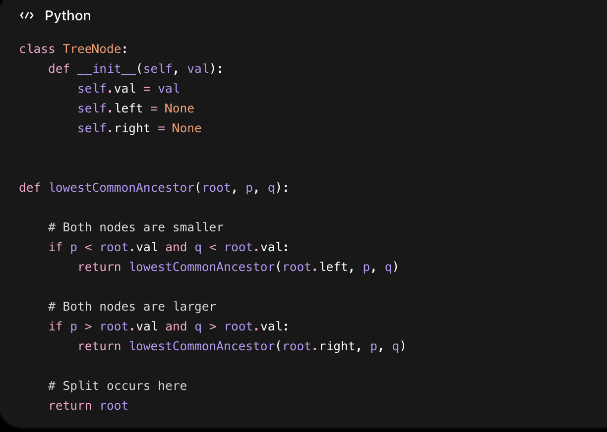

Slide 17
12. Balanced vs Degenerate
Insertion order silently destroys your O(log N) guarantee
Balanced — height ≈ log₂ N
Degenerate — sorted insert collapses to a chain
10
1
2
5
15
3
2
7
12
20
4
5
What went wrong?
Inserting [1,2,3,4,5] into a plain BST yields a right-only chain. Search becomes O(N). Self-balancing trees (AVL, Red-Black, B-trees) restore O(log N) by re-shaping after insertions.
Data Structures & Algorithms · Week 06 · Trees & BSTs
Slide 15 / 22

Slide 18
13. Complexity Reference
h = tree height. Balanced ⇒ h = log N. Degenerate ⇒ h = N.
Operation
Avg / Balanced
Worst / Degenerate
Search
O(log N)
O(N)
Insert
O(log N)
O(N)
Delete
O(log N)
O(N)
Min / Max
O(log N)
O(N)
In-order walk
O(N)
O(N)
Space
O(N)
O(N)
Recursion depth
O(log N)
O(N) ← stack-overflow risk
Self-balancing trees (AVL, Red-Black) guarantee the average column even on adversarial input.
Data Structures & Algorithms · Week 06 · Trees & BSTs
Slide 16 / 22

Slide 19
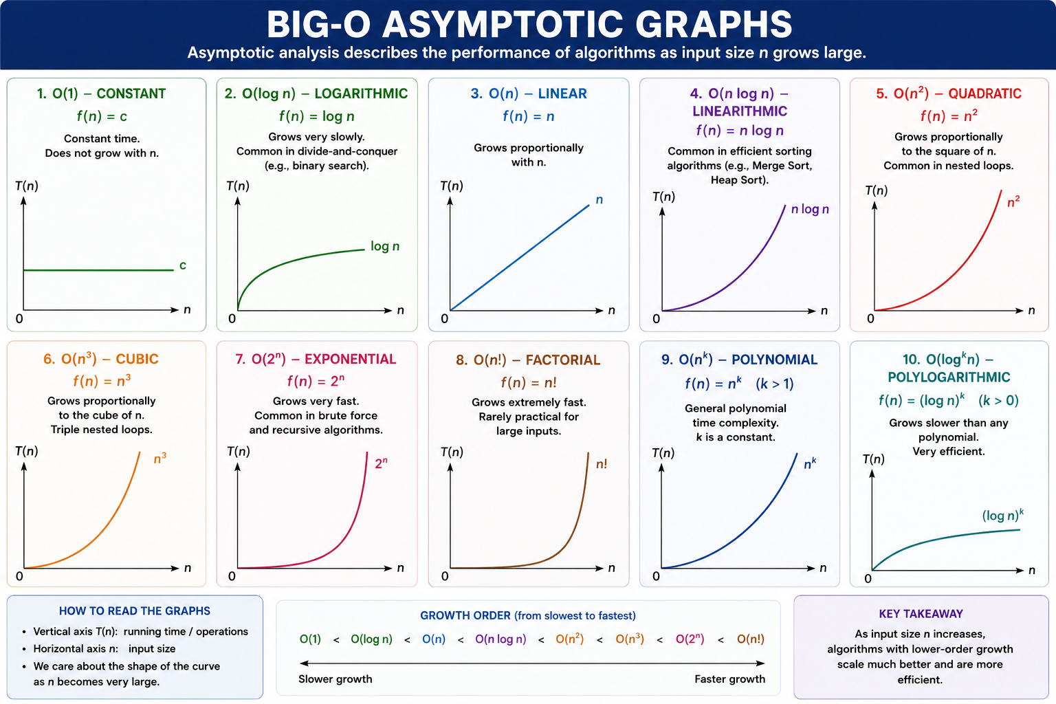

Slide 20
14. Common Pitfalls
Where students lose marks — and where production code breaks
▸ Forgetting the empty tree. Calling root.val on None raises AttributeError; always guard root is None first.
▸ Confusing the BST property. It applies recursively: every value in the left subtree, not just the immediate child.
▸ Equal values inconsistency. Pick a side (left or right) for duplicates and apply it everywhere; document it.
▸ Recursive depth on degenerate trees. A chain of 10⁴ nodes can blow Python's default 1000-frame stack. Prefer iteration.
▸ Mutating during traversal. Inserting or deleting while walking the tree corrupts the iteration. Snapshot first.
▸ Wrong traversal for the job. Use post-order to delete; in-order to print sorted; pre-order to copy structure.
Data Structures & Algorithms · Week 06 · Trees & BSTs
Slide 17 / 22

Slide 21
15. Trees in the Real World
Where the structures from this lecture run in production
Filesystems
Databases
HTML / DOM
Directories form a tree; ext4 and NTFS use B-trees for indexing.
Indexes are B+ trees — every SQL WHERE you've ever written touches one.
Browsers parse pages into a tree the JS engine traverses to render.
Compilers
Game AI
Networking
Source code becomes an Abstract Syntax Tree before optimisation and codegen.
Decision trees and Monte-Carlo Tree Search drive chess, Go, and modern game AI.
IP routing tables use radix / trie trees for longest-prefix match.
Data Structures & Algorithms · Week 06 · Trees & BSTs
Slide 18 / 22

Slide 22
16. Practical Lab — practice.py
Three exercises. Build, traverse, reason.
▸ Exercise 1. Implement BST.insert() iteratively, preserving the BST invariant.
▸ Exercise 2. Implement inorder_traversal() and preorder_traversal() recursively.
▸ Exercise 3. Implement lowest_common_ancestor(root, p, q) using the BST property in O(h).
Submission expectations
▸ Test the empty tree, single-node tree, and a degenerate (sorted-insert) tree.
▸ Verify that inorder_traversal returns a sorted list.
▸ Annotate each function with its time and space complexity.
▸ Avoid recursion deeper than necessary; prefer iteration where natural.
Data Structures & Algorithms · Week 06 · Trees & BSTs
Slide 19 / 22

Slide 23
17. Summary
Six sentences worth memorising
▸ A tree is a hierarchy of nodes connected by edges; one root, no cycles.
▸ A binary tree has at most two children per node — left and right.
▸ A BST imposes left < parent < right recursively, enabling O(log N) search on balanced inputs.
▸ Pre-order, In-order, and Post-order are DFS traversals distinguished by where the node visit happens relative to the recursive calls.
▸ Level-order is BFS over a queue — used for tier-by-tier algorithms.
▸ Insertion order matters: a sorted insert produces a degenerate tree; balancing trees fix this.
Data Structures & Algorithms · Week 06 · Trees & BSTs
Slide 20 / 22

Slide 24
18. Further Reading
Trusted sources for deeper study
▸ CLRS — Introduction to Algorithms (4th ed.). Cormen, Leiserson, Rivest, Stein. Chapter 12 — Binary Search Trees.
▸ The Art of Computer Programming, Vol. 3. Donald E. Knuth. Section 6.2 — Searching by Tree Insertion.
▸ Algorithms (4th ed.). Sedgewick & Wayne. Princeton University. Chapter 3.2 — BSTs.
▸ Adelson-Velsky & Landis (1962). An algorithm for the organization of information. Origin of AVL trees.
▸ LeetCode practice set. 94 (Inorder), 144 (Preorder), 102 (Level-order), 235 (LCA-BST), 98 (Validate BST).
Data Structures & Algorithms · Week 06 · Trees & BSTs
Slide 21 / 22

Slide 25
Questions?
Bring your traces, your edge cases, and your degenerate trees.
Next week · Heaps & Priority Queues — the BST's specialised cousin.
Data Structures & Algorithms · Week 06 · Trees & BSTs

