Slide 1
Graph Data Structures & Algorithms
3-Hour University Session • Python Implementations
Representations • BFS • DFS • Shortest Paths • MST • Topological Sort

Slide 2
Session Agenda
Part 1 — 60 min
Graph Basics & Representations
Part 2 — 60 min
BFS, DFS & Connected Components
Part 3 — 60 min
Shortest Paths, MST & Topological Sort

Slide 3
1
PART 1 — GRAPH BASICS & REPRESENTATIONS
Adjacency Matrix • Adjacency List

Slide 4
What Is a Graph? — G = (V, E)
V — Vertices (Nodes)
B
A
Individual entities. E.g. cities, users, web pages.
E — Edges (Links)
C
E
Relationships between vertex pairs. Directed (→) or undirected (—).
Real-World Examples
D
• Social networks — users & friendships
• Road maps — cities & roads
|V| = 5 |E| = 6
• Internet — routers & cables
• Compilers — code & dependencies

Slide 5
Graph Types
Undirected
Directed (DAG)
Weighted
Edges have no direction. Friendships, roads.
Edges have direction →. Web pages, tasks.
Edges carry a cost. Maps, distances.
Unweighted
Cyclic
Acyclic (DAG)
Edges treated equally. Simple traversal.
Contains at least one cycle. General graphs.
No cycles — directed. Build systems.

Slide 6
Adjacency Matrix vs Adjacency List
Adjacency Matrix
Adjacency List
• Space: O(V²)
• Space: O(V + E)
• Edge check: O(1)
• Edge check: O(degree)
• Iterate neighbors: O(V)
• Iterate neighbors: O(degree)
• Best for: dense graphs (E ≈ V²)
• Best for: sparse graphs (most cases)
0
1
2
3
Metric
Matrix
List
0
0
1
1
0
Space
O(V²)
O(V+E)
1
1
0
0
1
Edge check
O(1)
O(degree)
2
1
0
0
1
Neighbors
O(V)
O(degree)
3
0
1
1
0
Best for
Dense
Sparse
Use Adjacency List for most problems — less memory, faster neighbor iteration. Use Matrix only when frequent O(1) edge-existence checks matter on dense graphs.

Slide 7
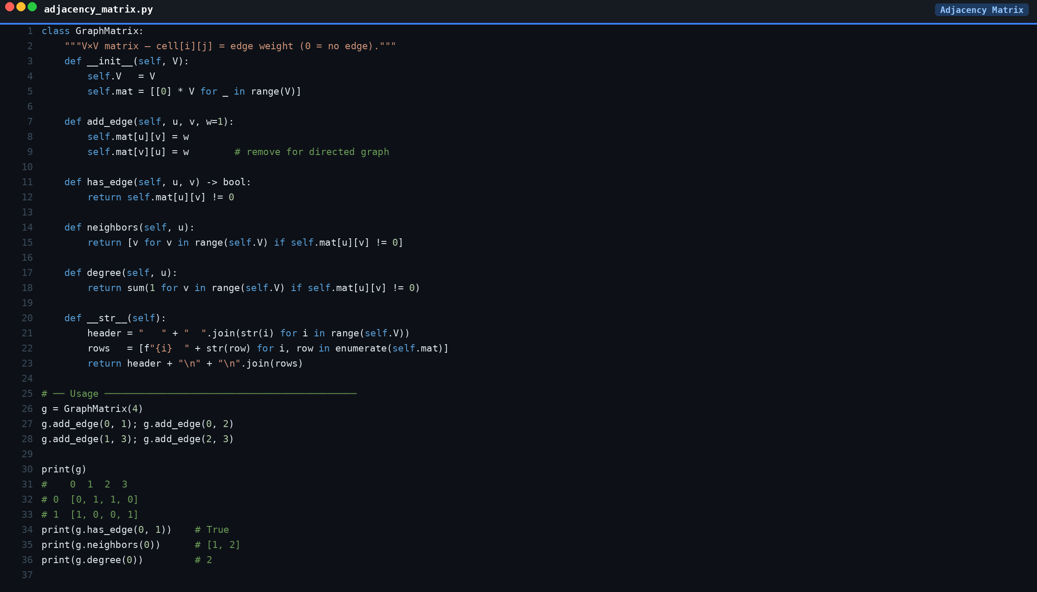

Slide 8
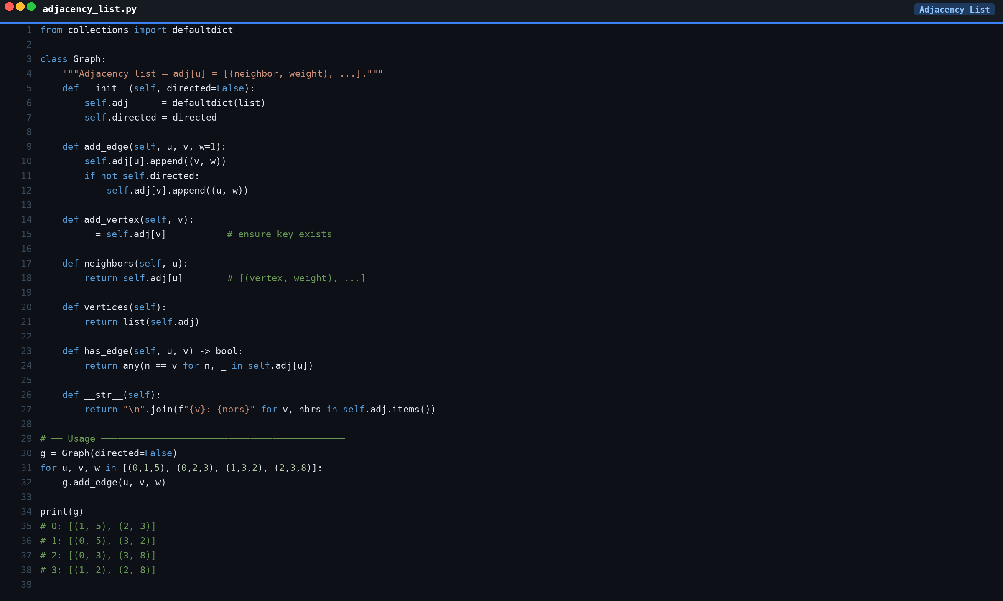

Slide 9
2
PART 2 — BFS, DFS & CONNECTED COMPONENTS
Breadth-First Search • Depth-First Search • Components & Cycles

Slide 10
Breadth-First Search (BFS)
Explores all neighbors at the current depth level before going deeper. Uses a Queue (FIFO).
Properties
Applications
• Time: O(V + E)
• Shortest path in unweighted graphs
• Space: O(V) — the queue
• Web crawlers & link discovery
• Guarantees shortest path (unweighted)
• Social network separation degrees
• Level-order traversal
• GPS — nearest location search
• Detects bipartite graphs
• Network broadcasting
Steps:
1. Mark start visited → 2. Enqueue start → 3. While queue not empty: dequeue node, visit it, enqueue all unvisited neighbors and mark visited.

Slide 11
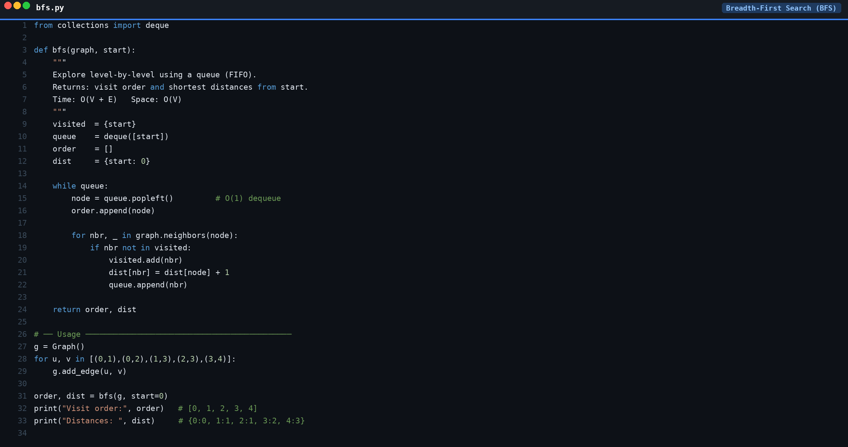

Slide 12
Depth-First Search (DFS)
Explores as far as possible along each branch before backtracking. Uses a Stack (or recursion).
Properties
BFS vs DFS
• Time: O(V + E)
BFS
DFS
• Space: O(V) — stack/recursion
Structure
Queue
Stack
• Does NOT find shortest paths
Shortest path
✓ Yes
✗ No
Wide graph
More mem
Less mem
• Detects cycles (back edges)
Cycle detect
✓
✓
• Finds connected components
Topo sort
✓ Kahn's
✓ Post-order
Recursive vs Iterative:
Recursive — clean and concise, limited by Python's ~1000 frame depth. Iterative — explicit stack handles arbitrarily deep graphs safely. Both visit nodes in identical order.

Slide 13
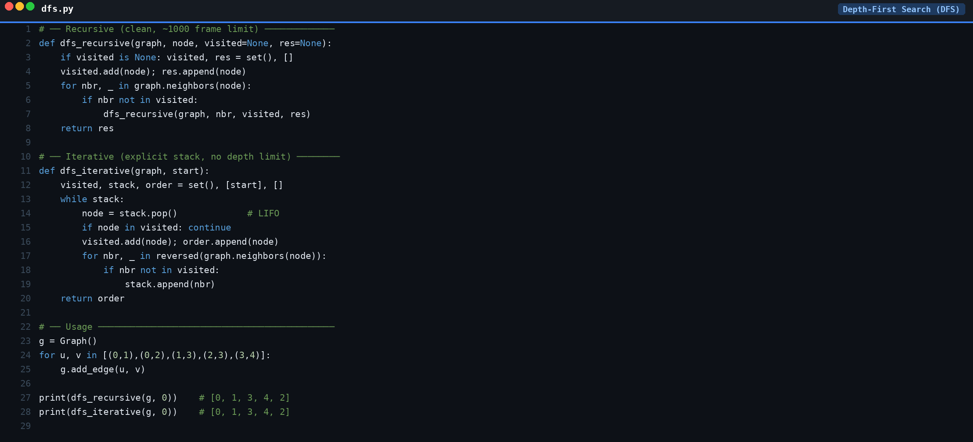

Slide 14
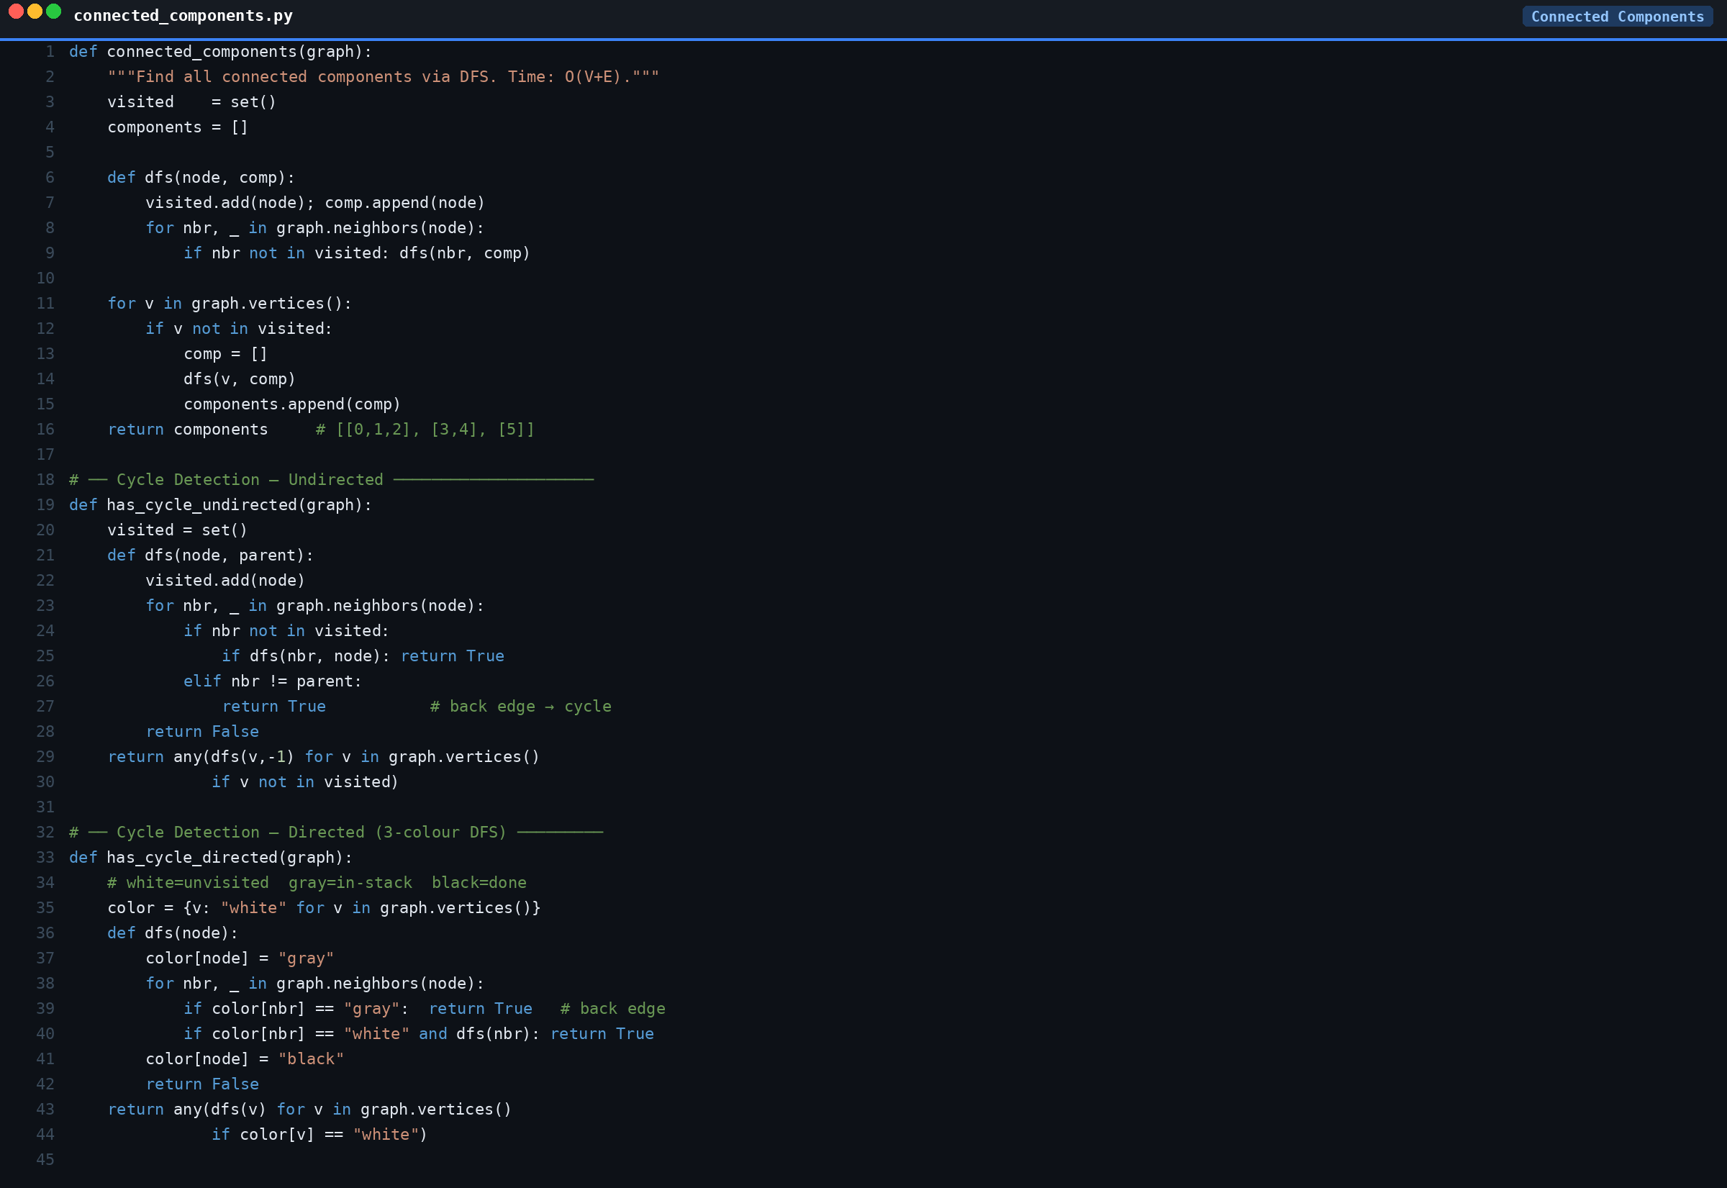

Slide 15
3
PART 3 — SHORTEST PATHS, MST & TOPOLOGICAL SORT
Dijkstra • Bellman-Ford • Floyd-Warshall • Prim's • Kruskal's • Topo Sort

Slide 16
Dijkstra's Shortest Path — Non-negative weights only
Greedy algorithm: once a vertex is popped from the min-heap its distance is finalised forever.
Steps
Complexity
1. dist[start] = 0, all others = ∞
• Time: O((V+E) log V) with min-heap
2. Push (0, start) into min-heap
• Space: O(V)
3. Pop vertex u with smallest dist
• Fast in practice for road networks
4. For each neighbor v: if dist[u]+w < dist[v]
• ⚠ Fails with negative weights
update dist[v], push (dist[v], v)
• ⚠ Use Bellman-Ford for negatives
5. Repeat until heap is empty
• ✓ Full path reconstructable
Comparison:
Dijkstra O((V+E)logV) — non-neg only, fastest in practice. Bellman-Ford O(V×E) — handles negative weights, detects negative cycles. Floyd-Warshall O(V³) — all-pairs shortest paths.

Slide 17
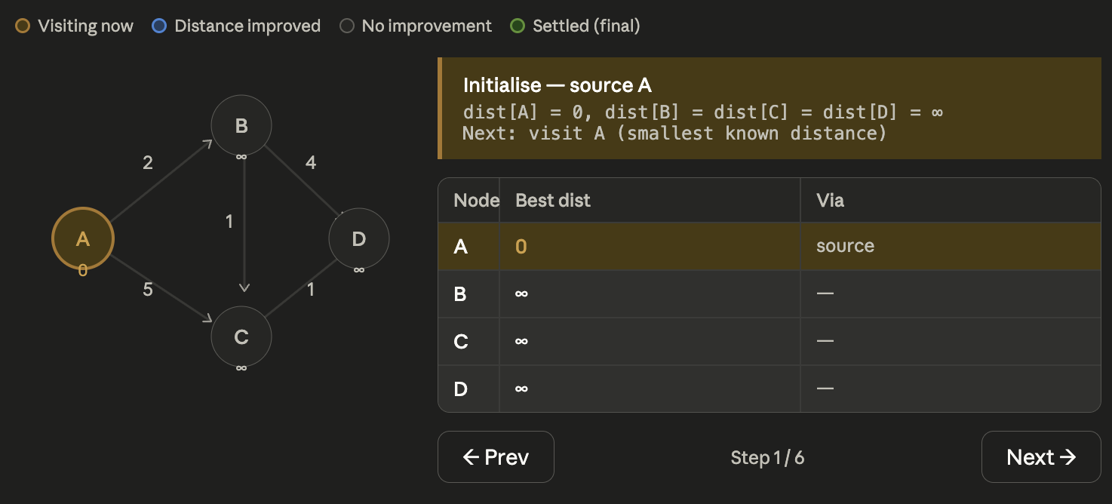
Dijkstra's Shortest Path — Non-negative weights only
Steps
Complexity

Slide 18
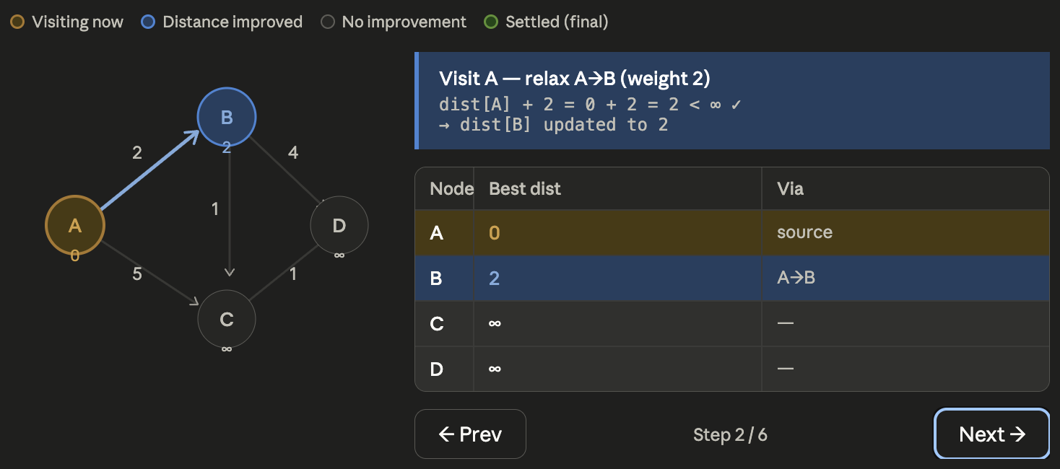
Dijkstra's Shortest Path — Non-negative weights only
Steps
Complexity

Slide 19
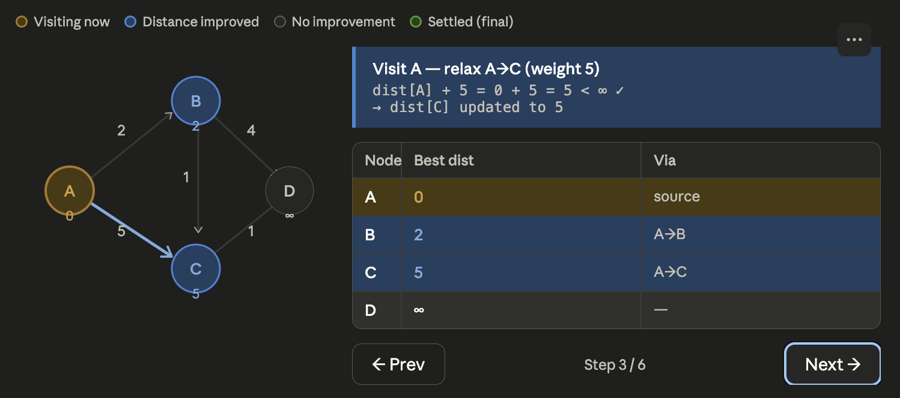
Dijkstra's Shortest Path — Non-negative weights only
Steps
Complexity

Slide 20
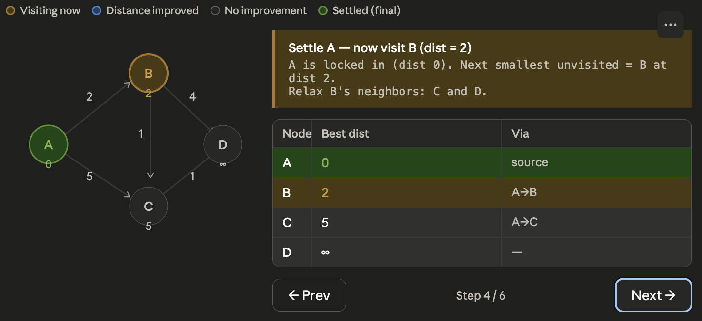
Dijkstra's Shortest Path — Non-negative weights only
Steps
Complexity

Slide 21
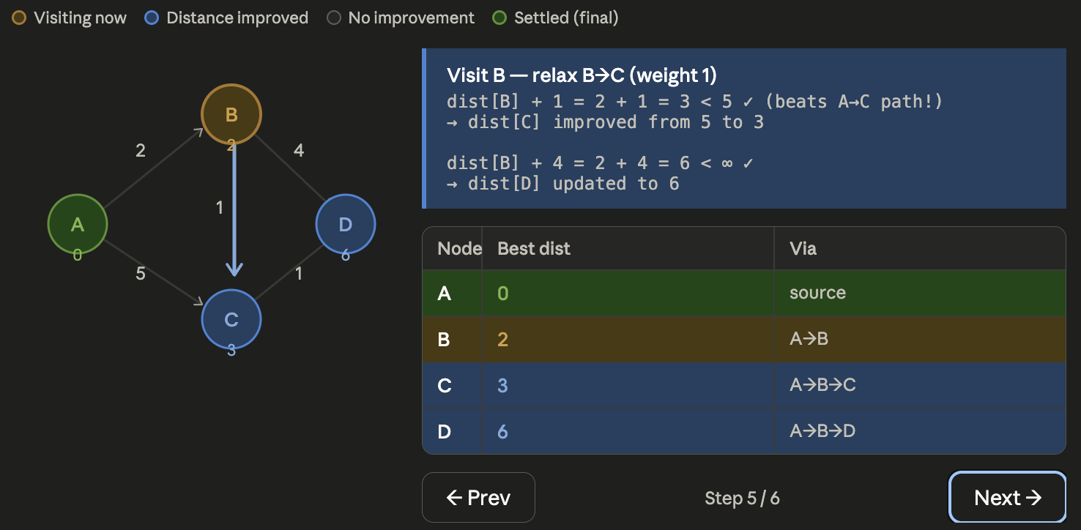
Dijkstra's Shortest Path — Non-negative weights only
Steps
Complexity

Slide 22
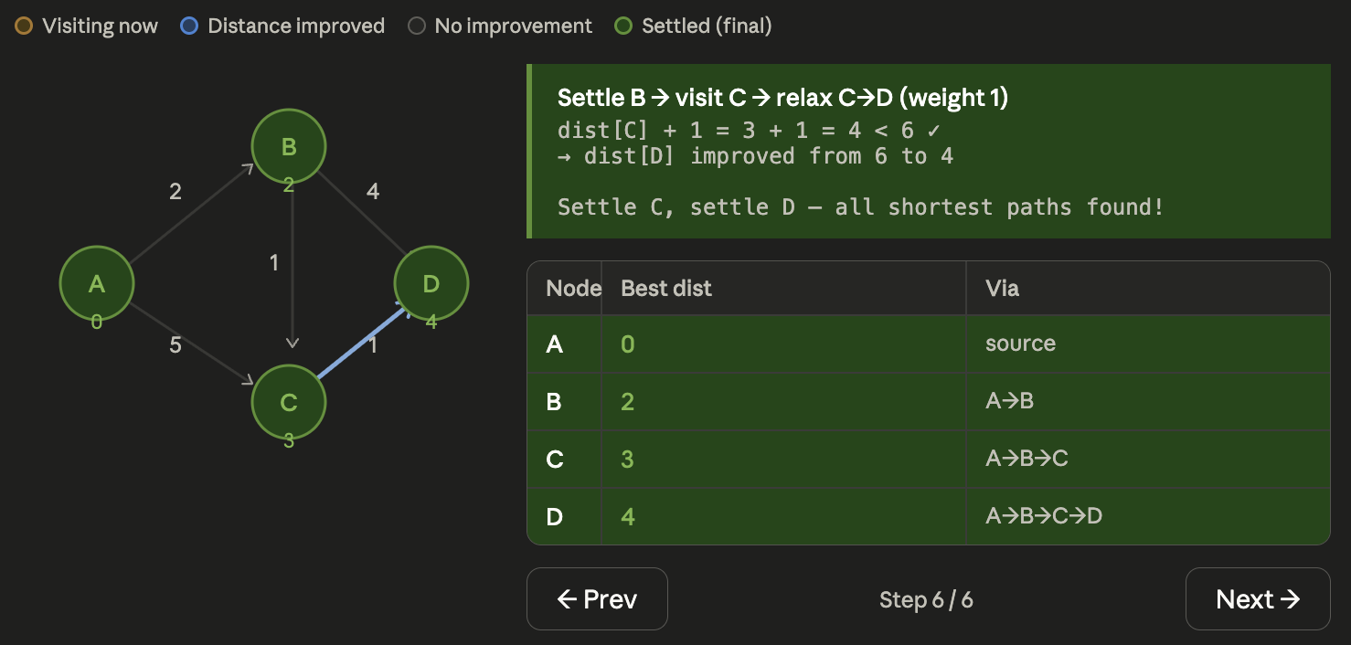
Dijkstra's Shortest Path — Non-negative weights only
Steps
Complexity

Slide 23
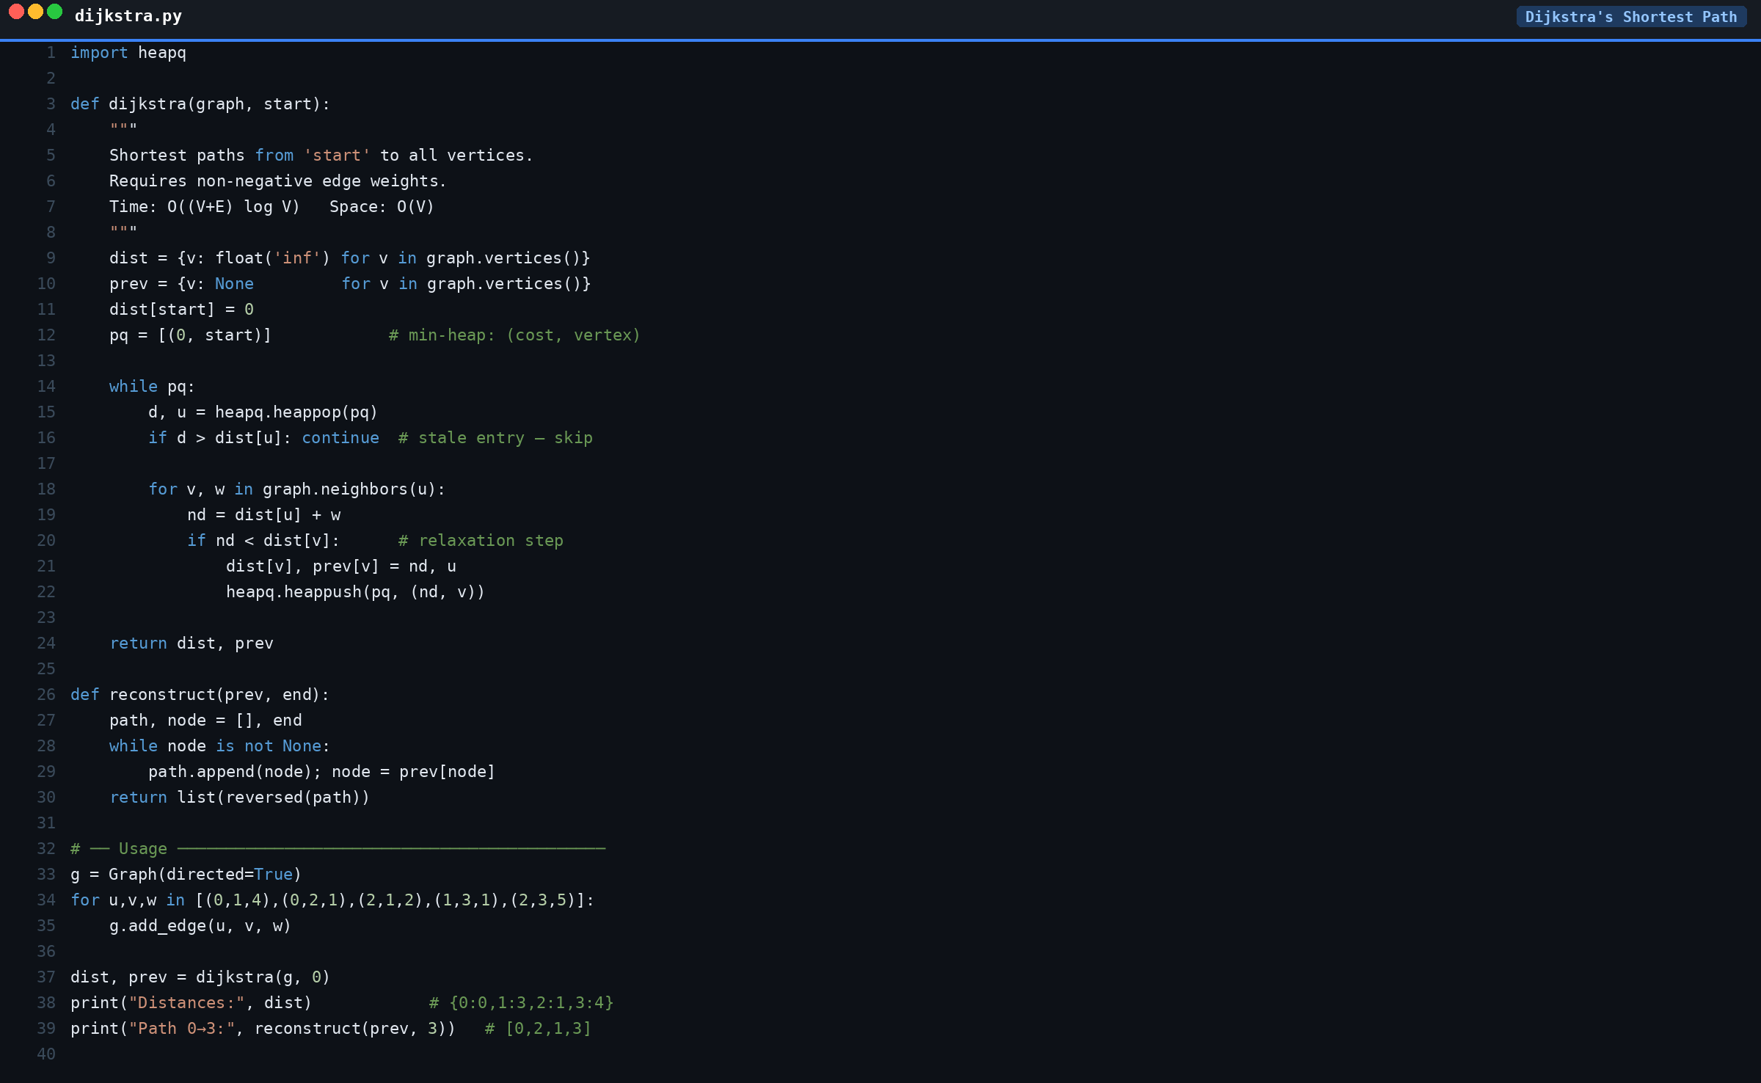

Slide 24
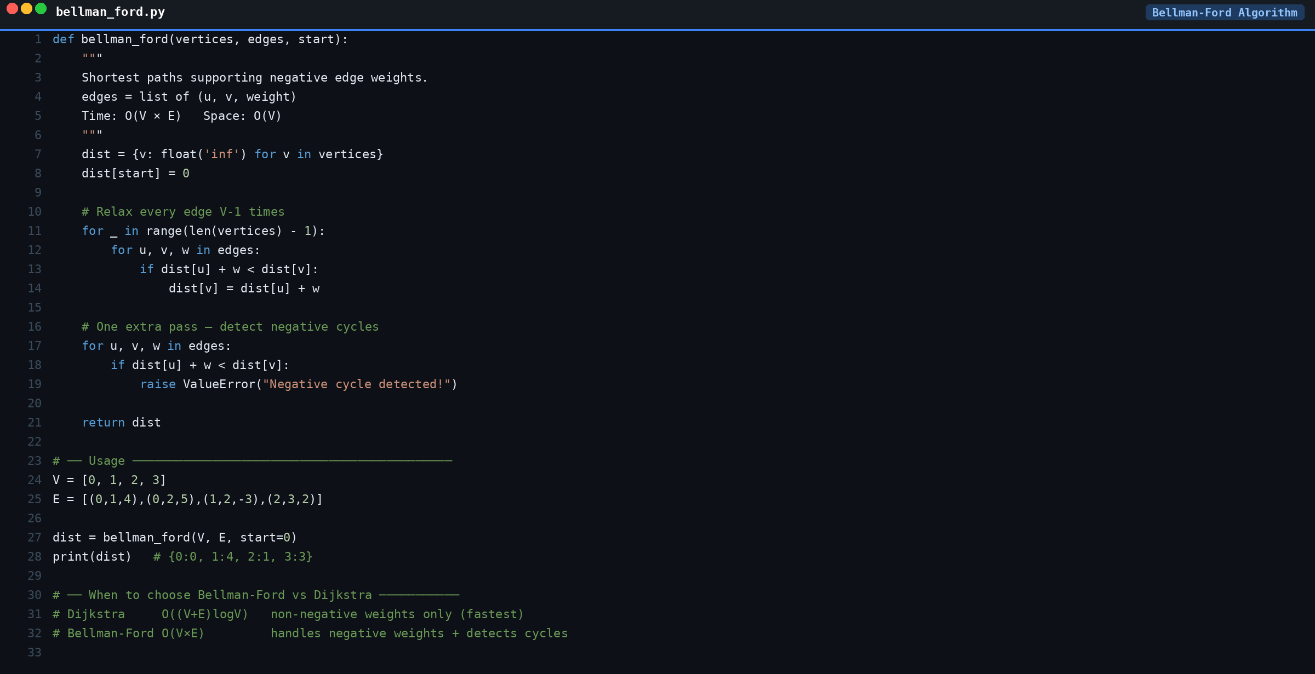

Slide 25
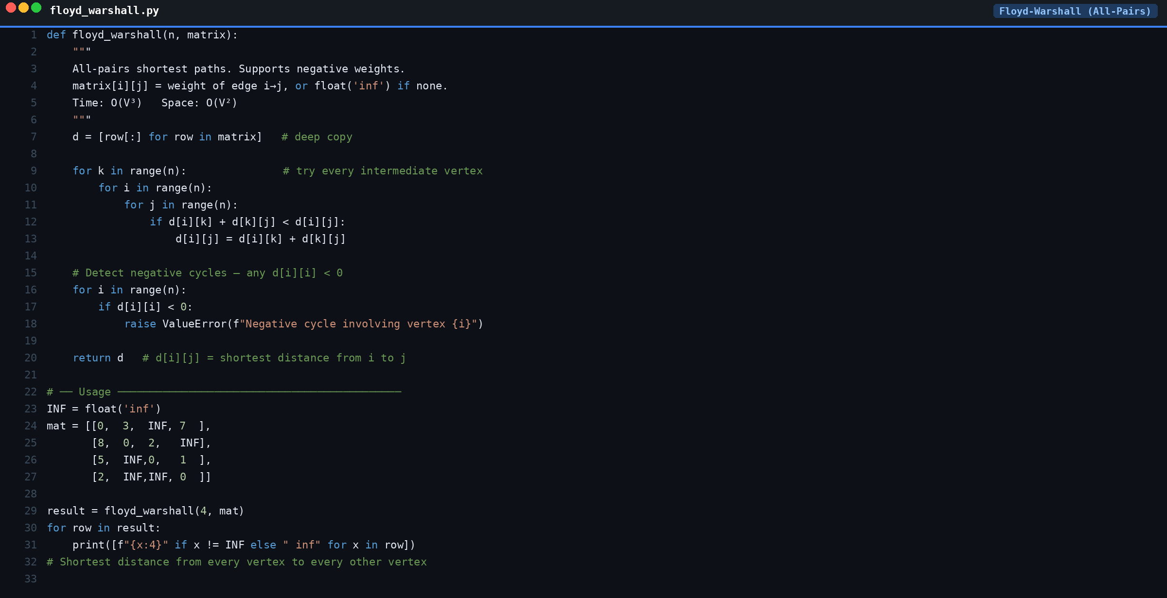

Slide 26
Minimum Spanning Tree (MST)
A spanning tree of all V vertices with minimum total edge weight — exactly V-1 edges, no cycles.
Prim's Algorithm
Kruskal's Algorithm
• Vertex-centric — grow MST from a start vertex
• Edge-centric — sort edges by weight
• Add cheapest edge crossing the cut
• Add edge if it doesn't create a cycle
• Uses a min-heap (priority queue)
• Uses Union-Find (Disjoint Set Union)
• Time: O((V+E) log V)
• Time: O(E log E)
• Best for: dense graphs
• Best for: sparse graphs
Applications:
Network cable layout (minimum cost wiring) • Cluster analysis • Image segmentation • Approximation for NP-hard problems (TSP).

Slide 27
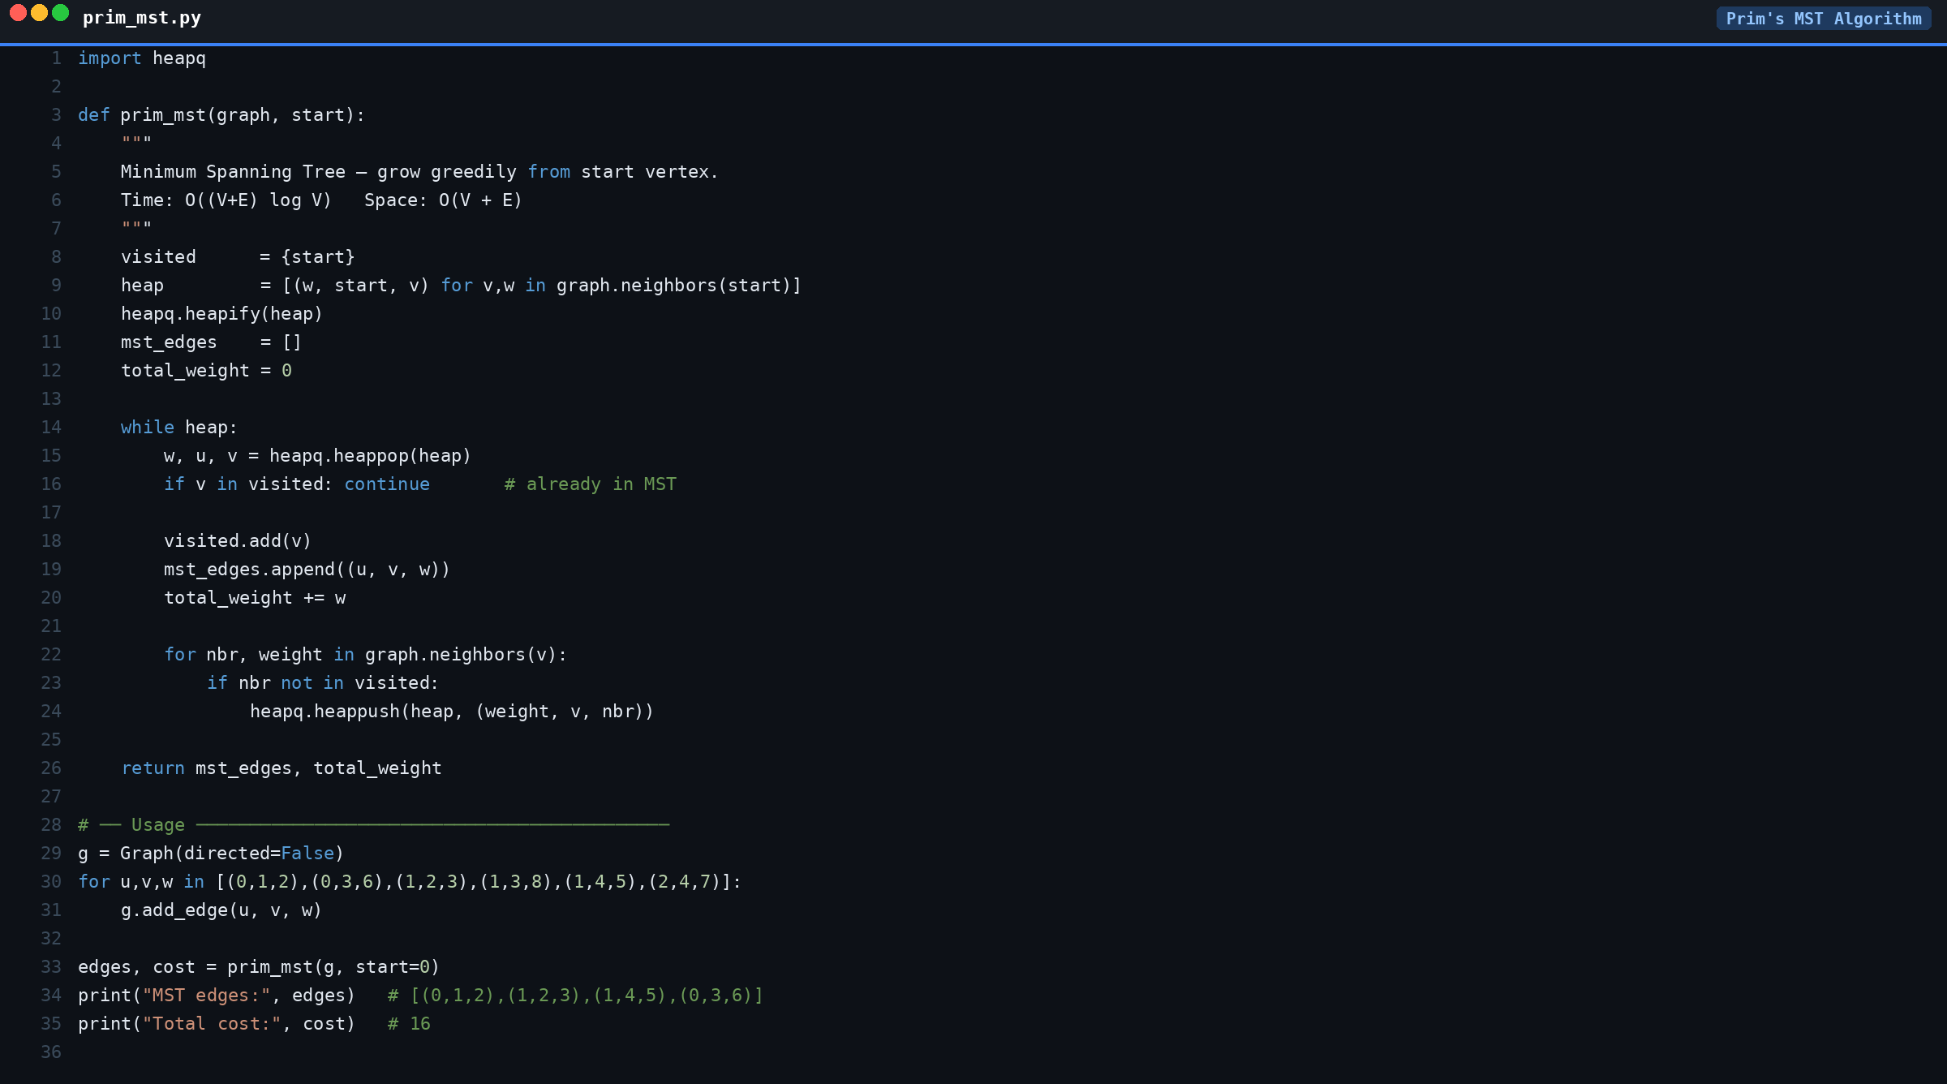

Slide 28
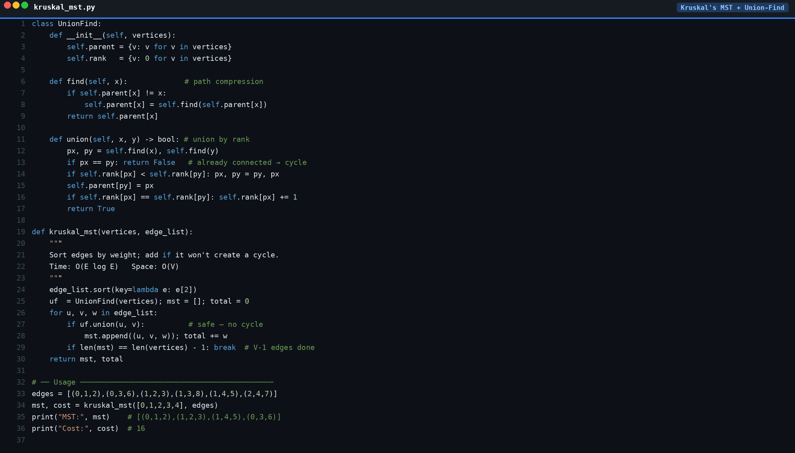

Slide 29
Topological Sort — DAGs only
Linear ordering of vertices so that for every directed edge u→v, u appears before v.
DFS Post-order
Kahn's Algorithm (BFS)
• Run DFS on all unvisited vertices
• Compute in-degree for all vertices
• Append node AFTER all descendants visited
• Enqueue all zero in-degree vertices
• Reverse the resulting stack
• Dequeue → output → reduce neighbors
• Time: O(V + E)
• Time: O(V + E)
• Naturally propagates through recursion
• Output length ≠ V → cycle exists!
Applications:
Build & compile order (Makefiles, npm) • Course prerequisite scheduling • Task scheduling with dependencies • Symbol resolution in linkers.

Slide 30
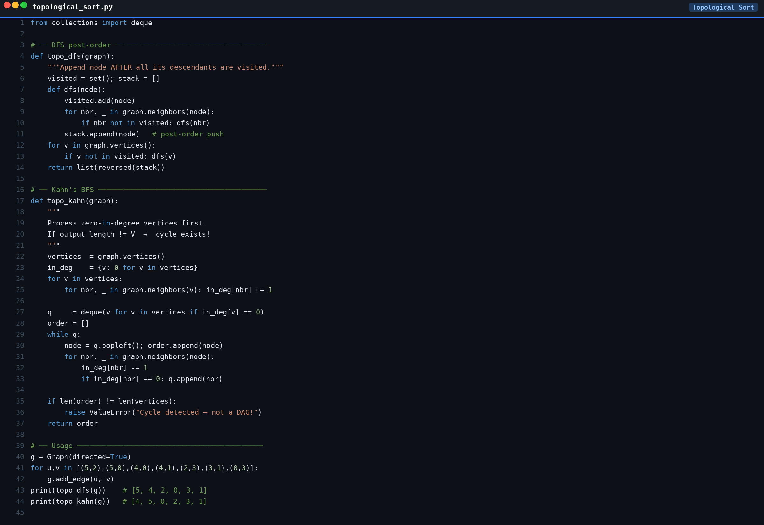

Slide 31
Algorithm Complexity Summary
Algorithm
Time Complexity
Space
Data Structure
Use Case
BFS
O(V + E)
O(V)
Queue
Shortest path (unweighted)
DFS
O(V + E)
O(V)
Stack / Recursion
Cycle detection, components
Dijkstra
O((V+E) log V)
O(V)
Min-Heap
Shortest path (pos weights)
Bellman-Ford
O(V × E)
O(V)
Array
Shortest path (neg weights)
Floyd-Warshall
O(V³)
O(V²)
2D Matrix
All-pairs shortest paths
Prim's MST
O((V+E) log V)
O(V)
Priority Queue
MST — dense graphs
Kruskal's MST
O(E log E)
O(V)
Union-Find
MST — sparse graphs
Topological Sort
O(V + E)
O(V)
Stack / Queue
Task ordering (DAGs)

Slide 32
Session Complete!
Key Takeaways
• Graphs = Vertices + Edges — adjacency list for sparse, matrix for dense
• BFS → shortest path (unweighted) • DFS → cycle detection, components
• Dijkstra (non-neg) • Bellman-Ford (neg weights) • Floyd-Warshall (all-pairs)
• Prim's & Kruskal's build MSTs • Topological Sort orders DAG dependencies
Questions & Discussion

