Slide 1

Module 11 : IQ – Math Library C28x
32-Bit-Digital Signal Controller
TMS320F2812
Texas Instruments Incorporated

Slide 2
Floating Point, Integer and Fixed Point
Two basic categories of processors:
  Floating Point
  Integer/Fixed Point
What is the difference?
What are advantages / disadvantages ?
Real – Time Control : Fixed Point !
Discuss fixed-point math development limitations
Compare/contrast floating-point and IQ representation
Texas Instruments IQ-Math approach

Slide 3
Processor Types
Floating Point Processors
  Internal Hardware Unit to support Floating Point Operations
  Examples : Intel’s Pentium Series , Texas Instruments C 6000 DSP
  High dynamic range for numeric calculation
  Rather expensive
Integer / Fixed – Point Processors
  Fixed Point Arithmetic Unit
  Almost all embedded controllers are fixed point machines
  Examples: all microcontroller families, e.g. Motorola HC68x, Infineon C166, Texas Instruments TMS430, TMS320C5000, C2000
  Lowest price per MIPS

Slide 4
IEEE Standard 754 Single Precision
Floating-Point
31
30
23
22
0
s
eeeeeeee
fffffffffffffffffffffff
1 bit sign
8 bit exponent
23 bit mantissa (fraction)
Case 1: if e = 255 and f = 0, then v = NaN
Case 2: if e = 255 and f = 0, then v = [(-1)^{s}]*infinity
Case 3: if 0 < e < 255, then v = [(-1)^{s}]*[2^{(e-127)}]*(1.f)
Case 4: if e = 0 and f = 0, then v = [(-1)^{s}]*[2⁽⁻¹²⁶⁾]*(0.f)
Case 5: if e = 0 and f = 0, then v = [(-1)^{s}]*0
/
/
Advantage ⇒ Exponent gives large dynamic range
Disadvantage ⇒ Precision of a number depends on its exponent

Slide 5
Floating - Point does not solve everything!
Example: x = 10.0 (0x41200000)
+ y = 0.000000238 (0x347F8CF1)
WRONG!
RIGHT?
z = 10.000000238
You cannot represent 10.000000238 with
single-precision floating point
0x412000000 = 10.000000000
10.000000238 ⇐ can’t represent!
0x412000001 = 10.000000950
So z gets rounded down to 10.000000000

Slide 6
Integer Numbering System Basics
Binary Numbers
0110₂ = (0*8)+(1*4)+(1*2)+(0*1) = 6₁₀
11110₂ = (1*16)+(1*8)+(1*4)+(1*2)+(0*1) = 30₁₀
Two’s Complement Numbers
0110₂ = (0*-8)+(1*4)+(1*2)+(0*1) = 6₁₀
11110₂ = (1*-16)+(1*8)+(1*4)+(1*2)+(0*1) = -2₁₀

Slide 7
Four-Bit Integer Multiplication
0100
x 1101
00000100
0000000
000100
11100
11110100
4
x -3
-12
Accumulator
11110100
Data Memory
?
Is there another (superior) numbering system?

Slide 8
Yes: Binary Fractions
1
0
1
1
•
-1
1/2
1/4
1/8
= -1 + 1/4 + 1/8 = -5/8
Fractions have the nice property that
fraction x fraction = fraction

Slide 9
Four-Bit Multiplication
0100
x 1101
00000100
0000000
000100
11100
11110100
1/2
x - 3/8
.
.
-3/16
Accumulator
11110100
Data Memory
1110
-1/4
.

Slide 10
Fractional Representation
31
0
S IIIIIIII
fffffffffffffffffffffff
32 bit mantissa
-2^{I} + 2^{I-1} + … + 2¹ + 2⁰ . 2⁻¹ + 2⁻² + … + 2^{-Q}
“IQ” – Format
“I” ⇒ INTEGER – Fraction
“Q” ⇒ QUOTIENT – Fraction
Advantage ⇒ Precision same for all numbers in an IQ format
Disadvantage ⇒ Limited dynamic range compared to floating point

Slide 11
IQ - Examples
I1Q3 – Format:
3
0
S fff
Most negative decimal number: -1.0 = 1.000 B
Most positive decimal number: + 0.875 = 0.111 B
Smallest negative decimal number: -1*2⁻³ (0.125) = 1.111 B
Smallest positive decimal number: 2⁻³ ( 0.125) = 0. 001 B
Range: -1.0 …. 0.875 (≈ + 1.0)
Resolution: 2⁻³

Slide 12
IQ - Examples
I3Q1 – Format:
3
0
SII f
Most negative decimal number: -4.0 = 100.0 B
Most positive decimal number: + 3.5 = 011.1 B
Smallest negative decimal number: -1 * 2⁻¹ = 111.1 B
Smallest positive decimal number: 2⁻¹ = 000.1 B
Range: -4.0 …. +3.5 (≈ + 4.0)
Resolution: 2⁻¹

Slide 13
IQ - Examples
I1Q31 – Format:
31
0
S fff ffff ffff ffff ffff ffff ffff ffff
Most negative decimal number: -1.0
1.000 0000 0000 0000 0000 0000 0000 0000 B
Most positive decimal number: ≈ + 1.0
0.111 1111 1111 1111 1111 1111 1111 1111 B
Smallest negative decimal number: -1*2⁻³¹
1.111 1111 1111 1111 1111 1111 1111 1111 B
Smallest positive decimal number: 2⁻³¹
0.000 0000 0000 0000 0000 0000 0000 0001 B
Range: -1.0 …. (+1.0)
Resolution: 2⁻³¹

Slide 14
IQ - Examples
I8Q24 – Format:
31
0
S III IIII ffff ffff ffff ffff ffff
Most negative decimal number: -128
1000 0000. 0000 0000 0000 0000 0000 0000 B
Most positive decimal number: ≈ + 128
0111 1111. 1111 1111 1111 1111 1111 1111 B
Smallest negative decimal number: -1*2⁻²⁴
1111 1111. 1111 1111 1111 1111 1111 1111 B
Smallest positive decimal number: 2⁻²⁴
0000 0000. 0000 0000 0000 0000 0000 0001 B
Range: -128 …. (+128)
Resolution: 2⁻²⁴

Slide 15
IQ-Math can do better!
I8Q24 Example: x = 10.0 (0x0A000000)
+ y = 0.000000238 (0x00000004)
z = 10.000000238 (0x0A000004)
Exact Result (this example)

Slide 16
What is Sign Extension?
When moving a value from a narrowed width location to a wider width location, the sign bit is extended to fill the width of the destination
Sign extension applies to signed numbers only
It keeps negative numbers negative!
Sign extension controlled by SXM bit in ST0 register; When SXM = 1, sign extension happens automatically
4 bit Example: Load a memory value into the ACC
memory
1101
= -2³ + 2² + 2⁰ = -3
Load and sign extend
ACC
1111
1101
= -2⁷ + 2⁶ + 2⁵ + 2⁴ + 2³ + 2² + 2⁰
= -128 + 64 + 32 + 16 + 8 + 4 + 1
= -3

Slide 17
Correcting Redundant Sign Bit
Accumulator
1 1 1 1 0 1 0 0
Redundant
Sign Bit
Correcting Redundant Sign Bit
  IQmath: automatically handled (next topic)
  Q math in “C”, shift in software:
  int x,y,z;
  z = ((long)x * (long)y) >> 15;

Slide 18
How is a fraction coded?
~ 1
~ 32K
7FFF
½
16K
4000
⇒
*32768
0
0
0000
–½
–16K
C000
–1
–32K
8000
Fractions
Integers
Hex
Example: represent the fraction number 0.707
void main(void) {
int coef = 32768 * 707 / 1000;
}
Notes:
How do we represent fractions in the DSP?
MOV ACC, #0.7
The assembler understands only integer values. Fractions must be normalized to be used in assembly code.
Ways to introduce fractions into assembly code and C code are shown. Remember, the 32768 represents the largest integer value in a 16 bit system. Thus, 32K times a fraction will yield a number which represents that fraction.
[DSP27]The assembler simply doesn't support mixed-type math (int and float) in expression analysis. Never has.
What I explained before was a different way to solve this problem which the assembler does support. Starting with version 6.65, the assembler expression analyzer allows you to write expressions with intermediate results much bigger than 16-bits signed. The final result of the expression still has to fit in 16-bits, but any intermediate step can be as big as 128-bits signed, which is an insanely huge number.
That means you can write your example below as ...
x .word (234 * 454)/10000
and get exactly what you want.

Slide 19
Fractional vs. Integer
Range
  Integers have a maximum range determined by the number of bits
  Fractions have a maximum range of ±1
Precision
  Integers have a maximum precision of 1
  Fractional precision is determined by the number of bits

Slide 20
So how do we really use all this fraction stuff?
The Fix-Point Development Dilemma
Simulation
Platform
(i.e. MatLab)
Natural development starts with simulation in floating-point
Takes many days/weeks to convert (one way process)
Fixed-Point Algorithm
(ASM, C, C++)
Floating-Point
Algorithm
(C or C++)
Can be easily ported to floating-point device
Floating-Point DSP
Fix-Point DSP

Slide 21
Traditional 16-bit “Q” Math Approach y = mx + b
s Q15
M
ss Q30
s Q15
X
sssssssssssss Q15
s Q15
B
Align Binary
Point For Add
<< 15
ss Q30
sI Q30
Align Binary
Point For Store
>> 15
ssssssssssssI Q15
s Q15
Y
in C:
Y = ((i32) M * (i32) X + (i32) B << Q) >> Q;

Slide 22
Traditional 32-bit “Q” Math Approach y = mx + b
I8 Q24
M
I16 Q48
I8 Q24
X
ssssssssssssssssssI8 Q24
I8 Q24
B
Align Decimal
Point for Add
<< 24
ssssI8 Q48
I16 Q48
Align Decimal
Point for Store
>> 24
sssssssssssssssssI16 Q24
I8 Q24
Y
in C:
Y = ((i64) M * (i64) X + (i64) B << Q) >> Q;
Note: Requires support for 64-bit integer data type in compiler

Slide 23
32-bit IQmath Approach y = mx + b
I8 Q24
M
I16 Q48
Align Decimal
Point Of Multiply
I8 Q24
X
>> 24
sssssssssssssssssI16 Q24
I8 Q24
B
I8 Q24
I8 Q24
Y
in C:
Y = ((i64) M * (i64) X) >> Q + B;

Slide 24
IQmath Approach
Multiply Operation
Y = ((i64) M * (i64) X) >> Q + B;
Redefine the multiply operation as follows:
_IQmpy(M,X) == ((i64) M * (i64) X) >> Q
This simplifies the equation as follows:
Y = _IQmpy(M,X) + B;
C28x compiler supports “_IQmpy” intrinsic; assembly code generated:
MOVL XT,@M
IMPYL P,XT,@X ; P = low 32-bits of M*X
QMPYL ACC,XT,@X ; ACC = high 32-bits of M*X
LSL64 ACC:P,#(32-Q) ; ACC = ACC:P << 32-Q
; (same as P = ACC:P >> Q)
ADDL ACC,@B ; Add B
MOVL @Y,ACC ; Result = Y = _IQmpy(M*X) + B
; 7 Cycles

Slide 25
IQmath Approach
It looks like floating-point!
Floating-Point
float Y, M, X, B;
Y = M * X + B;
Traditional
Fix-Point Q
long Y, M, X, B;
Y = ((i64) M * (i64) X + (i64) B << Q)) >> Q;
“IQmath”
In C
_iq Y, M, X, B;
Y = _IQmpy(M, X) + B;
“IQmath”
In C++
iq Y, M, X, B;
Y = M * X + B;
Taking advantage of operator overloading feature in C++,
“IQmath” looks like floating-point math (looks natural!)

Slide 26
IQmath Approach
GLOBAL_Q simplification
User selects “Global Q” value for the whole application
GLOBAL_Q
based on the required dynamic range or resolution, for example:
GLOBAL_Q
Max Val
Min Val
Resolution
28
7.999 999 996
-8.000 000 000
0.000 000 004
24
127.999 999 94
-128.000 000 00
0.000 000 06
20
2047.999 999
-2048.000 000
0.000 001
#define GLOBAL_Q 18 // set in “IQmathLib.h” file
_iq Y, M, X, B;
Y = _IQmpy(M,X) + B; // all values are in Q = 18
The user can also explicitly specify the Q value to use:
_iq20 Y, M, X, B;
Y = _IQ20mpy(M,X) + B; // all values are in Q = 20

Slide 27
IQmath Approach
Targeting Fixed-Point or Floating-Point device
Y = _IQmpy(M, X) + B;
User selects target math type
(in “IQmathLib.h” file)
#if MATH_TYPE == IQ_MATH
#if MATH_TYPE == FLOAT_MATH
Y = (float)M * (float)X + (float)B;
Compile & Run
using “IQmath” on
C28x
Compile & Run
using floating-point math on
C3x, C67x,C28x (RTS), PC,..
All “IQmath” operations have an equivalent floating-point operation

Slide 28
IQmath Library: math & trig functions (v1.4)
Operation
Floating-Point
“IQmath” in C
“IQmath” in C++
type
float A, B;
_iq A, B;
iq A, B;
constant
A = 1.2345
A = _IQ(1.2345)
A = IQ(1.2345)
multiply
A * B
_IQmpy(A , B)
A * B
divide
A / B
_IQdiv (A , B)
A / B
add
A + B
A + B
A + B
substract
A - B
A - B
A – B
boolean
>, >=, <, <=, ==, |=, &&, ||
>, >=, <, <=, ==, |=, &&, ||
>, >=, <, <=, ==, |=, &&, ||
trig
functions
sin(A),cos(A)
sin(A*2pi),cos(A*2pi)
atan(A),atan2(A,B)
atan2(A,B)/2pi
sqrt(A),1/sqrt(A)
sqrt(A*A + B*B)
_IQsin(A), _IQcos(A)
_IQsinPU(A), _IQcosPU(A)
_IQatan(A), _IQatan2(A,B)
_IQatan2PU(A,B)
_IQsqrt(A), _IQisqrt(A)
_IQmag(A,B)
IQsin(A),IQcos(A)
IQsinPU(A),IQcosPU(A)
IQatan(A),IQatan2(A,B)
IQatan2PU(A,B)
IQsqrt(A),IQisqrt(A)
IQmag(A,B)
saturation
if(A > Pos) A = Pos
if(A < Neg) A = Neg
_IQsat(A,Pos,Neg)
IQsat(A,Pos,Neg)
Accuracy of functions/operations approx ~28 to ~31 bits

Slide 29
IQmath Library: Conversion Functions (v1.4)
Operation
Floating-Point
“IQmath” in C
“IQmath” in C++
iq to iqN
A
_IQtoIQN(A)
IQtoIQN(A)
iqN to iq
A
_IQNtoIQ(A)
IQNtoIQ(A)
integer(iq)
(long) A
_IQint(A)
IQint(A)
fraction(iq)
A – (long) A
_IQfrac(A)
IQfrac(A)
iq = iq*long
A * (float) B
_IQmpyI32(A,B)
IQmpyI32(A,B)
integer(iq*long)
(long) (A * (float) B)
_IQmpyI32int(A,B)
IQmpyI32int(A,B)
fraction(iq*long)
A - (long) (A * (float) B)
_IQmpyI32frac(A,B)
IQmpyI32frac(A,B)
qN to iq
A
_QNtoIQ(A)
QNtoIQ(A)
iq to qN
A
_IQtoQN(A)
IQtoQN(A)
string to iq
atof(char)
_atoIQ(char)
atoIQ(char)
IQ to float
A
_IQtoF(A)
IQtoF(A)
IQmath.lib > contains library of math functions
IQmathLib.h > C header file
IQmathCPP.h > C++ header file

Slide 30
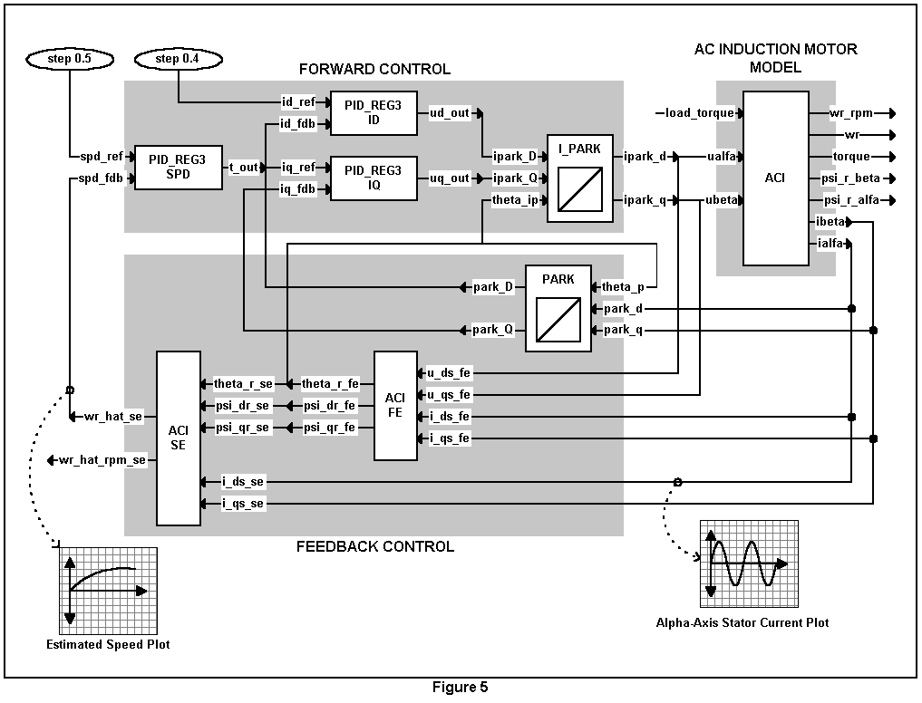
AC Induction Motor Example
One of the more complex motor control algorithms
Sensorless, ACI induction machine direct rotor flux control
Goal: motor speed estimation & alpha-axis stator current estimation

Slide 31
AC Induction Motor Example
Park Transform - floating-point C code
#include “math.h”
#define TWO_PI 6.28318530717959
void park_calc(PARK *v)
{
float cos_ang , sin_ang;
sin_ang = sin(TWO_PI * v->ang);
cos_ang = cos(TWO_PI * v->ang);
v->de = (v->ds * cos_ang) + (v->qs * sin_ang);
v->qe = (v->qs * cos_ang) - (v->ds * sin_ang);
}

Slide 32
AC Induction Motor Example
Park Transform - converting to “IQmath” C code
#include “math.h”
#define TWO_PI 6.28318530717959
void park_calc(PARK *v)
{
float cos_ang , sin_ang;
sin_ang = sin(TWO_PI * v->ang);
cos_ang = cos(TWO_PI * v->ang);
v->de = (v->ds * cos_ang) + (v->qs * sin_ang);
v->qe = (v->qs * cos_ang) - (v->ds * sin_ang);
}
#include “IQmathLib.h”
_IQ(6.28318530717959)
_iq
_IQsin(_IQmpy(TWO_PI , v->ang));
_IQcos(_IQmpy(TWO_PI , v->ang));
_IQmpy(v->ds , cos_ang) + _IQmpy(v->qs , sin_ang);
_IQmpy(v->qs , cos_ang) - _IQmpy(v->ds , sin_ang);

Slide 33
AC Induction Motor Example
Park Transform - converting to “IQmath” C++ code
#include “math.h”
#define TWO_PI 6.28318530717959
void park_calc(PARK *v)
{
float cos_ang , sin_ang;
sin_ang = sin(TWO_PI * v->ang);
cos_ang = cos(TWO_PI * v->ang);
v->de = (v->ds * cos_ang) + (v->qs * sin_ang);
v->qe = (v->qs * cos_ang) - (v->ds * sin_ang);
}
extern “C” { #include “IQmathLib.h” }
#include “IQmathCPP.h”
IQ(6.28318530717959)
iq
IQsin(TWO_PI * v->ang);
IQcos(TWO_PI * v->ang);

Slide 34
AC Induction Motor Example
Q stability range
Q range
Stability Range
Q31 to Q27
Unstable
(not enough dynamic range)
Q26 to Q19
Stable
Q18 to Q0
Unstable
(not enough resolution, quantization problems)
The developer must pick the right GLOBAL_Q value!

Slide 35
Where Is IQmath Applicable?
Anywhere a large dynamic range is not required
Motor Control (PID, State Estimator, Kalman,...)
Servo Control
Modems
Audio (MP3, etc.)
Imaging (JPEG, etc.)
Any application using 16/32-bit fixed-point Q math
Where it is not applicable
Graphical applications (3D rotation, etc.)
When trying to squeeze every last cycle

Slide 36
IQmath Approach Summary
“IQmath” + fixed-point processor with 32-bit capabilities =
Seamless portability of code between fixed and floating-point devices
  User selects target math type in “IQmathLib.h” file
    #if MATH_TYPE == IQ_MATH
    #if MATH_TYPE == FLOAT_MATH
One source code set for simulation vs. target device
Numerical resolution adjustability based on application requirement
  Set in “IQmathLib.h” file
    #define GLOBAL_Q 18
  Explicitly specify Q value
    _iq20 X, Y, Z;
Numerical accuracy without sacrificing time and cycles
Rapid conversion/porting and implementation of algorithms
IQmath library is freeware - available from TI DSP website
http://www.dspvillage.ti.com (follow C2000 DSP links)

Slide 37




