Slide 1
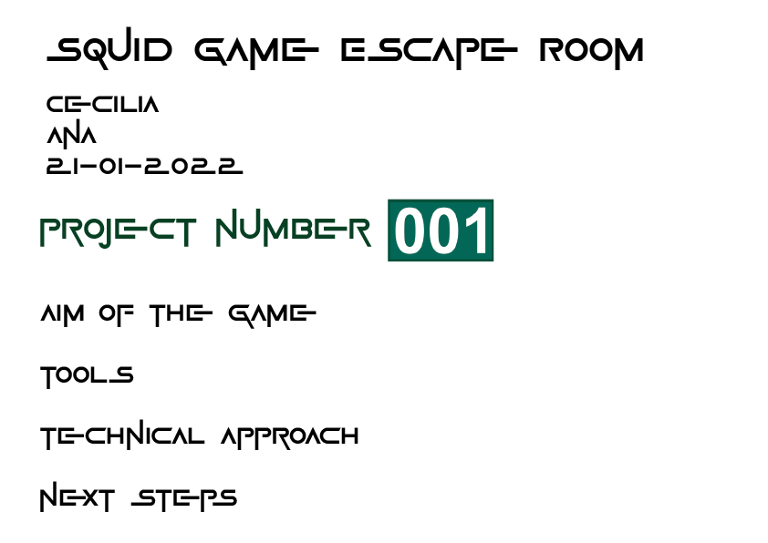



Slide 2

You are one of the (un)lucky 456 people that could win almost $40.000.000
Notes:
Target: people that loved the popular Netflix series squid game

Slide 3
ARE YOU READY FOR IT?
Notes:
Target: people that loved the popular Netflix series squid game

Slide 4
Congratulations!
You won!
Notes:
Target: people that loved the popular Netflix series squid game

Slide 5
More interesting theme:
Design modifications;
Sound and images.
Adding challenges for the user:
Box with Marbles;
Glass corridor.
Making it more user-friendly
Notes:
Design modifications - Cookie as key / Security guard as door
User-friendly stuff - (1 or 3 and y or n)

Slide 6
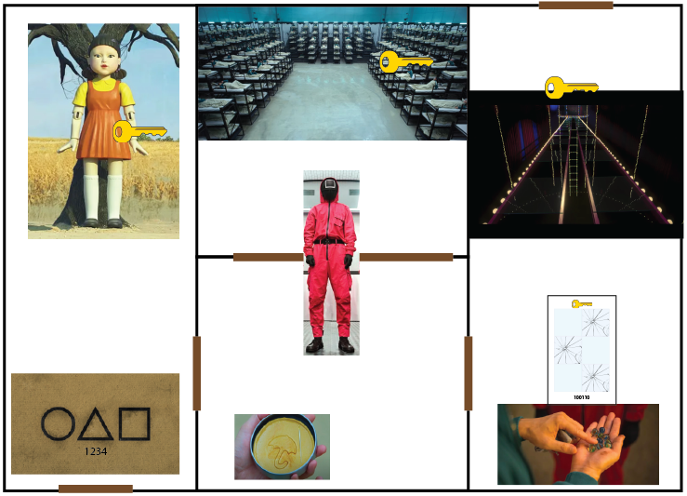

Slide 7
Libraries:
PyGame;
Time;
OS.
Coding:
for loops and while loops;
append method.

Slide 8
Timer
Prize collection
Randomizing the challenges codes
Design modifications (rooms, images and sound)
Notes:
Countdown: parallel execution
Prize collection: list append
Randomizing the code: random
Design modifications (rooms, images and sound): pygame and os

Slide 9
Acknowledgements
Gladys
Jose

