Slide 1
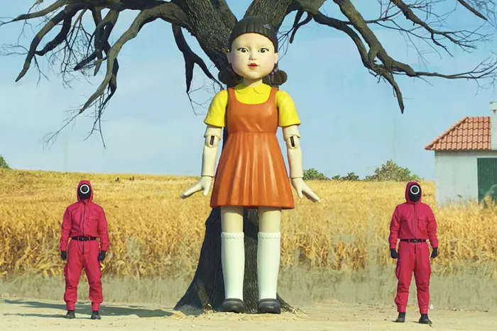
You will need this code to win the game:
1234

