Slide 1


CallMe – Helpdesk System
Made with Spring Boot and Angular
Welcome to the CallMe presentation, a new system designed to streamline IT support for public organizations.
por Khawan Fellipe

Slide 2
The Problem: Managing IT Support
Public departments often struggle with IT support requests. Current methods are inefficient.
Outdated methods cause significant delays and disorganization.
📧 Email overload
📋 Spreadsheet chaos
❌ Hard to track progress
This leads to slow response times and frustration.

Slide 3




CallMe: The Solution for Organized Support
Online requests
Users submit requests easily.
Unique token
Each request gets a tracking number.
Track status
Managers monitor progress.

Slide 4

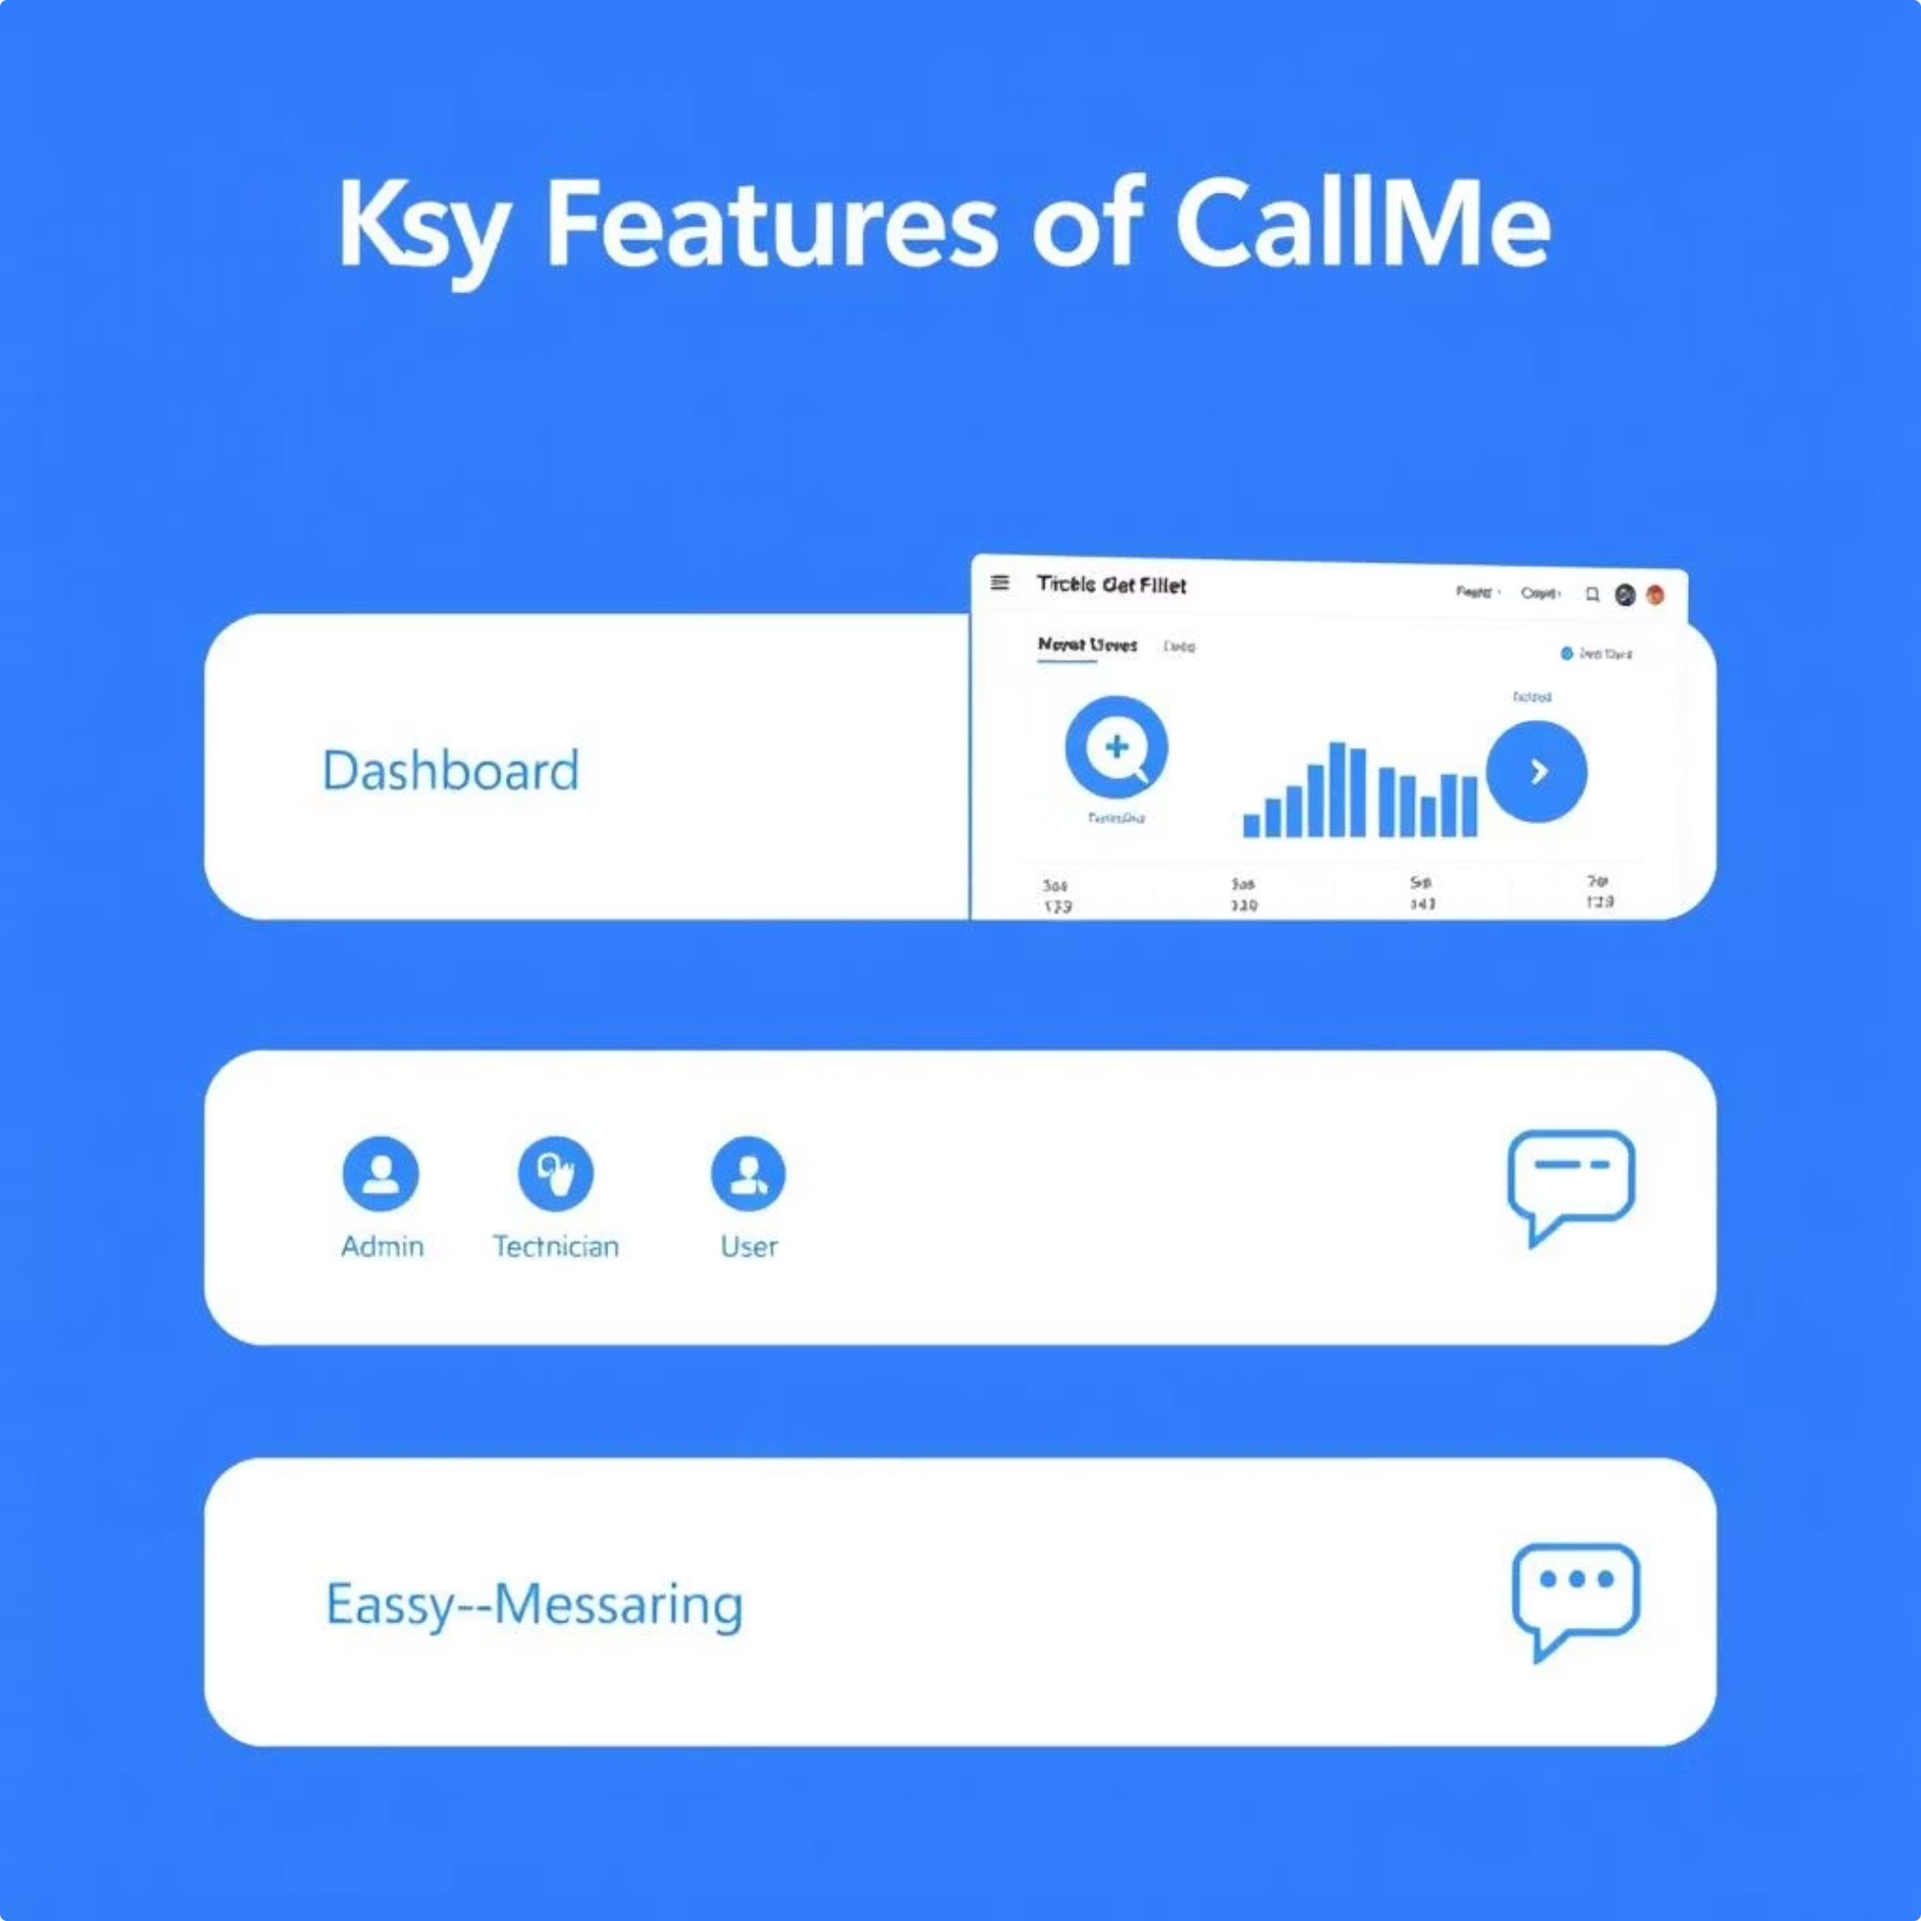
Key Features of CallMe
➕ New Request
Quickly open a new ticket.
📊 Dashboard
Overview with key numbers.
👥 User Roles
Admin, Technician, User access.
💬 Easy Messaging
Direct communication with technicians.

Slide 5
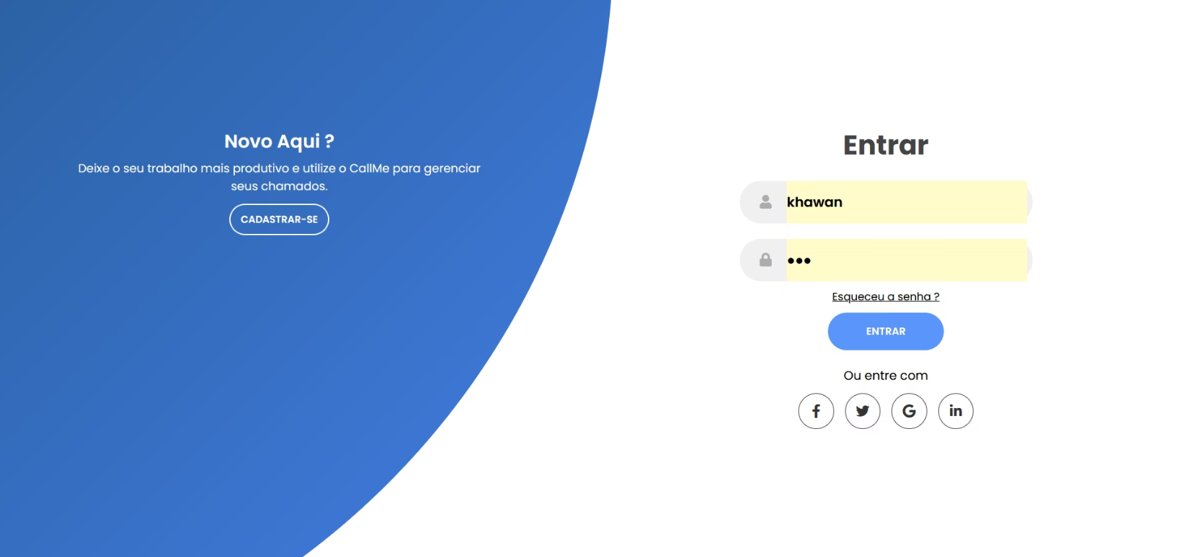
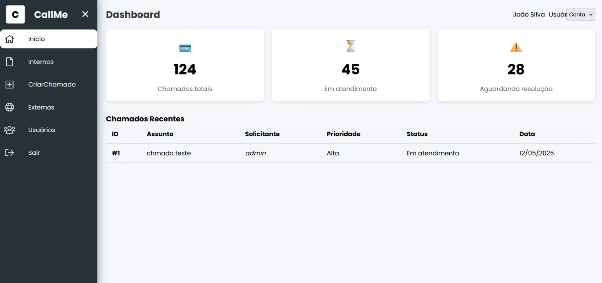
CallMe in Action: Login and Dashboard
Secure login for all users, ensuring data privacy.
Intuitive dashboard provides an immediate overview of all requests and their statuses.

Slide 6
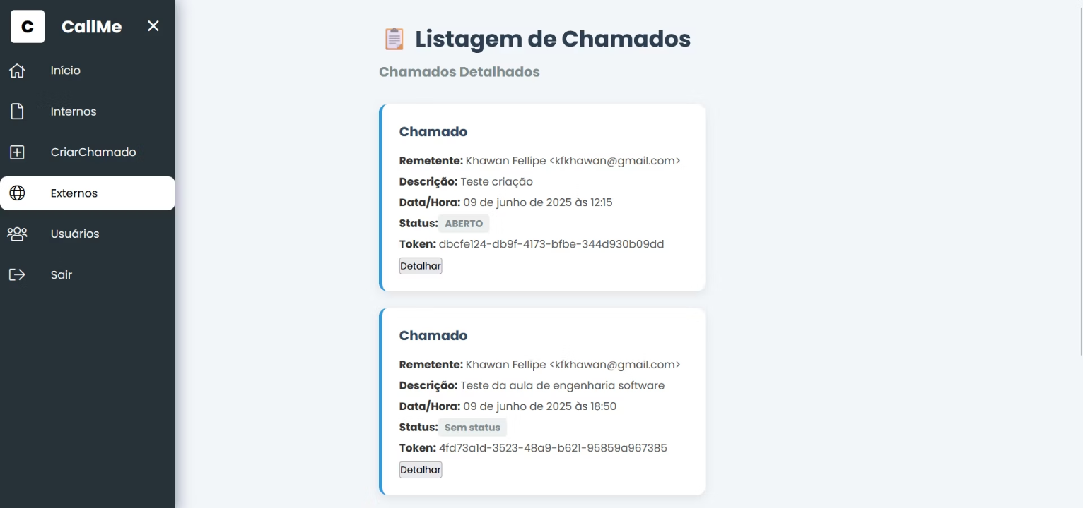
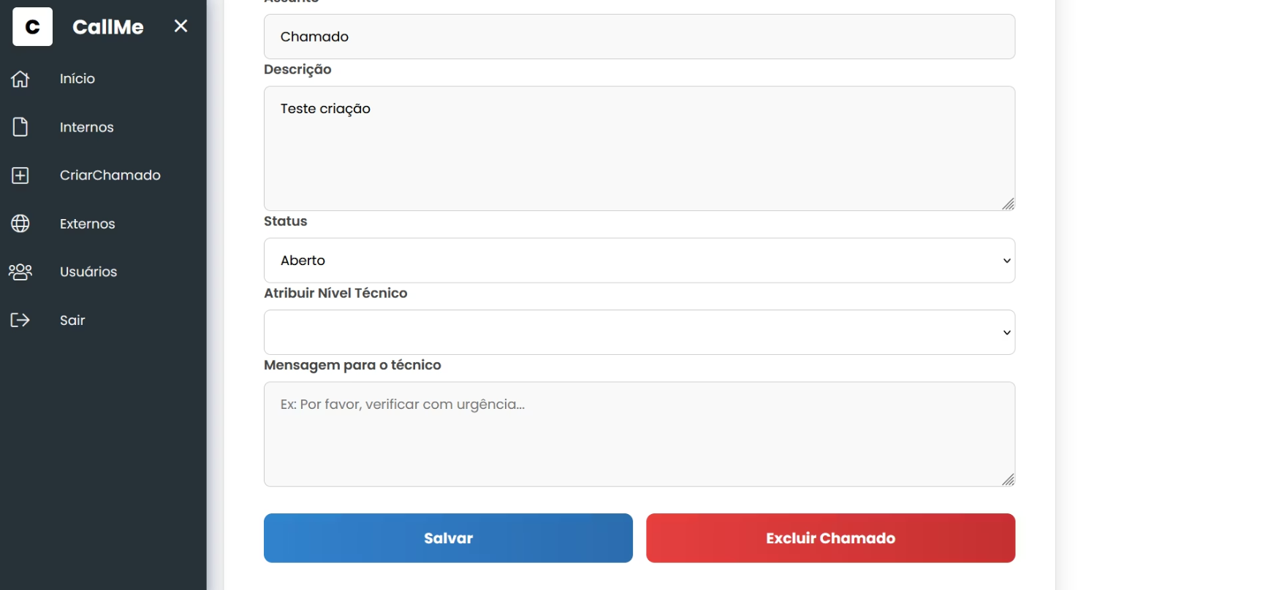
Creating and Managing Requests
Simple form to create new support requests, capturing all details.
Comprehensive list of requests for easy filtering and management by technicians.

Slide 7
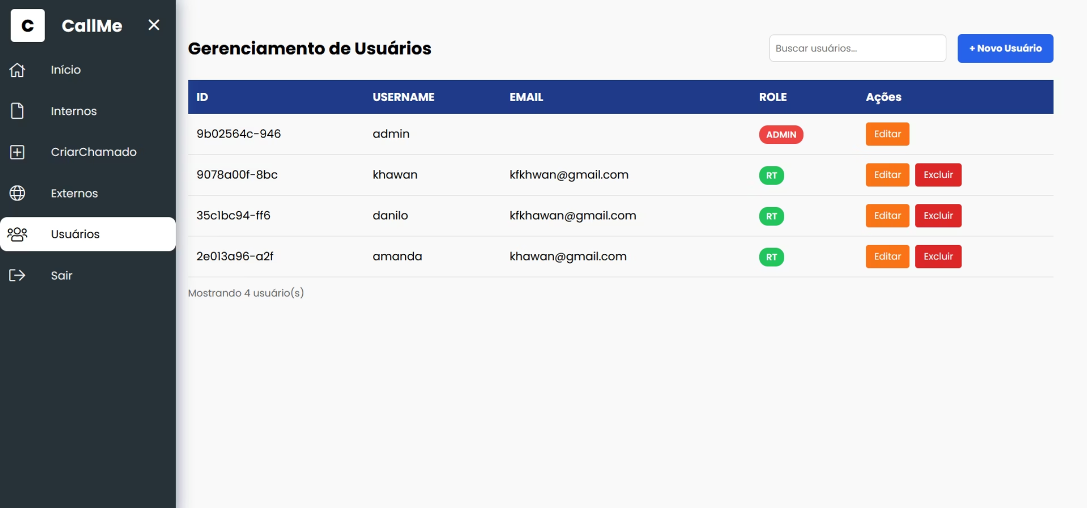
User Management
User roles ensure proper access levels:
Admin: Full control.
Technician: Handle requests.
User: Create and track requests.
Simplifies permission handling.

Slide 8

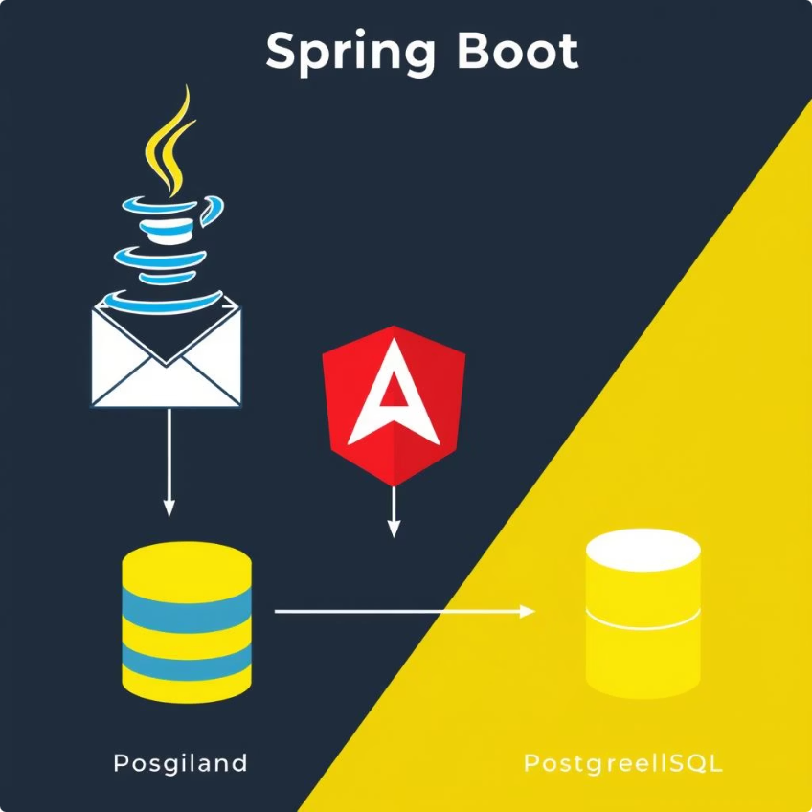
Under the Hood: Technology Stack
Java Spring Boot
Angular Frontend
Robust backend foundation.
Modern user interface.
JavaMail System
PostgreSQL Database
Reliable email notifications.
Secure data storage.

Slide 9
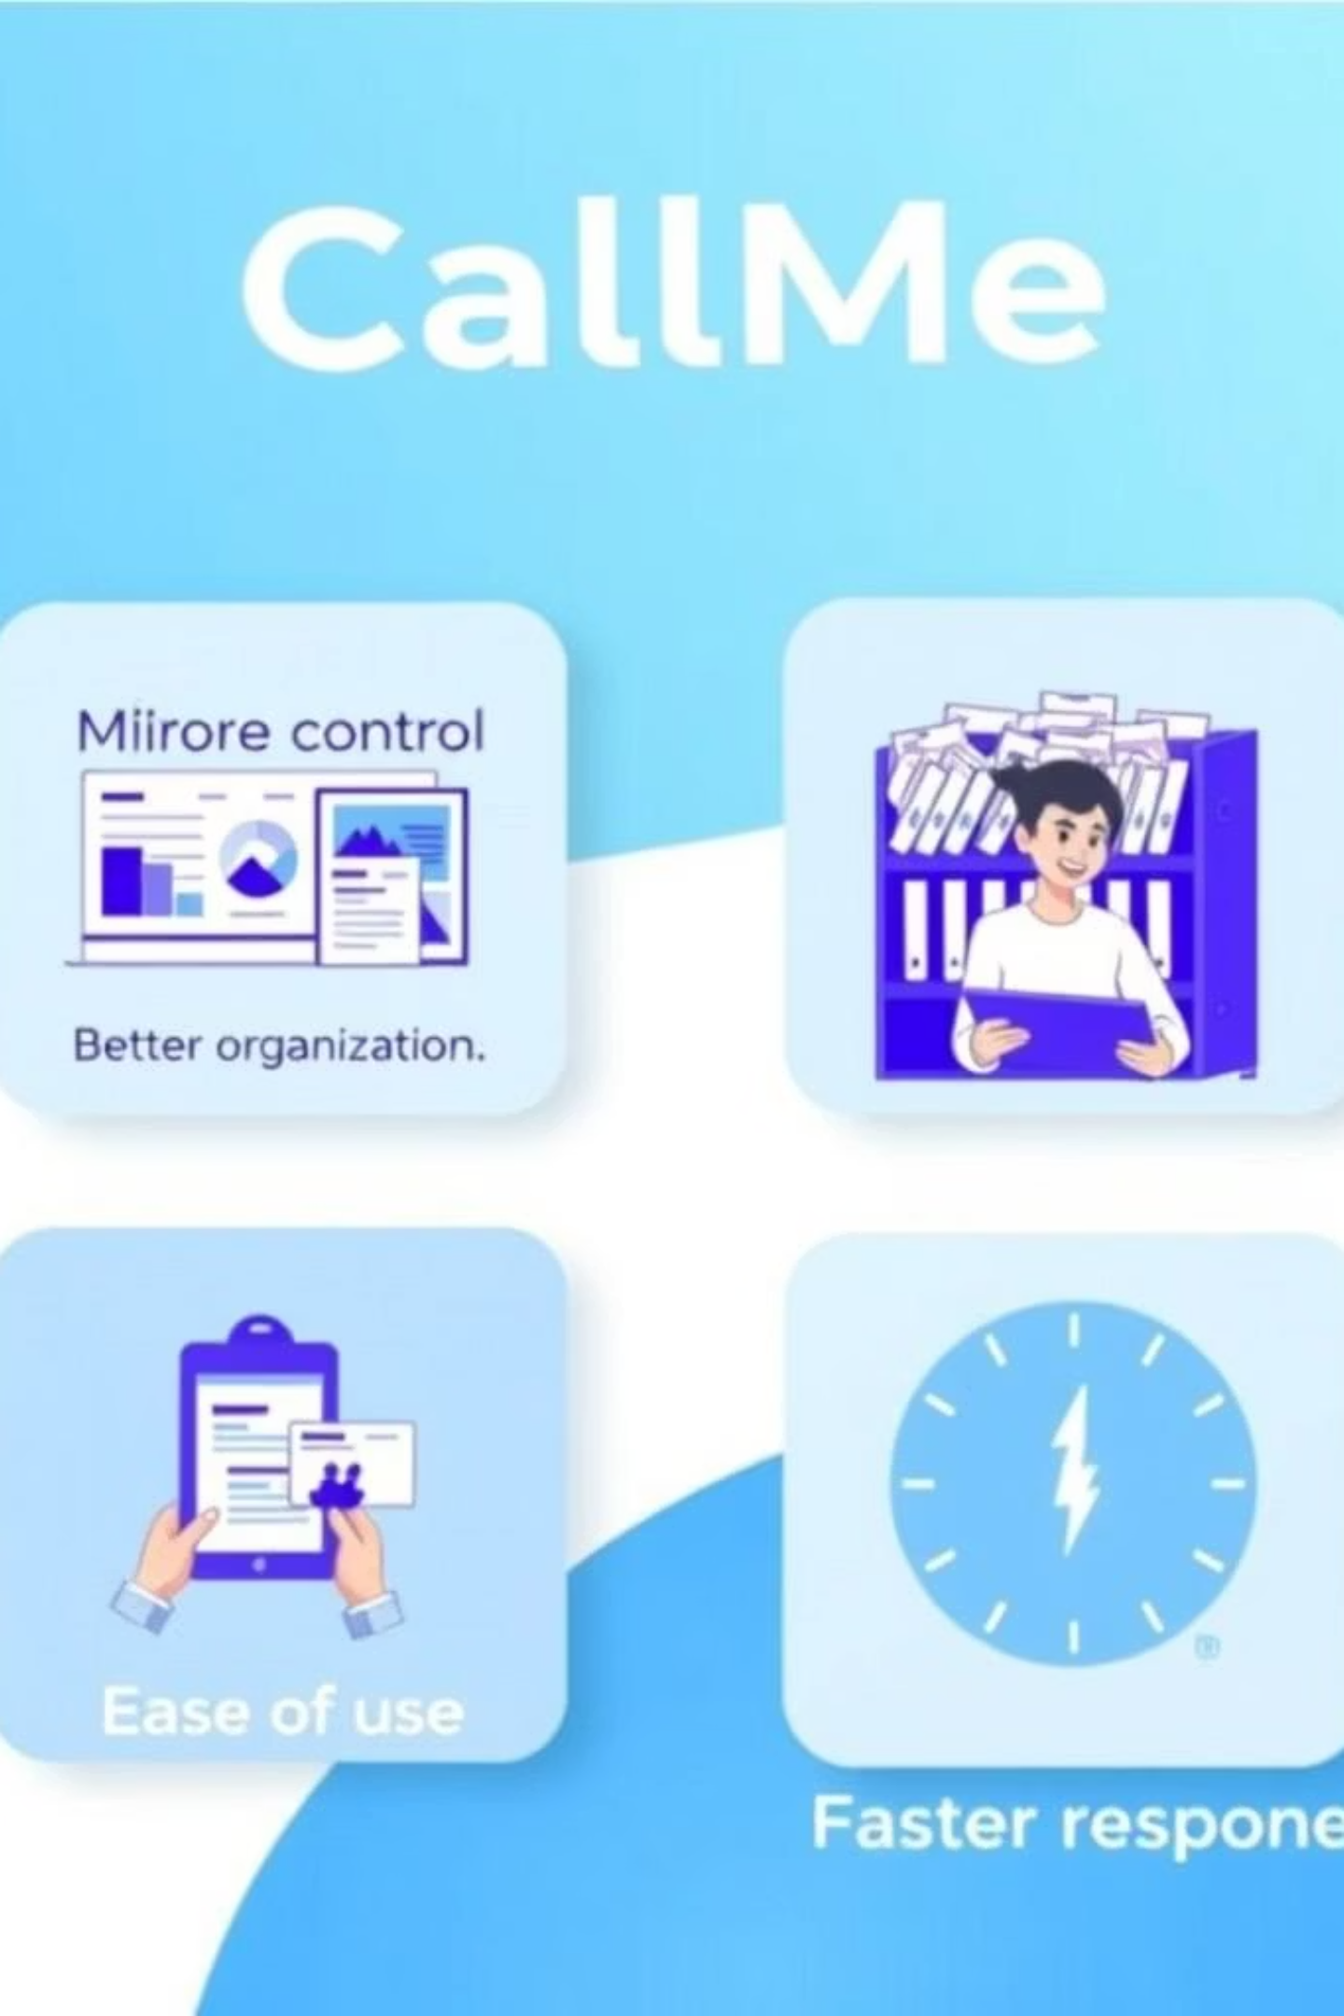




Benefits of CallMe
More Control
Better oversight of all requests.
Better Organization
Structured and clear process.
Easy to Use
Intuitive for all users.
Faster Response
Quicker resolution times.

Slide 10
Thank You!
Thank you for your attention!
Do you have any questions?

