Slide 1

GraphEvol: A Graph Evolution Technique for Web Service Composition
Alexandre Sawczuk da Silva, Hui Ma, Mengjie Zhang
26th International Conference on Databases and Expert System Applications (DEXA)
Valencia, Spain, 1-4 September 2015
Notes:
Good morning/afternoon! I am Dr. Hui Ma and today I am going to talk about our work on GraphEvol, which is a graph-based evolutionary computing technique for Web service composition.

Slide 2
Service-Oriented Computing
Organise processes and data in reusable modules for integration into new applications.
Currency conversion
Calculate total bill
Process payment
Web service: A functionality module that provides operations accessible over the network via a standard communication protocol.
Notes:
This work builds on the concept of Service-Oriented Computing.
The key idea in SOC is to organise business processes and data into independent modules which can then be reused in applications as needed.
For example, an e-commerce website may need to perform currency conversion depending on the location of its current customer, and so it uses an already existing currency conversion module.
The basic components in SOC are services, which are functionality modules accessible over the network. In this example, currency conversion is a Web service.

Slide 3
Web Service Composition
The combination of Web services to achieve a more complex task:
Input: ZipCode
Output: City
LocationByZip
Input: ZipCode, Date
Output:
City, WeatherInfo
USWeather
Input: City, Date
Output: WeatherInfo
Notes:
The combination of multiple modular Web services in order to achieve a single, more complex task is known as Web service composition.
For example, imagine we need to create a service that provides the weather forecast of a location based on its ZIP code. We can identify and connect two different services, one that identifies a city based on a ZIP code and another that uses the city and date information to produce the forecast.

Slide 4
The Aspects of Service Composition
The intricacy of Web service composition lies in the number of distinct aspects it must simultaneously account for:
Sequence
Output:
City
Parallel
Input:
City, Date
Vs.
Output:
Date
Composition constructs
Composition quality
Functionality
Notes:
The complexity of Web service compositions is in the number of aspects it needs to address simultaneously.
The first aspect is the functionality of compositions. Web service composition solutions must be functionally correct, meaning that the inputs to each service included are completely fulfilled using compatible connections. This is important because it ensures that the composite application can be fully executed at runtime.
The second aspect is that of composition constructs, which determine how services are configured in the composition. In this research we assume that services may either be organised in a sequence construct, where services are chained so that the output of a preceding service feeds the input of the next, or in a parallel construct, where services are executed simultaneously in an independent manner.
The third aspect is the quality of compositions. For example, the more services in a composition, the longer that composition takes to produce a result; therefore, a composition with less services would be considered to have better quality than a larger composition.

Slide 5
Existing Composition Approaches
Different strategies have been employed to the problem of Web service composition:
Planning-based approaches
Traditional optimisation approaches
Evolutionary computation approaches
Notes:
There are many different strategies that have been employed to the problem of Web service composition.
One popular group is that of planning-based approaches. The central idea of these approaches is to create a composition solution step by step, each time adding a new service whose input is completely fulfilled by the existing values available. The advantage of this is that it makes it easy to check that the connections between services are correct, however it is difficult to optimise the quality of compositions using this method.
The composition problem has also been tackled by using traditional optimisation approaches, such as Integer Linear Programming. These approaches allow us to optimise the quality of the final composition solutions; however, they do not scale well as the number of candidate atomic services grows, since the connection possibilities become exponentially larger.
Finally, we have evolutionary computation approaches, where the quality of solutions is gradually optimised using concepts borrowed from the Darwinian theory of evolution. These approaches are especially promising because they allow us to optimise composition solutions in a way that scales well for large numbers of candidate services.

Slide 6
Genetic Programming Approaches
GP simultaneously constructs the composition workflow and optimise the services in it:
Parallel
Sequence
Sequence
FindHotel
BookHotel
FindRentalCompany
RentalComBook
Limitation: difficult to check connections between services.
Notes:
One of the most promising evolutionary computing approaches to composition is genetic programming (GP), because it allows us to simultaneously construct a composition workflow and optimise the atomic services in it.
GP approaches represent solutions as trees, where the terminal nodes are candidate services and the non-terminal nodes represent workflow constructs.
In the example shown here, adapted from the literature, we have a Web service composition that sets up accommodation and transport for a trip. Based on the destination city, arrival data, and departure date, it finds and books a hotel, as well as finding a car rental company and renting a car.
A population of these trees is randomly created, and genetic operations are then applied to these trees. These operations include mutation, where a subtree of a candidate is randomly modified to introduce diversity, and crossover, where the subtrees of two candidates are swapped to create children that have characteristics from both parents.
The main limitation with using GP is that, as we are trying to encode a graph-like framework into a tree structure, it may be difficult to check that the connections between the different services in the composition are functionally correct.

Slide 7
GraphEvol
Compositions are represented directly as graphs:
Start
FindHotel
FindRentalCompany
BookHotel
RentalComBook
End
Notes:
The approach proposed in this work represents solutions directly as a graph with Web service nodes.
As we can see from this example, the travel-booking composition that we previously saw as a tree can now be easily visualised in its graph form.
This allows us to directly check that the connections between services have been satisfied, however we must implement mutation and crossover operations so that they handle graphs instead of the simpler concept of subtrees.
Another important aspect of GraphEvol is that it uses a graph-building algorithm for creating the initial solutions, as we will discuss in the upcoming slides.

Slide 8
The GraphEvol Process
Initialise the population using graph-building algorithm.
Evaluate the fitness of the initialised population.
while max. generations not met do
Select the fittest candidates for reproduction.
Perform mutation and crossover on the selected candidates, generating offspring.
Evaluate the fitness of the new graph individuals.
Replace the lowest-fitness individuals in the population with the new graph individuals.
Notes:
Here we have the overview of the GraphEvol technique, which we will then explore in detail in subsequent slides. The algorithm works on the basic principle of a fitness function. A fitness function is used to evaluate the quality of a composition candidate in the population; the higher the quality, the more attractive that candidate is to us. We breed the best candidates to achieve the fittest solution possible.
We begin by initialising the population by building an initial set of graphs.
We then evaluate each of these graphs to determine their quality.
Then, for a set number of generations we do the following steps:
We select the fittest candidates (i.e. The candidates with the highest quality) to be reproduced, which involves using mutation and crossover operators.
We apply these operators, generating offspring that may have a better quality than their parents.
Then we evaluate the fitness of these newly created graphs, and replace the lowest-quality individuals in the population with the new candidates.
Finally, we select the fittest candidate from the final population to be our composition solution.

Slide 9
Graph-Building Algorithm
Builds solutions step by step, always checking connections:
Input: ZipCode
Output: City
Input: ZipCode, Date
Input: ZipCode, Date
LocationByZip
Input: ZipCode, Date
LocationByZip
USWeather
Output:
City, WeatherInfo
Input: ZipCode
Output: City
Input: City, Date
Output: WeatherInfo
Step 1
Step 2
Step 3
Notes:
The general idea of the graph-building algorithm is to build solutions step by step, each time adding a new service whose input is completely fulfilled by the existing values available. After each addition, we check whether the overall desired input can be created, and we stop if we can.
As an example, we revisit our weather forecast example from earlier.
In step 1, we begin with the overall composition input of ZipCode and date.
With those values, in step 2 we can fulil the LocationByZip service, so we add it in; we check if we are producing our overall composition output, and conclude that we are still not producing it (WeatherInfo) is missing.
We then try to add another service and manage to connect the Weather service in step 3, as all its inputs are satisfied; finally, we determine that we are now producing the overall desired output and we stop the building process.

Slide 10
Mutation
Replaces subpart of candidate graph with newly generated fragment:
Root
C
F
A
I
Start
D
G
End
J
B
E
H
C
A
K
L
End
Start
D
B
E
H
Notes:
Intuitively, the mutation operator for a graph candidate implements the same idea of a tree mutation: a subpart of the candidate should be removed and replaced with a new randomly generated fragment, while maintaining the functional properties of the original subpart (i.e. correct output-input matches). The difference is that the multiple dependency points in a graph require more careful consideration.
Initially, a random node in the graph is selected as the mutation root (in this example, node F), and any nodes that are dependent on it are identified.
These nodes and their associated edges are then removed from the graph, and the partially constructed composition is fed into the graph building algorithm discussed earlier.
The algorithm then finishes constructing the partially built composition, resulting in a candidate that retains some of the original features (i.e. nodes A-H, excluding F) but also has new structures (nodes K and L, and their associated edges).

Slide 11
Crossover
Merges two parents and extracts a new candidate:
3
1
6
Start
4
End
2
3
7
5
1
6
Start
4
End
2
7
3
8
9
5
0
1
6
Start
4
End
8
9
5
0
Notes:
The basic idea of the crossover operator is to select two candidate graphs, merge them into a single structure, and then extract a new candidate out of this merged structure.
By doing so, we reuse parts of the structure of both parents to create an original offspring, as intended by the traditional tree-based crossover.
The merging process consists of combining any two nodes with the same name into a single node, maintaining all original dependencies from both graphs. This will create a structure that is functionally correct but presents redundant services and connections.
Once the merge has taken place, an offspring can be extracted from the structure to obtain a new non-redundant solution (as the one highlighted in green in this example). This extraction is done using a modified version of the graph-building algorithm.

Slide 12



Fitness Function
Encourages smallest number of nodes and shortest paths:
$${fitness}_{i}=ω_{1}\frac{1}{{runPath}_{i}}+ω_{2}\frac{1}{{\#atomicService}_{i}}$$
where:
$$ω_{1}+ω_{2}=1$$
${runPath}_{i}$ is the longest start-end path
${\#atomicService}_{i}$ is the total number of services in composition
Notes:
The fitness function used in this approach encourages the creation of solutions containing the lowest possible number of atomic services, and the shortest possible paths from the start to the end node. These measures are used as indicatives of the quality of a solution, since solutions with less services and shorter paths are likely to execute faster.
This is a maximising function where the weights $ω_{1}$ and $ω_{2}$ add to 1, ${runPath}_{i}$ corresponds to the longest path from the start node to the end node of a solution (measured using a longest path algorithm), and ${\#atomicService}_{i}$ corresponds to the total number of service nodes included in a solution.

Slide 13
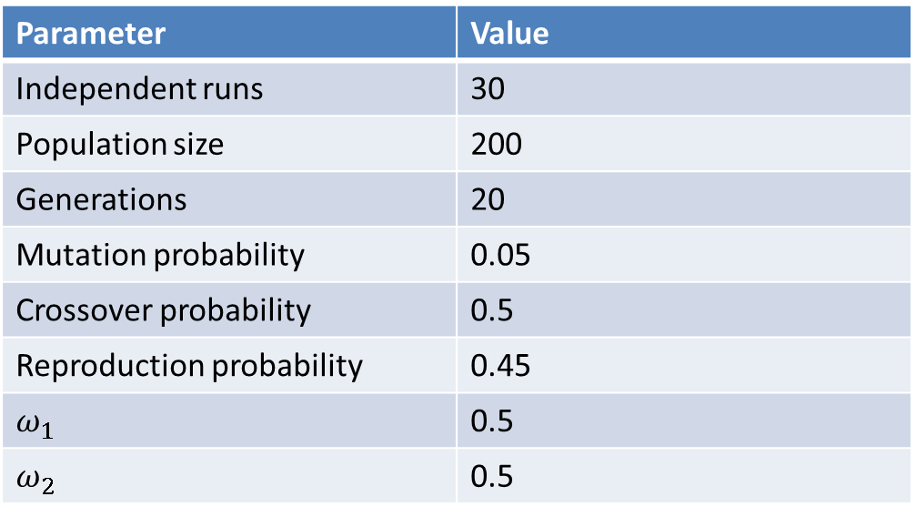
Experiments
Compared performance of GraphEvol against a tree-based GP approach from the literature.
OWL-S TC and WSC2008 datasets were used.
Parameter | Value
Independent runs | 30
Population size | 200
Generations | 20
Mutation probability | 0.05
Crossover probability | 0.5
Reproduction probability | 0.45
$$ω_{1}$$ | 0.5
$$ω_{2}$$ | 0.5
Notes:
Experiments were conducted to test the performance of GraphEvol against a tree-based GP composition approach from the literature.
The fitness function implemented by us is exactly the same as the one used by the tree-based GP approach, and we have used the same benchmark datasets as those authors (OWL-S TC and WSC2008).
We have also used the same parameters as those used by the tree-based GP.
Therefore, we can directly compare the quality of the solutions produced by the two approaches.

Slide 14
Results
 | GraphEvol |  |  | GP Approach
Task | Time (ms) | runPath | #atomServ | Time (ms) | runPath | #atomServ
OWL-S-1 | 469.6 | 1 | 1 | 749.0 | 1 | 1
OWL-S-2 | 326.7 | 1 ↓ | 1 ↓ | 484.0 | 2 | 2
OWL-S-3 | 517.2 | 2 | 2 | 473.6 | 2 | 2
OWL-S-4 | 674.2 | 2 ↓ | 4 ↓ | 3010.2 | 2.2 | 5.7
OWL-S-5 | 472.2 | 1 | 3 ↓ | 1098.3 | 1 | 3.3
WSC-1 | 699.4 | 3 ↓ | 10 ↓ | 6919.7 | 6 | 15.8
WSC-2 | 734.6 | 3 ↓ | 5 ↓ | 11137.2 | 3.5 | 6
WSC-5 | 918.4 | 8 ↓ | 20 ↓ | 95360.2 | 9.2 | 49.9
Notes:
Experiment results are shown in this table. As we can see, the average path length and number of atomic services is consistently significantly lower for GraphEvol as opposed to GP (this was measured using unpaired t-tests at 0.05 significance level).
For OWL-S TC 3, the quality of both approaches was equivalent.
These results show that GraphEvol is a powerful alternative when performing fully automated Web service composition.
As for the execution time, we cannot directly compare it, as the two approaches were run in different environments. However, the patterns displayed by GraphEvol and GP are roughly similar.

Slide 15
Conclusion
GraphEvol represents solutions directly as graphs
Relies on graph-building algorithm
Uses modified crossover and mutation
Experiment results showed GraphEvol produces better quality solutions
Future work: consider more sophisticated quality measures.
Notes:
This work presented GraphEvol, which is an evolutionary computation technique aimed at performing fully automated Web service composition.
The key advantage of GraphEvol is that it represents compositions directly as graphs, which means that it is simpler to enforce the functional correctness of solutions.
To support this graph representation, we rely on a graph-building algorithm to initialise the population, and also on modified mutation and crossover operators.
When compared to a traditional tree-based GP approach, results show that GraphEvol produces solutions with better quality, showing that it is a promising technique.
In our future work, we would like to test GraphEvol using more sophisticated Quality of Service measures, including the availability, reliability, and financial cost of services.

Slide 16
Thank you!
Questions?
Notes:
Thank you for listening! Are there any questions?

