Slide 1

Fragment-based Genetic Programming for Fully Automated Multi-Objective Web Service Composition
Alexandre Sawczuk da Silva, Yi Mei, Hui Ma, Mengjie Zhang
The Genetic and Evolutionary Computation Conference (GECCO)
Berlin, Germany ▪ 15 - 19 July 2017
Notes:
Good morning/afternoon! My name is Alex da Silva, and today I am going to talk about a fragment-based genetic programming representation for evolving Web service compositions in a fully automated way.

Slide 2
Service-Oriented Computing
Organise processes and data in reusable modules for integration into new applications.
Currency conversion
Calculate total bill
Process payment
Web service: A functionality module that provides operations accessible over the network via a standard communication protocol.
Notes:
This work builds on the concept of Service-Oriented Computing.
The key idea in SOC is to organise business processes and data into independent modules which can then be reused in applications as needed.
For example, an e-commerce website may need to perform currency conversion depending on the location of its current customer, and so it uses an already existing currency conversion module.
The basic components in SOC are services, which are functionality modules accessible over the network. In this example, currency conversion is a Web service.

Slide 3
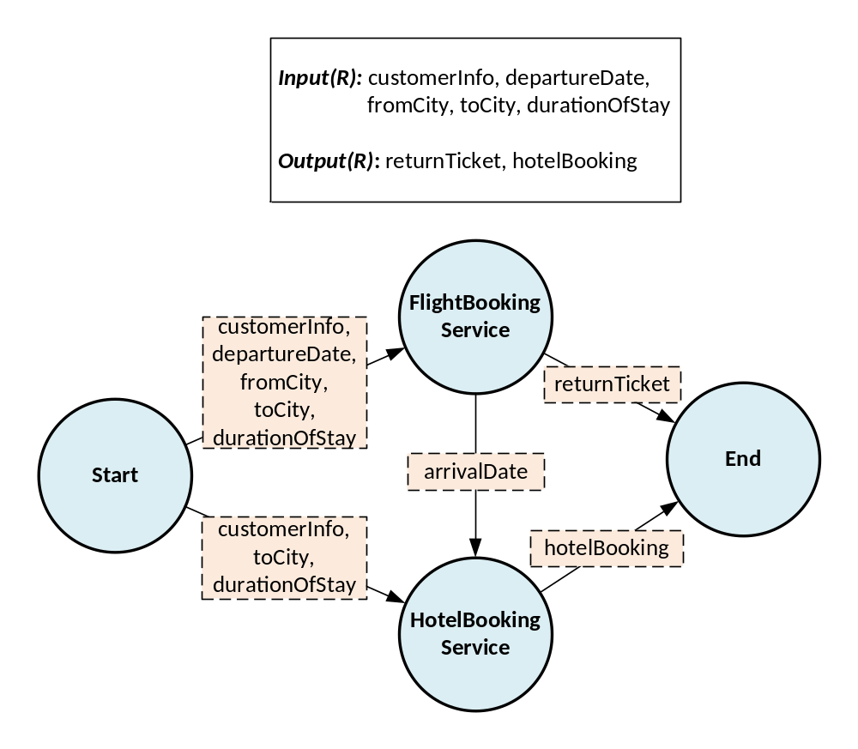
Web Service Composition
The combination of Web services to achieve a more complex task:
Notes:
The combination of multiple modular Web services in order to achieve a single, more complex task is known as Web service composition.
For example, imagine we need to create a service that allows a customer to book tickets and accommodation for a trip. The customer provides certain information relevant to the trip, and this is used to produce the tickets and bookings.
We begin by executing the flight booking service, whose inputs are completely satisfied by the given composition request inputs, and this produces the tickets. It also allows us to determine the arrival date at the destination city, which is then used to execute the hotel booking service.
We see that the basic idea here is to identify and connect different services with complementary functionality, ensuring that the connections between the solutions are correct.

Slide 4
Quality of Service (QoS)
The non-functional aspects of services must also be considered: Time, Cost, Availability, Reliability
Overall
T = 5 A = 0.941192
C = 6 R = 0.941192
S₁
t = 1 a = 0.98
c = 1 r = 0.98
S₃
t = 3 a = 0.98
c = 3 r = 0.98
Start
End
S₂
t = 2 a = 0.98
c = 2 r = 0.98
Notes:
In addition to taking the correctness of compositions into account, we must also consider non-functional aspects of services when selecting them to , i.e. their Quality of Service attributes.
In this work we take four popular QoS attributes into account: the service’s execution time, its financial cost, its probability of being available when requested, and the probability that the response it returns is reliable (i.e. it matches the expected).
We calculate the overall quality by aggregating individual service values into single scores.
The overall availability and reliability are calculated by multiplying together the availability and reliability values of each individual service; the overall cost is calculated by adding up the cost values of each individual service in the composition; the overall time is calculated by finding the longest path timewise, since it is possible to execute services in parallel.

Slide 5
Aspects of Service Composition
The intricacy of Web service composition lies in the number of distinct aspects it must simultaneously account for:
Output:
City
Overall
A = 0.8
C = 4
Vs.
Input:
City, Date
Vs.
Overall
A = 0.6
C = 2
Output:
Date
Functionality
Structure
Conflicting QoS
Notes:
The complexity of Web service compositions is in the number of aspects it needs to address simultaneously.
The first aspect is the functionality of compositions. Web service composition solutions must be functionally correct, meaning that the inputs to each service included are completely fulfilled using compatible connections. This is important because it ensures that the composite application can be fully executed at runtime.
The second aspect is the structure of compositions. Services can be combined in different sets, with different connections, and still accomplish the same task. Thus, part of the composition process is to identify the most promising structures.
The third aspect is the trade-off between the different quality attributes of compositions. For example, certain composition alternatives may favour execution time over cost, while others favour cost over time. The composition process should identify the best quality options, taking QoS conflicts into account.

Slide 6
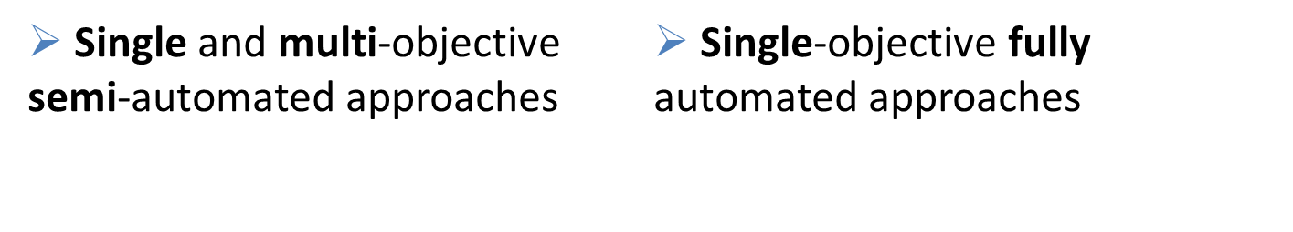
Existing EC Composition Approaches
EC has been extensively employed to the problem of Web service composition, using the following strategies:
S
P
S
P
However, the following strategy is not considered:
Multi-objective fully automated approaches
Notes:
Researchers have investigated EC applied to the composition problem, and they came up with a number of strategies.
Some works are focused on semi-automated composition, which is when the abstract composition workflow is already known, and EC’s job is simply to select the best possible concrete service from a pool of candidates to fulfil a given workflow slot. This has been investigated using techniques such as GA and PSO, both in a single-objective or in a multi-objective context.
Other works are focused on fully automated composition, which is when the composition workflow is created at the same time the services to be included in the composition are selected. This has been investigated using techniques such as GP in a single-objective context.
However, fully automated composition has not been investigated in a multi-objective context.

Slide 7
Goal
To propose a multi-objective fully automated approach for Web service composition.
Investigate a novel fragment-based genetic programming (GP) approach.
Combine the new representation with NSGA-II.
Graph-based
Tree-based
Indirect
P
1
3
S
S
3
5
4
2
1
2
4
1
P
2
4
3
4
Notes:
Thus, the goal of this work is to propose a multi objective fully automated approach for Web service composition, achieving two objectives:
Firstly, we want to investigate a novel fragment-based genetic programming approach to composition. In comparison to previously investigated representations, the fragment-based representation has the following advantages:
When compared to a graph-based representation, it is easier to perform operations on individuals. That is because we can update fragments individually and gradually, whereas updating a graph is often more complex.
When compared to a tree-based representation, we can avoid the replication of service nodes that happens when representing densely connected structures.
When compared with an indirect representation, we can avoid the potentially time-consuming decoding process required before evaluating the quality of each composition.
Secondly, to combine this new representation with NSGA-II so that it can be executed in a multi-objective context.

Slide 8
Fragment-based Genetic Programming
Individuals structured as a series of fragments, where each fragment records a service’s predecessors:
Start
Flight
Booking
Service
Hotel
Booking
Service
End
Start
Start
Flight
Booking
Service
Flight
Booking
Service
Hotel
Booking
Service
Notes:
In the proposed fragment-based genetic programming, a composition is represented as a series of fragments. Each fragment represents a service in the composition (plus start and end nodes) and all of its predecessors.
We can think of the fragments as pieces of a puzzle that once put together show us the overall composition workflow.

Slide 9
Fragment-based MO Method
Input: Population size N
Output: Solution set
Preprocess repository to identify layers.
Initialise the population of fragmented candidates.
Perform non-dominated sorting on candidates.
while stopping criteria not met do
Select N best candidates from the population, using the NSGA-II selection, and place them in a mating pool.
Select candidates from mating pool and apply crossover and mutation.
Combine mating pool and offspring as the new population, and perform non-dominated sorting.
return solution set with highest-rank candidates
Notes:
Here we have the overview of the fragment-based MO method, which we will then explore in detail in subsequent slides. The algorithm works basically like the standard NSGA-II
We begin by preprocessing the repository in order to identify composition layers, which will be useful for initialisation.
Then, we initialise the population by building an initial set of fragmented individuals and perform non-dominated sorting on the candidates.
Then, we perform the following steps as long as the stopping criteria is not met:
We select the N best candidates from the population and place them in a mating pool (here N is the size of the population).
We then select candidates from the mating pool (using tournament selection) and apply the crossover and mutation operations to them.
Finally, we combine the mating pool and its offspring to form the new population and perform non-dominated sorting.
Once the evolution is over, the highest-ranked candidates in the latest generation are return as the Pareto front of solutions.

Slide 10
Layer Identification
Progressively discover additional services, until no new service can be reached.
Available: a
Avaliable: a, b, c
Avaliable:
a, b, c, e, f
serv1
Input: a
Output: b
serv3
Input: c
Output: e
serv5
Inputs: e, f
Output: g
serv2
Input: a
Outputs: c
serv4
Input: c
Output: f
Layer 1
Layer 2
Layer 3
Notes:
In order to retrieve the layer information, we use a simple layer identification algorithm.
We begin with the overall composition inputs, and identify the services from the repository whose inputs can be fulfilled using those available inputs. These services make up our first layer.
We then update the set of available inputs with the outputs of the service in the first layer.
We repeat this process, finding other layers until no new services can be identified.

Slide 11
Initialisation Algorithm
Gradually builds fragments from the end towards the start.
Service Repository
serv1
Input: a
Output: b
Layer: 1
serv2
Input: a
Output: c
Layer: 1
serv3
Input: c
Output: e
Layer: 2
serv4
Input: c
Output: f
Layer: 2
serv5
Input: e,f
Output: g
Layer: 3
Service Queue
Composition Request
input(R): a
output(R): g
End
Input: g
serv5
Input: e,f
Output: g
Layer: 3
serv3
Input: c
Output: e
Layer: 2
serv4
Input: c
Output: f
Layer: 2
serv2
Input: a
Output: c
Layer: 1
serv2
Input: a
Output: c
Layer: 1
Start
Output: a
Composition Candidate
Start
Output: a
End
Input: g
serv5
Input: e,f
Output: g
Layer: 3
serv3
Input: c
Output: e
Layer: 2
serv4
Input: c
Output: f
Layer: 2
serv2
Input: a
Output: c
Layer: 1
serv5
Input: e,f
Output: g
Layer: 3
serv3
Input: c
Output: e
Layer: 2
serv4
Input: c
Output: f
Layer: 2
serv2
Input: a
Output: c
Layer: 1
serv2
Input: a
Output: c
Layer: 1
Start
Output: a
Notes:
We use a candidate initialisation algorithm that gradually builds solution from the end fragment towards the start fragment.
We begin by creating a composition candidate that contains only the start node.
Then, we create a service queue for processing that contains the end node.
Then, we perform the following process as long as the queue is not empty:
We remove the head of the queue, and check if a fragment with that root already exists in our composition candidate.
If not, then we find a set of suitable predecessors from previous layers and create a new fragment.
Then, we add these predecessors to the service queue.
Once the queue is empty, the fragmented composition candidate has been completely built.

Slide 12
Mutation
Regenerates the chosen fragment (and adds fragments as necessary) using the initialisation algorithm:
Start
Output: a
End
Input: g
serv5
Input: e,f
Output: g
Layer: 3
serv5
Input: e,f
Output: g
Layer: 3
serv6
Input: c
Output: e,f
Layer: 2
serv3
Input: c
Output: e
Layer: 2
serv4
Input: c
Output: f
Layer: 2
serv2
Input: a
Output: c
Layer: 1
serv5
Input: e,f
Output: g
Layer: 3
serv6
Input: c
Output: e,f
Layer: 2
serv3
Input: c
Output: e
Layer: 2
serv4
Input: c
Output: f
Layer: 2
serv2
Input: a
Output: c
Layer: 1
serv2
Input: a
Output: c
Layer: 1
Start
Output: a
serv2
Input: a
Output: c
Layer: 1
Notes:
The mutation process works by regenerating a randomly chosen fragment, and any other required fragments, to partially modify the structure of the candidate. This is done using the initialisation algorithm.
For example, let’s say we’ve chosen the fragment with root 5 to be modified. We remove this fragment from the individual and add a new randomly generated fragment for service 5, this time with a single predecessor (service 6).
Then, following the principles of the initialisation algorithm, we check whether a fragment with root 6 exists in our candidate.
It does not, so we generate a fragment for service 6 also (having 2 as a predecessor). Now we have all the fragments we need.
However, you will notice that we were left with a couple of useless fragments (i.e. fragments whose roots are not predecessors of any services). We remove these useless fragments, and then our mutation process is complete.

Slide 13
Crossover
Swaps fragments with common root (and copies others as necessary) between two parents to create the offspring:
serv3
Input: c
Output: e
Layer: 2
serv3
Input: c
Output: e
Layer: 2
serv4
Input: c
Output: f
Layer: 2
Start
Output: a
End
Input: g
serv5
Input: e,f
Output: g
Layer: 3
serv4
Input: c
Output: f
Layer: 2
serv2
Input: a
Output: c
Layer: 1
serv2
Input: a
Output: c
Layer: 1
serv2
Input: a
Output: c
Layer: 1
Start
Output: a
serv5
Input: e,f
Output: g
Layer: 3
serv3
Input: c
Output: e
Layer: 2
serv4
Input: c
Output: f
Layer: 2
serv2
Input: a
Output: c
Layer: 1
serv2
Input: a
Output: c
Layer: 1
Start
Output: a
End
Input: g
serv5
Input: e,f
Output: g
Layer: 3
serv6
Input: c
Output: e,f
Layer: 2
serv4
Input: c
Output: f
Layer: 2
serv2
Input: a
Output: c
Layer: 1
serv6
Input: c
Output: f
Layer: 2
serv5
Input: e,f
Output: g
Layer: 3
serv3
Input: c
Output: e
Layer: 2
serv6
Input: c
Output: f
Layer: 2
serv2
Input: a
Output: c
Layer: 1
serv2
Input: a
Output: c
Layer: 1
Start
Output: a
serv2
Input: a
Output: c
Layer: 1
Notes:
The crossover process begins by randomly finding two fragments with the same root in the two candidates, and it then swaps these fragments.
We then check the predecessors of each newly inserted fragment, and verify whether the the candidate they were inserted into contains fragments whose roots match those predecessors.
If they do not, then we copy over the required fragments from the candidate of origin, until all predecessors have a corresponding fragment.
Once again, we may be left with a number of useless fragments within each offspring. As with the mutation, these are removed.
This concludes the crossover operation.

Slide 14
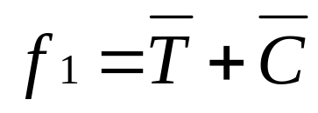
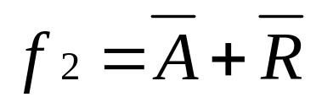
Objective Functions
Both range between 0 and 2, with 0 being the best possible value.
QoS attributes are normalised, with A and R being offset so that the smaller the better.
Notes:
Two objective functions were independently applied during the evolutionary process. One objective combines time and cost measurements, and the other combines availability and reliability.
Both of them range between 0 and 2, with 0 being the best possible value and 2 being the worst.
In order for the values to be within this range, each QoS attribute is normalised.
A and R are offset during the normalisation so that smaller values also indicate better quality.
We combined the QoS attributes in this way based on our observations when performing single-objective optimisation: we noticed a pull between T/C and A/R, i.e. the improvement of T/C often led to worse A/R (and vice-versa) during the run.

Slide 15
Experiments
Compared performance of Fragment-based method against two previously proposed approaches, both adapted to use NSGA-II.
Datasets: WSC 2008 and WSC 2009.
Performance metrics: IGD and hypervolume.
Parameter | Fragmented | GraphEvol | Encoded
Independent runs | 30 | 30 | 30
Population size | 500 | 500 | 500
Generations | 51 | 51 | 51
Mutation probability | 0.1 | 0.1 | -
Crossover probability | 0.8 | 0.8 | 0.95
Reproduction probability | 0.1 | 0.1 | -
Local search probability | - | - | 0.05
Tournament size | 2 | 2 | 2
Fitness function weights | 0.25 (all) | 0.25 (all) | 0.25 (all)
Notes:
Experiments were conducted to test the performance of the novel Fragmented approach against two previously proposed fully automated composition approaches.
One of these approaches is GraphEvol, which represents and evolves solutions as directed acyclic graphs. The other is a method that encodes compositions as sequences of services. These sequences are evolved in that format, and are only decoded into a corresponding workflow during the fitness calculation.
These previous approaches, which were originally single-objective, were modified to use the NSGA-II framework.
WSC 2008 and WSC 2009, which are popular benchmark datasets in the field, were used measure the performance of each approach. These datasets contain service repositories, composition tasks, and taxonomies of input/output concepts.
Two performance metrics were used to evaluate the results: IGD and hypervolume.
Statistical significance testing was conducted using the Wilcoxon rank-sum test, with a 0.05 significance level.
The following parameters were used to run each approach 30 independent times.
Before I present the results, I’d like to make a clarification. Thanks to the reviewers, I caught a mistake in the normalisation bounds used. The results have been corrected accordingly, and they do not interfere with the main goal of the paper.

Slide 16
Execution Time Results (s)
Task (Repo. Size) | Fragmented | GraphEvol | Encoded
08-1 (158) | 0.72 ± 0.05 | 1.96 ± 0.14 | 17.37 ± 2.09
08-2 (558) | 0.62 ± 0.02 | 1.24 ± 0.06 | 22.62 ± 4.5
08-3 (604) | 2.61 ± 0.19 | 7.63 ± 0.36 | 563.78 ± 36.39
08-4 (1041) | 1.49 ± 0.11 | 2.43 ± 0.27 | 25.17 ± 3.55
08-5 (1090) | 1.59 ± 0.13 | 3.66 ± 0.13 | 768.83 ± 136.78
08-6 (2198) | 11 ± 0.38 | 11.1 ± 0.43 | 11606.46 ± 1526.67
08-7 (4113) | 1.58 ± 0.08 | 8.31 ± 0.45 | 7219.27 ± 867.27
08-8 (8119) | 5.15 ± 0.42 | 8.98 ± 0.56 | 12668.87 ± 1340.09
09-1 (572) | 0.66 ± 0.03 | 1.43 ± 0.08 | 32.55 ± 2.59
09-2 (4129) | 14.12 ± 0.76 | 5.07 ± 0.21 | 3991.17 ± 449.69
09-3 (8138) | 5.8 ± 0.29 | 3.16 ± 0.13 | 3897.65 ± 360.19
09-4 (8301) | 19.45 ± 1.33 | 16.78 ± 0.88 | 194089.64 ± 12302.51
09-5 (15211) | 10.02 ± 0.64 | 10.96 ± 0.86 | 48600.75 ± 8161.52
Notes:
The execution time for the three approaches is shown in seconds in this table.
We can see that the Fragmented approach takes significantly less time to execute for almost all of the tasks, except for 09-2, 09-3, and 09-4. For those tasks, GraphEvol requires significantly less time.
The encoded approach, on the other hand, has very high execution times for most datasets, most likely due to the repeated decoding process and local search.

Slide 17
IGD Results
Task (Repo. Size) | Fragmented | GraphEvol | Encoded
08-1 (158) | 0.14 ± 0.02 | 0.19 ± 0.07 | 0.13 ± 0.01
08-2 (558) | 0.09 ± 0.02 | 0.09 ± 0 | 0.09 ± 0
08-3 (604) | 0.65 ± 0.08 | 0.73 ± 0.09 | 0.06 ± 0.03
08-4 (1041) | 0.28 ± 0.14 | 0.11 ± 0.03 | 0.06 ± 0
08-5 (1090) | 0.68 ± 0.01 | 0.88 ± 0.06 | 0.04 ± 0.02
08-6 (2198) | 0 .84 ± 0.05 | 0.46 ± 0.01 | 0.06 ± 0.02
08-7 (4113) | 0.5 ± 0.07 | 0.41 ± 0.04 | 0.09 ± 0.01
08-8 (8119) | 0.32 ± 0.04 | 0.24 ± 0.08 | 0.28 ± 0
09-1 (572) | 0.03 ± 0.03 | 0.04 ± 0.01 | 0 ± 0
09-2 (4129) | 0.15 ± 0.03 | 0.24 ± 0.05 | 0.04 ± 0.02
09-3 (8138) | 0.2 ± 0.27 | 0.11 ± 0.07 | 0.02 ± 0
09-4 (8301) | 0.31 ± 0.08 | 0.36 ± 0.05 | 0.05 ± 0.01
09-5 (15211) | 0.31 ± 0.07 | 0.23 ± 0.03 | 0.03 ± 0.01
Notes:
The IGD was calculated using an aggregate front . This front was obtained by combining the results of all runs for each method, then identifying the non-dominated solutions within that group.
This table shows the IGD results for each approach, where the smaller the value the better the performance.
We see that the Encoded approach shows consistently better IGD values, while the Fragmented and GraphEvol approaches are roughly equivalent to each other overall.

Slide 18
Hypervolume Results
Task (Repo. Size) | Fragmented | GraphEvol | Encoded
08-1 (158) | 1.33 ± 0.01 | 1.31 ± 0.02 | 1.34 ± 0.01
08-2 (558) | 2.06 ± 0.01 | 2.06 ± 0 | 2.06 ± 0
08-3 (604) | 0.14 ± 0.1 | 0.23 ± 0.18 | 1.39 ± 0.06
08-4 (1041) | 1 ± 0.26 | 1.36 ± 0.03 | 1.4 ± 0
08-5 (1090) | 0.35 ± 0.02 | 0.18 ± 0.03 | 2.32 ± 0.05
08-6 (2198) | 0.12 ± 0.15 | 0.03 ± 0.01 | 1.04 ± 0.15
08-7 (4113) | 0.31 ± 0.21 | 0.51 ± 0.1 | 1.4 ± 0.04
08-8 (8119) | 0.46 ± 0.1 | 0.61 ± 0.37 | 0.83 ± 0.03
09-1 (572) | 2.1 ± 0.09 | 2 ± 0.06 | 2.19 ± 0
09-2 (4129) | 0.92 ± 0.09 | 0.67 ± 0.11 | 1.39 ± 0.1
09-3 (8138) | 2.54 ± 0.67 | 2.91 ± 0.3 | 3.04 ± 0
09-4 (8301) | 0 ± 0.01 | 0 ± 0 | 0.24 ± 0.28
09-5 (15211) | 0.31 ± 0.24 | 0.64 ± 0.12 | 1.24 ± 0.13
Notes:
The hypervolume was calculated using a reference point of (2, 2).
This table shows the hypervolume results for each approach, where the higher the value the better the performance.
Once again, we see that the Encoded approach shows consistently better hypervolume values, while the Fragmented and GraphEvol approaches are still roughly equivalent to each other overall.

Slide 19
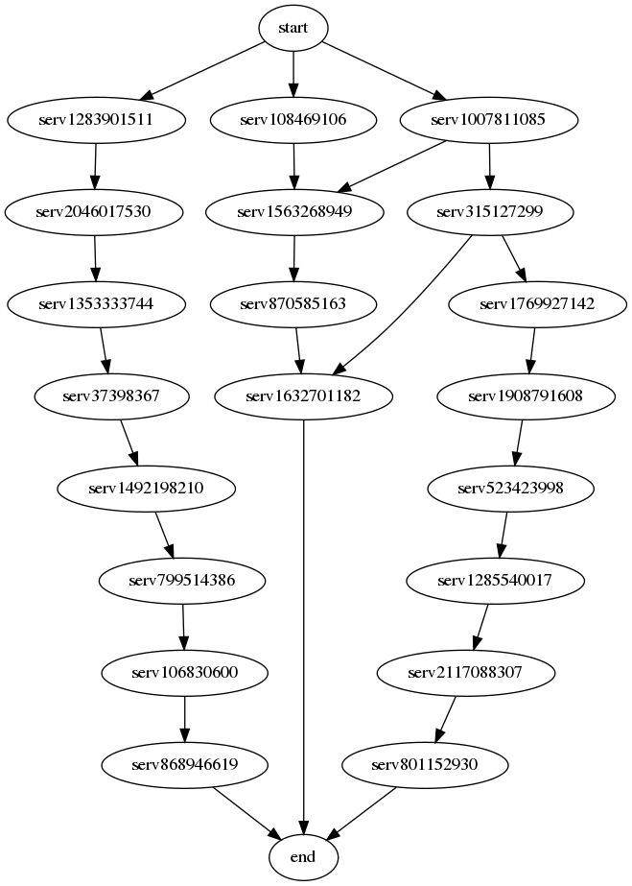
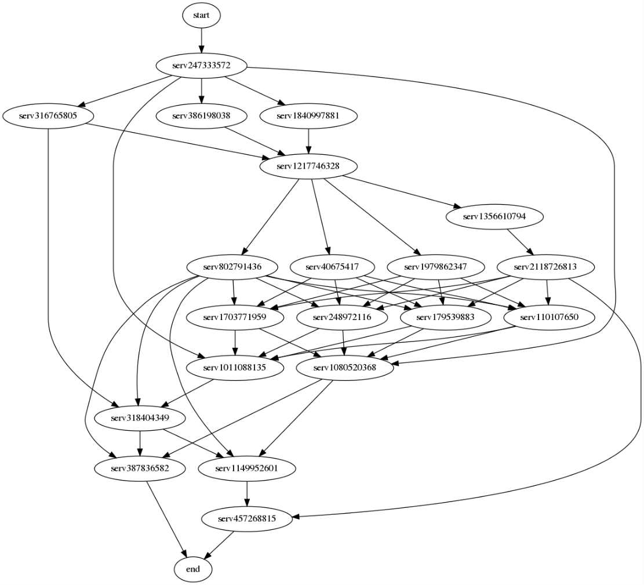
Solution Analysis
Fragment-based
Indirect
Notes:
We performed some additional analysis by looking at the solutions produced by fragment-based approach in comparison to those produced by the indirect approach.
In this example, we show solutions produced for task 3 of WSC-2008 for both approaches.
For a number of composition tasks, we noticed this same pattern: the fragment-based approach favours compositions that are less densely connected than those produced by the indirect approach. This is because the fragment-based approach finds predecessors for services in isolation (potentially encouraging less reuse of parents), whereas the indirect approach finds predecessors as part of a graph-building algorithm (potentially encouraging more reuse).
While more easily readable, this likely accounts for the difference in performance between the two methods (the more densely connected solutions often have better objective values).

Slide 20
Conclusion
Key contributions:
Novel fragment-based representation.
MO method for fully automated composition.
Findings:
Novel method is more efficient, though at the expense of IGD and hypervolume (when compared to Encoded method).
Despite this, the fragmented representation has promising characteristics that are worth further investigation.
Future work: Alternative MO algorithms, local search.
Notes:
In conclusion, in this work we had two key contributions: we proposed a novel fragment-based representation, and we used it to develop a multi-objective method for fully automated composition (an area which hadn’t been investigated before).
Our experiments revealed that the fragmented method is the most efficient in this comparison, though the Encoded approach can produce better quality fronts.
Despite that, the fragmented representation still has a number of promising characteristics (simpler operations, no replication of service nodes) that are worth investigating further
Further work in this area should investigate other MO algorithms for fully automated Web service composition, as well as employing local search in the evolution process.

Slide 21
Thank you! Q&A
Alexandre Sawczuk da Silva
Contact: sawczualex@ecs.vuw.ac.nz
Publications: ecs.victoria.ac.nz/Main/GradAlexandreSawczukdaSilva
Interests: Evolutionary computation, Web service composition, combinatorial optimisation.
Notes:
Thank you! Are there any questions?

