Slide 1

A Hybrid Memetic Approach for Fully Automated Multi-Objective Web Service Composition
Alexandre Sawczuk da Silva, Hui Ma, Yi Mei, Mengjie Zhang
hui.ma@ecs.vuw.ac.nz
IEEE International Conference on Web Services (ICWS)
San Francisco, CA, USA ▪ 2 - 7 July 2018
Notes:
Good morning/afternoon! My name is Alex da Silva, and today I am going to talk about a hybrid memetic approach for performing multi-objective Web service composition in a fully automated way.

Slide 2
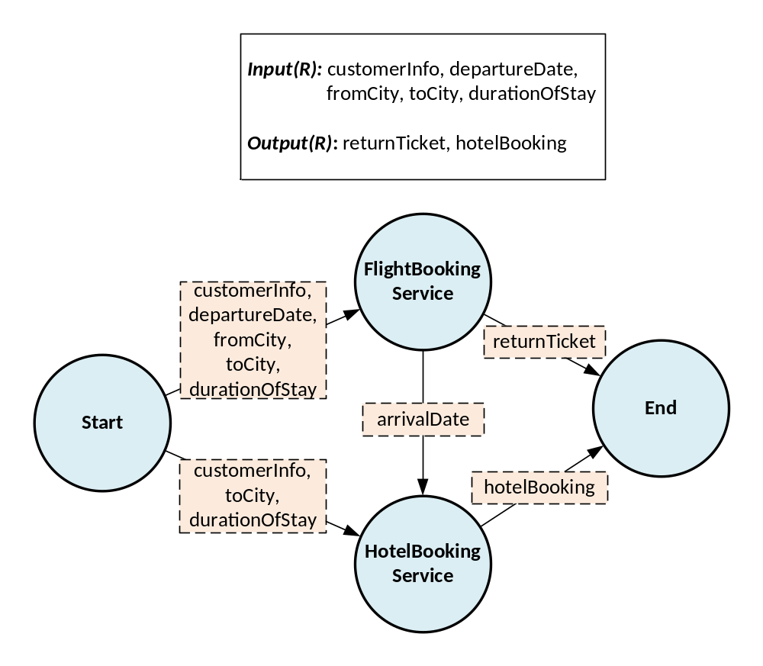
Web Service Composition
The combination of Web services to achieve a more complex task. Non-functional aspects:
Time
Cost
Availability
Reliability
hui.ma@ecs.vuw.ac.nz
Notes:
The combination of multiple modular Web services in order to achieve a single, more complex task is known as Web service composition.
For example, imagine we need to create a service that allows a customer to book tickets and accommodation for a trip. The customer provides certain information relevant to the trip, and this is used to produce the tickets and bookings.
We begin by executing the flight booking service, whose inputs are completely satisfied by the given composition request inputs, and this produces the tickets. It also allows us to determine the arrival date at the destination city, which is then used to execute the hotel booking service.
We see that the basic idea here is to identify and connect different services with complementary functionality, ensuring that the connections between the solutions are correct.
In addition to taking the correctness of compositions into account, we must also consider non-functional aspects of services when selecting them to , i.e. their Quality of Service attributes.
In this work we take four popular QoS attributes into account: the service’s execution time, its financial cost, its probability of being available when requested, and the probability that the response it returns is reliable (i.e. it matches the expected).
We calculate the overall quality by aggregating individual service values into single scores.
The overall availability and reliability are calculated by multiplying together the availability and reliability values of each individual service; the overall cost is calculated by adding up the cost values of each individual service in the composition; the overall time is calculated by finding the longest path timewise, since it is possible to execute services in parallel.

Slide 3
Aspects of Service Composition
The intricacy of Web service composition lies in the number of distinct aspects it must simultaneously account for:
Output:
City
Overall
A = 0.8
C = 4
Vs.
Input:
City, Date
Vs.
Overall
A = 0.6
C = 2
Output:
Date
Functionality
Structure
Conflicting QoS
hui.ma@ecs.vuw.ac.nz
Notes:
The complexity of Web service compositions is in the number of aspects it needs to address simultaneously.
The first aspect is the functionality of compositions. Web service composition solutions must be functionally correct, meaning that the inputs to each service included are completely fulfilled using compatible connections. This is important because it ensures that the composite application can be fully executed at runtime.
The second aspect is the structure of compositions. Services can be combined in different sets, with different connections, and still accomplish the same task. Thus, part of the composition process is to identify the most promising structures.
The third aspect is the trade-off between the different quality attributes of compositions. For example, certain composition alternatives may favour execution time over cost, while others favour cost over time. The composition process should identify the best quality options, taking QoS conflicts into account.

Slide 4
Evolutionary Computing
Optimisation strategy that relies on Darwinian principles to evolve promising solutions to a problem:
Create initial population
Select fittest remaining solutions
Breed individuals over generations
hui.ma@ecs.vuw.ac.nz
Notes:
One popular strategy for addressing the Web service composition problem is evolutionary computing.
Evolutionary computing is an optimisation strategy that relies on Darwinian principles to evolve promising solutions to a problem. The key idea is to create an initial population of Web service compositions, then breed these compositions over several generations. This allows the compositions with better quality to survive while the low quality compositions are eliminated from the population.

Slide 5
Evolutionary Computing for Composition
Output:
City
Overall
A = 0.8
C = 4
Vs.
Input:
City, Date
Vs.
Overall
A = 0.6
C = 2
Output:
Date
It can ensure a solution’s functional correctness^{[1,2,3,4,5]}.
It allows for the exploration of a variety of structures^{[1,2,3]}.
It efficiently optimises the QoS of solutions^{[2,3,4,5]}.
hui.ma@ecs.vuw.ac.nz
Notes:
In the context of Web service composition, evolutionary computing is a promising technique because it can successfully address the three distinct aspects discussed previously.
In terms of functionality, EC can ensure that a composition is functionally correct by initialising candidates with the appropriate connections and then maintaining their correctness during genetic operations.
In terms of the structure of workflows, EC allows for a variety of structures to be explored if a suitable problem representation is selected.
Finally, EC can be used to independently optimise composition solutions in terms of conflicting QoS attributes by using multi-objective mechanisms.

Slide 6

Existing EC Composition Approaches
S
P
S
P
Our previous work: multi-objective fully automated approach.
However, local search was not explored
hui.ma@ecs.vuw.ac.nz
Notes:
Existing EC-based composition approaches can be roughly divided into two groups according to the composition aspects they address.
The first group comprises single-objective and fully automated approaches. These approaches can explore a variety of workflow structures and can maintain the correctness of the compositions, however they optimise solutions in a single-objective way. This means that conflicting QoS attributes cannot be independently optimised.
The second group comprises multi-objective and semi-automated approaches. These approaches can independently optimise conflicting QoS attributes and maintain the correctness of compositions, however they do not explore a variety of workflow structures. Instead, they assume that the structure overall structure of the workflow has already been provided, meaning all that the optimisation needs to do is to select the best possible concrete service for each abstract slot.
In our previous work we proposed a multi-objective and fully automated approach that addresses all three composition aspects simultaneously. However, in that work we did not explore the use of local search.

Slide 7
Goal
To propose a memetic multi-objective and fully automated Web service composition approach that employs local search to produce compositions with better QoS trade-offs.
Challenge: A multi-objective form of local search can be quite computationally expensive.
hui.ma@ecs.vuw.ac.nz
Notes:
Thus, the goal of this work is to propose a multi objective fully automated approach for Web service composition that employs local search to further improve the quality of the compositions created and produce better QoS trade-offs.
However, in order to meet this goal we need to address a challenge, which is that performing local search in a multi-objective context can be quite computationally expensive. For example, when using a non-dominated form of local search, the number of neighbours to explore quickly increases if not bound in some way.

Slide 8
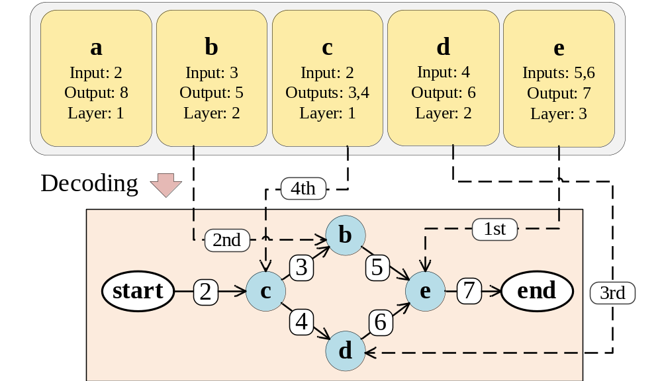
A Hybrid Memetic Composition Approach
Combines a hybrid algorithm^{[6]} with a sequential representation that encodes services as a queue.
Retains NSGA-II’s simple non-dominated sorting.
Decomposes problem using MOEA/D principles.
Enables single-objective local search.
hui.ma@ecs.vuw.ac.nz
Notes:
In order to achieve our goal, we employ a previously proposed hybrid algorithm with a linear Web service composition representation. This algorithm hybridises NSGA-II and MOEA/D, which are both popular multi-objective algorithms.
The hybrid algorithm uses the non-dominated sorting strategy from NSGA-II to determine the best candidates at each generation, however it also decomposes the multi-objective problem into several single-objective subproblems using MOEA/D principles.
This decomposition means that a single-objective local search operator can be employed, which is simpler and consequently less computationally expensive than its multi-objective counterpart.
The hybrid algorithm is combined with a sequential representation for Web service composition. In this representation solutions are optimised by changing the order of services in the sequence. In order to obtain the corresponding workflow, the sequence is decoded using an algorithm that ensures the resulting workflow is functionally correct.

Slide 9
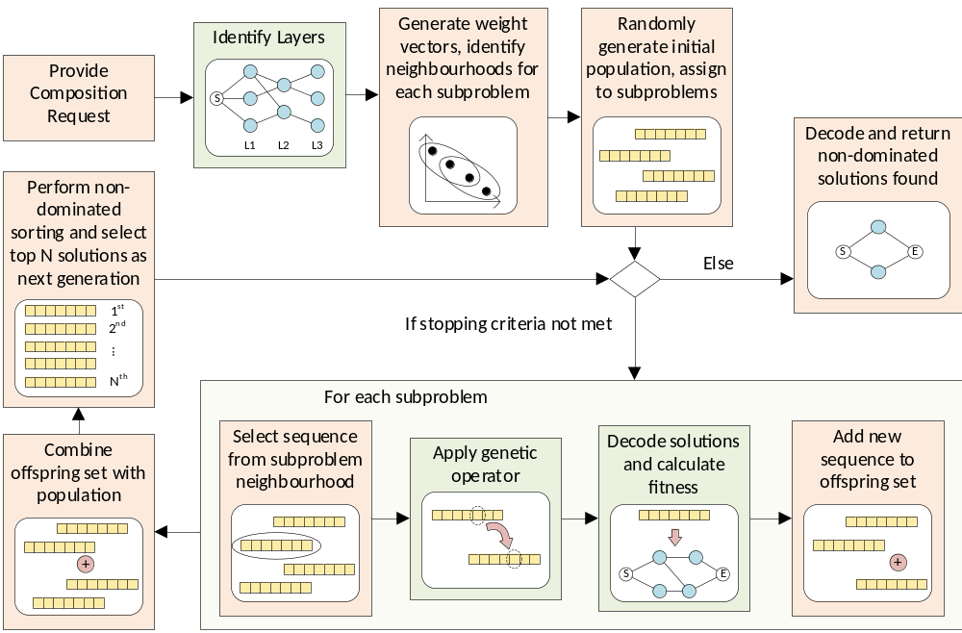
Overall Flow
hui.ma@ecs.vuw.ac.nz
Notes:
Here we see the overall flow for the proposed approach. I have highlighted the steps we will discuss in more detail.
Given a composition request, we begin by identifying the layers each service belongs to. This information is useful when decoding service sequences.
Then we generate uniformly distributed weight vectors to decompose the multi-objective problem into a number of subproblems, as well as finding the neighbours for each vector.
The initial population of service sequences is then generated, and each candidate is assigned to a different subproblem (vector).
Then, as long as the stopping criteria are not met, we perform the following steps:
For each subproblem, we select a sequence from that subproblem’ s neighbourhood, apply a genetic operator to it, and decode the resulting offspring in order to calculate its fitness. The offspring is then added to an offspring set.
After evaluating all subproblems, the overall offspring set is combined with the population and all candidates are sorted in a non-dominated way. The top N solutions (where N is the number of subproblems/size of the population) are chosen as the next generation (candidates in the next generation are assigned to subproblems in the order they were sorted).
Finally, once the stopping criteria are met, all non-dominated solutions found are decoded and returned.

Slide 10
Identification of Layers
Progressively discover additional services, until no new service can be reached.
Available: 1,2
Avaliable: 1,2,3,4,8
Avaliable:
1,2,3,4,5,6,8
a
Input: 2
Output: 8
b
Input: 3
Output: 5
e
Inputs: 5, 6
Output: 7
c
Input: 2
Output: 3,4
d
Input: 4
Output: 6
Layer 1
Layer 2
Layer 3
hui.ma@ecs.vuw.ac.nz
Notes:
Let’s look more closely at the layer identification algorithm.
This algorithm begins with the overall composition inputs, and identifies the services from the repository whose inputs can be fulfilled using those available inputs. These services make up our first layer.
We then update the set of available inputs with the outputs of the service in the first layer.
We repeat this process, finding other layers until no new services can be identified.

Slide 11
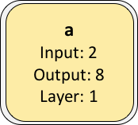
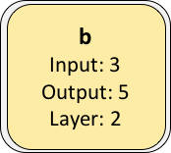
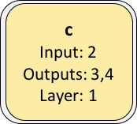
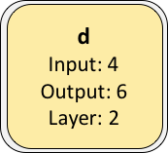
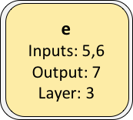
Sequence Decoding
Cost:
Avail:
Relia:
0
1
2
3
4
Given: 1,2
Required: 7
0.6
0.9
0.8
1
0.7
1
0.6
0.8
0.7
0.9
Input: 7
Time: 0
Layer: 4
Input: 5
Time: 1
Layer: 3
Input: 6
Time: 1
Layer: 3
Input: 3
Time: 2
Layer: 2
Input: 4
Time: 3
Layer: 2
Input: 2
Time: 4
Layer: 1
hui.ma@ecs.vuw.ac.nz
Notes:
The layer information is later used in the solution decoding process. Because we work backwards, we can calculate the QoS attributes at the same time that we decode the solution, without having to go through the more expensive process of actually building the solution graph.
We begin by adding the composition outputs to our set of unfulfilled inputs, keeping track of the total time used so far and the layer they come from (in this case we assume the end node is in layer 4).
Then, for each layer, from the highest to the lowest, we find services in previous layers that can fulfil the inputs in the set.
In our case, this is service c. We update the overall QoS values according to those of c, and we add c’s inputs to the set of inputs to be fulfilled. Notice that we keep track of the c’s layer and the total execution time so far.
We repeat this process until we are only left with services in the first layer, which can be fulfilled by the given composition inputs.
We are then left with the each overall QoS attribute, and we can use the weighted sum discussed earlier to obtain a fitness score.

Slide 12
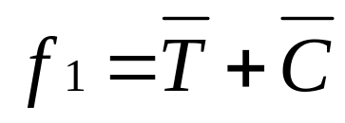
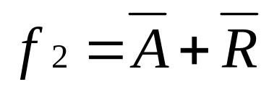
Evaluation: Objective Functions
Both range between 0 and 2, with 0 being the best possible value.
QoS attributes are normalised, with A and R being offset so that the smaller the better.
hui.ma@ecs.vuw.ac.nz
Notes:
Once solutions are decoded and their QoS attributes are calculated, they can then be evaluated.
Two objective functions were independently applied during the evolutionary process. One objective combines time and cost measurements, and the other combines availability and reliability.
Both of them range between 0 and 2, with 0 being the best possible value and 2 being the worst.
In order for the values to be within this range, each QoS attribute is normalised.
A and R are offset during the normalisation so that smaller values also indicate better quality.
We combined the QoS attributes in this way based on our observations when performing single-objective optimisation: we noticed a pull between T/C and A/R, i.e. the improvement of T/C often led to worse A/R (and vice-versa) during the run.

Slide 13
Genetic Operators: Mutation
Offspring is created by swapping two services in the sequence.
a
b
c
d
e
f
a
b
c
d
e
f
hui.ma@ecs.vuw.ac.nz
Notes:
There are three operators used in this work.
The first one is mutation, where the idea is to create a child by swapping the position of a randomly chosen pair of services in the parent.

Slide 14
Genetic Operators: Crossover
Children are created by exchanging parent subsections, ensuring no service duplicates are introduced.
a
Parent 1
a
e
e
f
b
f
b
d
c
d
c
d
Parent 2
d
c
c
b
a
b
a
f
e
f
e
a
Child 1
a
e
b
f
e
b
f
d
c
d
c
a
c
Child 2
b
f
c
d
e
f
e
hui.ma@ecs.vuw.ac.nz
Notes:
The second one is crossover, where we create children by exchanging the subsections of two parents, ensuring no service duplicates are introduced.
We begin by copying the two randomly selected parent subsections to the children (parent 1 to child 1, parent 2 to child 2).
Then, we fill the remaining blank slots of child 1 by checking parent 2 from left to right, and adding the services that were not already included in the subsection.
Then we do the same to child 2, using parent 1.

Slide 15


Genetic Operators: Local Search
Neighbours are created by swapping pair of services (most promising neighbour replaces parent). Two conditions:
One service is in the workflow, the other is not.
Service not in workflow has better score.
a
b
c
0.3
0.5
0.4
Quality scores (smaller is better)
a
Neighbour 1: Both a and b in workflow
b
c
a
b
c
Neighbour 2: c’s score worse than a’s
a
b
c
Neighbour 3: Valid swap
hui.ma@ecs.vuw.ac.nz
Notes:
The third one is local search.
Here, the general idea is to create neighbours by swapping the position of a pair of services.
A pair is only considered for swapping if two conditions are met:
Firstly, one of the services being swapped is used in the decoded composition and the other is not.
Secondly, the service that is not used in the composition has a better overall QoS than the service that has been included. These scores are calculated using the QoS attributes of each particular service, using the previously proposed fitness functions and combining their resulting values using the Tchebycheff approach.
We evaluate the fitness of all value neighbours and replace the parent with the most promising one (if better than parent).
In the example shown here, potential neighbour 1 not considered, as both services that would be swapped are in the workflow. Potential neighbour 2 is also not considered. Even though one service is in the workflow and the other is not, the score of the service not in the workflow is worse. Finally, neighbour 3 is a valid swap and thus it is considered.

Slide 16
Experiments
Compared performance of hybrid memetic approach (Hybrid-L) against Hybrid without local search and NSGA-II.
Datasets: WSC 2008 and WSC 2009.
Performance metrics: IGD and hypervolume.
Parameter | Hybrid-L | Hybrid | NSGA-II
Independent runs | 30 | 30 | 30
Population size | 500 | 500 | 500
Generations | 51 | 51 | 51
Mutation probability | 0.1 | 0.1 | 0.1
Crossover probability | 0.8 | 0.8 | 0.8
Reproduction probability | - | 0.1 | 0.1
Local search probability | 0.1 | - | -
Local search iterations | 100 | - | -
Tournament size | 2 | 2 | 2
hui.ma@ecs.vuw.ac.nz
Notes:
Experiments were conducted to test the performance of the hybrid memetic approach (referred to as Hybrid-L) against the Hybrid approach without local search and NSGA-II, all using the sequential representation.
WSC 2008 and WSC 2009, which are popular benchmark datasets in the field, were used measure the performance of each approach. These datasets contain service repositories, composition tasks, and taxonomies of input/output concepts.
Two performance metrics were used to evaluate the resulting Pareto fronts: IGD and hypervolume.
Statistical significance testing was conducted using the Wilcoxon rank-sum test, with a 0.05 significance level.
The following parameters were used to run each approach 30 independent times.

Slide 17
Hypervolume Results
Task (Repo. Size) | Hybrid-L | Hybrid | NSGA-II
08-1 (158) | 1.14 ± 0.01 | 1.13 ± 0.03 | 1.17 ± 0.01
08-2 (558) | 1.62 ± 0.06 | 1.59 ± 0.03 | 1.6 ± 0
08-3 (604) | 1.18 ± 0.06 | 1.12 ± 0.06 | 1.2 ± 0.06
08-4 (1041) | 1.39 ± 0.01 | 1.39 ± 0.01 | 1.24 ± 0
08-5 (1090) | 1.59 ± 0.05 | 1.47 ± 0.32 | 1.19 ± 0.33
08-6 (2198) | 1.05 ± 0.21 | 0.92 ± 0.24 | 1.02 ± 0.12
08-7 (4113) | 1.45 ± 0.01 | 1.42 ± 0.1 | 1.35 ± 0.13
08-8 (8119) | 0.87 ± 0.11 | 0.77 ± 0.17 | 0.78 ± 0.02
09-1 (572) | 2 ± 0 | 2 ± 0.01 | 1.99 ± 0.02
09-2 (4129) | 1.1 ± 0.15 | 1.06 ± 0.12 | 1.36 ± 0.14
09-3 (8138) | 2.48 ± 0 | 2.48 ± 0.01 | 2.46 ± 0
09-4 (8301) | 0.3 ± 0.22 | 0.21 ± 0.16 | 0.25 ± 0.14
09-5 (15211) | 1.28 ± 0.01 | 1.27 ± 0.01 | 1.21 ± 0.1
hui.ma@ecs.vuw.ac.nz
Notes:
The hypervolume was calculated using a reference point of (2, 2).
This table shows the hypervolume results for each approach, where the higher the value the better the performance.
We see that Hybrid-L produces significantly better of equivalent values for 10 tasks, while NSGA-II produces the best results for 3 tasks.

Slide 18
IGD Results
Task (Repo. Size) | Hybrid-L | Hybrid | NSGA-II
08-1 (158) | 0.16 ± 0.01 | 0.16 ± 0.02 | 0.05 ± 0.01
08-2 (558) | 0.35 ± 0.22 | 0.34 ± 0.2 | 0.14 ± 0
08-3 (604) | 0.04 ± 0.02 | 0.06 ± 0.02 | 0.03 ± 0.02
08-4 (1041) | 0.01 ± 0.01 | 0.02 ± 0.03 | 0.18 ± 0
08-5 (1090) | 0.04 ± 0.03 | 0.1 ± 0.11 | 0.18 ± 0.11
08-6 (2198) | 0.06 ± 0.05 | 0.08 ± 0.06 | 0.07 ± 0.03
08-7 (4113) | 0.03 ± 0.01 | 0.03 ± 0.02 | 0.05 ± 0.02
08-8 (8119) | 0.08 ± 0.11 | 0.17 ± 0.17 | 0.07 ± 0.02
09-1 (572) | 0.02 ± 0.02 | 0.01 ± 0.01 | 0.04 ± 0.01
09-2 (4129) | 0.2 ± 0.07 | 0.22 ± 0.06 | 0.05 ± 0.07
09-3 (8138) | 0.01 ± 0 | 0.02 ± 0.01 | 0.01 ± 0.01
09-4 (8301) | 0.11 ± 0.03 | 0.13 ± 0.03 | 0.09 ± 0.02
09-5 (15211) | 0.09 ± 0.02 | 0.09 ± 0.02 | 0.02 ± 0.01
hui.ma@ecs.vuw.ac.nz
Notes:
The IGD was calculated using an aggregate front . This front was obtained by combining the results of all runs for each method, then identifying the non-dominated solutions within that overall group.
This table shows the IGD results for each approach, where the smaller the value the better the performance.
In this case we see that NSGA-II has significantly better values for 8 tasks, whereas Hybrid-L has significantly better or equivalent values for 5 tasks.

Slide 19
Execution Time Results (s)
Task (Repo. Size) | Hybrid-L | Hybrid | NSGA-II
08-1 (158) | 4.15 ± 0.58 | 0.62 ± 0.05 | 0.64 ± 0.05
08-2 (558) | 4.52 ± 0.81 | 0.73 ± 0.09 | 0.75 ± 0.1
08-3 (604) | 24.06 ± 1.31 | 3.7 ± 0.17 | 3.63 ± 0.17
08-4 (1041) | 6.51 ± 0.33 | 1.28 ± 0.1 | 1.09 ± 0.06
08-5 (1090) | 39.95 ± 4.33 | 5.68 ± 0.93 | 5.08 ± 0.52
08-6 (2198) | 133.75 ± 15.87 | 18.59 ± 2.74 | 16.3 ± 1.66
08-7 (4113) | 136.45 ± 20.78 | 18.61 ± 2.18 | 16.62 ± 2.2
08-8 (8119) | 382.8 ± 75.39 | 59.03 ± 6.96 | 56.2 ± 6.79
09-1 (572) | 4.53 ± 0.51 | 0.76 ± 0.06 | 0.72 ± 0.06
09-2 (4129) | 111.88 ± 22.34 | 16.92 ± 3.27 | 16.36 ± 2.6
09-3 (8138) | 202.29 ± 35.74 | 15.2 ± 2.09 | 14.18 ± 1.79
09-4 (8301) | 835.39 ± 102.76 | 128.8 ± 13.37 | 125.55 ± 13.79
09-5 (15211) | 407.73 ± 47.31 | 64.34 ± 10.81 | 62.21 ± 10.42
hui.ma@ecs.vuw.ac.nz
Notes:
The execution time for the three approaches is shown in seconds in this table.
We can see that NSGA-II consistently has the lowest execution time, though the Hybrid approach is equivalent to it for many tasks.
Due to the use of local search, the Hybrid-L approach takes the longest to execute for all tasks, though it still fits within a reasonable time budget.

Slide 20
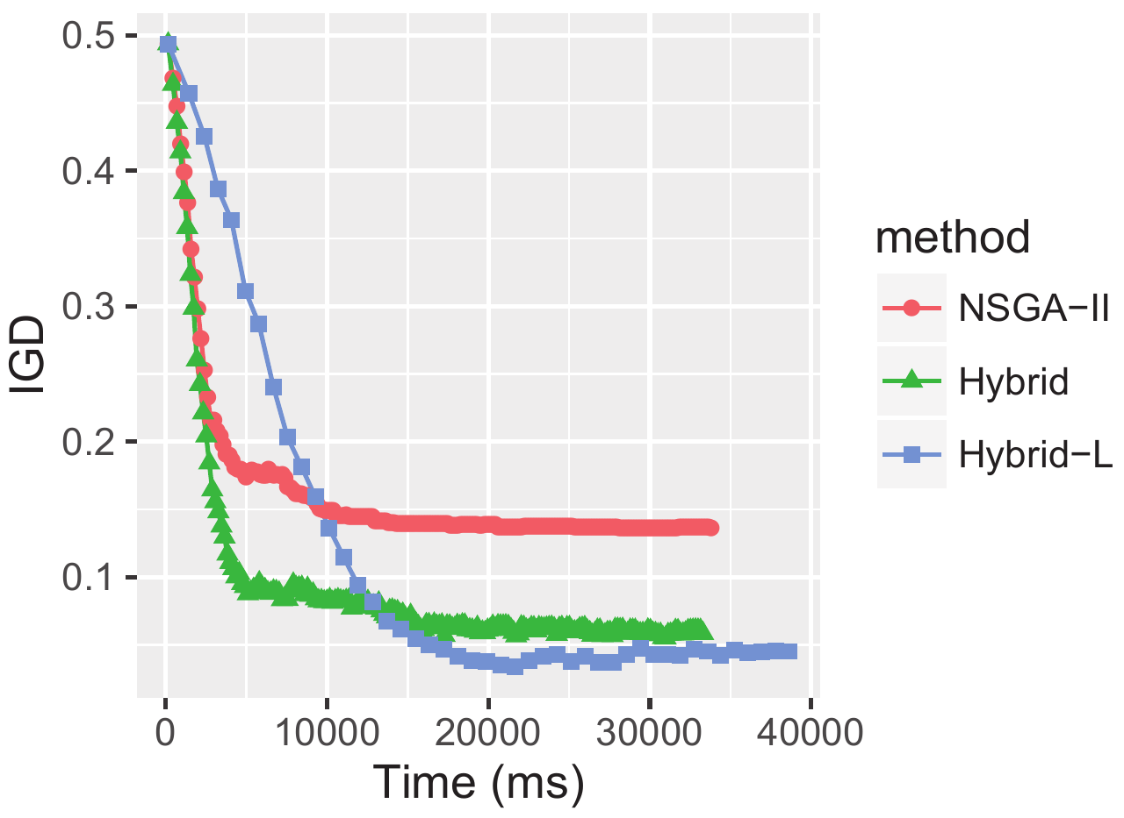
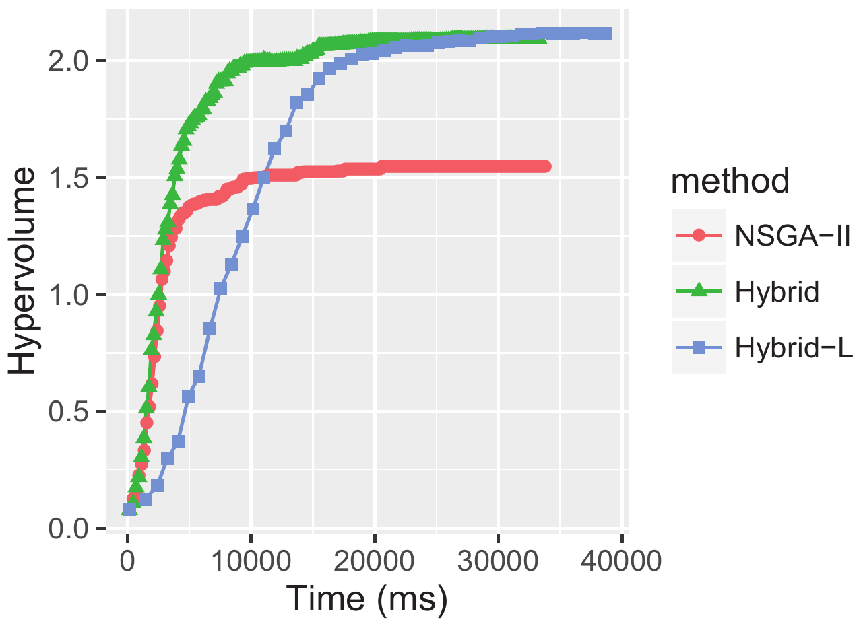
Convergence Analysis
Mean IGD and hypervolume over time for non-dominated solutions (task 08-5).
hui.ma@ecs.vuw.ac.nz
Notes:
We also analysed the convergence of the IGD and hypervolume values for the three approaches when running task 08-5, where Hybrid-L produced solutions with significantly better IGD and hypervolume values.
To verify whether the other approaches could achieve equivalent quality to Hybrid-L given longer execution times, NSGA-II and Hybrid were allowed to run for 200 generations (all other original settings were maintained).
This analysis shows that even given the additional time, NSGA-II cannot reach the same levels as the other approaches. The Hybrid approach almost arrives at the levels of the Hybrid-L approach for IGD, but it eventually converges to a local optimum. For the hypervolume, on the other hand, the Hybrid approach reaches an equivalent level to Hybrid-L.

Slide 21
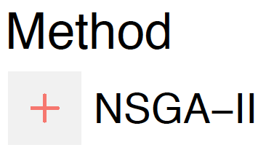


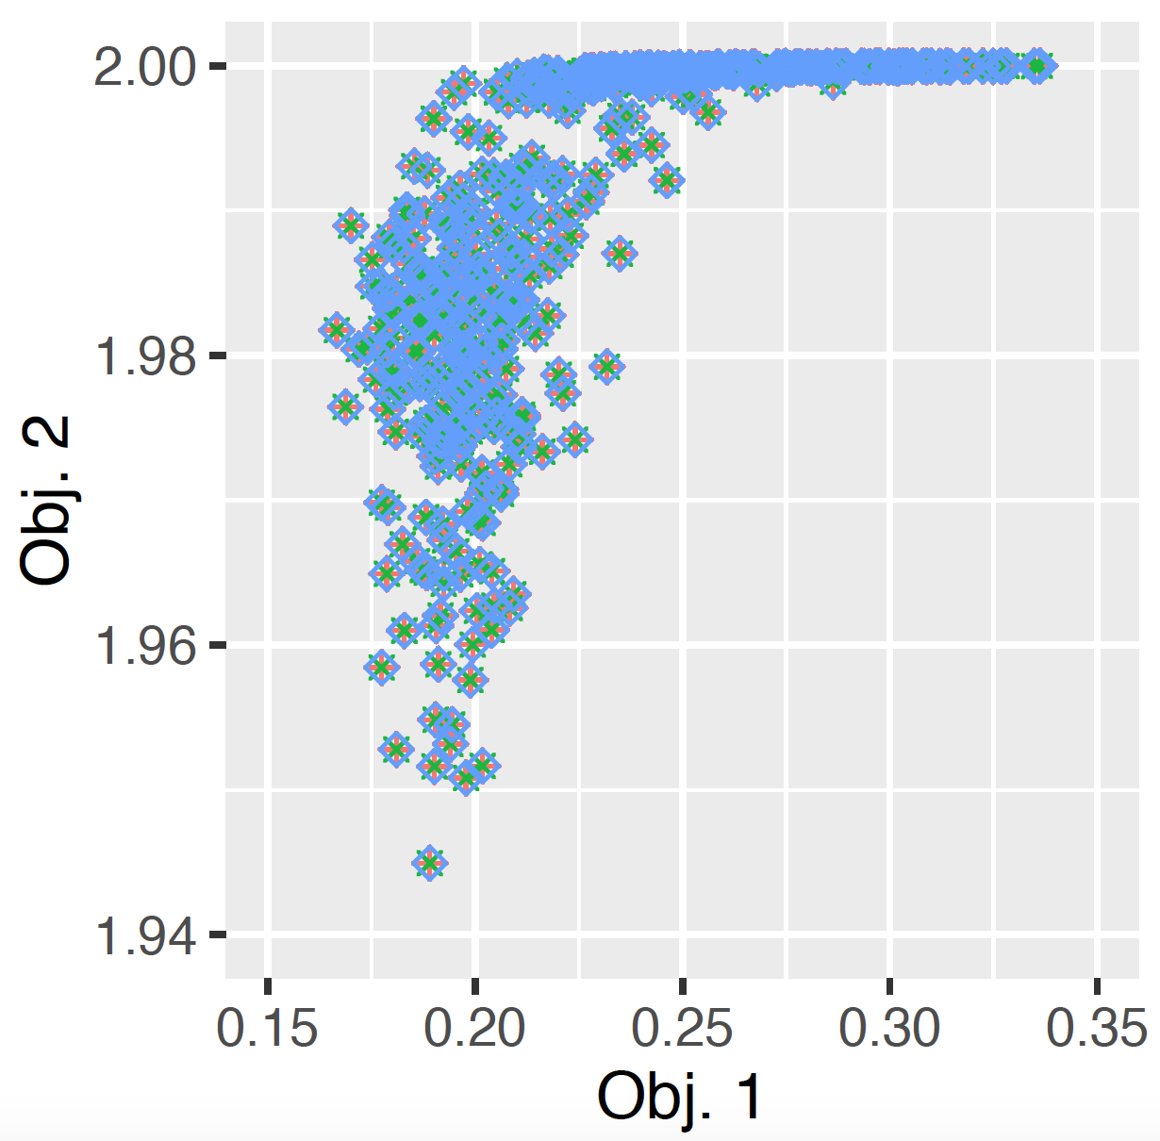
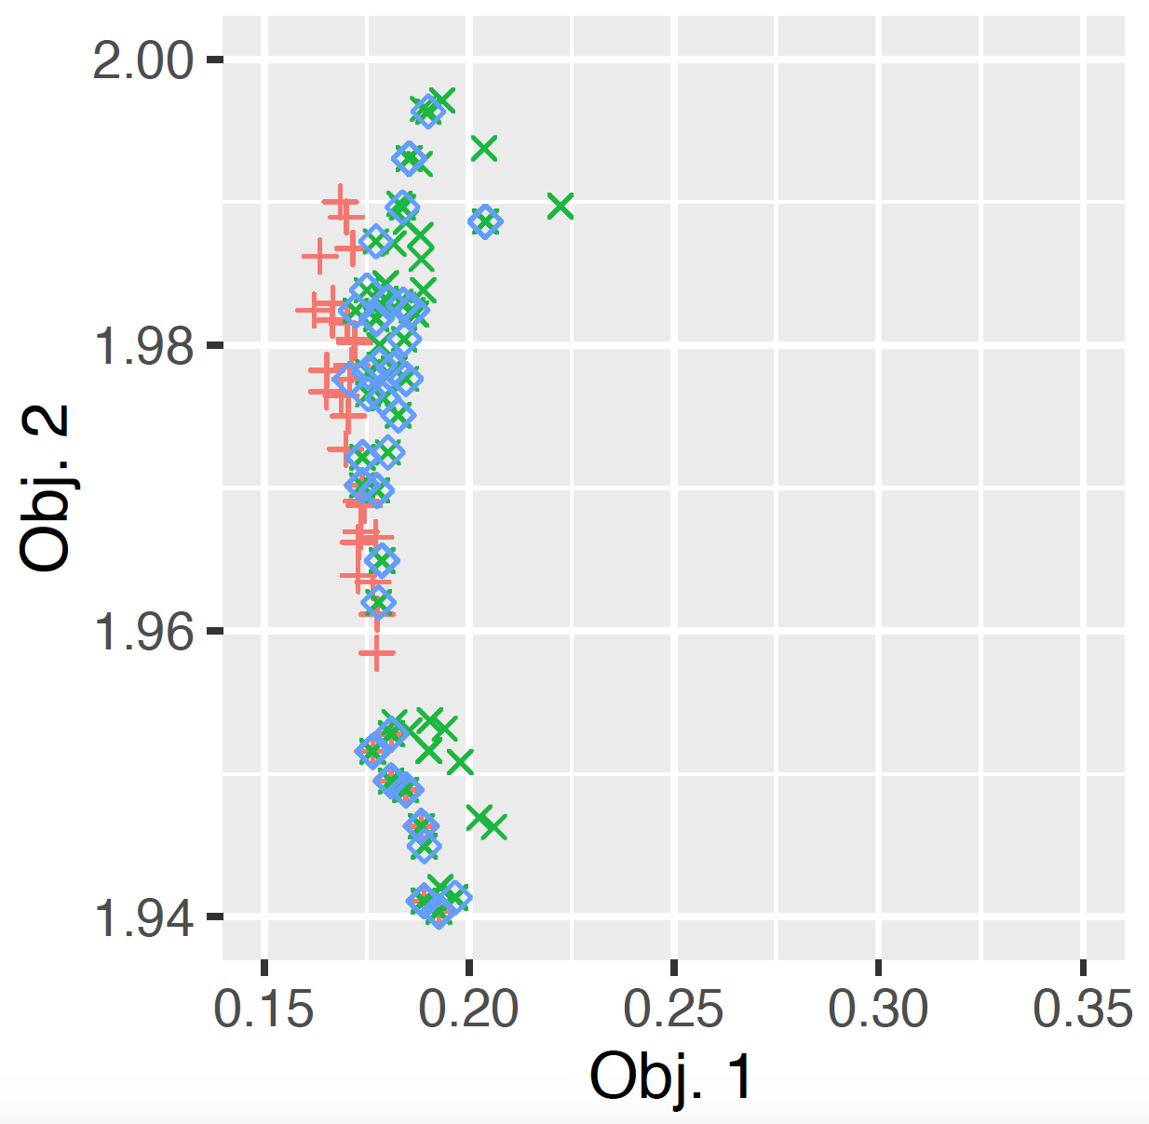
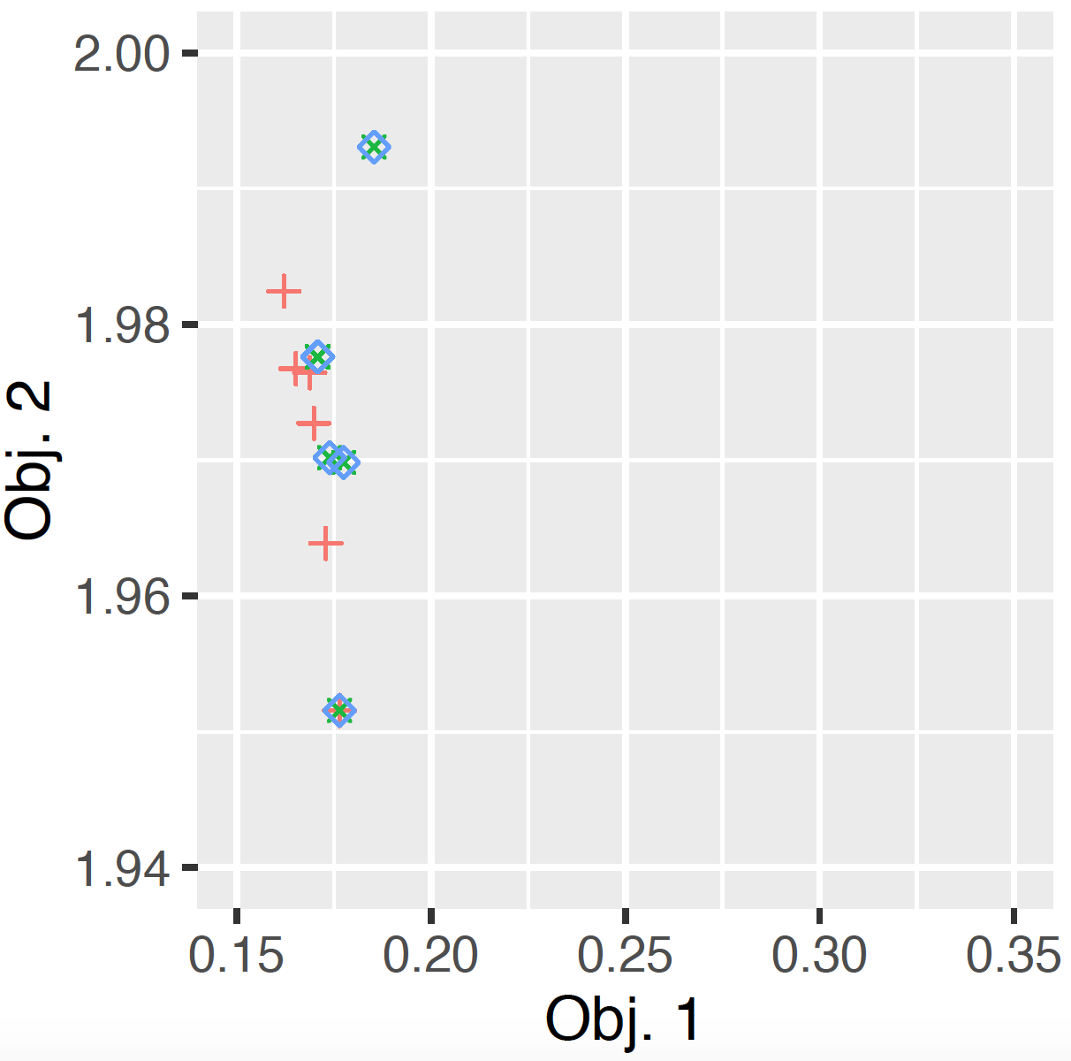
Behaviour Analysis
Generation 1
Generation 5
Generation 51
Positions of each method’s population in the objective space for task 08-4.
hui.ma@ecs.vuw.ac.nz
Notes:
The behaviour of each method was further analysed by observing the position of the population individuals in the objective space at different generations.
The plots on this slide show the analysis for task 08-4, presenting a plot of the populations of each method before, during, and after one run has taken place.
Firstly the population is randomly initialised for each approach, ensuring that all compositions are functionally correct.
Then, as genetic operations are performed, solutions gradually move towards more promising areas of the objective space.
Finally, the populations converge to promising areas.
The convergence towards a few locations is to be expected, given the highly constrained nature of this problem.
One interesting observation is that, while NSGA-II converges very quickly during the run, Hybrid and Hybrid-L manage to maintain a more diverse population. This may account for their better IGD and hypervolume results for this task.

Slide 22
Conclusion
Key contribution:
Approach to fully automated and multi-objective Web service composition with local search (Hybrid-L).
Findings:
Quality of Hybrid-L solutions is improved for a number of composition tasks (compared to NSGA-II and Hybrid).
Hybrid-L’s execution time is higher but still fits within a reasonable time budget.
Future work: Variations of local search and decoding strategies, to reduce the overall execution time.
hui.ma@ecs.vuw.ac.nz
Notes:
In conclusion, in this work we proposed an approach to fully automated and multi-objective Web service composition that employs local search.
Our findings were that Hybrid-L improves the quality of the solutions produced for a number of composition tasks, though it does require a higher execution time than the others due to the use of local search. Still, its execution time is still relatively reasonable.
Further work in this area could investigate other local search variations and different decoding strategies, aiming to reduce the overall execution time.

Slide 23

Notes:
Thank you for listening! Are there any questions?

Slide 24
References
[1] P. Rodriguez-Mier, M. Mucientes, M. Lama, and M. I. Couto, “Composition of web services through genetic programming,” Evolutionary Intelligence, vol. 3, no. 3-4, pp. 171–186, 2010.
[2] H. Ma, A. Wang, and M. Zhang, “A hybrid approach using genetic programming and greedy search for QoS-aware web service composition,” in Transactions on Large-Scale Data and Knowledge-Centered Systems XVIII. Springer, 2015, pp.180-205.
[3] V. R. Chifu, C. B. Pop, I. Salomie, D. S. Suia, and A. N. Niculici, “Optimizing the semantic web service composition process using cuckoo search,” in Intelligent distributed computing V. Springer, 2011, pp. 93–102.
[4] S. Liu, Y. Liu, N. Jing, G. Tang, and Y. Tang, “A dynamic web service selection strategy with QoS global optimization based on multi-objective genetic algorithm,” in International Conference on Grid and Cooperative Computing. Springer, 2005, pp. 84–89.
[5] H. Wada, J. Suzuki, Y. Yamano, and K. Oba, “E³ : A multiobjective optimization framework for SLA-aware service composition,” IEEE Transactions on Services Computing, vol. 5, no. 3, pp. 358–372, 2012.
[6] Y. Mei, K. Tang, and X. Yao, “Decomposition-based memetic algorithm for multiobjective capacitated arc routing problem,” IEEE Transactions on Evolutionary Computation, vol. 15, no. 2, pp. 151–165, 2011.
hui.ma@ecs.vuw.ac.nz

