Slide 1

Neural Networks: Getting Started
Notes:
Hello and welcome to this first presentation in the Practicum AI Deep Learning Foundations workshop series. I’m Dan Maxwell, and I will act as your guide and mentor for this learning experience. I currently work as an AI Trainer / Consultant in the Research Computing Department at the University of Florida.
Let’s get started…

Slide 2

Notes:
Create Symbolic Link
Overview of Jupyter & CoLab
Clone the repository

Slide 3
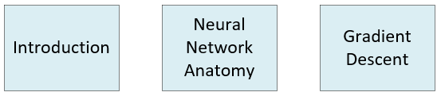
Deep Learning Foundations
Notes:
Our Deep Learning Foundations series comprise 3 workshops. In this session and the next two which follow, we cover the basics of deep learning. Keep in mind that this series is foundational for our intermediate workshops.

Slide 4
Essential Questions
How does it work?
Where can I use it?
Notes:
Two essential questions:
1st question: Just as you can drive a car without understanding the laws of thermodynamics, you can drive neural networks without having to master the math (calculus) which underpin them. Do not need a year of calculus…
2nd question: Equally important – but one you must creatively answer yourself, though we will share applications in today’s mini-lectures.
=====
This workshop series is guided by two essential questions: How does it – a particular AI algorithm – work? And where can I use it?
With respect to the first question, let me assure you that you can do interesting work in AI without having to master the mathematical details. Just as you can drive a car without understanding the laws of thermodynamics, likewise you can drive the various types of neural network without having to master the calculus, statistics, and algebra which power them. Of course, you need to know how they work at a higher level – what the various dials and gauges mean (called hyperparameters) – and the various ways you can manage the learning process. But you do not need a year of calculus to achieve that kind of understanding.
The second question is also important. In fact, it is the primary focus of this learning experience. It is not a question we can fully answer for you as it requires a certain level of knowledge and imagination on your part, though we can prime your thinking by demonstrating a specific application. That’s what you will be doing today. You are going to write some code to build and then test a neural network capable of classifying images.

Slide 5
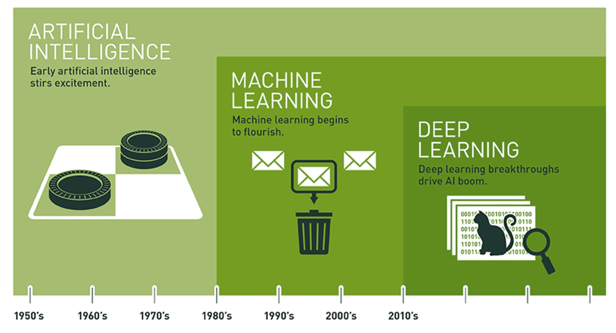
Notes:
This graphic comes from our “What is AI” workshop
Expansive AI
AI encompasses ML and DL
Distinct domains
Uneven progress since the 1950’s, with multiple ‘winters’ where interest and funding dried up
Let’s review and revisit definitions
=====
Artificial intelligence is the branch of computer science aimed at developing machines that can simulate human intelligence. And human intelligence is dependent on our five senses – sight, hearing, touch, smell, and taste. AI is an established field and has been in existence since the 1950s.
Machine learning is the subset of AI that performs specific tasks by identifying patterns within data and extracting inferences. The inferences derived from data are then used to predict outcomes on unseen data. In machine learning, unlike traditional computer programming, the rules and heuristics are not explicitly written. Rather, they are learned from the dataset.
Deep learning is a subset of machine learning and an extension of a certain kind of algorithm called Artificial Neural Networks (ANNs). Neural networks are not a new phenomenon. Neural networks were created in the first half of the 1940s. Two factors have led to the exponential rise of deep learning in the past ten years. The first is Big Data. The second is enhanced hardware – graphical processing units or GPUs made by companies like Nvidia. And the third is open-source deep learning software like TensorFlow from Google.

Slide 6
Artificial Intelligence
Artificial Intelligence is the study of “rational agents”: any system that perceives its environment and takes actions that maximize its chance of achieving its goals.
-- Russell & Norvig (2003)
Notes:
Leading AI textbooks define the field of Artificial Intelligence as the study of “intelligent or rational agents” – any system that perceives its environment and takes actions that maximize its chance of achieving its goals.
Restatement of Russell & Norvig’s definition – Artificial Intelligence: A Modern Approach, 2nd edition – most widely used introductory text.
AI system performance = humans in many cases.
Broad array of applications.
=====
Leading AI textbooks define the field of Artificial Intelligence as the study of “intelligent agents”: any system that perceives its environment and takes actions that maximize its chance of achieving its goals. Such systems are now able to perform tasks humans are good at; for example, recognizing objects, making sense of speech, and decision making in a constrained environment. As our computer programs have become more sophisticated, our ideas of which tasks require human intelligence have evolved. Thus, AI is now used in a wide variety of tasks.

Slide 7
Machine Learning
Machine learning is the field of study that gives computers the ability to learn without being explicitly programmed.
-- Arthur Samuel (1959)
Machine learning is the science and art of programming computers so they can learn from data.
Notes:
… and here’s a definition of machine learning coined by Arthur Samuel in 1959. This is concise and one of my personal favorites. However, I also like this second definition: Machine learning is the science (and art) of programming computers so they can learn from data. Now, the key word in that second definition is data.
=====
Machine Learning algorithms parse data, learn from it, and then make a prediction about something in the world. So rather than hand-coding software routines with a specific set of instructions to accomplish a particular task, the machine is “trained” using large amounts of data and algorithms that give it the ability to learn how to perform the task.

Slide 8

Deep Learning
Image Credit: https://www.bettycrocker.com/recipes/rainbow-layer-cake/4969fed8-141e-45f5-9a04-e03addd20fbb
Notes:
Deep learning is a subfield of machine learning with a focus on neural networks
A neural network is a special type of learning algorithm, inspired by the billions of interconnected neurons in the human brain.
In a NN, neurons grouped together in layers – image of a multi-layered cake – if you have many layers, the cake is “deep” when viewed from above.
Since 2010, deep learning became possible because:
Enhanced hardware – GPUs from Nvidia and other suppliers
Open AI software frameworks – Tensorflow, Pytorch, Keras, etc…
Big Data

Slide 9

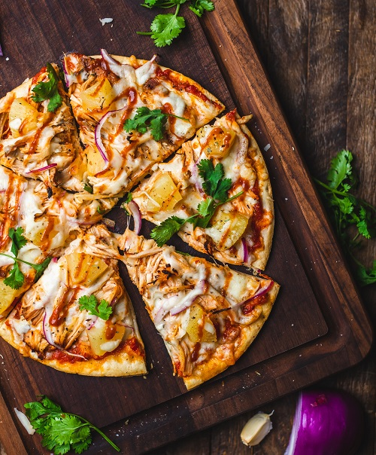
Amelia’s Pizza Obsession
Notes:
Amelia, our tech-geek, teenaged heroine, is an extremely picky eater. Some say she’s a pizza fanatic 🍕. When dinner rolls around, she only wants to come down from her bedroom if pizza is served. To achieve that goal, Amelia has installed a hidden camera in the dining room. Once dinner is set, the camera snaps a photo of the meal. Now, she wants to develop an AI image recognition system to determine if pizza is on the menu or not.
After doing some research, Amelia finds ResNet, a neural network classifier trained to identify a thousand different kinds of images, include pizza. But how was ResNet created?
Let’s quickly review the three-step process of creating a ResNet like classifier.

Slide 10

Train Model
“This is an image of a pizza”
ResNet50 Model
1,000 Categories
Notes:
The first step is to design a deep learning model. In this case, the ResNet50 architecture, as its name suggest, consists if 50 layers. The box picture here is black because the inner workings of a deep neural network is largely hidden. This is known as the black-box problem. Also, we do not discuss the technical details of the architecture here.
The second step is to train the ResNet model using the ImageNet dataset. This dataset has a distinguished history in the field of AI, being one of the largest and earliest training datasets. Since 2010, it has been used for the ImageNet Large Scale Visual Recognition Challenge. AlexNet was the first deep neural network to blow away the competition in 2012.
And finally, the last step is to move the trained model to production. Submit a pizza image to the model to see if it classifies it correctly.

Slide 11
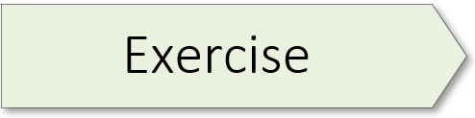
(A Simple Classification Model) 01.1_resnet.ipynb

Slide 12
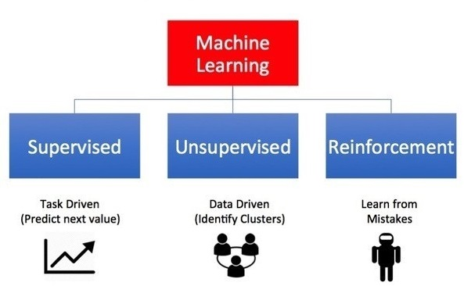
Image Credit: https://towardsdatascience.com/what-are-the-types-of-machine-learning-e2b9e5d1756f
Notes:
I want to introduce you to the different kinds of A.I. learning systems. There are three principal types of machine / deep learning systems (supervised, unsupervised, and reinforcement).
Supervised Learning is Task Driven (Predict next value)
Unsupervised Learning is Data Driven (Identify Clusters)
Reinforcement Learning is Experience Driven (Learn from Mistakes)
Let’s dive into the details…

Slide 13
Source: Palmas, A. (2019). The Reinforcement Learning Workshop. Birmingham, UK: Packt Publishing. (Chapter 1)
Notes:
And another look at the three types of ML/DL systems:
1. Supervised learning minimizes the error of the output of the model with respect to a target (label) specified in the training set.
2. Reinforcement Learning maximizes the reward signal of the actions.
3. Unsupervised learning has no target and no reward; it tries to learn a data representation that can be useful.

Slide 14
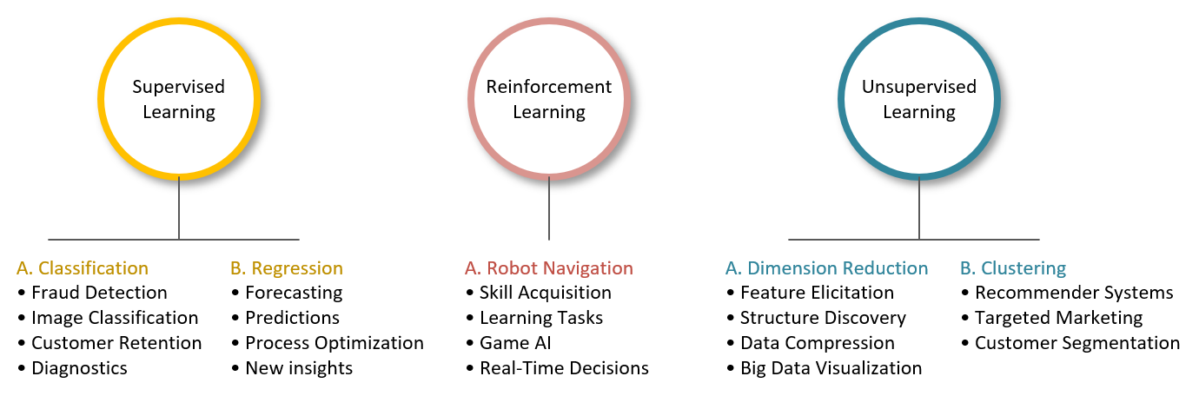
Applications
Notes:
And finally, this image summarizes some of the primary ways in which AI is being used today. I present these applications because background knowledge is key to helping you imagine AI possibilities in your domain. Of course, the challenge is to take an application in another area and then modify it, so it works in yours. I believe this is where a lot of innovation is going to happen in the future.

Slide 15
Neural Network Architectures
Notes:
There are a variety of neural network types and innovation is ongoing in this area. So, I’d like to conclude this presentation with a brief overview of some of the more popular architectures, including their various applications.

Slide 16
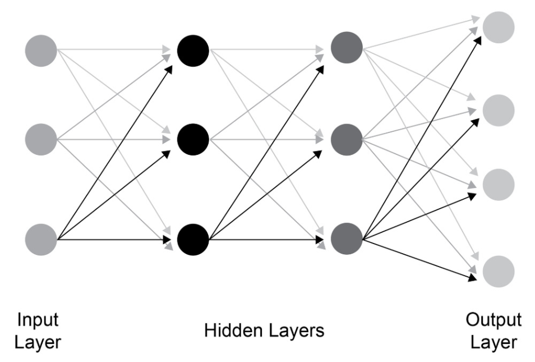
Fully-Connected Network
Notes:
A fully connected network is the most basic kind of neural network, also known as feed-forward networks. Some application include:
Complex Classification
Machine Translation

Slide 17
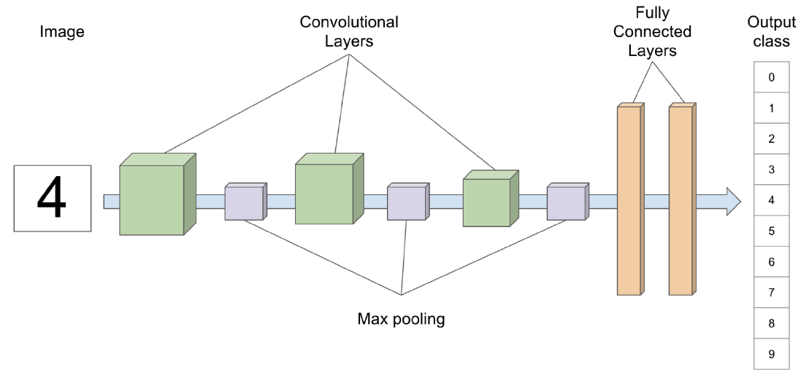
Convolutional Neural Network
Notes:
A convolutional neural network (CNN) is a class of AI models used primarily for image recognition tasks. In a fully connected network, each neuron in a layer is connected to every other neuron in the next layer (previous slide). CNNs, however, adopt a different strategy and do not use a fully connected architecture. As well, CNNs are typically constructed with one or more convolution and/or pooling layers. These specialized layers allow the model to extract local features from images which are then fed to the subsequent layers.
Some application of CNNs include:
Image processing
Computer Vision
Speech Recognition

Slide 18
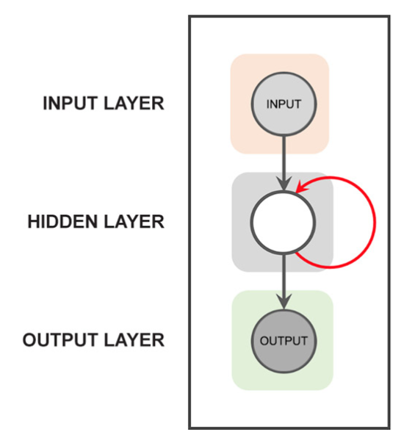
Recurrent Neural Network
Notes:
Recurrent neural networks (RNNs) propagate data forward, but also backwards. As pictured here, the red arrow indicates that the hidden layer connects back to itself, thereby allowing the network to remember what it has already done. RNN’s are a good choice for sequenced data where the order of the data elements is important. More recently, Transformers have started to displace RNNs as they are more versatile and effective.
Some application of RNNs include:
Text processing like auto suggest, grammar checks, etc.
Text to speech processing
Sentiment Analysis
Time sequence projections
Translation

Slide 19
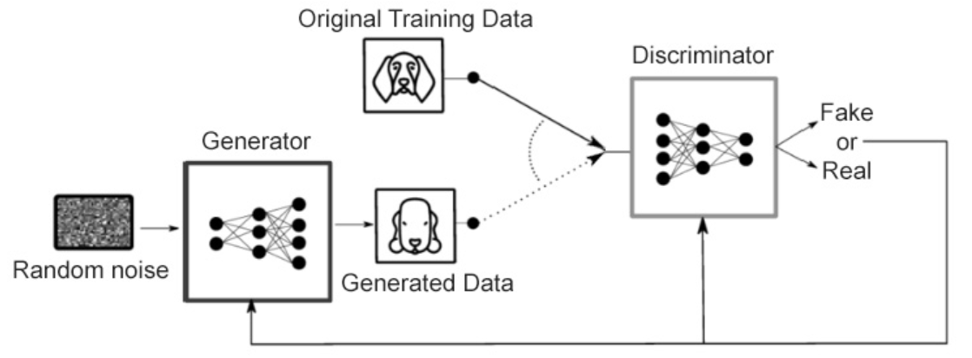
Generative Adversarial Network
Notes:
A generative adversarial network (GAN) is a model in which two neural networks compete with each other to become more accurate in their predictions. The two neural networks that make up a GAN are referred to as the generator and the discriminator. The goal of the generator is to artificially manufacture outputs that could easily be mistaken for real data. The goal of the discriminator is to identify which outputs it receives have been artificially created.
GANs are a big area of research, and there are many use cases for them. Some of the useful applications of GANs are as follows:
• Image translation
• Text to image synthesis
• Generating videos
• The restoration of art

Slide 20

(Tensorflow Introduction) 01.2_tensorflow_intro.ipynb

Slide 22

Image Credit: https://cktechcheck.com/

