Slide 1

Gradient Descent
Notes:
In our last presentation, I briefly noted that the backpropagation process adjusts the network’s weights. We now need to take a closer look at how backprop works, how it adjusts those weights, using gradient descent and the chain rule from calculus. But do not fear, this presentation does not use mathematical formulas but focuses instead on visualizing the underlying process.

Slide 2


Notes:
Alright – let’s put everything we’ve discussed so far into a single image / example.
Pictured here is a complete, albeit small, neural network. As such, it consists of an input layer, a single hidden layer, and an output layer.
Input features are fed to the input layer, one feature per node. And depending on the size of the input example, the number of input nodes varies. The input data can be structured data (such as a CSV file) or unstructured data, such as an image. Feature engineering, as it’s called, is an important component of any deep learning project.
During forward propagation, the flow of numbers is from left to right. That flow is reversed in back propagation, to be discussed in our next presentation.
We now label each of our weights. During forward propagation, the output from each node is multiplied by its corresponding weight before becoming input to the downstream node. So, for example, the output from (G) is multiplied by weight Wgf1 before becoming input to node (F).
A bias node is typically associated with each layer – the function of bias nodes will be discussed in just a few minutes.
In this example, the network’s output is passed from node (F) to an error function which calculates the network’s total error, the difference between ground truth (labelled y) and the output. A more complete explanation of the error function will be discussed in our next workshop when we explain the back propagation / gradient descent process.

Slide 3
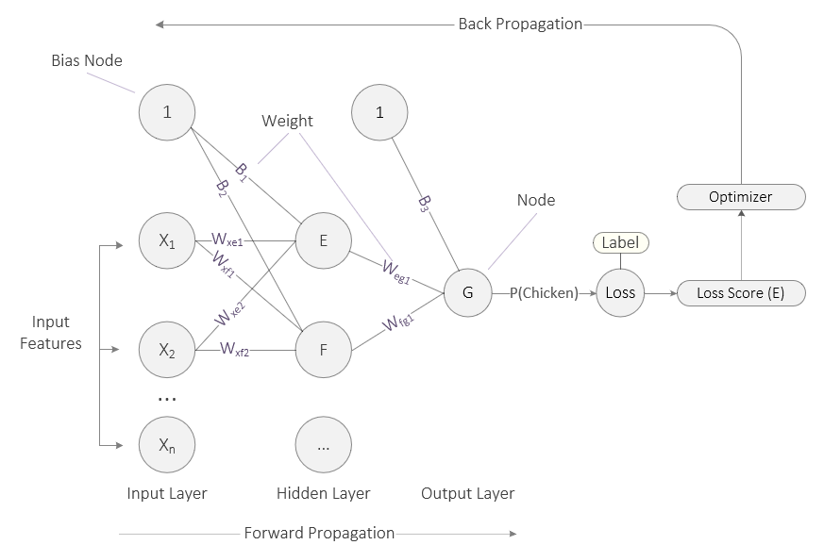
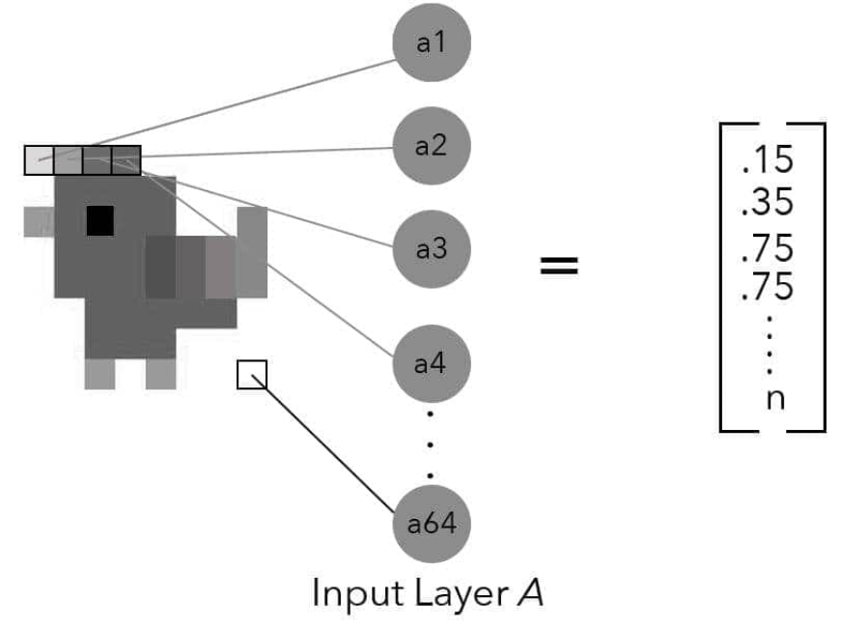
Source: Taylor, M. (2017). Neural networks: A visual introduction for beginners. Vancouver, Canada: Blue Windmill Media.
Notes:
And finally, let’s simulate the forward propagation process with another simple example. Here we feed an image to a small neural network, and it outputs the probability that the image is a chicken. Again, this network consists of an input layer, a single hidden layer, and an output layer.
Each example of input data is fed to the input layer. In this example, a greyscale image of a chicken 8 pixels by 8 pixels has been converted into a vector of 64 numbers, each one representing the intensity of the color at that point. These features are then fed to the input layer, one feature per node. In this case, X sub 2 is the second value in the vector.
The value in X sub 2 is then multiplied by weight xf2.
At node F, the net input function sums up all incoming values and passes that value to its activation function which then calculates the output value.
The output value from node F is then multiplied by weight wfg1.
At node G, the net input function sums up all incoming values and passes that value to its activation function. Because node G is the only node in the output layer, its output is the probability P() that the input image is a chicken. That value is then passed to the loss function which compares it to the label and calculates a loss score (E). The optimizer then takes that loss score and uses that to adjust the weights in the backpropagation phase – this is where the network “learns.”
Before we end this mini-lecture, we still have a mystery to clear up. Why does our network contain bias nodes? What’s their purpose? Let’s answer that question…
====
We note that the input layer is fully connected to the hidden layer, consisting of two nodes. And as you can see, each weight on the connecting lines is labelled. During forward propagation, the output from each node is multiplied by the weights before becoming input to the downstream node. The numbers flow from left to right. However, the flow is reversed during backpropagation, and this is where the neural network ‘learns.’ The backpropagation process is fully described in our next presentation, including the loss function, total error, and optimizer.

Slide 4
Create Simulation of Backpropagation Process

Slide 5
Notes:
With backpropagation, we start with the error function and work backward. It first passes its calculation of the network’s total error to the optimizer which oversees the backpropagation process.
The goal of the optimizer is to minimize the network’s error, in a process called gradient descent. At this point, the network needs to adjust all of its weights such that the total error is minimized. More concretely, the network must calculate the individual contribution of each weight to the total error and then proceed to adjust each (up / down) in relation to its contribution to the total error.

Slide 6
δ
Notes:
Let’s now take a closer look at how the network’s weights are adjusted.
We start with a key observation: When the output of any neuron in our network changes, the final output error changes by a proportional amount. The connection between any change in the neuron’s output and the resulting change in the final error is just the neuron’s change multiplied by some number.
This number goes by various names, but the most popular is the lowercase Greek letter δ (delta), though sometimes the uppercase version, Δ, is used. Mathematicians often use the delta character to mean “change” of some sort, so this was a natural (if terse) choice of name.

Slide 7
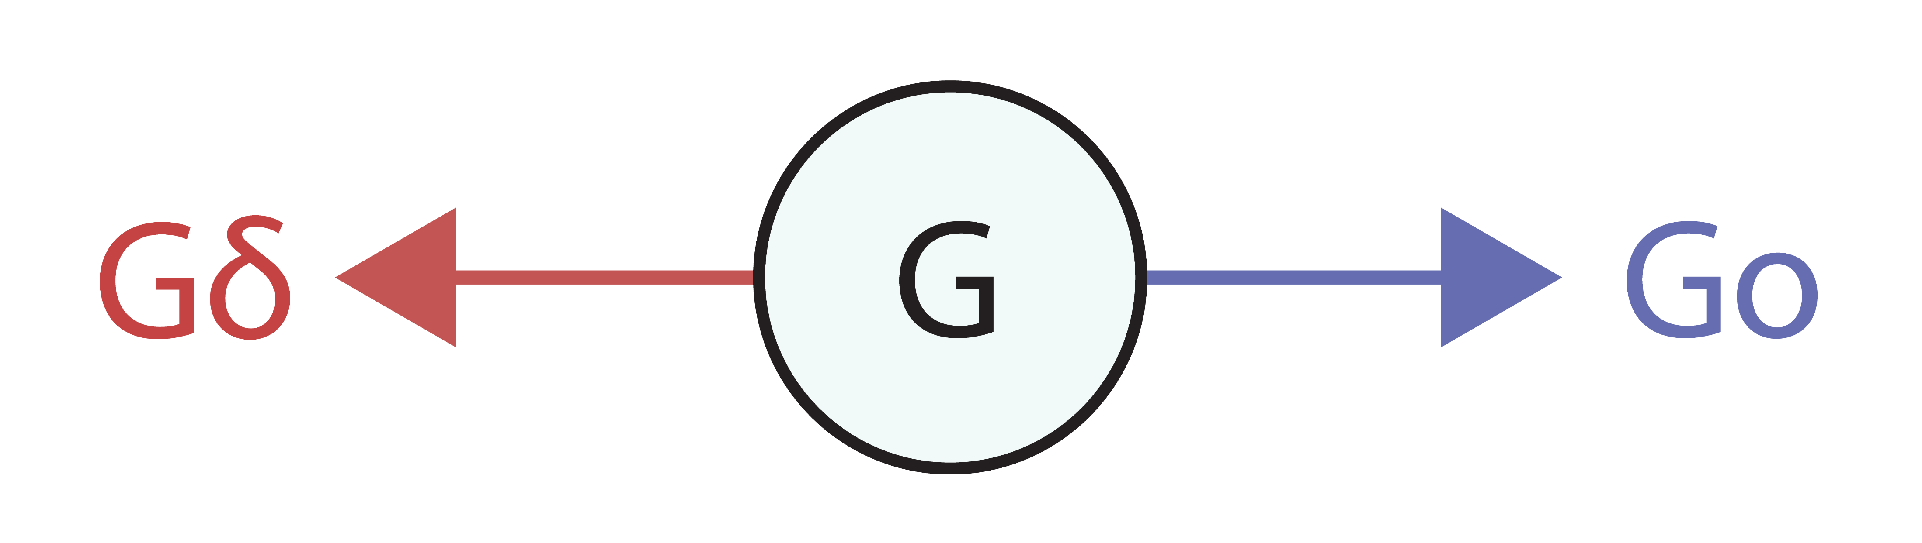
Notes:
Because network training includes both forward and backpropagation processes, each node in a neural network has two outputs. Node G, for example, produces an output to the right, during forward propagation, and an output to the left, during backpropagation. Here the output to the right (forward prop) is called Go while the output to the left (backprop) is called Gδ.
Now with this naming convention established, the process for finding the updated value for weight Wgf1 can be summarized as follows.,,

Slide 8
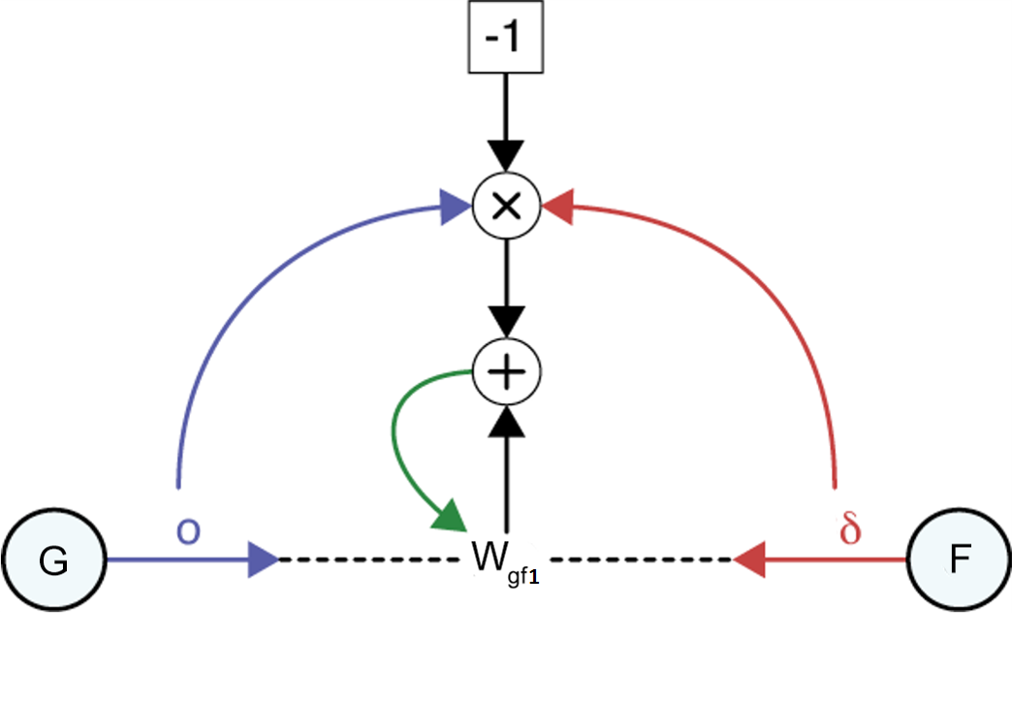
Go
Fδ
Source: Glassner, A. (2021). Deep learning: A visual approach. San Francisco, CA: No Starch Press. (Chapter 14)
Notes:
The entire process for finding the updated value for weight Wgf1 is pictured here. Showing subtraction in a diagram like this is hard, because if we have a “minus” node with two incoming arrows, it’s not clear which value is being subtracted from the other (that is, if the inputs are x and y, do we compute x − y or y − x?). So to sidestep that problem, we compute Wgf1 − (Go × Fδ) by finding Go × Fδ, multiplying that by −1, and then add that result to Wgf0.
Let’s walk through this figure. We start with the output Go from neuron G and the delta Fδ from output neuron F. We then multiply these two numbers together, as shown by the multiplication sign. What we want to do is subtract that from the current value of Wgf0. To show this clearly in the diagram, we multiply the product by −1 and then add it to the weight Wgf0. The green arrow is the update step, where this result becomes the new value of Wgf0.
Source: Deep Learning: A Visual Approach (p. 367)

Slide 9
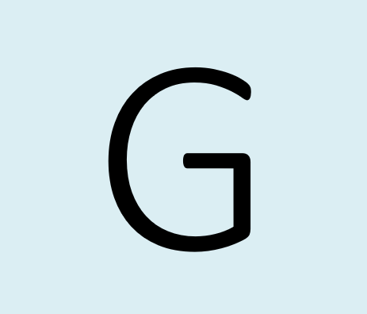
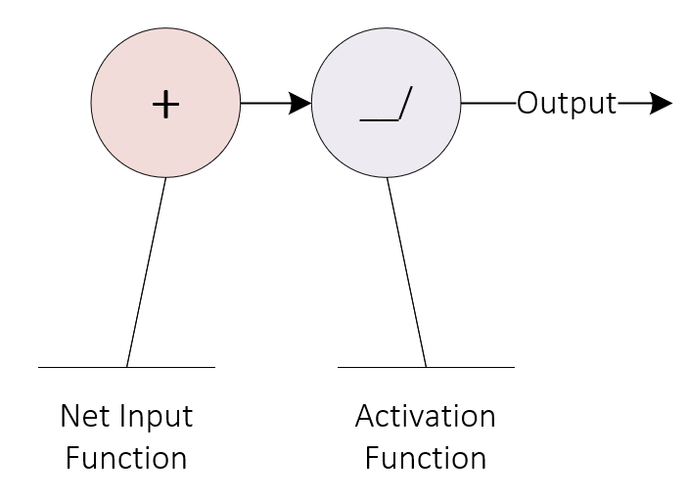
Notes:
As presented in an earlier slide, each node or neuron in a network is activated in a two-step process. First, the net input function sums up the incoming input, consisting of numbers. Here the plus sign indicates that operation, though an upper-case Sigma (Greek letter) is frequently used in the literature. And second, the net input function is tightly coupled to its corresponding activation function which, in turn, produces the node’s output. Keep in mind that an activation function can output a positive or negative number, or even zero.

