Slide 1
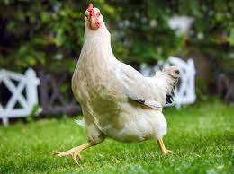
Future of Chicken

Slide 2
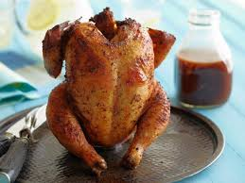
Team Members
David Hustell
Saidee Padilla
Silvano Ross
Ryan Svendson

Slide 3
Why did we choose chicken?
We chose the chicken market due to the fact of the pricing of chicken rising every day we wanted to see what season was best to buy chicken. When looking at the data we noticed that it was best to buy chicken before the holidays. We have pulled data from Kaggel to compare meat prices from 3 months , six months and three years.
Also thought it would be interesting to assume we were chicken farmers and maybe could buy chicken futures when the seasonal pricing is low and predict when in the future it would be best to buy futures.

Slide 4
Machine learning model
We used Kaggle to pull the prices of the chicken.
Pandas
Jupyter Labs
PyViz hvPlot
Scikit-Learn
Pickle
Facebook Prophet
XGBOOST – New ML Model

Slide 5
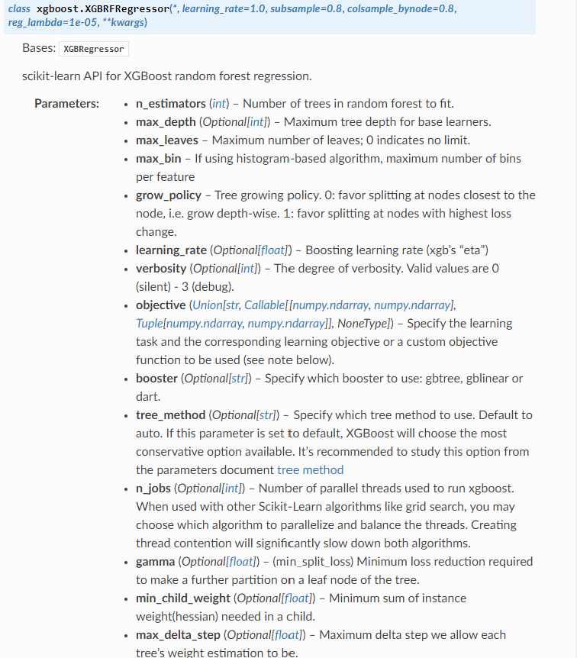
XGBoost

Slide 6
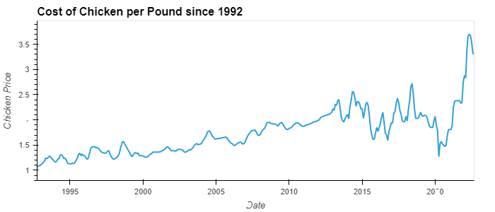
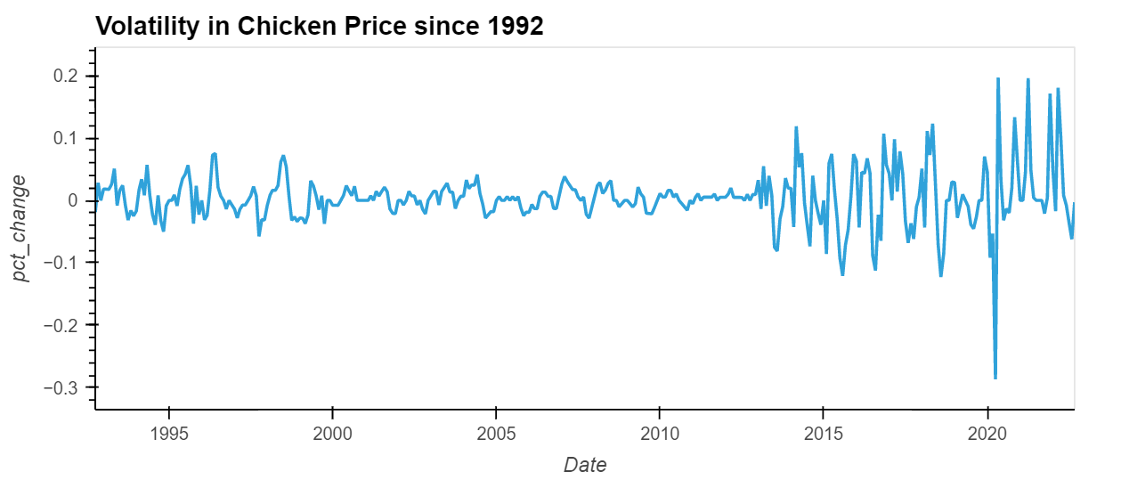
Chicken Price History

Slide 7
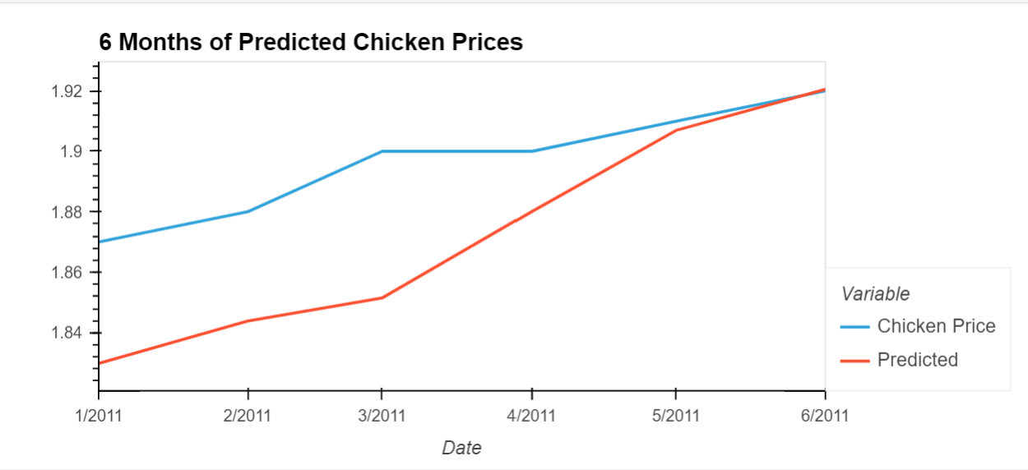
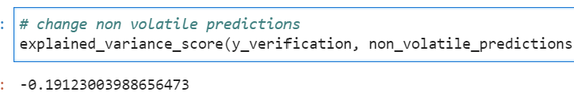
6 Months predicted using future dates outside training set

Slide 8
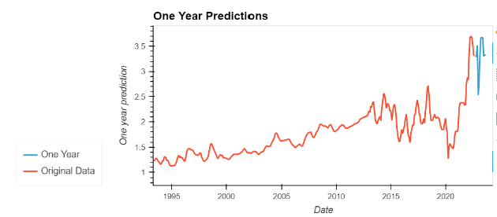
1 Year

Slide 9
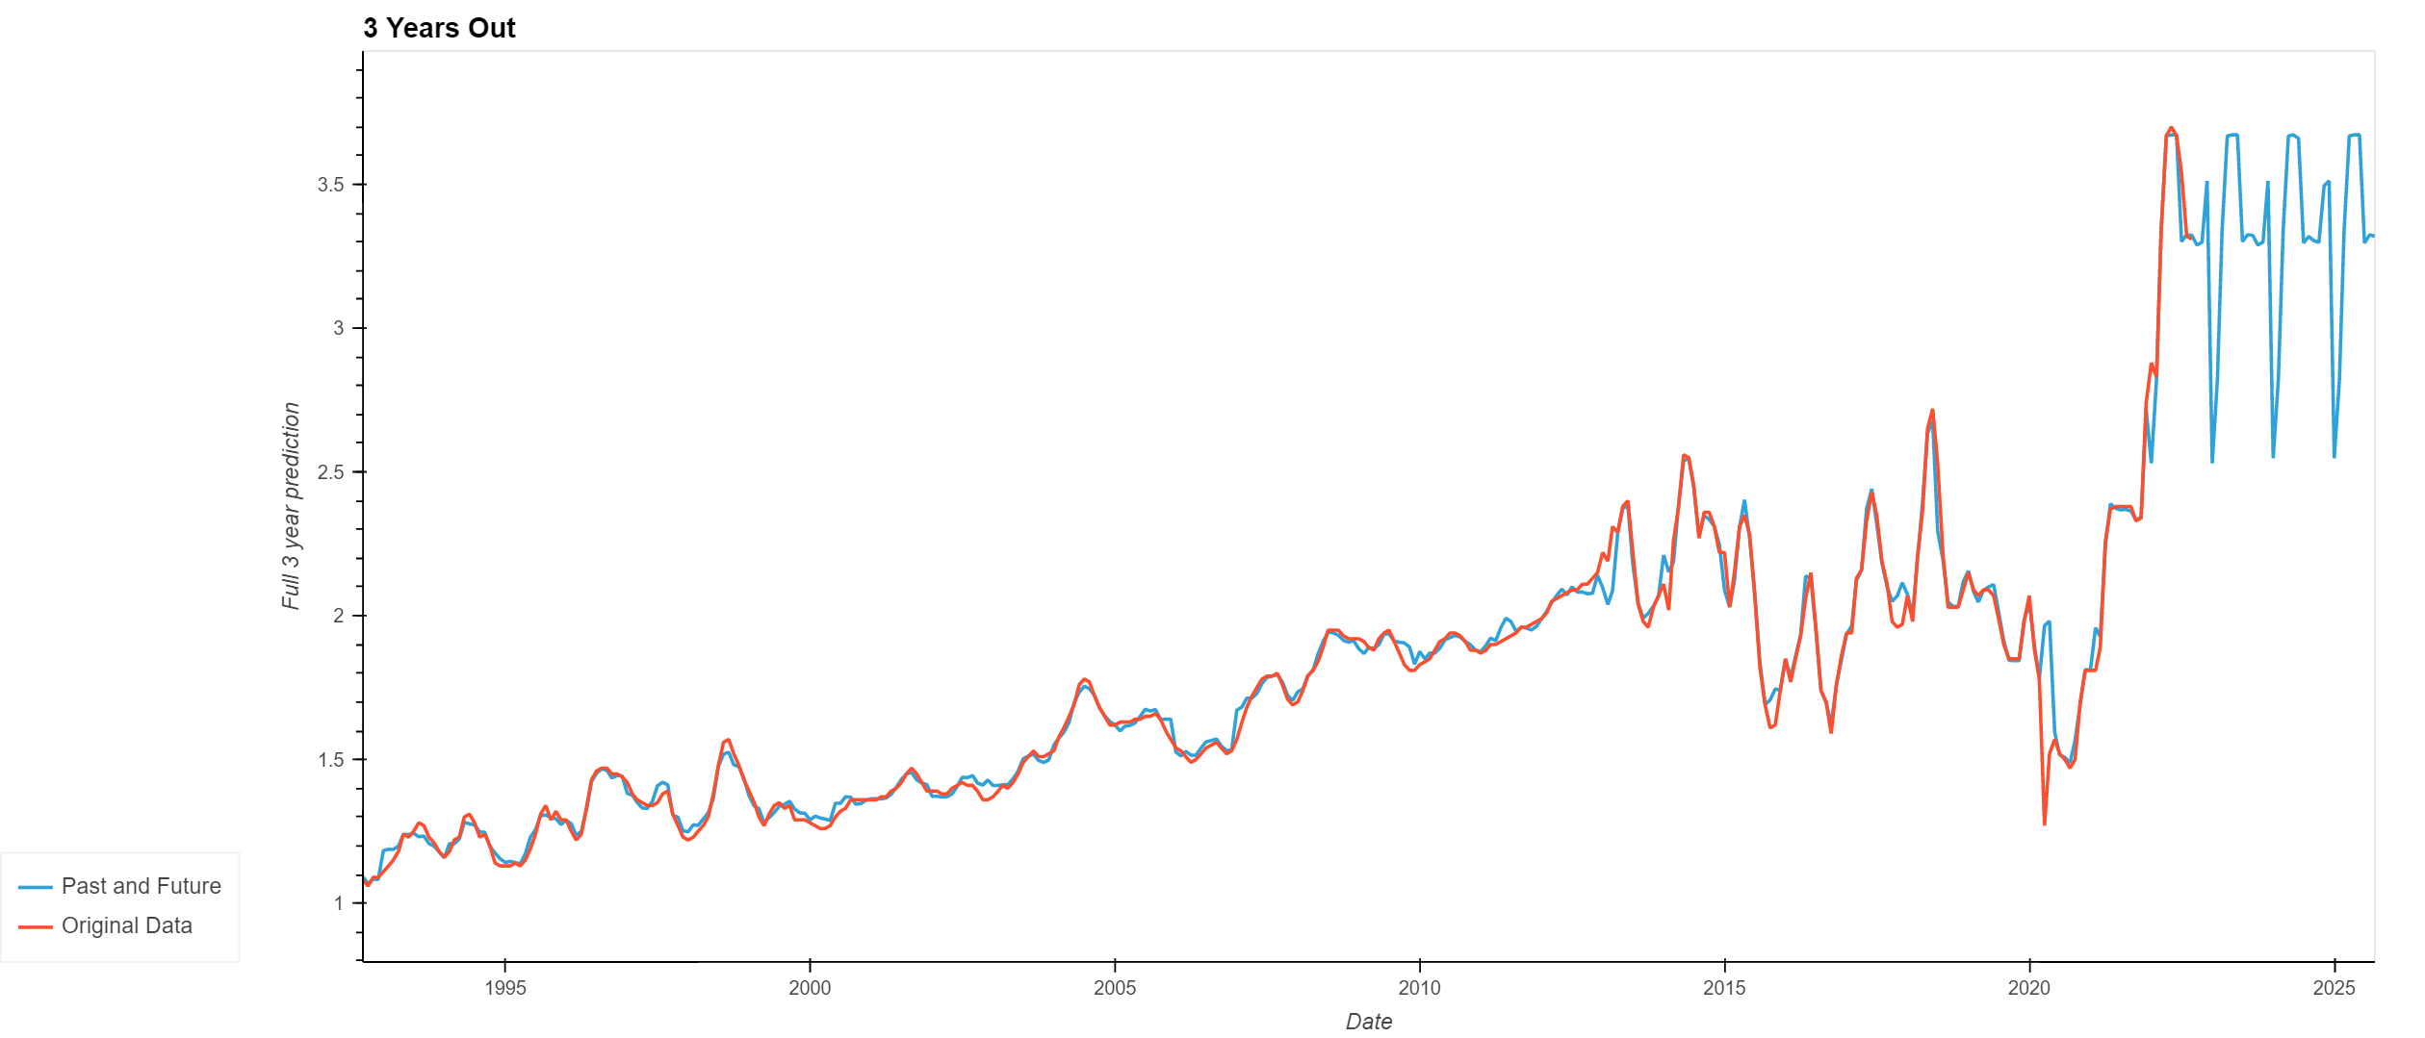
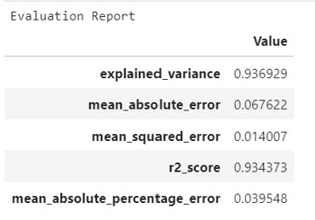
3 Years
XGBoost picked up on some seasonality - The peaks lie between months 4-6 and the dips are in January of each year

Slide 10
Pickling the model

Slide 11
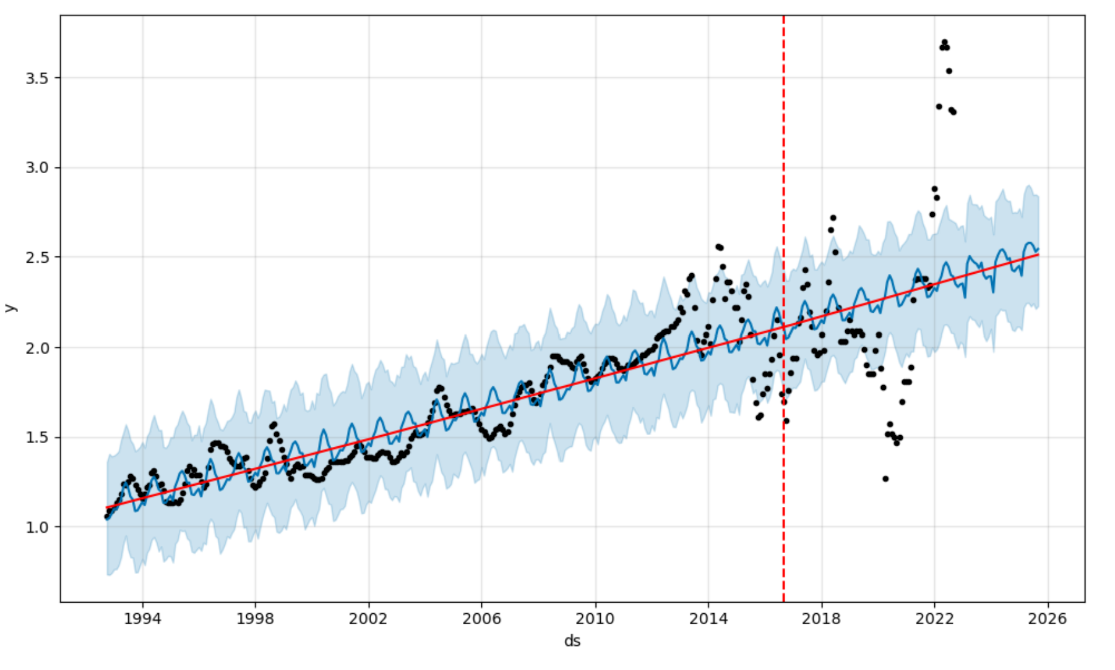
Prophet Model 3 Years

Slide 12
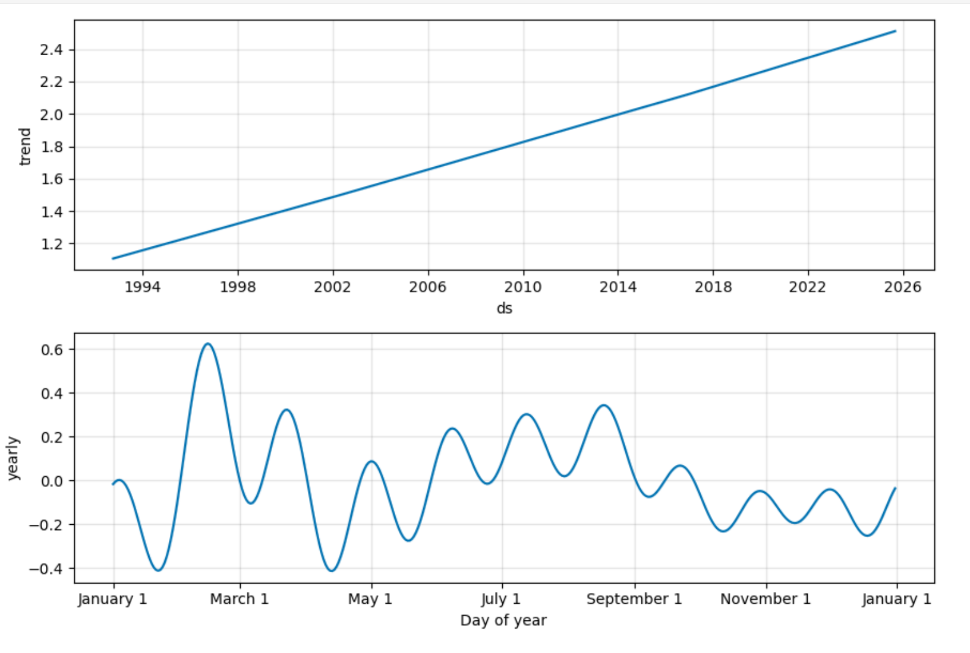
Seasonality

Slide 13
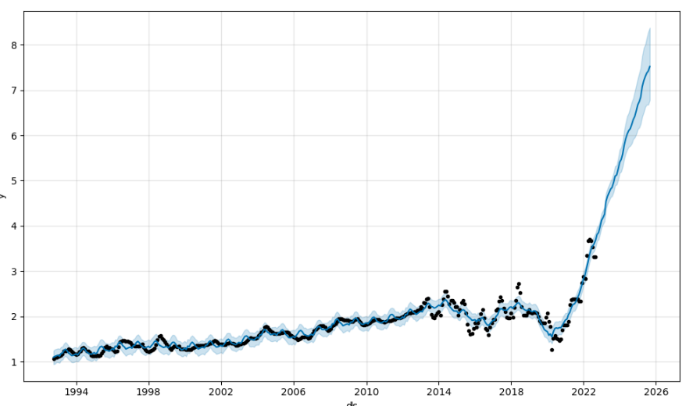
Prophet Tuning

Slide 14
What Worked
Prophet seemed like it created best time-series model
XGBoost easy to install
XGBoost could hold many different features and seemed like it was a very strong model
Many parameters for XGBoost Model
Good experience seeing the similarities and differences in the XGBoost Regression model

Slide 15
Challenges
One of the challenges that we faced was to decide on the years we wanted to use, couldn’t go too far out, tried 10 years, did not work.
One other challenge that we faced was trying to apply the XGBOOST Regression Model – needed to transform time-series into raw numbers to scale
Regression model did not pick up on upward trend of prices
The profit of chicken depends on the season, prices fluctuates from year to year.

Slide 16
Future Direction
Create a bot to alert when there's a seasonal price change that’s worth acting on
Info repository for future farmers who aren't in the lifestyle but want to know what future prices are
Alert for consumers who want to see chicken price history and where it's going
Add the predicting each day from the day prior's percent return – tip from Dan

Slide 17
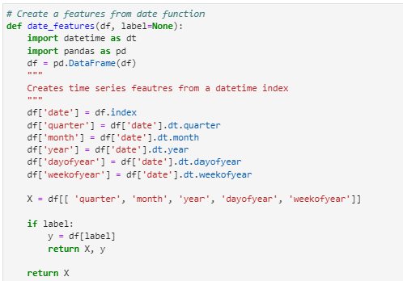
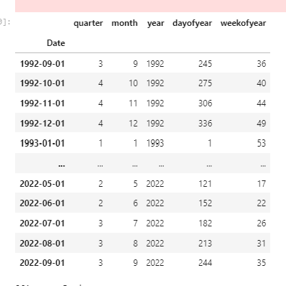
Cool Tip

