Slide 1
3D Motion Analysis System in Gymnastics
Proposal & Research Question
Silvan Troxler | ZHdK | Master Interaction Design

Slide 2
1887

Slide 3
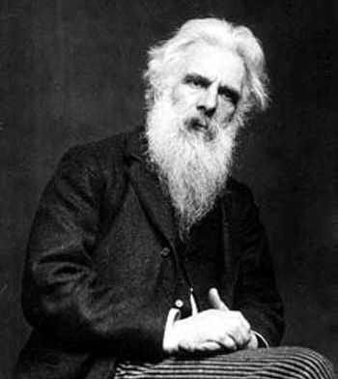
1887

Slide 4
Eadweard Muybridge
British photographer
Stop-action photographs
1887:
Animal Locomotion; An Electro-Photographic Investigation of Consecutive Phases of Animal Movement

Slide 5
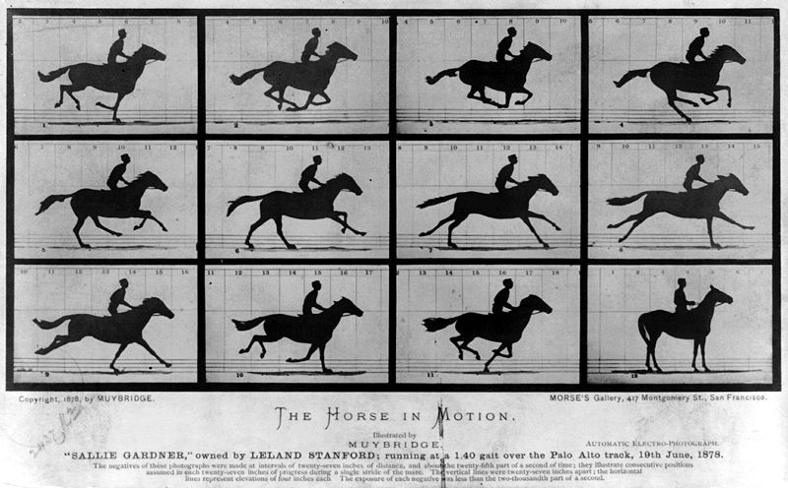

Slide 6
So What?

Slide 7
So What?
Begin of Motion Capture
Similar situation
3D cameras are getting cheap and accessible for everybody
New possibilities - How can we use them?

Slide 8
1 Project Description
Subject, Relevance & Goal

Slide 9
Project Description
Capture 3D motion data with Kinect
Find ways to represent and analyse this data
Create a motion analysis system to improve the training

Slide 10
Thematic Focus
Interdisciplinary
Interaction Design
Science of Sport and Human Movement
( Neurologie / Psychologie )
Cooperation with men’s national gymnastics team

Slide 11
Relevance
New technology offers new possibilities
can increase performance
chance to neglect main point of training
Often too complicated, expensive or not suitable for environment
Applicable in other sports and different levels

Slide 12
2 State of the Art
& Knowledge Gap

Slide 13
State of The Art
Science of Sport and Human Motion
The effect of modeling and verbal feedback on skill learning - Tzetzis et al. (1999)
Can skilled performers readily change technique? - Sanders et al (1995)
Studies about best timing for feedback
Interaction Design
Design for Sport - Cereijo Roibàs et al. (2011)

Slide 14
State of The Art
OpenNI
Opensource project for natural interaction
Kinect as one of its input devices
Motion Analysis Software
Video analysis programs
Recreating Movement (Hilpoltsteiner 2005)

Slide 15
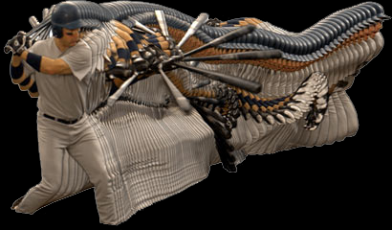

Slide 16
Knowledge Gap
Visual feedback is helpful, but how does a good visual feedback look like?
how to use 3D data?
Training environment not considered

Slide 17
3 Research Question

Slide 18
How can an Interactive Motion Analysis System Improve the Training?

Slide 19
Research Question
How can data be represented?
How does a good visual feedback look like?
How has the system to be designed to fit the training environment?
3 Research Question

Slide 20
4 Approach & Methods

Slide 21
Approach & Methods
1 Observation
2 Interviews
3 Research
4 Prototyping

Slide 22
Workflow
Observation
Interviews
Research
Prototyping

Slide 23
Questions / Discussion
?

