Slide 1

MSc | IT5514 Applied Machine Learning
Predicting Seasonal
Paddy Production
in Sri Lanka
Explainable Boosting Machine (EBM)
vs four ensemble regression models
W.D.N. De Silva | Student ID 269096C
IT5514 • W.D.N. De Silva • 269096C
01
Notes:
Hello everyone. My research investigates prediction of seasonal paddy production at district level in Sri Lanka. I focus on Explainable Boosting Machine, or EBM, and compare its results and interpretability with four established ensemble regressors.
Cover visuals are illustrative AI-generated paddy cultivation scenes (not photographs of specific dataset observations).

Slide 2
01 | RESEARCH QUESTION
Why this problem matters
Can district-level paddy harvest be estimated from agricultural and seasonal weather records?
RECORDS
DISTRICTS
YEARS
660
25
14
The project estimates production in tonnes for a district and cultivation season. It does not forecast harvest before planting, because complete-season weather is used.
District–season
Across Sri Lanka
2010–2023
DATA SOURCES • FROM THE NOTEBOOK
01 AGRICULTURAL / PADDY STATISTICS
Department of Census and Statistics (Sri Lanka)
Combined dataset: DCS paddy production and Open-Meteo weather variables, prepared as 660 district–season records.
statistics.gov.lk • Paddy Statistics
02 SEASONAL WEATHER VARIABLES
Open-Meteo • Weather data
open-meteo.com/en/features
IT5514 • W.D.N. De Silva • 269096C
02
Notes:
Paddy production is important for agricultural planning, but it varies across districts and seasons. The dataset has 660 records, 25 districts and covers 2010 through 2023. The target is production in tonnes, and the main inputs include sown area, previous production, rainfall and temperature. An important distinction is that this is an end-of-season estimation study.
The notebook identifies two data sources: Department of Census and Statistics, Sri Lanka, Paddy Statistics: https://www.statistics.gov.lk/Agriculture/StaticalInformation/PaddyStatistics; and Open-Meteo weather source: https://open-meteo.com/en/features. The workbook combines historical agricultural and district-level weather variables; the row-level joins and weather aggregation method require source documentation.

Slide 3
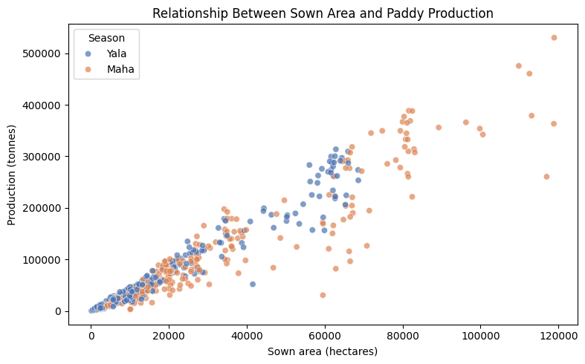
02 | EDA AND DATA QUALITY
What the data tells us
AREA AND OUTPUT
r = 0.953
Sown area vs paddy production
Five missing previous-year production values were imputed using training-only medians. No duplicate district–year–season keys were found.
IT5514 • W.D.N. De Silva • 269096C
03
Notes:
Exploratory analysis shows a strong positive relationship between sown area and paddy output, with correlation 0.953. The dataset has five missing previous-year production values, no missing target values and no duplicate district-year-season keys. Missing values are imputed from training data only to prevent leakage.

Slide 4
03 | EXPERIMENT DESIGN
Fair time-based evaluation
TRAIN
VALIDATE
TEST
2010–2019
→
2020–2021
→
2022–2023
464 records
98 records
98 records
Three expanding chronological tuning folds
Train ≤2015 → test 2016–17 • Train ≤2017 → test 2018–19 • Train ≤2019 → test 2020–21
IT5514 • W.D.N. De Silva • 269096C
04
Notes:
A random data split could leak information from later years into earlier training. Instead, I used 2010 to 2019 for initial training, 2020 to 2021 for validation, and kept 2022 to 2023 untouched until final testing. Hyperparameters were optimized using three expanding chronological validation periods.

Slide 5
04 | MAIN ALGORITHM
Why Explainable Boosting Machine?
Four benchmarks
EBM prediction = baseline + feature contributions
• Random Forest
Baseline
81,000 t
• XGBoost
Sown area effect
+229,129 t
• CatBoost
District effect
+52,855 t
• LightGBM
Previous production
−29,400 t
EBM provides built-in global and local explanations.
IT5514 • W.D.N. De Silva • 269096C
05
Notes:
EBM is the focus algorithm because it can fit nonlinear relationships while remaining interpretable. It combines a baseline with learned effects for individual features and some interactions. That lets us inspect why it produced a particular number. I compare it with Random Forest, XGBoost, CatBoost and LightGBM. This numeric example comes from the Ampara 2022 record.

Slide 6
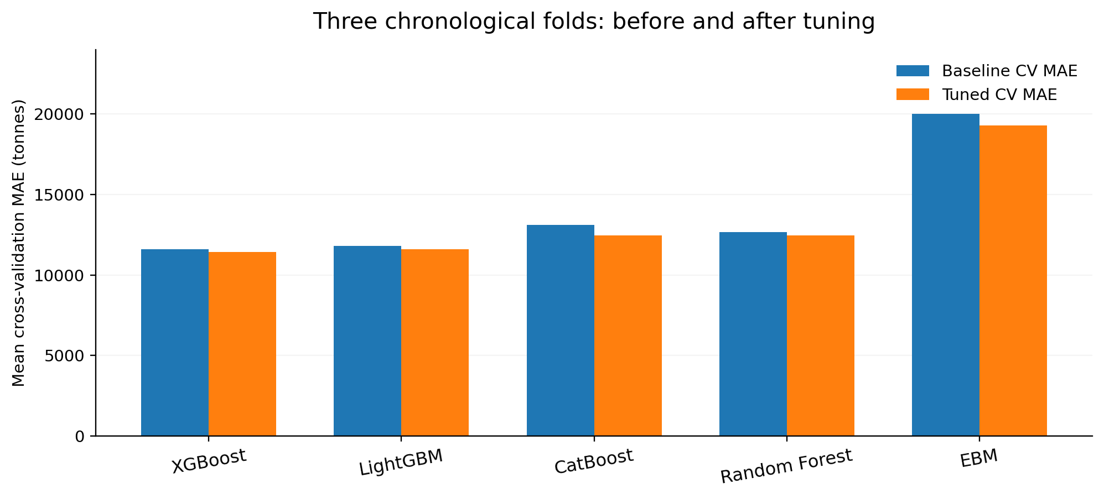
05 | MODEL TRAINING
Tuning: XGBoost leads validation
11,440
XGBoost tuned CV MAE
(tonnes)
EBM improved to 19,310 tonnes CV MAE, but remained behind the other four models.
IT5514 • W.D.N. De Silva • 269096C
06
Notes:
I compared each model across three time-based folds and tuned hyperparameters. XGBoost had the lowest mean validation error of 11,439.53 tonnes. For EBM, the best settings were learning rate 0.02, maximum leaves 2 and two interactions. Its validation error improved to 19,310.48 tonnes, but was still the highest among the five.

Slide 7
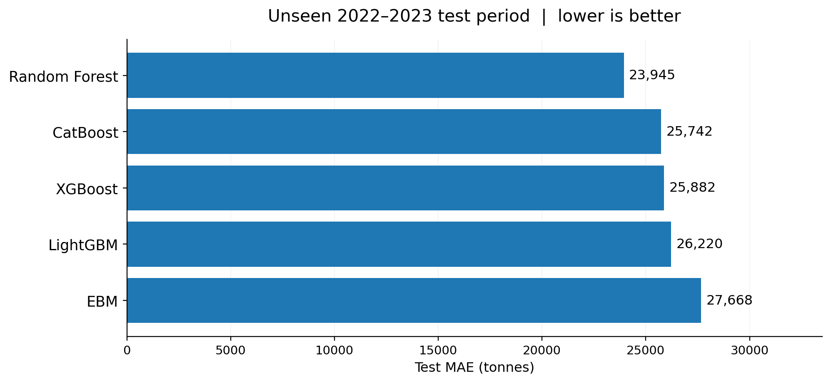
06 | FINAL EVALUATION
Unseen test: a different ranking
EBM TEST RESULTS
27,668
MAE • tonnes
43,430
RMSE • tonnes
0.736
R²
Random Forest had the lowest observed test MAE; XGBoost remained selected by validation.
IT5514 • W.D.N. De Silva • 269096C
07
Notes:
On the truly unseen 2022 to 2023 data, Random Forest had the lowest observed MAE of 23,945 tonnes. EBM recorded MAE 27,668 tonnes, RMSE 43,430 tonnes and R squared about 0.736. The important lesson is to distinguish the model selected by validation, XGBoost, from the model with the lowest test error. We should not use the final test set to re-select hyperparameters or models.

Slide 8
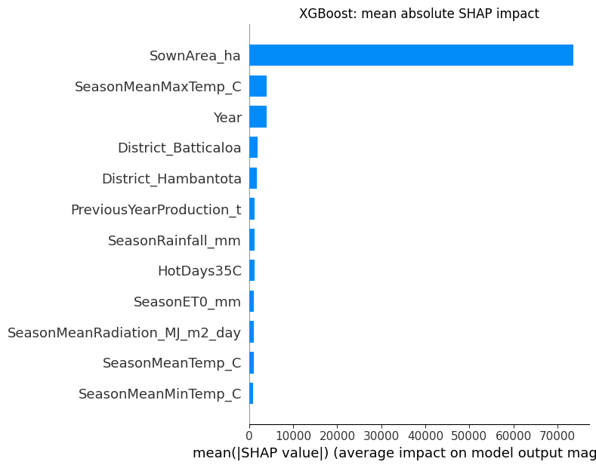
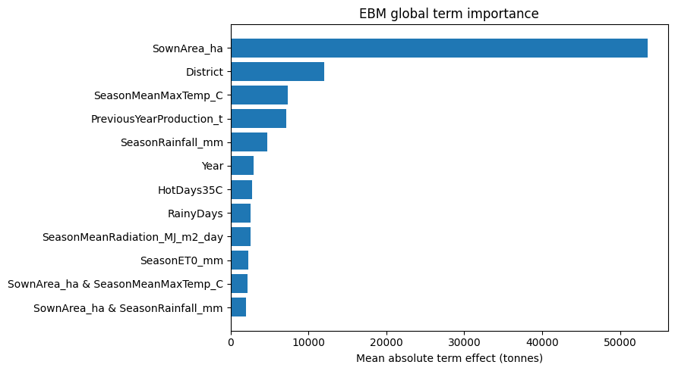
07 | EXPLAINABILITY
What explains the predictions?
XGBoost + SHAP (post-hoc)
EBM (intrinsic importance)
Both identify sown area as the dominant input. Feature influence is not proof of causation.
IT5514 • W.D.N. De Silva • 269096C
08
Notes:
To explain XGBoost, I used SHAP and LIME. SHAP ranked sown area far ahead of all other variables, with mean absolute impact around 73,525 tonnes. EBM has its own built-in feature contributions. Its sown-area term was the most important at about 53,517 tonnes, followed by district and temperature. Both models heavily reflect production scale and cultivated area; these are learned associations, not causal evidence.

Slide 9
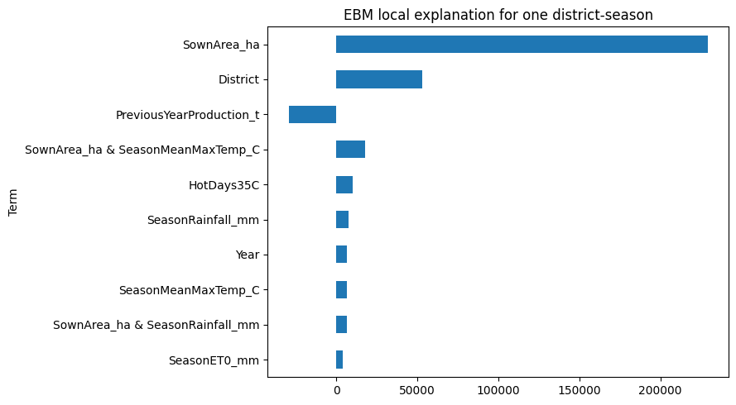
08 | LOCAL EXAMPLE
EBM explains a large prediction error
AMPARA • MAHA • 2022
394,730 t
EBM predicted
221,529 t
Actually recorded
+173,201 t
Overestimate
IT5514 • W.D.N. De Silva • 269096C
09
Notes:
For the selected Ampara Maha 2022 record, EBM predicted about 394,730 tonnes, but actual production was 221,529 tonnes. That is an overestimate of more than 173,000 tonnes. EBM’s explanation shows sown area contributing about 229,129 tonnes above baseline while previous-year production reduces the estimate. This makes the reason for the error easier to inspect, but an explanation does not make the prediction accurate.

Slide 10
09 | CRITICAL DISCUSSION
Limitations and responsible use
Data provenance
Link each combined row to DCS source tables and the weather extraction method.
Group reliability
EBM errors were larger in 2022 and Maha; some district groups have only four test records.
Forecast timing
Complete-season weather makes this an end-of-season estimate, not a before-sowing prediction.
Ethical use
Do not use this prototype alone for resource or farmer-level decisions.
IT5514 • W.D.N. De Silva • 269096C
10
Notes:
There are four main limitations. First, the exact combined-data extraction steps need stronger documentation. Second, performance is less reliable in some years, seasons and districts; EBM error was especially high for 2022 and Maha. Third, complete-season weather means this is not a before-sowing forecast. Finally, this prototype should not be used as the sole basis for decisions affecting farmers or agricultural resources.

Slide 11
10 | TAKEAWAYS
Conclusion and demonstration
VALIDATION CHOICE
BEST OBSERVED TEST
INTERPRETABLE FOCUS
XGBoost
Random Forest
EBM
11,440 t mean CV MAE
23,945 t MAE
27,668 t test MAE
EBM adds understandable global and local explanations, but accuracy and data quality still matter.
IT5514 • W.D.N. De Silva • 269096C
11
Notes:
In conclusion, XGBoost was best on chronological validation, while Random Forest had the lowest test MAE. EBM did not lead accuracy, but it gave easily understandable feature-level explanations. In my demo I would open the Streamlit application, select EBM, enter district and seasonal agricultural/weather values, view the predicted harvest and then compare all five models. Thank you.

