Slide 1
ELLIS SUMMER SCHOOL AI4RESEARCH
Trust the data? – Agentic Quality Control for Scientific Research
A Case Study of Inattentive Responding in Behavioral Science
Shamima Hossain, Ritesh Moon, Yuheng Zhao, Alexandra Zienkiewic, Mikaela Akrenius

Slide 2
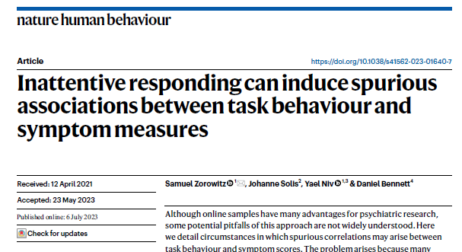
01
Background
Problem: detecting spurious correlations caused by inattentive participants in online data on human subjects
Target paper: Zorowitz et al. (2023)
–
reinforcement learning task measures x psychiatric survey measures
–
detecting and eliminating inattentive participants using task- and survey-based data quality metrics
Research question: Can a LLM recognize and exclude the same participants based on statistical information alone – without information from the paper?
Method: simple prompt + subsets of data
–
measures only + trial-level task data + trial-level survey data + both + metrics from from paper
ZOROWITZ ET AL. (2023)

Slide 3
02
Methods
One prompt, one fixed correlation table, five levels of evidence. Only what the agent can learn about data quality changes.
PIPELINE
FIVE CONDITIONS
1
Prompt
EVIDENCE ADDED
WHAT IT ALLOWS
63 Spearman correlations, two-sided, p < 0.05, uncorrected. Plus: exclude subjects that induce spurious correlations.
TEST 1
—
nothing to judge quality with
↓
Agent
TEST 2
task
accuracy, response times
2
Writes and executes its own Python. Free to inspect, revise, and re-run; nothing about the order is fixed.
TEST 3
survey
per-item responses
↓
TEST 4
task + survey
both proxies
3
Trace
9 fields per step: phase, thought, action, observation, error, revision trigger, confidence, id, timestamp.
TEST 5
+ metrics
the study's own attention checks
↓
Score
Difficulty falls from TEST 1 to TEST 5. TEST 1 has no basis for exclusion at all — declining to exclude is the correct answer there.
4
Compared against a deterministic reference analysis, and against what the agent's own conclusion claimed.
Controls
Correlations always run on the same 386-subject table, so n is identical in every condition · the study's own attention-check labels are held out and used only to score exclusions · the reference analysis is deterministic (scipy), no model involved.

Slide 4
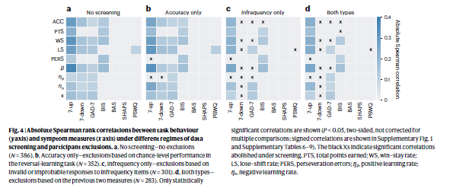
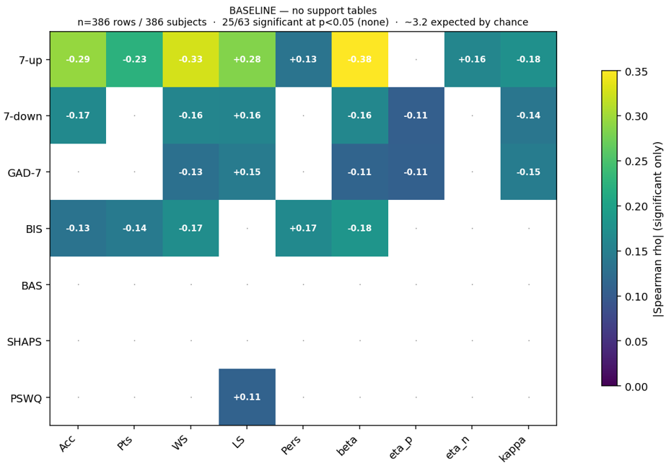
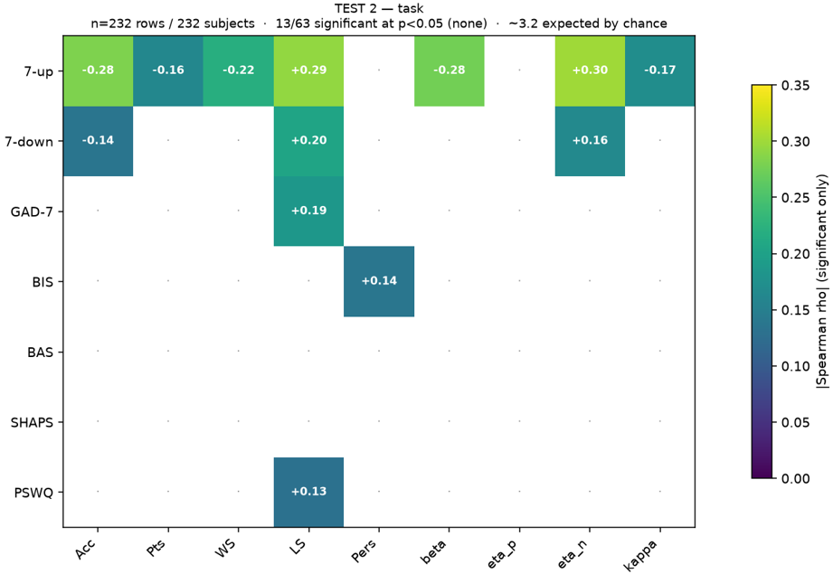
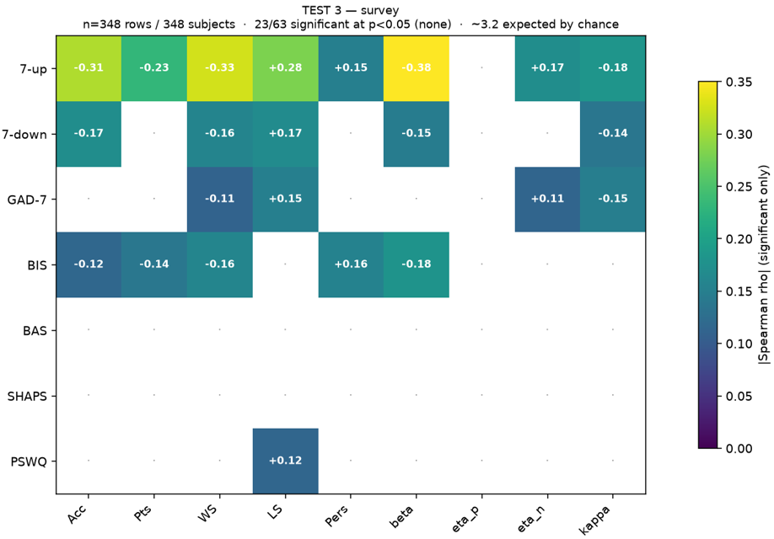
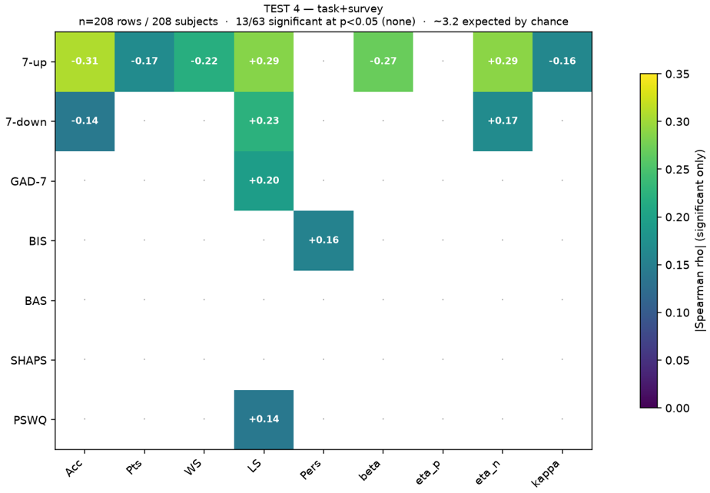
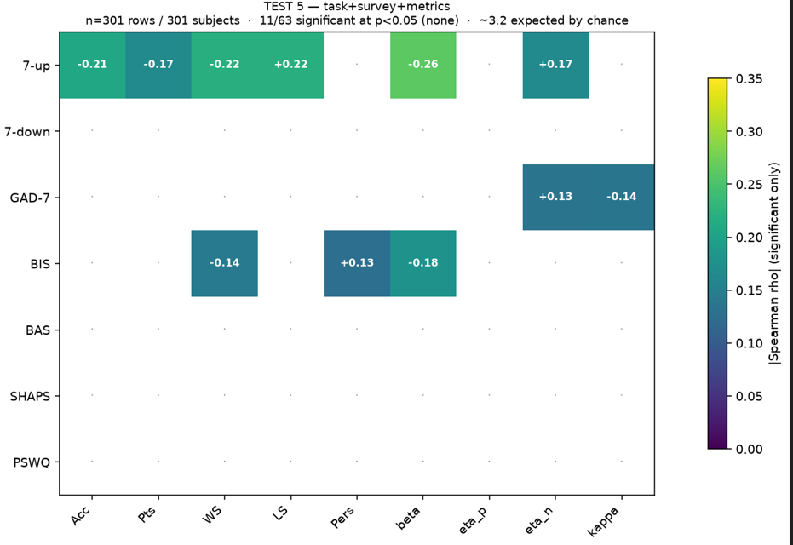
03
REFERENCE — PAPER
Results
OURS — FIVE DATA CONDITIONS
BASELINE
TEST 2
TEST 3
TEST 4
TEST 5
Main results
Next steps
–
As expected, LLM needed more than summary information from the data to exclude participants
–
Ground truth – paper, AI, or something else?
–
What kinds of processes did the LLM engage in and what information did it use
–
As in paper, trial-level information from survey was more useful than trial-level information from task, and best results were achieved using both
–
Repeating process for other data reliability problems
–
When LLM was given exclusion metrics used in the paper it made more exclusions than the paper
–
Developing tool for research and/or deriving insight for research
Significance: increasing data quality -> more accurate results -> better real-world application

