Slide 1
Trust the data? – Agentic Quality Control for Scientific Research
A Case Study of Inattentive Responding in Behavioral Science
Data Guardians
Shamima Hossain, Ritesh Moon, Yuheng Zhao, Alexandra Zienkiewic, Mikaela Akrenius
ELLIS Summer School AI4Research

Slide 2
Background
In the 21st century, a plethora of sciences ranging from business and economics to experimental psychology and psychiatry rely on information gathered through online experiments
Benefits of online studies: At its best, online experiments can provide a way to collect data from hundreds of participants in a few hours or days whereas in the past it took weeks or months + gives access to participants from more diverse populations (e.g., undergrad students vs. participants from any country, profession, age group)
Main issue: data quality, leading to false conclusions
Participants multitask, get distracted -> inattention to experiment/survey -> inflated correlations, false negatives and positives
Participants maximize reward for completing a larger number of tasks more quickly instead of providing good quality data
Participants misunderstand instructions
These conclusions can be fatal in e.g., psychiatry
Assessing data quality without interacting with participants is difficult
Current state of the art: attention checks, task-based quality measures (e.g., accuracy), following threads on participant forums, developing statistical tools for specific experimental settings -> slow process whereas data collection needs to be fast and participant strategies change quickly
Excluding participants from a study requires sturdy, pre-defined criteria
We need a fast, automated, justified process for detecting participants that provided poor quality data

Slide 3
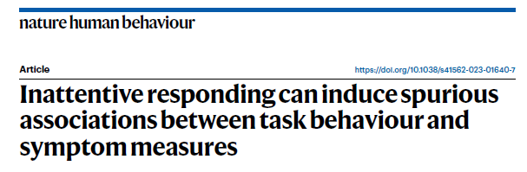
Target Paper
Spurious correlations between poor task performance and symptom measures
Task measures: descriptive + model-based measures of performance in reinforcement learning task
Symptom measures: scales assessing psychiatric symptoms (e.g., depression, anxiety, worry)
Earlier work aimed to detect these based on task performance (e.g., accuracy) alone
Authors introduce novel measures based on responses in survey measures (e.g., coherence)

Slide 4
Hypothesis and Baseline for AI
The conditions for creating spurious correlations and presence of inattentive participants are also reflected in statistical properties of the data (e.g., skewed distributions, shifted means, outliers)
Could AI use baseline statistical properties of the data to trace the same participants that the researchers did using red flag heuristics?
Could AI be used more generally for tracing unreliable participants and/or results based on statistical information that humans did not take a look at?

Slide 5
Methods
Task: 63 Spearman correlations, 7 symptom scales x 9 task measures
two-sided, p < 0.05, deliberately uncorrected (~3 false positives expected by chance)
test prompt adds one sentence: exclude subjects that appear to induce spurious correlations
Agent writes and executes its own Python
no fixed tool menu — it inspects, revises and re-runs; the path it takes is a result, not a setting
Every step recorded as a 9-field trace
phase, thought, action, observation, error, revision trigger, confidence, id, timestamp
Five conditions — the prompt never changes, only the evidence available for judging quality
TEST 1 nothing · TEST 2 task data · TEST 3 survey data · TEST 4 both · TEST 5 + the paper's quality metrics
TEST 1 has no basis for exclusion at all — declining to exclude is the correct answer
Controls
correlations always run on the same 386-subject table, so n is identical in every condition
the paper's attention-check labels are held out and used only to score exclusions afterwards
reference analysis is deterministic (scipy) — scored against it, and against what the agent itself claimed

Slide 6
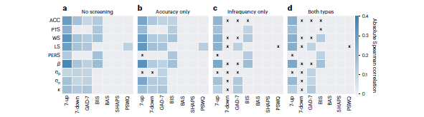
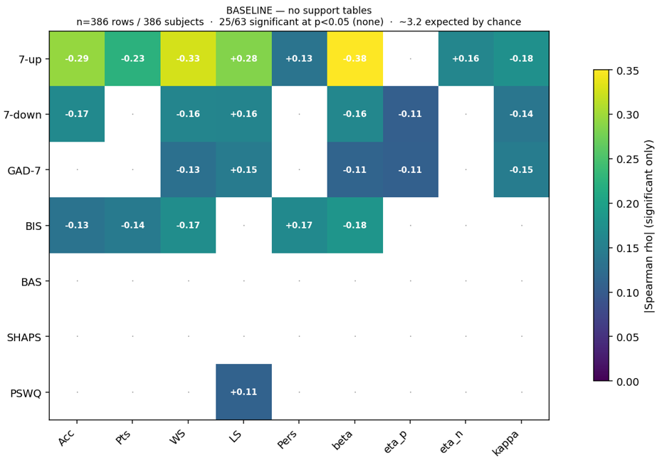
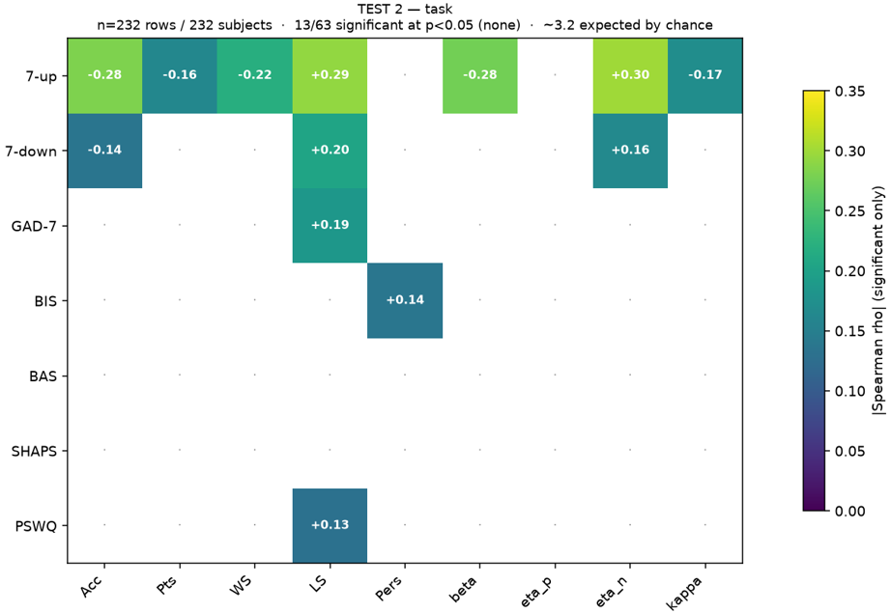
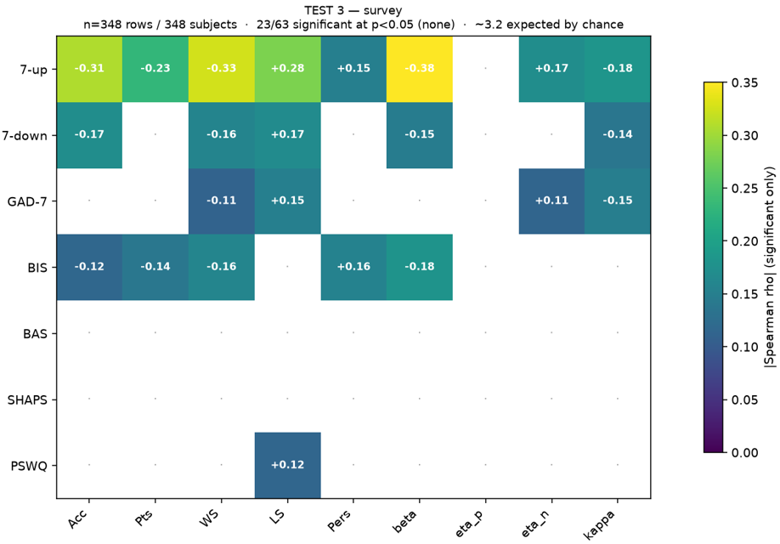
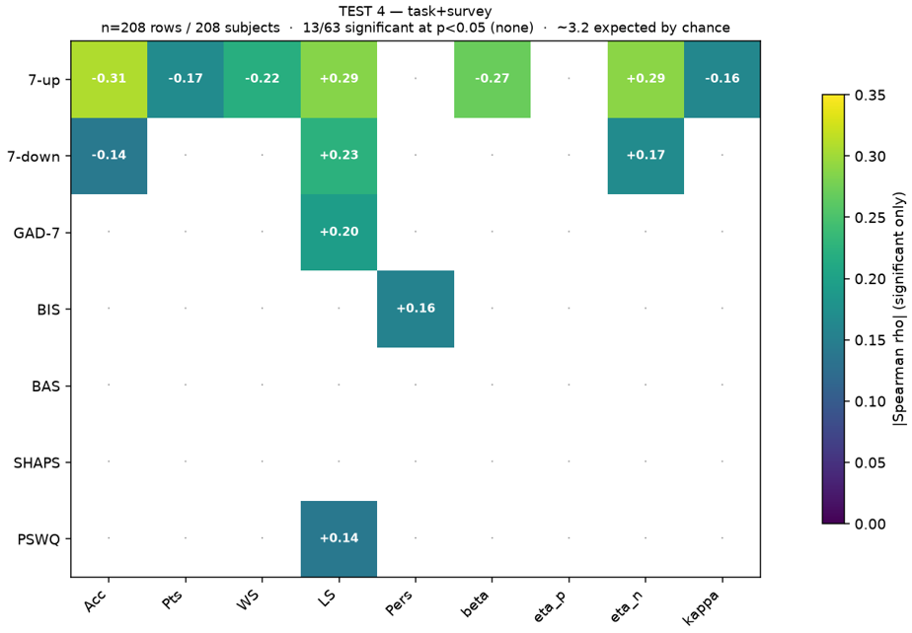
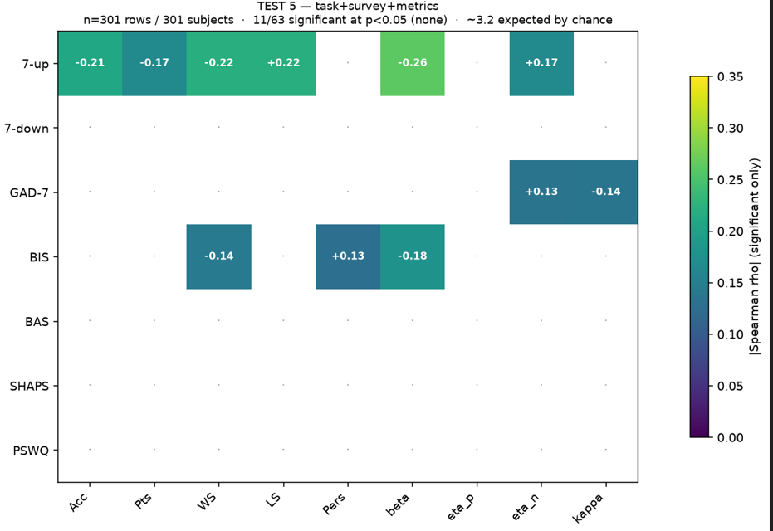
Aggregate Results

Slide 7
Results
Main results
As expected, LLM needed more than summary information from the data to exclude participants
As in paper, trial-level information from survey was more useful than trial-level information from task, and best results were achieved using both
When LLM was given exclusion metrics used in the paper it made more exclusions than the paper
Next steps
Ground truth – paper, AI, or something else?
What kinds of processes did the LLM engage in and what information did it use
Repeating process for other data reliability problems
Developing tool for research and/or deriving insight for research
Significance: increasing data quality -> more accurate results -> better real-world applications

Slide 8
Significance

