Slide 1
AI for Research Using AI to Identify Spurious Correlations in Human Subject Data Improving Data Quality Using AI Using LLMs to …
Shamima Hossain, Ritesh Moon, Yuheng Zhao, Alexandra Zienkiewic, Mikaela Akrenius
ELLIS Summer School AI4Research

Slide 2
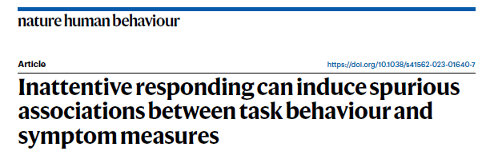
Background
Problem: detecting spurious correlations caused by inattentive participants in online data on human subjects
Target paper: Zorowitz et al. (2023)
reinforcement learning task measures x psychiatric survey measures
detecting and eliminating inattentive participants using task- and survey-based data quality metrics
Research question: Can a LLM recognize and exclude the same participants based on statistical information alone – without information from the paper?
Method: simple prompt + subsets of data
measures only + trial-level task data + trial-level survey data + both + metrics from from paper

Slide 3
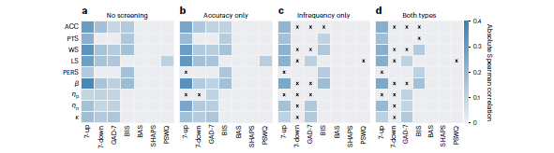
Results
Tables here from paper + from AI
Main comparison result (what’s different, same, better, worse)
Main internal result (paper vs. AI – improvement across conditions)
Processes: what humans did vs. what AI did
Future prospects: what to look at next, what to build upon
Significance: usefulness, applications, benefits

