Slide 1
DATA GUARDIANS
Trust the data? – Agentic Quality Control for Scientific Research
A Case Study of Inattentive Responding in Behavioral Science
Shamima Hossain, Ritesh Moon, Yuheng Zhao, Alexandra Zienkiewic, Mikaela Akrenius
ELLIS Summer School AI4Research

Slide 2
01
Background
In the 21st century, a plethora of behavioral sciences rely on information gathered through online experiments
Benefits:
–
fast data collection, larger samples
–
participants from more diverse populations
Main issue: data quality, leading to false conclusions
–
Participants multitask, get distracted -> inattention to experiment/survey -> inflated correlations, false negatives and positives
–
Participants maximize reward for completing a larger number of tasks more quickly instead of providing good quality data
–
Participants misunderstand instructions
Assessing data quality without interacting with participants is difficult
Current state of the art: attention checks, task-based quality measures (e.g., accuracy), following threads on participant forums, developing statistical tools for specific experimental settings -> slow process whereas data collection needs to be fast and participant strategies change quickly
Excluding participants from a study requires sturdy, pre-defined criteria
We need a fast, automated, justified process for detecting participants that provided poor quality data

Slide 3
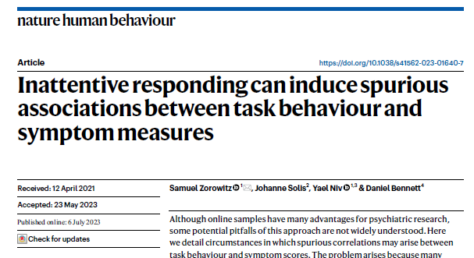
02
Target Paper
Spurious correlations between poor task performance and symptom measures
Task measures: descriptive + model-based measures of performance in reinforcement learning task
Symptom measures: scales assessing psychiatric symptoms (e.g., depression, anxiety, worry)
Earlier work aimed to detect these based on task performance (e.g., accuracy) alone
Authors introduce novel measures based on responses in survey measures (e.g., coherence)
ZOROWITZ ET AL. (2023)

Slide 4
03
Hypothesis and Baseline for AI
01
The conditions for creating spurious correlations and presence of inattentive participants are also reflected in statistical properties of the data (e.g., skewed distributions, shifted means, outliers)
02
Could AI use baseline statistical properties of the data to trace the same participants that the researchers did using red flag heuristics?
03
Could AI be used more generally for tracing unreliable participants and/or results based on statistical information that humans did not take a look at?

Slide 5
04
Methods
PIPELINE
FIVE CONDITIONS
1
Prompt
The prompt never changes. Only the evidence available for judging quality.
63 Spearman correlations, 7 symptom scales x 9 task measures. Two-sided, p < 0.05, deliberately uncorrected. The test prompt adds one sentence: exclude subjects that induce spurious correlations.
TEST 1
—
no basis to exclude at all
↓
TEST 2
task
accuracy, response times
2
Agent
Writes and executes its own Python. No fixed tool menu -- it inspects, revises and re-runs, so the path it takes is a result, not a setting.
TEST 3
survey
per-item responses
↓
TEST 4
task + survey
both proxies
3
Trace
TEST 5
+ metrics
the paper's own attention checks
Nine fields per step: phase, thought, action, observation, error, revision trigger, confidence, id, timestamp.
↓
TEST 1 has no basis for exclusion — declining to exclude is the correct answer.
4
Score
Against a deterministic reference analysis, and against the agent's own conclusion -- did it do what it said it did?
Controls
Correlations always run on the same 386-subject table, so n is identical in every condition · the paper's attention-check labels are held out and used only to score exclusions · the reference analysis is deterministic (scipy), no model.

Slide 6
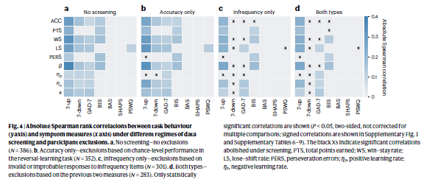
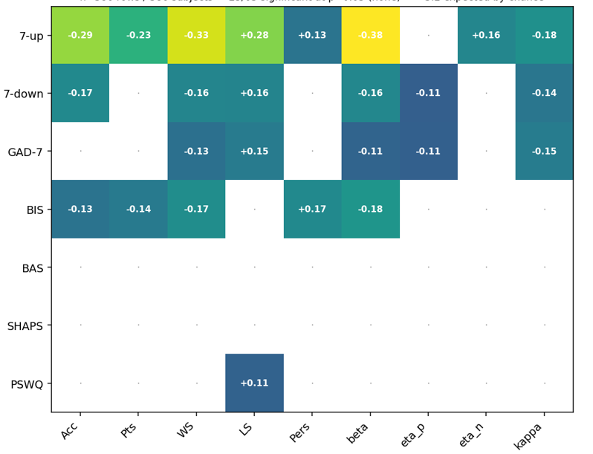
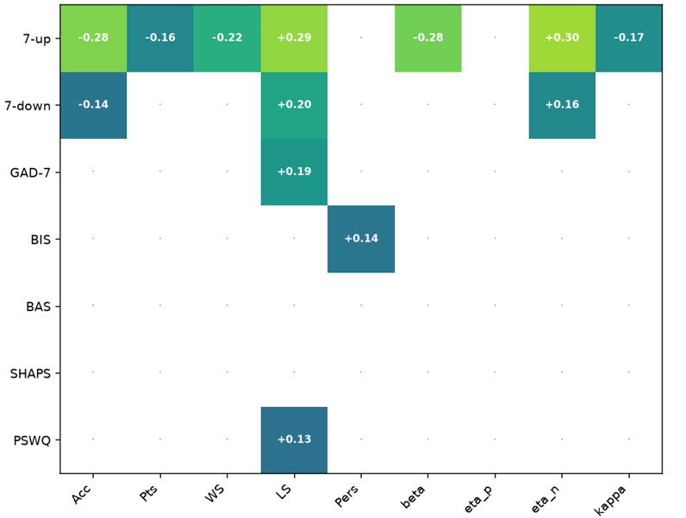
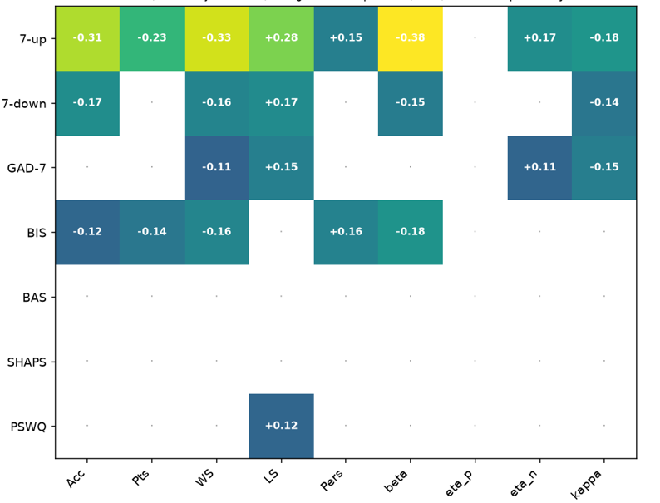
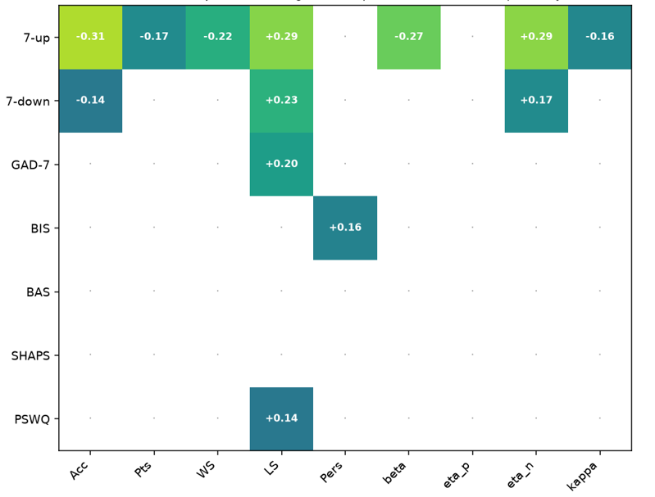
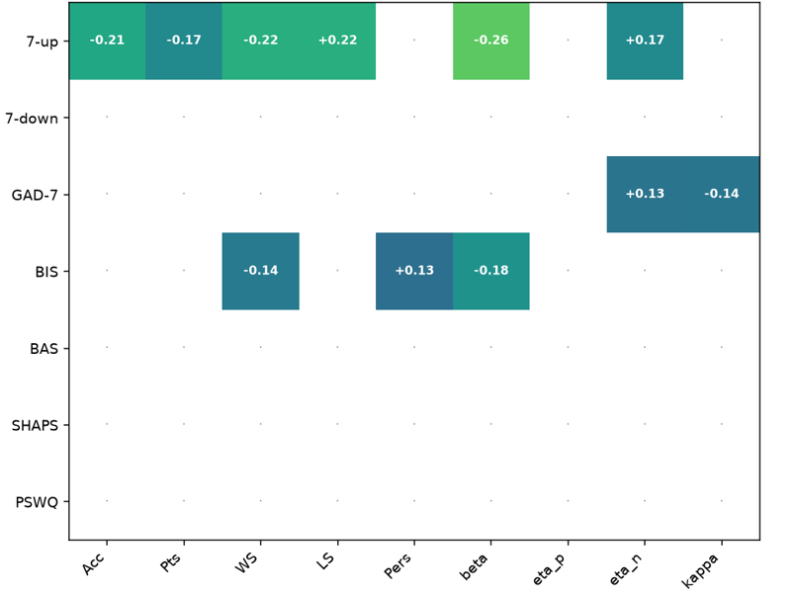
05
Aggregate Results
REFERENCE — ZOROWITZ ET AL.
The paper's own result: correlations that look significant under no screening largely vanish once inattentive participants are removed. Our five conditions reproduce that sweep while varying only how much evidence the agent has for spotting them.
OURS — SIGNIFICANT CORRELATIONS REMAINING
25/63
13/63
23/63
13/63
11/63
BASELINE
TEST 2
TEST 3
TEST 4
TEST 5
no screening
task
survey
task + survey
+ metrics
~3 of 63 are expected by chance. Excluding the 85 who failed an attention check leaves 11 — fourteen findings do not survive quality control.

Slide 7
06
Results
Main results
Next steps
–
As expected, LLM needed more than summary information from the data to exclude participants
–
Ground truth – paper, AI, or something else?
–
What kinds of processes did the LLM engage in and what information did it use
–
As in paper, trial-level information from survey was more useful than trial-level information from task, and best results were achieved using both
–
Repeating process for other data reliability problems
–
When LLM was given exclusion metrics used in the paper it made more exclusions than the paper
–
Developing tool for research and/or deriving insight for research

Slide 8
07
Significance
Better participants, better science – more reliable results and applications

