Slide 1
Trust the data? – Agentic Quality Control for Scientific Research
A Case Study of Inattentive Responding in Behavioral Science
Shamima Hossain, Ritesh Moon, Yuheng Zhao, Alexandra Zienkiewic, Mikaela Akrenius
ELLIS Summer School AI4Research

Slide 2
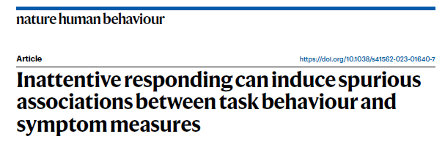
Background
Problem: detecting spurious correlations caused by inattentive participants in online data on human subjects
Target paper: Zorowitz et al. (2023)
reinforcement learning task measures x psychiatric survey measures
detecting and eliminating inattentive participants using task- and survey-based data quality metrics
Research question: Can a LLM recognize and exclude the same participants based on statistical information alone – without information from the paper?
Method: simple prompt + subsets of data
measures only + trial-level task data + trial-level survey data + both + metrics from from paper

Slide 3
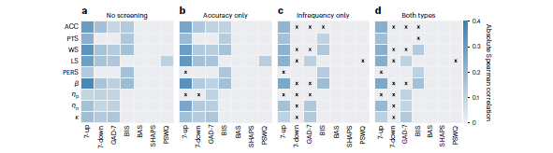
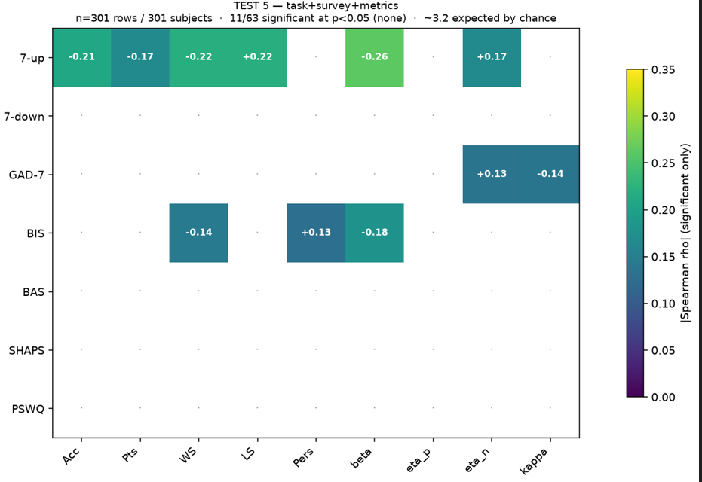
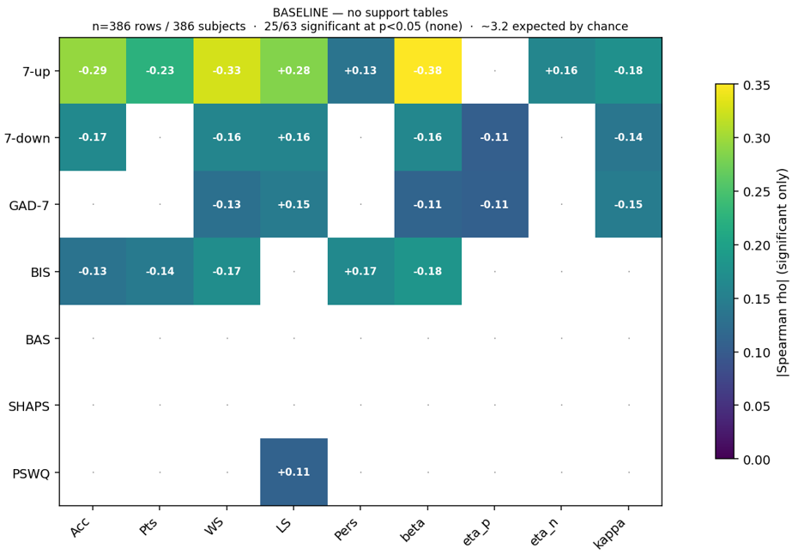
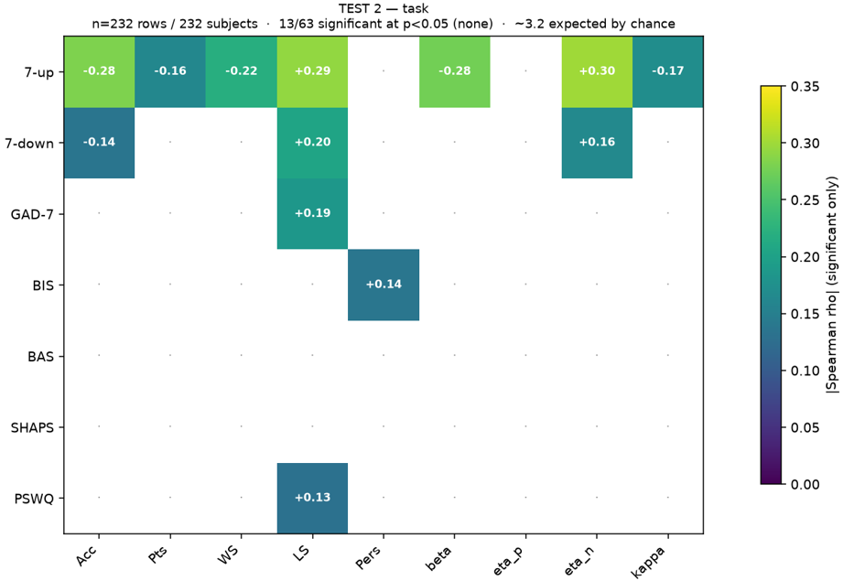
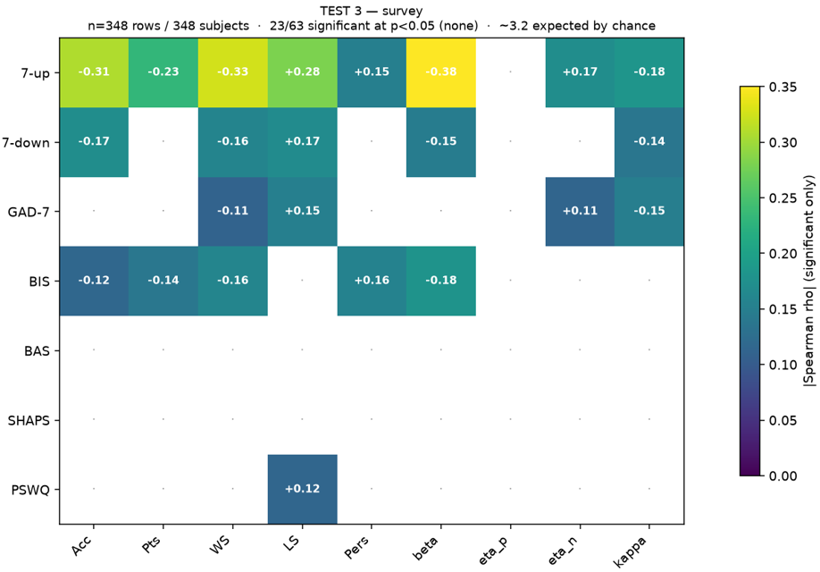
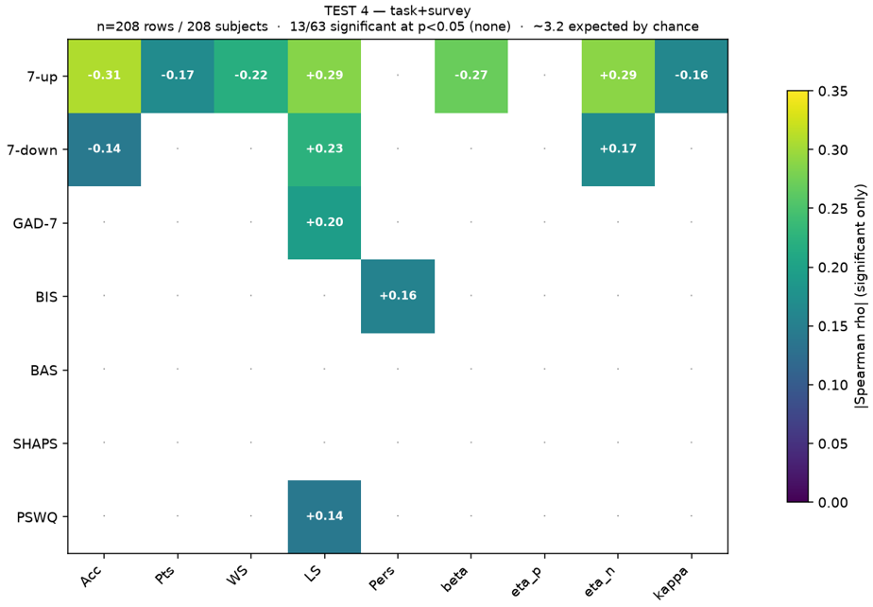
Results
Main results
As expected, LLM needed more than summary information from the data to exclude participants
As in paper, trial-level information from survey was more useful than trial-level information from task, and best results were achieved using both
When LLM was given exclusion metrics used in the paper it made more exclusions than the paper
Next steps
Ground truth – paper, AI, or something else?
What kinds of processes did the LLM engage in and what information did it use
Repeating process for other data reliability problems
Developing tool for research and/or deriving insight for research
Significance: increasing data quality -> more accurate results -> better real-world application

