Slide 1
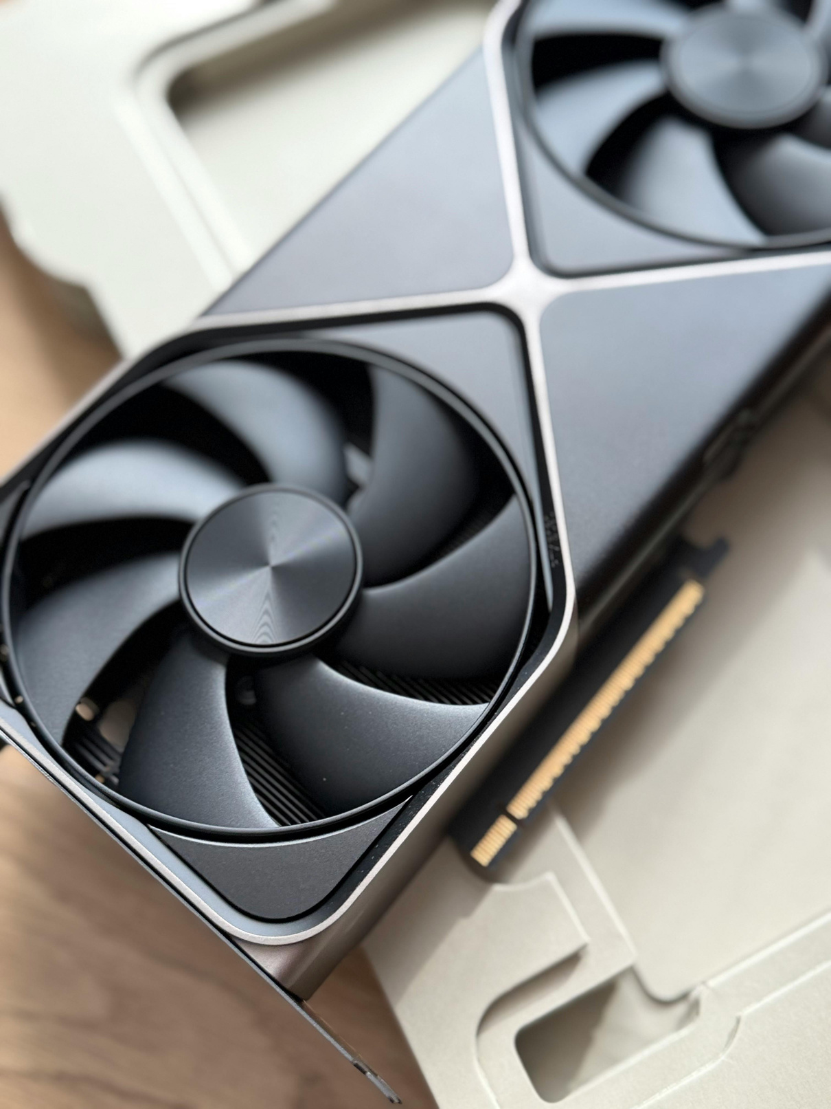

GPU-Accelerated Image Compression with Content-Aware Quality Mapping
Parallel & Distributed Computing Project
Team:
1) Aditya Chauhan - 102303130
2) Gaurang Garg - 102303134
3) Saksham Mittal - 102303135
Notes:
1

Slide 2



What is JPEG?
JPEG is fundamentally a compression algorithm, not a file format itself. The actual file formats such as JFIF and EXIF are merely wrappers that encapsulate the compressed data.
Lossy Compression
Perceptual Optimization
Data is intentionally discarded to reduce file size, unlike PNG or BMP which preserve all information
Exploits human visual system limitations to discard imperceptible information
Two Key Perceptual Limitations
01
02
Color Sensitivity
Frequency Perception
Humans are significantly less sensitive to fine color detail than to brightness variations
We struggle to perceive high-frequency intensity changes in images. We are physically incapable of noticing minute frequency changes
Three-Stage Pipeline
The JPEG compression pipeline consists of three main stages that work sequentially:
Color Space Conversion
transforms RGB to YCbCr, DCT + Quantization
DCT + Quantization
transforms spatial data to frequency domain and discards high-frequency components
Entropy Encoding
applies Huffman coding for final lossless compression.
Notes:
2

Slide 3
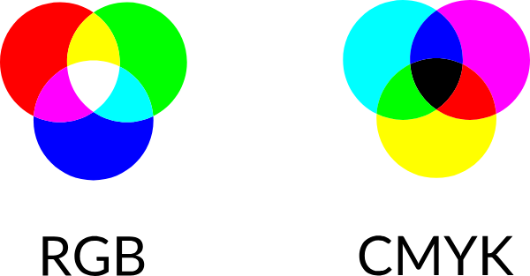

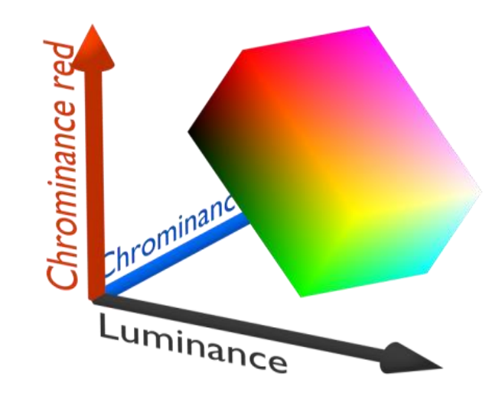


Color Spaces
Understanding different color representations is critical for JPEG compression, as the algorithm relies on separating luminance from chrominance information.
RGB: Additive Model
Used by monitors and displays. Adding Red + Green + Blue = white light. Each channel ranges from 0-255 intensity values.
CMYK: Subtractive Model
Used by printers. Adding inks makes the image darker. 'K' (black) exists because mixing Cyan + Magenta + Yellow produces muddy brown, not true black.
YCbCr: Luminance-Chrominance
Used in TV broadcast and video. Separates luminance (Y = brightness/grayscale) from chrominance (Cb = blueness, Cr = redness). Critical for JPEG chroma downsampling.
YCbCr
Notes:
3

Slide 4
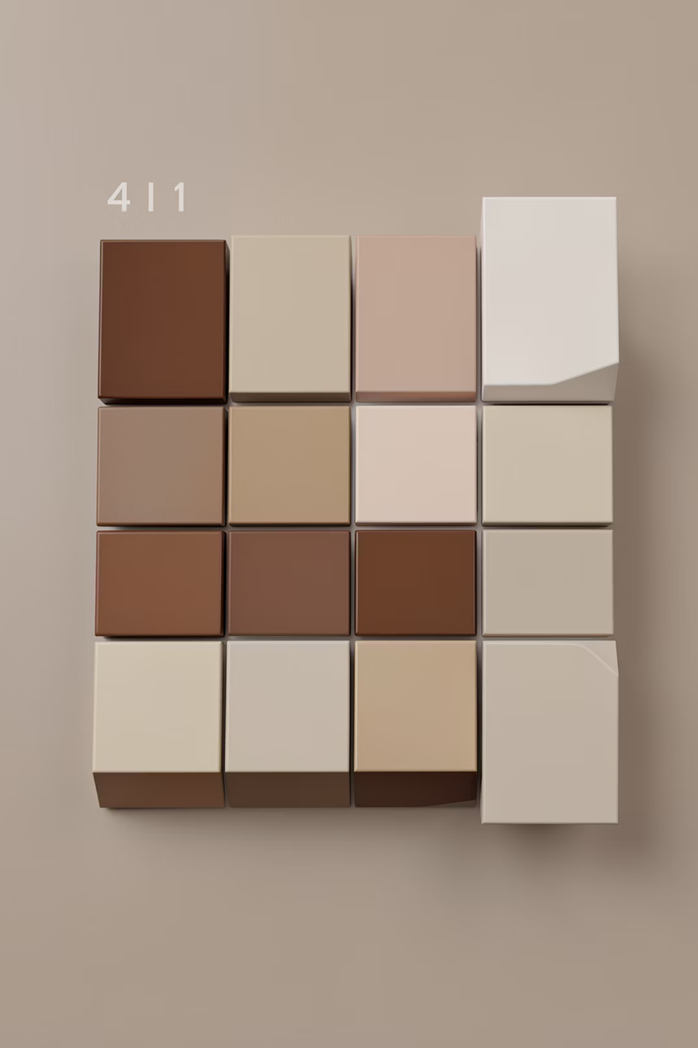



Chroma Downsampling
The first step in JPEG compression converts from RGB to YCbCr color space. This transformation is essential because the human eye resolves brightness (luminance) at far higher resolution than color (chrominance).
RGB → YCbCr
Color space conversion separates brightness from color information
Downsample Cb, Cr
Chroma channels downsampled by factor of 2 in both dimensions
Full Y Resolution
Luminance kept at full resolution for visual quality
This step alone reduces color data by 4× before any DCT is applied, dramatically shrinking file size with minimal perceptual quality loss. Higher quality settings reduce the amount of downsampling applied.
Key Insight
Human vision prioritizes brightness over color detail, making chroma downsampling highly effective
Notes:
4

Slide 5

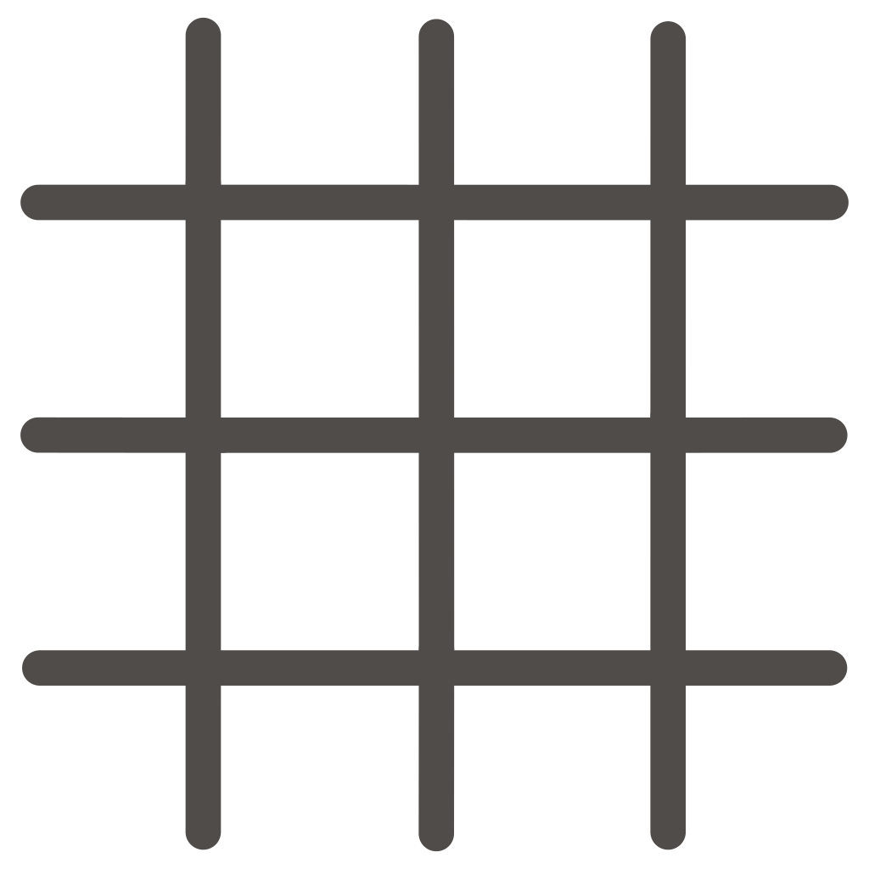
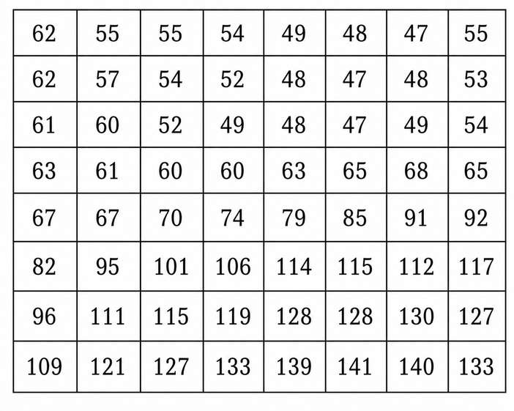
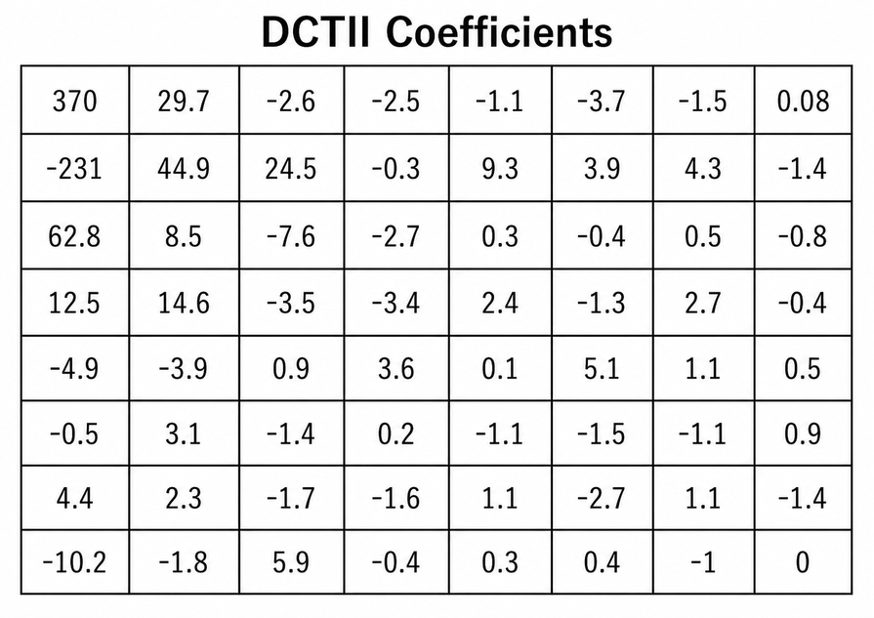

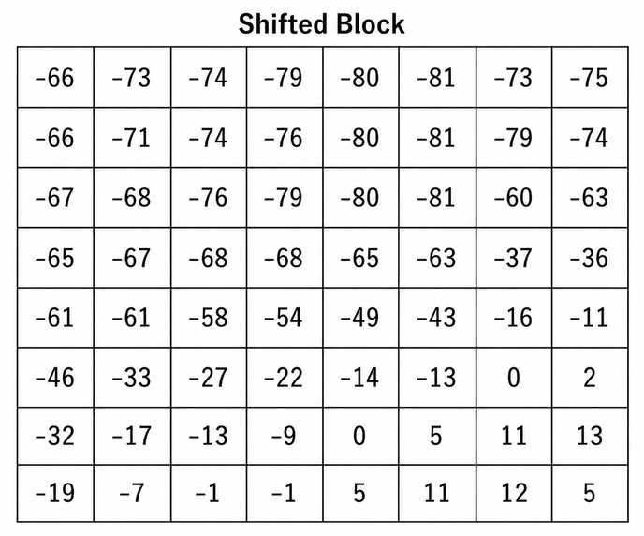
Discrete Cosine Transform
Step 3: Coefficient Calculation
The DCT transforms image data from the spatial domain into the frequency domain, enabling efficient compression by separating important low-frequency information from discardable high-frequency details.
DCT computes coefficients representing frequency component magnitudes.
The 8×8 block of pixels becomes an 8×8 block of coefficients. Top-left = DC (average brightness). As you move right/down, frequency increases.
Step 1: Pick an 8×8 block from your image
Step 2: Subtract 128 (center around zero)
Low-frequency coefficients (top-left) carry most visual energy and remain intact. High-frequency coefficients (bottom-right) are usually small and often discarded during quantization, representing fine details imperceptible to human vision.
Notes:
5

Slide 6
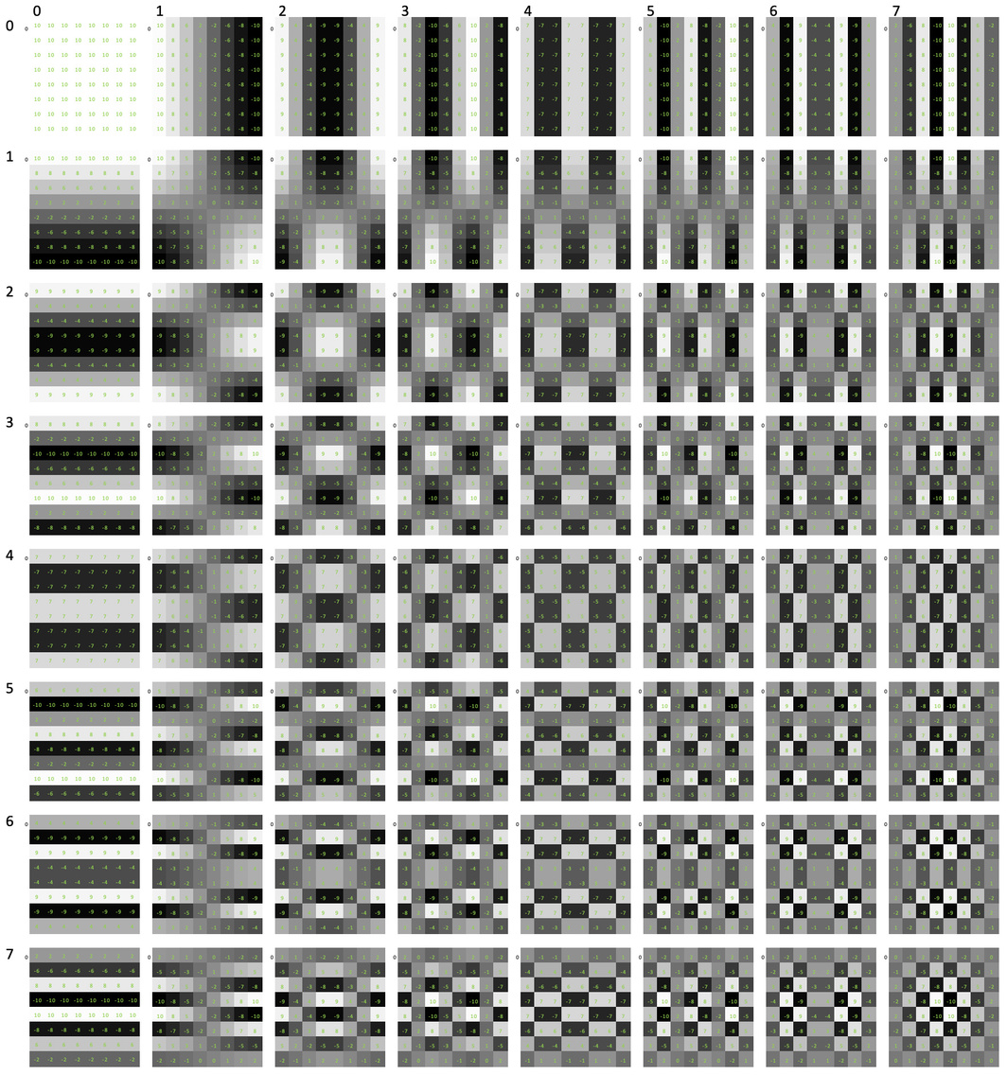
What this shows :
Each small block is a DCT basis function (filter)
Used to transform image data from spatial domain → frequency domain

Slide 7
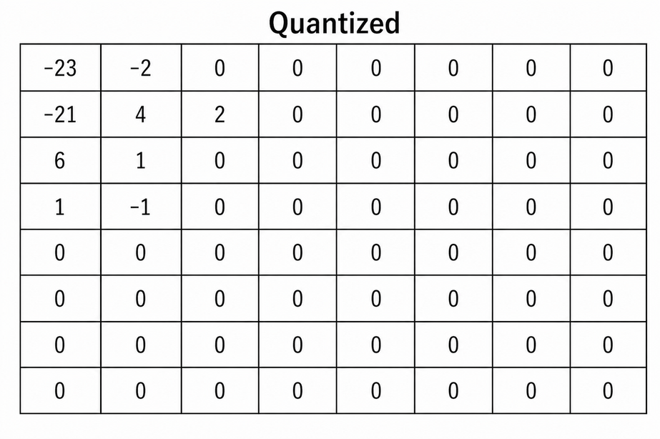
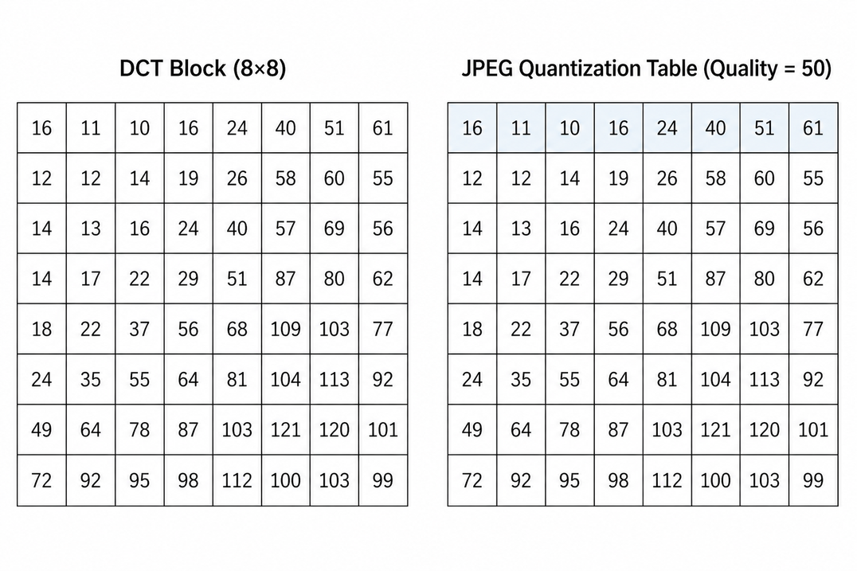
Quantization & Entropy Encoding
1
Quantization
2
Data Loss
Each DCT coefficient divided by quantization table value and rounded to nearest integer
High-frequency coefficients rounded to zero—this is where actual data loss occurs
3
Zig-Zag Scan
Remaining coefficients serialized in zig-zag pattern to cluster zeros together
4
Huffman Encoding
Decompression Pipeline
Quality Control
Lossless compression applied to coefficient stream for final bit reduction
Multiply by quantization table
Apply Inverse DCT
Reconstruct pixels
Quality setting controls quantization table values: higher quality = smaller divisors = more coefficients survive
Notes:
6

Slide 8
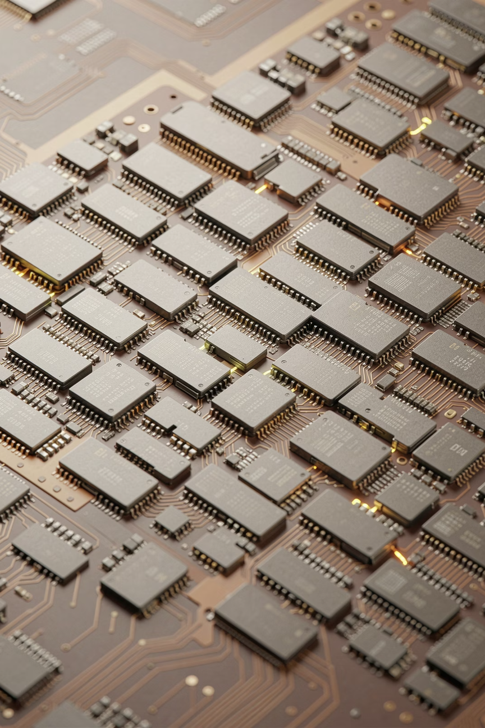
Why Parallelize Image Compression?
JPEG compression represents a classic data-parallel workload perfectly suited for GPU acceleration. Each 8×8 block in JPEG is completely independent—no block depends on another for DCT or quantization operations.
Massive Parallelism
GPU Advantage
A 4K image contains approximately 1,40,000 8×8 blocks, ideal for simultaneous processing
Thousands of GPU cores process all blocks simultaneously rather than sequentially
CPU Limitation
Single-threaded CPU processes blocks one at a time, creating sequential bottleneck
~100% Parallelizable Fraction
Amdahl's Law states that speedup is limited by the sequential portion of a program — even 5% serial work caps your speedup at 20×, regardless of core count.
In JPEG compression, the only serial work is one-time setup: loading the image and uploading DCT/quantization tables to GPU memory. The actual compression across all 8×8 blocks is fully parallel — no thread ever waits on another.
This makes JPEG one of the best real-world cases for GPU acceleration.
Notes:
7

Slide 9
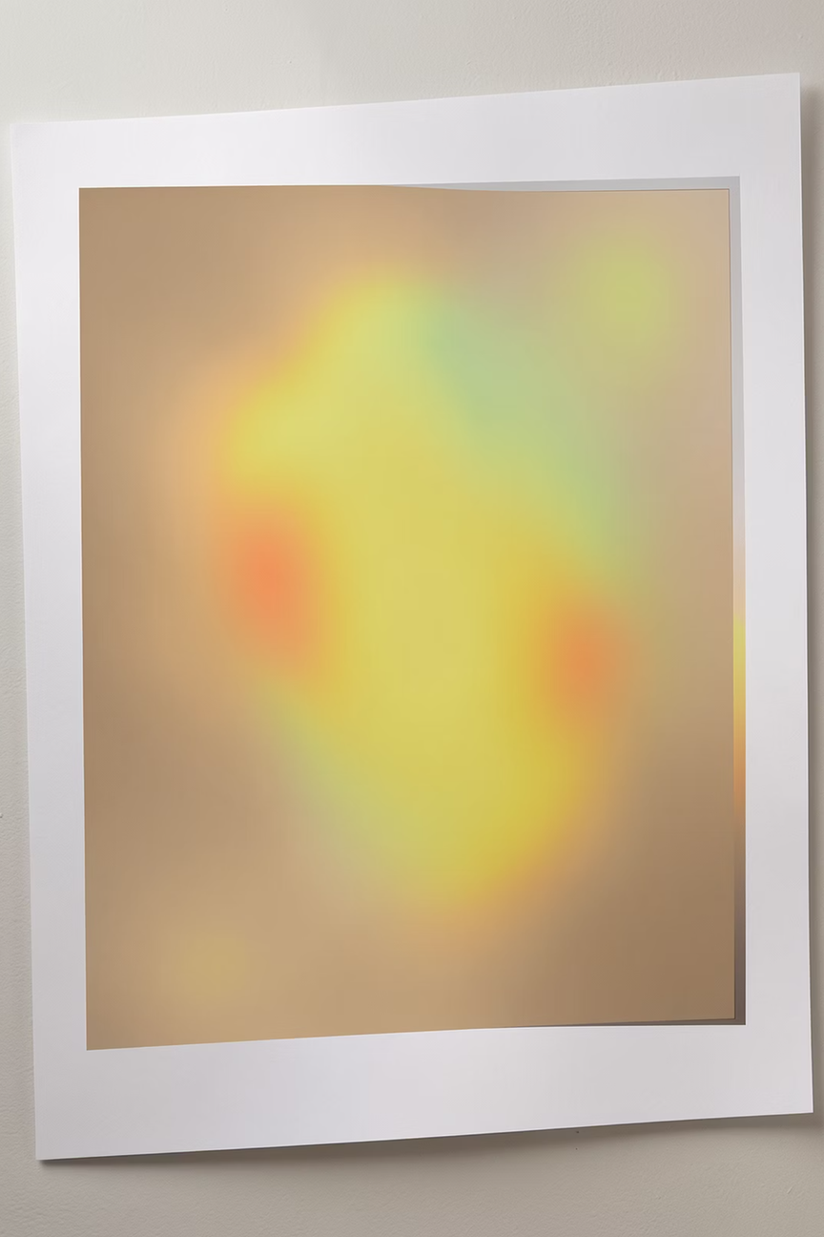
Content-Aware Quality Mapping
Our project extends standard JPEG with saliency-based quality mapping, applying variable compression levels across different image regions based on visual importance.
01
Standard JPEG Limitation
Single quality level applied uniformly across entire image
02
Saliency Detection
Compute per-block importance from local contrast and luma variance
03
Quality Scaling
Important regions receive higher quality, background gets more compression
04
Perceptual Gain
Same file size with better quality, or smaller file with same apparent quality
Implementation
Result
Per-block quality scales computed from importance map and applied before quantization step
Content-aware compression improves perceptual quality at reduced bitrates
Notes:
8

Slide 10
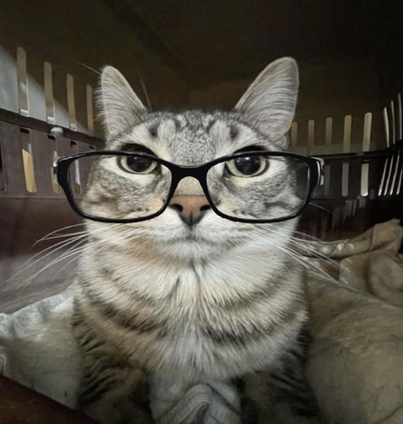

GPU CUDA Kernel & Performance Results
Thread Block Size
Grid Dimensions
8×8 threads maps exactly to one JPEG block
(image_width/8) × (image_height/8) blocks processes every block in parallel
Shared Memory
Constant Memory
8×9 float arrays (+1 padding avoids bank conflicts)
DCT matrix (T), transpose (Tt), quantization table (d_qLuma) uploaded once, broadcast to all threads
GPU vs CPU — Benchmark Results
Metric
GPU
CPU
Compression time (test image)
22.625 ms
138.928 ms
Speedup
6.140x
1x
Output quality (PSNR)
68.361
-
Quality map support
Yes
Yes
Both paths produce pixel-identical output verified via PSNR comparison. GPU advantage grows with image resolution as more blocks enable greater parallelism. Content-aware mode achieves same or better perceptual quality at reduced bitrate.
MrMeow.png
MrMeow.jpg(CPU)
MrMeow.jpg(GPU)
Notes:
10

Slide 11


