Slide 1
XAI
Neurosymbolic AI

Slide 2
Reference material
De Raedt, L. (2008). Logical and relational learning. Springer Science & Business Media.
Kautz, H. (2022). The third AI summer: AAAI Robert S. Engelmore memorial lecture. AI magazine, 43(1), 105-125.
Marra, G., Dumančić, S., Manhaeve, R., & De Raedt, L. (2024). From statistical relational to neurosymbolic artificial intelligence: A survey. Artificial Intelligence, 104062.

Slide 3
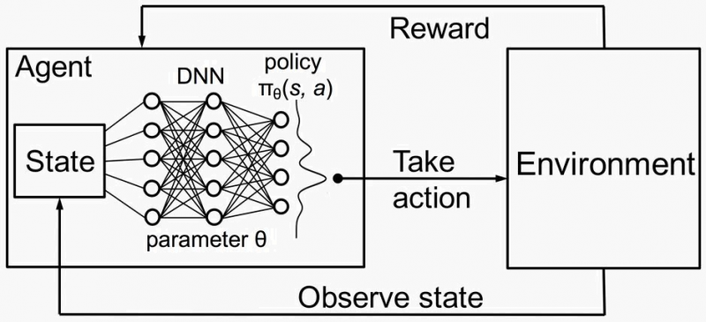
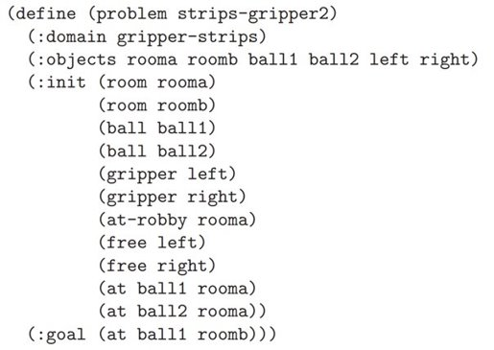
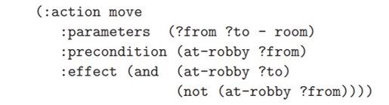
ILP for planning
room(room1;room2).
at(room1,0). closed_door(0).
move(A,B,T) :- at(A,T) room(B).
init(at(A),T) :- move(B,A,T-1).
term(at(A),T) :- move(A,B,T-1), A!=B.
at(A,T) :- init(at(A),T).
at(A,T) :- at(A,T-1), not term(at(A),T).
:- move(A,B,T), closed_door(T).
:- not at(room2,1). (GOAL AS CONSTRAINT)
ILP can learn policy specifications in a given logic programming formalism (e.g., ASP)

Slide 4


ILP for planning
Is this really ILP for planning?
  Offline ILP
  Policy explanations
  Can we do something more?
Dataset of state-action pairs

Slide 5
Reasoning while acting
reward
Agent
actions
Environment
Logical knowledge
observations

Slide 6
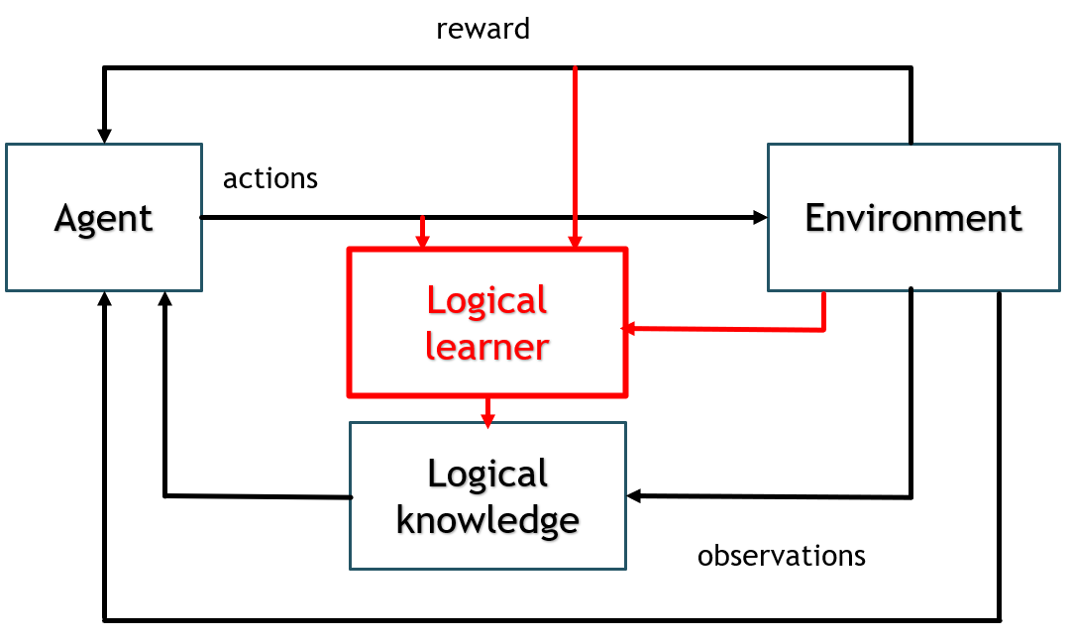
Learning while acting

Slide 7
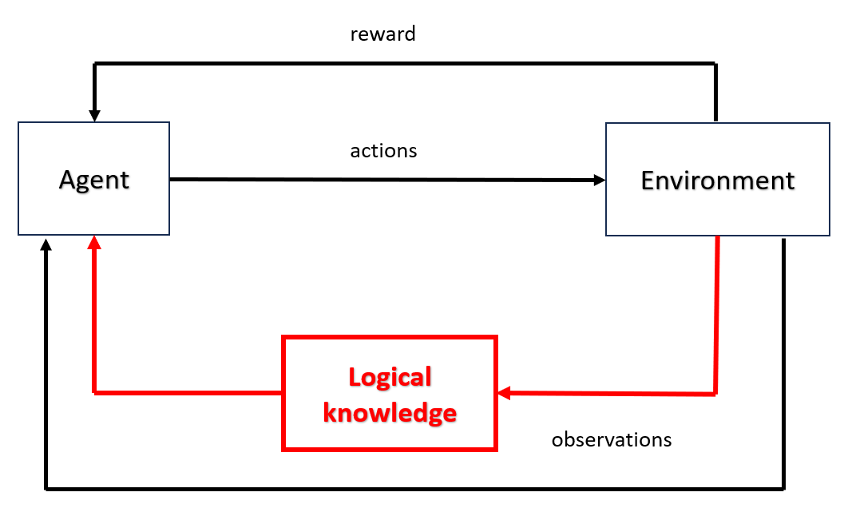
Logics for planning
Neurosymbolic AI for explainable planning and learning
  Explaining while acting
  Maybe planning better?

Slide 8
Neurosymbolic AI
How did we come to this?
3 summers (and winters) of AI
Kautz, H. (2022). The third AI summer: AAAI Robert S. Engelmore memorial lecture. Ai magazine, 43(1), 105-125.

Slide 9
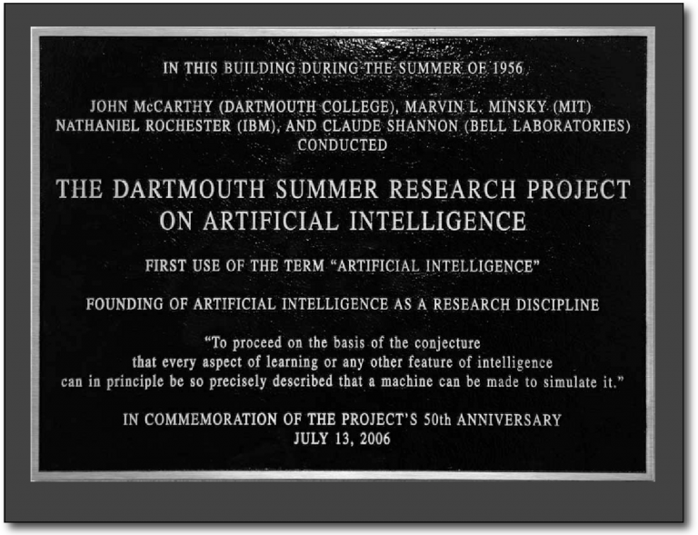
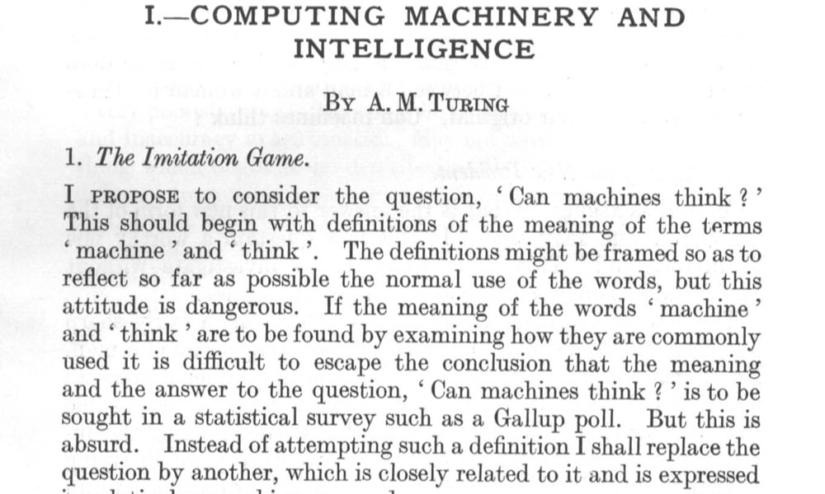
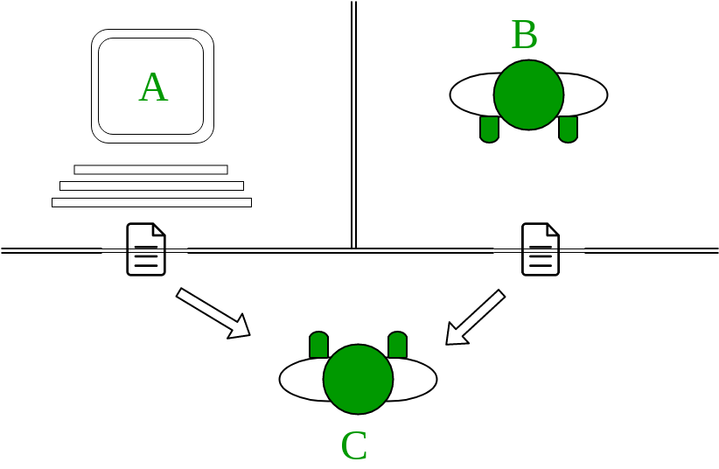
The first summer (1948-1966)
From computing to intelligent machines

Slide 10
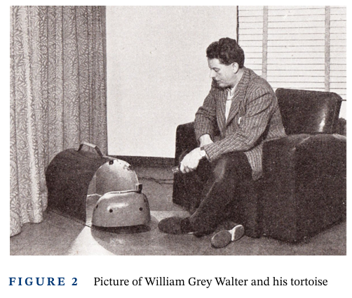
The first summer (1948-1966)
William Grey Walter studies connections between neural signals and the intention of actions
Walter, W. G., Cooper, R., Aldridge, V. J., McCallum, W. C., & Winter, A. L. (1964). Contingent negative variation: an electric sign of sensori-motor association and expectancy in the human brain. Nature, 203(4943), 380-384.
Uptake of ANNs
A physical neural artificial system

Slide 11
The first summer (1948-1966)
William Grey Walter studies connections between neural signals and the intention of actions
Walter, W. G., Cooper, R., Aldridge, V. J., McCallum, W. C., & Winter, A. L. (1964). Contingent negative variation: an electric sign of sensori-motor association and expectancy in the human brain. Nature, 203(4943), 380-384.
Uptake of ANNs
Uptake of logic-based AI
McCarthy, J. (1959). Programs with common sense.
Allen, J., Cohen, P., Cohen, R., Perrault, C. R., Reason, C., & Horrigan-Tozer, M. (1977). A computer model of conversation. ACM SIGART Bulletin, (61), 29-29.
A physical neural artificial system

Slide 12
The first winter (1967-1977)
Immature technology
Unmet promises from Dartmouth summer school
No more fundings from USA and UK

Slide 13
The second summer (1978-1987)
The advent of expert systems (vs. human experts)
Machines to boost production, medicine, etc.
The first AI tool for engineering: XCON
McDermott, J. P. (1980, August). RI: an Expert in the Computer Systems Domain. In AAAI (Vol. 1, pp. 269-271).
A language to enter programming rules as a non-programmer
  LISP
  Prolog

Slide 14
The second winter (1988-2011)
Commercial causes
  Trustability of AI (e.g., in medicine)
  Uptake of Unix systems (supporting LISP and Prolog)
Technical causes
  How to deal efficiently with probability and uncertainty?
  Too much background knowledge for expert systems
  How to learn?

Slide 15
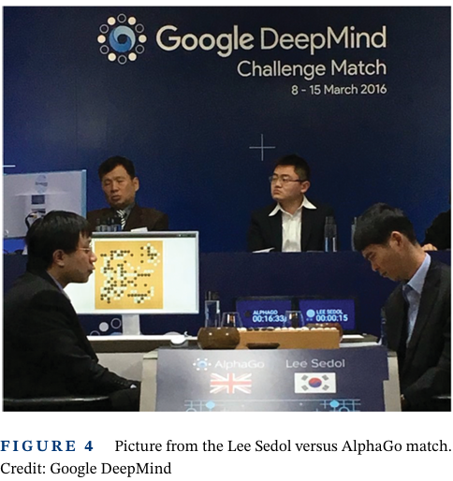
The third summer (2011-today)
The uptake of Deep Learning from imaging
DL captures some aspects of intelligence
  Concept similarity
  Representation learning (feature extraction)

Slide 16
A new winter for AI?
Probably not!
  AI is now involved in many real-world applications
  Commercial push will not stop

Slide 17
A new winter for AI?
Probably not!
  AI is now involved in many real-world applications
  Commercial push will not stop
Open challenges
  Privacy, trustworthyness, reliability, …
  Can modern AI replicate human intelligence?

Slide 18
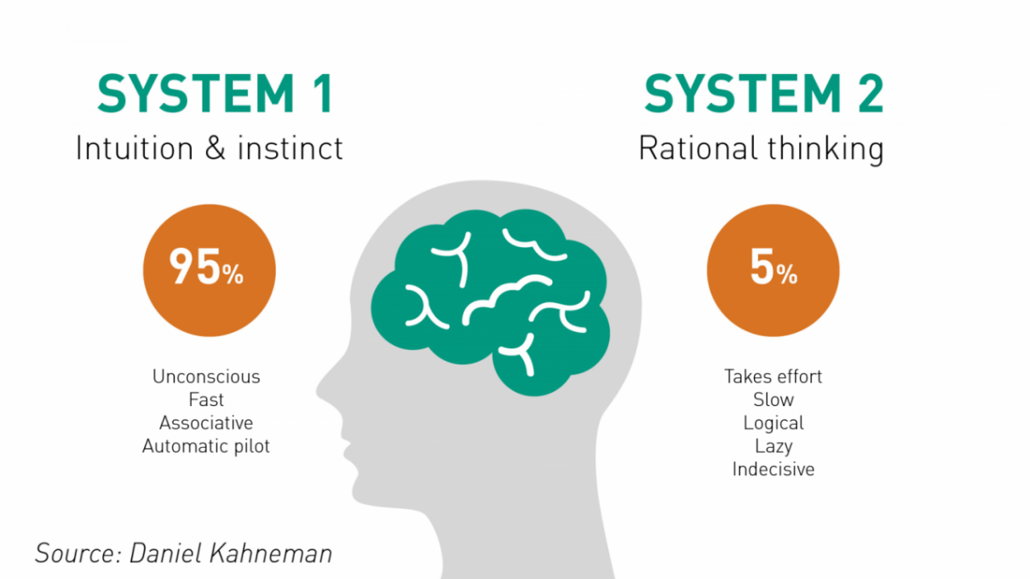
Neurosymbolic AI
How does human mind work?
Kahneman, D. (2011). Thinking, fast and slow.
Farrar, Straus and Giroux.
Nobel Prize 2002 for the interconnection between psychology, human rationality, and economy (with Vernon Smith)

Slide 19
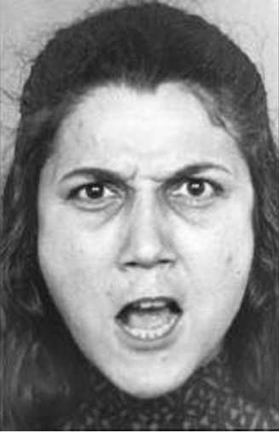
Neurosymbolic AI
How does human mind work?
  System 1
    Immediate perception of the current situation and possible future
    Experience association
Kahneman, D. (2011). Thinking, fast and slow.
Farrar, Straus and Giroux.
Nobel Prize 2002 for the interconnection between psychology, human rationality, and economy (with Vernon Smith)

Slide 20
Neurosymbolic AI
How does human mind work?
  System 1
    Immediate perception of the current situation and possible future
    Experience association
  System 2
    A rough idea of how to solve, possible range of outcome, … from experience / intuition
    What is the exact result? Need time and effort to compute…
Kahneman, D. (2011). Thinking, fast and slow.
Farrar, Straus and Giroux.
Nobel Prize 2002 for the interconnection between psychology, human rationality, and economy (with Vernon Smith)
17 X 24 = ?

Slide 21
Neurosymbolic AI
How does human mind work?
  System 1 – fast intuition
  DL association
  System 2 – slow detailed processing
  Rule-based (logical) reasoning
Kahneman, D. (2011). Thinking, fast and slow.
Farrar, Straus and Giroux.
Nobel Prize 2002 for the interconnection between psychology, human rationality, and economy (with Vernon Smith)

Slide 22
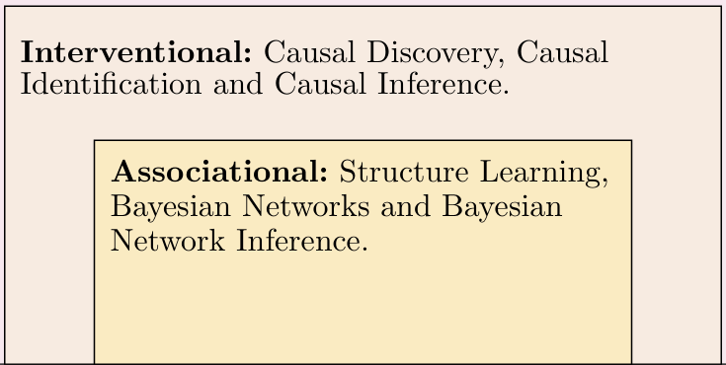
Neurosymbolic AI
How does human mind work?
  System 1 – fast intuition
  DL association
  System 2 – slow detailed processing
  Rule-based (logical) reasoning
Kahneman, D. (2011). Thinking, fast and slow.
Farrar, Straus and Giroux.
Nobel Prize 2002 for the interconnection between psychology, human rationality, and economy (with Vernon Smith)
Throwback
Association is «easy», but causation (more processing) is more accurate

Slide 23
Neurosymbolic AI
How does human mind work?
  System 1 – fast intuition
  DL association
  System 2 – slow detailed processing
  Rule-based (logical) reasoning
How to combine system 1-2?
  Towards a comprehensive simulatable AI model
Kahneman, D. (2011). Thinking, fast and slow.
Farrar, Straus and Giroux.
Nobel Prize 2002 for the interconnection between psychology, human rationality, and economy (with Vernon Smith)

Slide 24
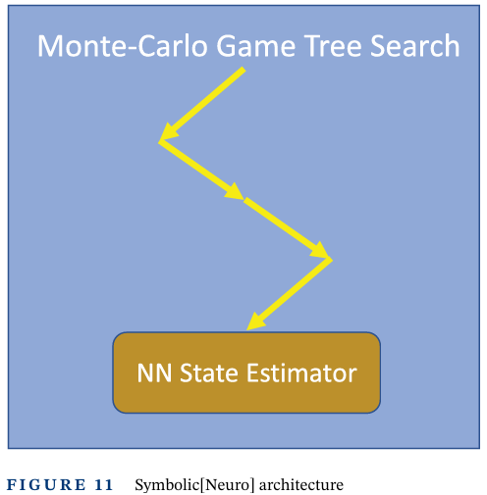
Symbolic[Neuro] architecture
System 2 in control
System 1 invoked in some cases
AlphaGo
  Model-based Monte Carlo Tree Search playing
  Rollout estimates from policy / value networks
Silver, D., Huang, A., Maddison, C. J., Guez, A., Sifre, L., Van Den Driessche, G., ... & Hassabis, D. (2016). Mastering the game of Go with deep neural networks and tree search. Nature, 529(7587), 484-489.

Slide 25
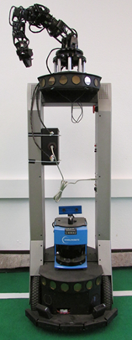
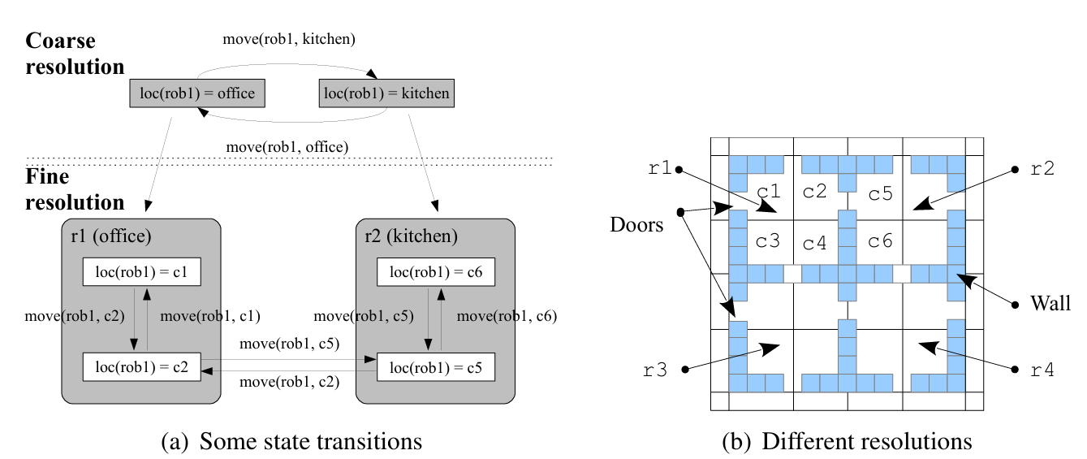
Symbolic[Neuro] architecture
System 2 in control
System 1 invoked in some cases
REBA – REfinement-Based Architecture
  Hierarchical planning
    Coarse logical planning
    Fine statistical (MDP) planning
Sridharan, M., Gelfond, M., Zhang, S., & Wyatt, J. (2019). REBA: A refinement-based architecture for knowledge representation and reasoning in robotics. Journal of Artificial Intelligence Research, 65, 87-180.

Slide 26
Symbolic[Neuro] architecture
System 2 in control
System 1 invoked in some cases
Pros
  Control (interpretability?) of the decision process
  Selected (more restricted) neural training
  Data reduction?

Slide 27
Symbolic[Neuro] architecture
System 2 in control
System 1 invoked in some cases
Humans think the opposite way

Slide 28
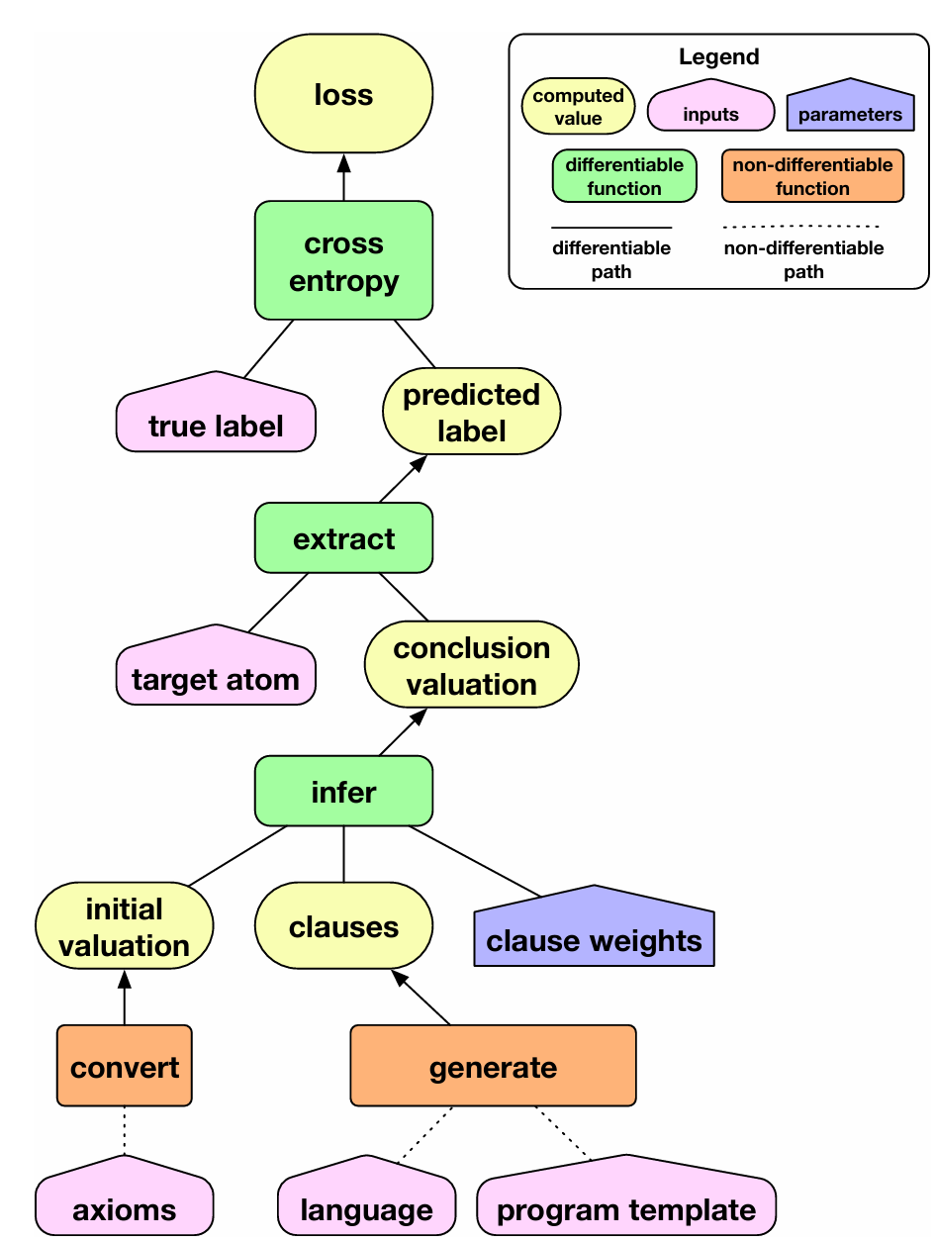
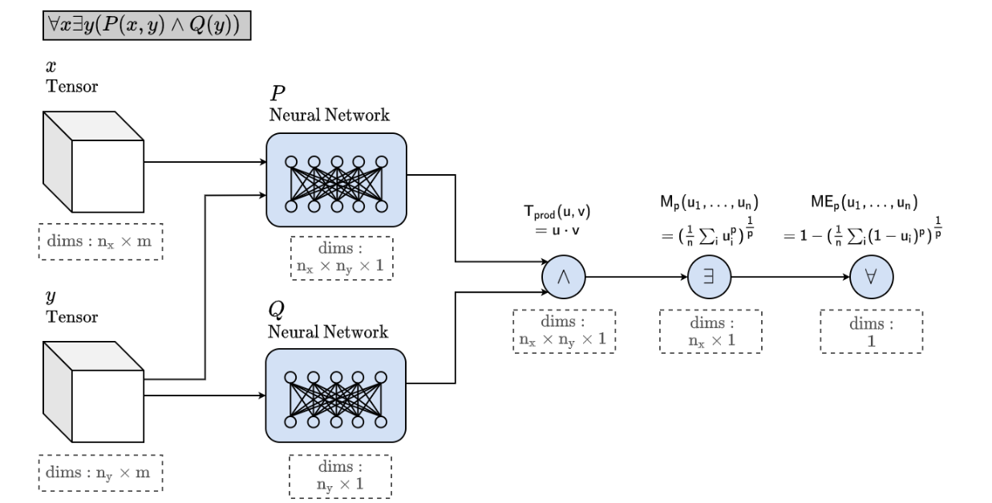
Neuro_{Symbolic} architecture
System 1 re-shaped by System 2
  Differentiable + non-differentiable operators
  A symbolic interpretation of DL
Real logics
Badreddine, S., Garcez, A. D. A., Serafini, L., & Spranger, M. (2022). Logic tensor networks. Artificial Intelligence, 303, 103649.
Differentiable ILP
Evans, R., & Grefenstette, E. (2018). Learning explanatory rules from noisy data. Journal of Artificial Intelligence Research, 61, 1-64.

Slide 29
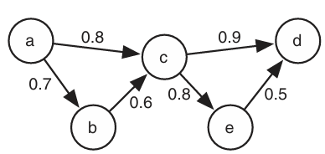
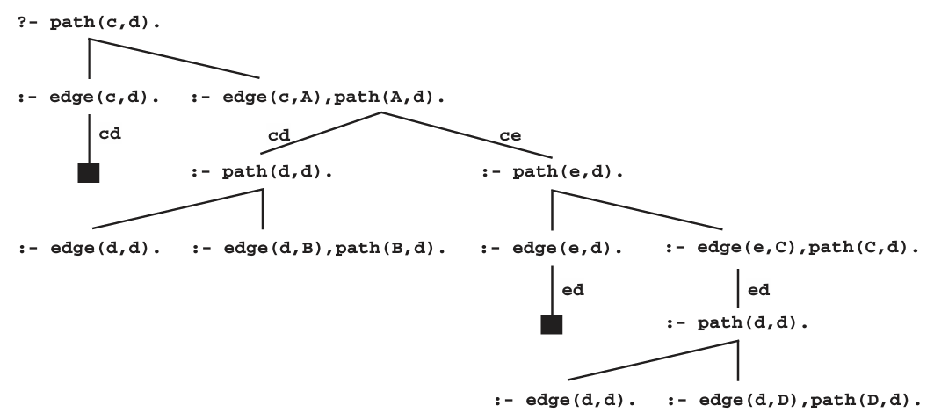
Neuro_{Symbolic} architecture
System 1 re-shaped by System 2
  Differentiable + non-differentiable operators
  A symbolic interpretation of DL
  Problog is a way to connect logics (expressive causality) and associational perspectives

Slide 30
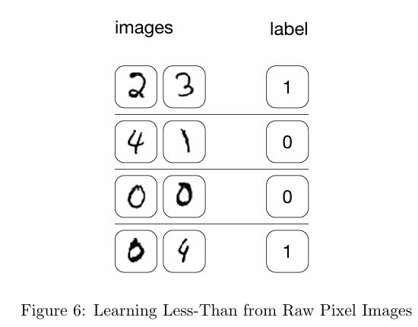
Neuro_{Symbolic} architecture
System 1 re-shaped by System 2
  Differentiable + non-differentiable operators
  A symbolic interpretation of DL
  Closer to the theory of mind
  More interpretable and controllable
  (explainable?)
Evans, R., & Grefenstette, E. (2018). Learning explanatory rules from noisy data. Journal of Artificial Intelligence Research, 61, 1-64.
From MNIST dataset
More than just digit recognition

Slide 31
Neuro_{Symbolic} architecture
System 1 re-shaped by System 2
  Differentiable + non-differentiable operators
  A symbolic interpretation of DL
  Closer to the theory of mind
  More interpretable and controllable
  (explainable?)
  Not really efficient
    Finding logical patterns over large (continuous) Herbrand spaces
    Add probabilities
      Problog complexity
      Many uncertain possible worlds

Slide 32

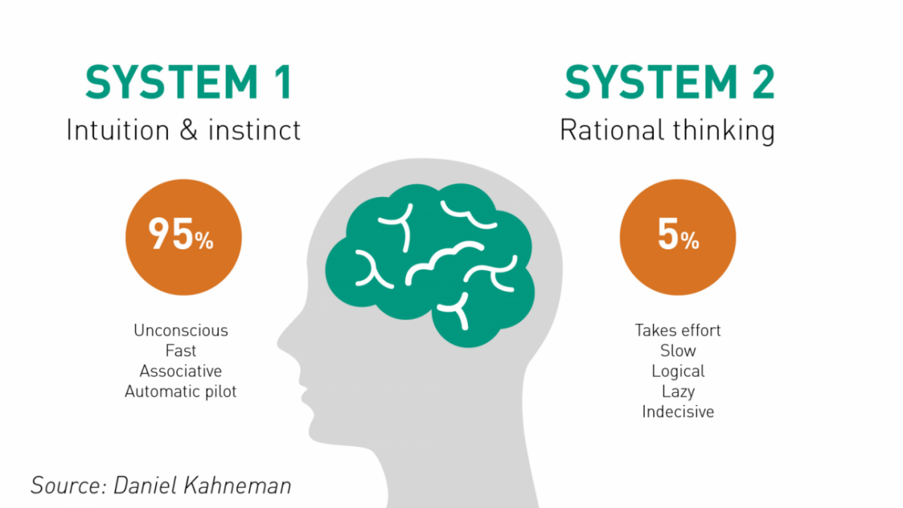
Neuro[Symbolic] architecture
System 1 in control
System 2 invoked when needed
The closest to the theory of mind
  Intelligence as a (deep) learning experience
  Experience adaptation through reasoning
    Abstract from data to concepts
    Analyze situations
    Deduce and apply past experience
    Or refine!

Slide 33
Neuro[Symbolic] architecture
System 1 in control
System 2 invoked when needed
The closest to the theory of mind
  Intelligence as a (deep) learning experience
  Experience adaptation through reasoning
    Abstract from data to concepts
    Analyze situations
    Deduce and apply past experience
    Or refine!
  Is this completely a new thing?

Slide 34
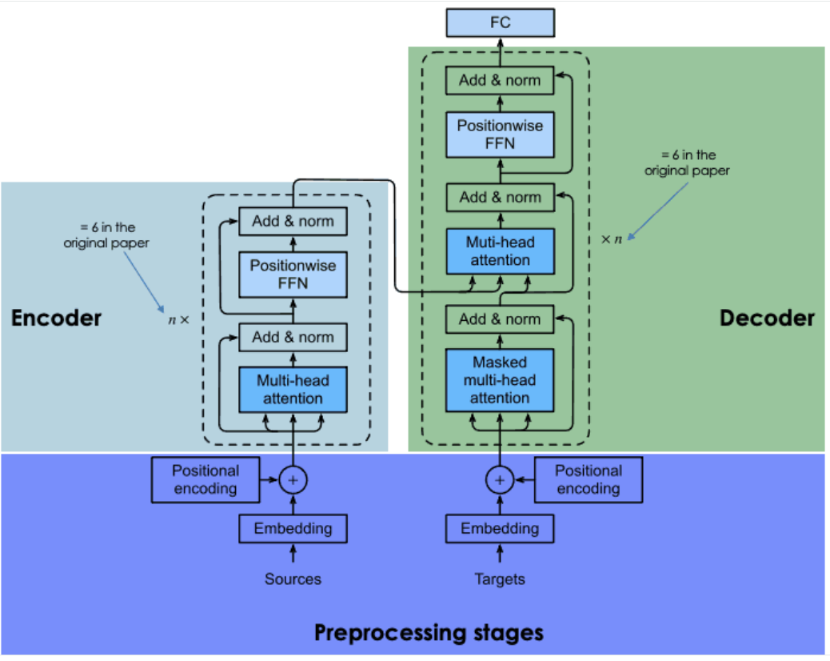
Neuro[Symbolic] architecture
System 1 in control
System 2 invoked when needed
The closest to the theory of mind
  Intelligence as a (deep) learning experience
  Experience adaptation through reasoning
    Abstract from data to concepts
    Analyze situations
    Deduce and apply past experience
    Or refine!
  Is this completely a new thing?
    NLP
      Embed and encode to a lower dimension (abstract)
      Decode with attention (analyze & deduce)
Graziano, M. S. (2019). Rethinking consciousness: a scientific theory of subjective experience. WW Norton & Company.
Attention schema as a cognitive mechanism of humans

Slide 35
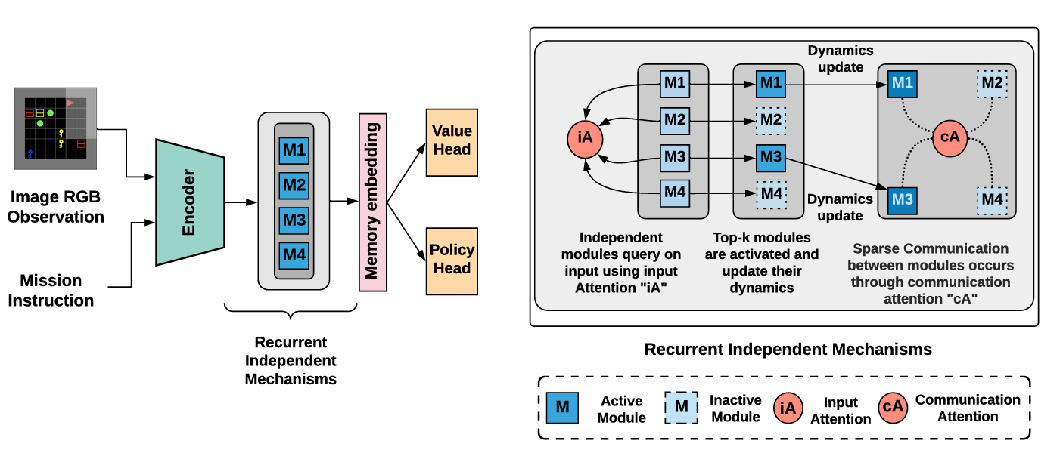
Neuro[Symbolic] architecture
System 1 in control
System 2 invoked when needed
The closest to the theory of mind
  Intelligence as a (deep) learning experience
  Experience adaptation through reasoning
    Abstract from data to concepts
    Analyze situations
    Deduce and apply past experience
    Or refine!
  Is this completely a new thing?
    Application to RL tasks
Madan, K., Ke, N. R., Goyal, A., Schölkopf, B., & Bengio, Y. (2021) Fast And Slow Learning Of Recurrent Independent Mechanisms. In International Conference on Learning Representations.
Graziano, M. S. (2019). Rethinking consciousness: a scientific theory of subjective experience. WW Norton & Company.
Attention schema as a cognitive mechanism of humans

Slide 36
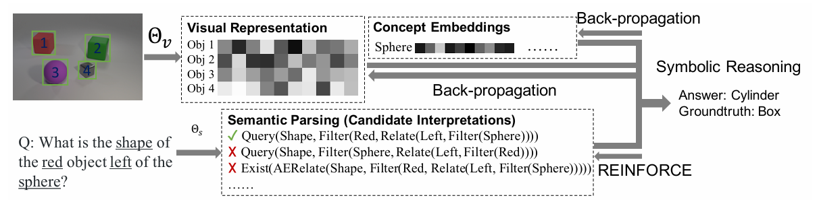
Neuro[Symbolic] architecture
System 1 in control
System 2 invoked when needed
The closest to the theory of mind
  Intelligence as a (deep) learning experience
  Experience adaptation through reasoning
    Abstract from data to concepts
    Analyze situations
    Deduce and apply past experience
    Or refine!
  Is this completely a new thing?
    Application to visual-language tasks
Mao, J., Gan, C., Kohli, P., Tenenbaum, J. B., & Wu, J. (2018, September). The Neuro-Symbolic Concept Learner: Interpreting Scenes, Words, and Sentences From Natural Supervision. In International Conference on Learning Representations.
A human-like concept learner (embedder)
Graziano, M. S. (2019). Rethinking consciousness: a scientific theory of subjective experience. WW Norton & Company.
Attention schema as a cognitive mechanism of humans

Slide 37
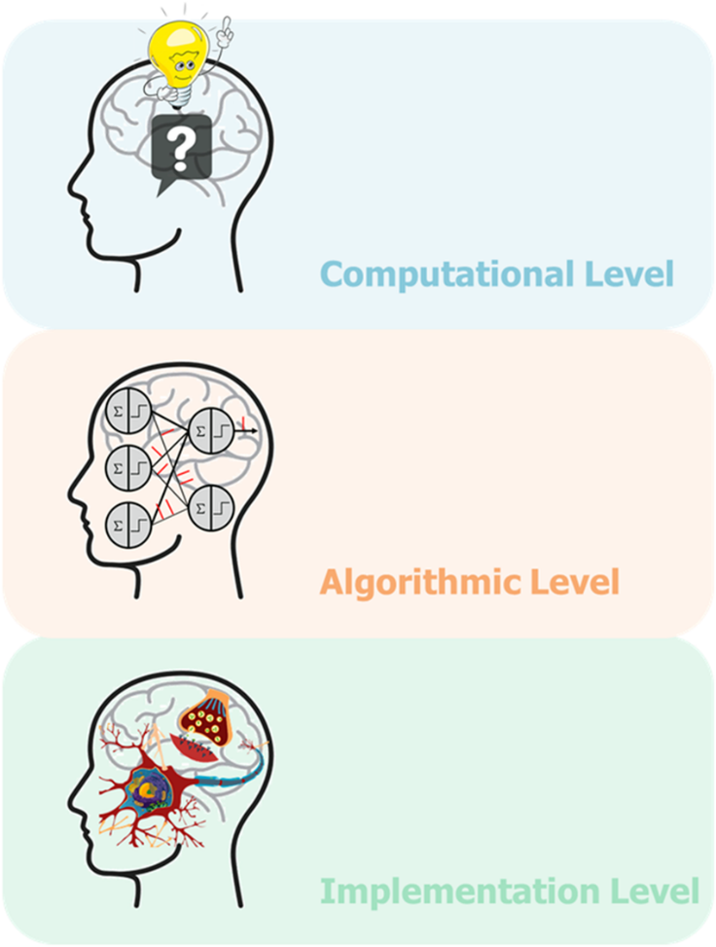
Neuro[Symbolic] architecture
I/O
System 1 in control
System 2 invoked when needed
The closest to the theory of mind
  Intelligence as a (deep) learning experience
  Experience adaptation through reasoning
    Abstract from data to concepts
    Analyze situations
    Deduce and apply past experience
    Or refine!
  Is this exactly like human mind?
Mathematical
relations
Numerical
approximations
Marr, D. (1982). Vision: A Computational Investigation into the Human Representation and Processing of Visual Information.
Our tools work at the implementation level
This is just an approximation (more powerful?)

Slide 38
Neuro[Symbolic] architecture
System 1 in control
System 2 (with interpretable logics) invoked when needed

Slide 39
Outline
Neuro_{Symbolic} AI
  Statistical Relational Learning
  Learn meaningful associations in a logical framework
Neuro[Symbolic] AI
  Reasoning while planning (and learning)
  Neruosymbolic planning and learning

Slide 40
XAI
Neuro_{Symbolic} AI: A peer-to-peer integration

Slide 41
Neuro_{Symbolic} architecture
System 1 re-shaped by System 2
  Differentiable + non-differentiable operators
  A symbolic interpretation of DL
Evans, R., & Grefenstette, E. (2018). Learning explanatory rules from noisy data. Journal of Artificial Intelligence Research, 61, 1-64.
Badreddine, S., Garcez, A. D. A., Serafini, L., & Spranger, M. (2022). Logic tensor networks. Artificial Intelligence, 303, 103649.
Real logics

Slide 42
Neuro_{Symbolic} architecture
System 1 re-shaped by System 2
  Differentiable + non-differentiable operators
  A symbolic interpretation of DL
  Problog is a way to connect logics (expressive causality) and associational perspectives

Slide 43
Neuro_{Symbolic} architecture
System 1 re-shaped by System 2
  Differentiable + non-differentiable operators
  A symbolic interpretation of DL
  Problog is a way to connect logics (expressive causality) and associational perspectives
Problog can be used for reasoning
How to learn a Problog program?

Slide 44
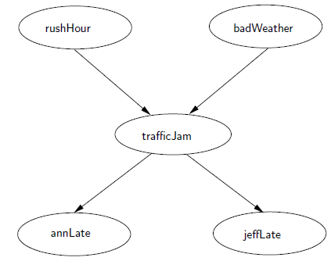
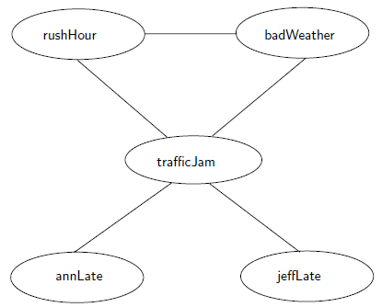
Probabilistic programs (networks)
Associations between probabilistic variables
Back to causal discovery…
Bayesian network
Directed, acyclic
Markov network
Undirected

Slide 45
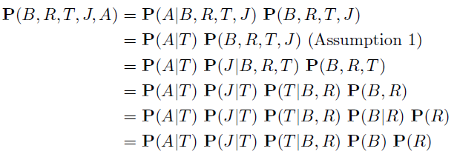
Probabilistic programs (networks)
Associations between probabilistic variables
Back to causal discovery…
Bayesian network
Directed, acyclic

Slide 46

Probabilistic programs (networks)
Associations between probabilistic variables
Back to causal discovery…
Inference on cliques: fully connected sub-graphs
Markov network
Undirected

Slide 47
Probabilistic programs (networks)
Not really different from a Problog program…
A probabilistic network over interpretations (Herbrand space)
Params
Structure
Bayesian network
Directed, acyclic
Markov network
Undirected

Slide 48
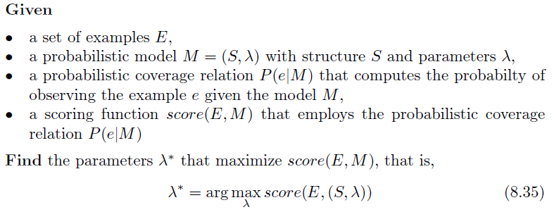
Probabilistic learning

Slide 49
Probabilistic learning

Slide 50
Probabilistic learning
Which scoring function?

Slide 51

Probabilistic learning
Which scoring function?
Maximum A Posteriori (MAP)

Slide 52

Probabilistic learning
Which scoring function?
Maximum Likelihood (ML)
Maximum A Posteriori (MAP)
No hypothesis prior

Slide 53


Probabilistic learning
Which scoring function?
Maximum Likelihood (ML)
iid examples

Slide 54
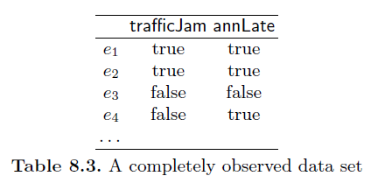
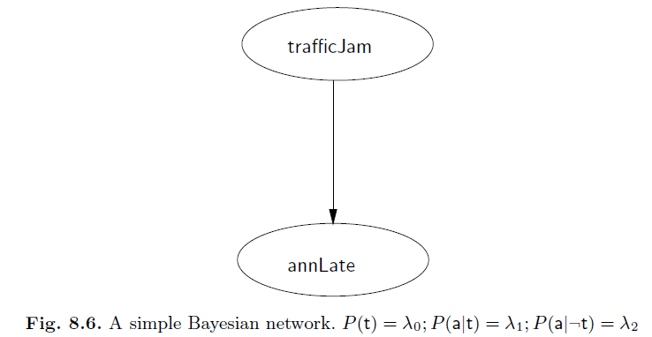

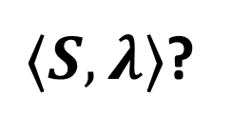
Probabilistic learning
E
Full observability
  We observe the realizations of all random variables
$⟨S,λ⟩$?

Slide 55
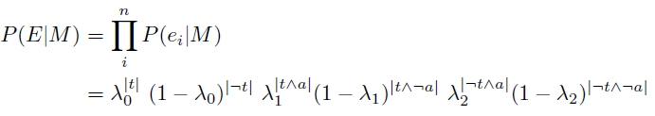
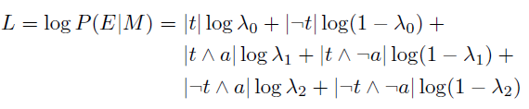
Probabilistic learning
|x| = # examples satisying x
E
Full observability
  We observe the realizations of all random variables
$⟨S,λ⟩$?

Slide 56
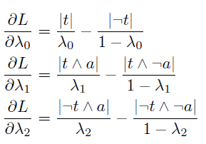
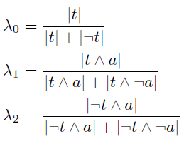
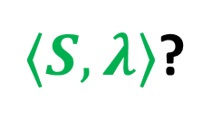
Probabilistic learning
|x| = # examples satisying x
E
Full observability
  We observe the realizations of all random variables
Maximum
(=0)
$⟨S,λ⟩$?
Partial derivatives

Slide 57
Probabilistic learning
|x| = # examples satisying x
E
Full observability (resorts to frequency counting)
  We observe the realizations of all random variables
Maximum
(=0)
$⟨S,λ⟩$?
Partial derivatives

Slide 58
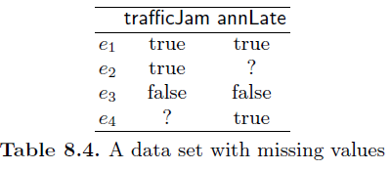
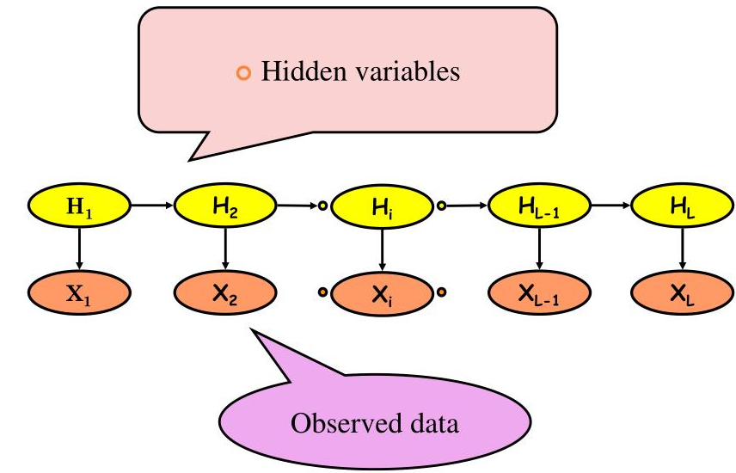
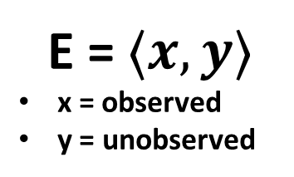

Probabilistic learning
E = $⟨x,y⟩$
x = observed
y = unobserved
Partial observability
  $E→P(E)$
  Worst case: completely missing observations
    Latent variables (like causal confounders)
    Hidden Markov models
$⟨S,λ⟩$?
Mor, B., Garhwal, S., & Kumar, A. (2021). A systematic review of hidden Markov models and their applications. Archives of computational methods in engineering, 28, 1429-1448.

Slide 59
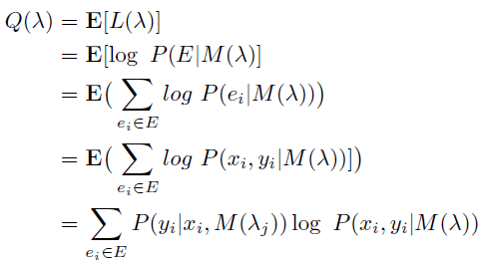

Probabilistic learning
E = $⟨x,y⟩$
x = observed
y = unobserved
Partial observability
  $E→P(E)$
$⟨S,λ⟩$?

Slide 60

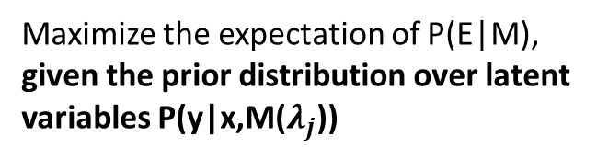
Probabilistic learning
E = $⟨x,y⟩$
x = observed
y = unobserved
Partial observability
  $E→P(E)$
$⟨S,λ⟩$?
Maximize the expectation of P(E|M),
given the prior distribution over latent variables P(y|x,M($λ_{j}$))

Slide 61
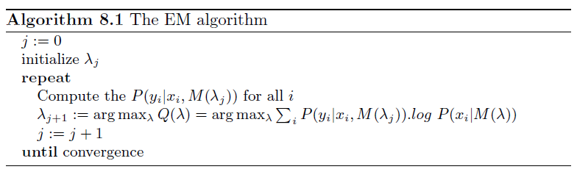

Probabilistic learning
E = $⟨x,y⟩$
x = observed
y = unobserved
Partial observability
  $E→P(E)$
Maximize the expectation of P(E|M),
given the prior distribution over latent variables P(y|x,M($λ_{j}$))
Fix P(y|x,M($λ$)) = P(y|x,M($λ_{j}$))
P(x,y|M) = P(x|M) P(y|x,M($λ_{j}$))
$⟨S,λ⟩$?
constant
Dempster, A. P., Laird, N. M., & Rubin, D. B. (1977). Maximum likelihood from incomplete data via the EM algorithm. Journal of the royal statistical society: series B (methodological), 39(1), 1-22.

Slide 62
Probabilistic learning
E = $⟨x,y⟩$
x = observed
y = unobserved
Partial observability
  $E→P(E)$
Expectation Maximization (EM)
Expectation (estimation) step
Compute the prior on latent variables (from a given distribution)
$⟨S,λ⟩$?

Slide 63
Probabilistic learning
E = $⟨x,y⟩$
x = observed
y = unobserved
Partial observability
  $E→P(E)$
Expectation Maximization (EM)
Expectation (estimation) step
Maximization step
Optimize P(E|M) parameters
$⟨S,λ⟩$?

Slide 64
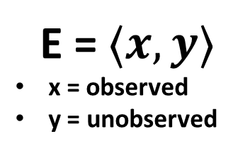

Probabilistic learning
E = $⟨x,y⟩$
x = observed
y = unobserved
Partial observability
  $E→P(E)$
Example
  E-step: complete the dataset
    $e_{2}=\left\langle e_{21}, e_{22}\right\rangle =\left\langle P\left(a | t\right), P\left(¬a | t\right)\right\rangle$
    $e_{4}=\left\langle e_{41}, e_{42}\right\rangle =\left\langle P\left(t | a\right), P\left(¬t | a\right)\right\rangle$
$⟨S,λ⟩$?

Slide 65

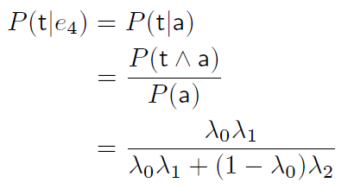


Probabilistic learning
E = $⟨x,y⟩$
x = observed
y = unobserved
Partial observability
  $E→P(E)$
Example
  M-step: update parameters
$⟨S,λ⟩$?

Slide 66
Probabilistic learning
E = $⟨x,y⟩$
x = observed
y = unobserved
Partial observability
  $E→P(E)$
Example
  M-step: update parameters
$⟨S,λ⟩$?
Gradient-based solutions available

Slide 67
Probabilistic learning
Who defines the structure?
Only propositional variables?

Slide 68


Probabilistic learning
Who defines the structure?
Friedman, N. (1998, July). The Bayesian structural EM algorithm. In Proceedings of the Fourteenth conference on Uncertainty in artificial intelligence (pp. 129-138).
Only propositional variables?

Slide 69

Probabilistic learning
Who defines the structure?
Only propositional variables?
  Can we learn probabilistic relations over ungrounded predicates?

Slide 70


Learning probabilistic (FO) logic programs
Our target: a relational (logic) Markov model

Slide 71
Learning probabilistic (FO) logic programs
Learning from interpretations
Learning from entailment

Slide 72


Learning probabilistic (FO) logic programs
Learning from interpretations
  Examples: interpretations
  Parameter learning
  P(h=v | b=w) = p
  Structure learning: generalization/specialization operators
Learning from entailment

Slide 73
Learning probabilistic (FO) logic programs
Learning from interpretations
Learning from entailment
  Examples are rules
    Structure learning both at probabilistic and logical level
  Hard and still largely unsolved

Slide 74
Relational Reinforcement Learning
If we can learn a probabilistic logic program, can we learn it online while acting?

Slide 75

Relational Reinforcement Learning
Relational Markov Decision Process (RMDP)
  Relational states and actions: probabilistic predicates in a sorted signature
  Relational transition and reward maps
  move(X,Y,Z) := move block X from Z to Y, e.g., in Tower of Hanoi

Slide 76

A neuro_{symbolic} approach
Hazra, R., & De Raedt, L. (2023, September). Deep explainable relational reinforcement learning: a neuro-symbolic approach. In Joint European Conference on Machine Learning and Knowledge Discovery in Databases (pp. 213-229). Cham: Springer Nature Switzerland.
How to plan and learn with RMDPs?
Map state -> logical predicates
Pick actions with probabilistic weights
Logical reasoning

Slide 77


A neuro_{symbolic} approach
Hazra, R., & De Raedt, L. (2023, September). Deep explainable relational reinforcement learning: a neuro-symbolic approach. In Joint European Conference on Machine Learning and Knowledge Discovery in Databases (pp. 213-229). Cham: Springer Nature Switzerland.
How to plan and learn with RMDPs?
NeSy
Neural
Higher return
Logical (relational) robustness and generality
Learned policy

Slide 78
A neuro_{symbolic} approach
Hazra, R., & De Raedt, L. (2023, September). Deep explainable relational reinforcement learning: a neuro-symbolic approach. In Joint European Conference on Machine Learning and Knowledge Discovery in Databases (pp. 213-229). Cham: Springer Nature Switzerland.
Some limitations
Continuous signals / observations and actions?
Large ground (Herbrand) space
Structural and parameter learning is hard

Slide 79

A neuro_{symbolic} approach
Hazra, R., & De Raedt, L. (2023, September). Deep explainable relational reinforcement learning: a neuro-symbolic approach. In Joint European Conference on Machine Learning and Knowledge Discovery in Databases (pp. 213-229). Cham: Springer Nature Switzerland.
Some limitations
Continuous signals / observations and actions?
Large ground (Herbrand) space
Structural and parameter learning is hard
Humans are mostly associative

Slide 80
XAI
Neuro[Symbolic] AI: association invokes reasoning

Slide 81
Logics for (RL) planning
Neurosymbolic AI for explainable planning and learning
  Explaining while acting
  Maybe planning better?

Slide 82





Logics for (RL) planning
Neurosymbolic AI for explainable planning and learning
  Explaining while acting
  Maybe planning better?
Cannot safely execute a trained policy
Amir, G., Corsi, D., Yerushalmi, R., Marzari, L., Harel, D., Farinelli, A., & Katz, G. (2023, April). Verifying learning-based robotic navigation systems. In International Conference on Tools and Algorithms for the Construction and Analysis of Systems (pp. 607-627). Cham: Springer Nature Switzerland.

Slide 83
Logics for (RL) planning
Neurosymbolic AI for explainable planning and learning
  Explaining while acting
  Maybe planning better?
  How to do this in a neuro[symbolic] way?

Slide 84

Neuro[symbolic] RL
Reward shaping

Slide 85
Reward shaping
How?
reward
Agent
actions
Environment
logical reward
Logical reasoning
observations

Slide 86

Reward shaping
DFA

Slide 87

Reward shaping
DFA
Σ sequence
<n,e,e,s,w,s,…>
Q sequence
<qs,q, q , qF ,…>
A sequence
<n,e,e,s,w,s,…>
S sequence
<s1,s2,…>

Slide 88

Reward shaping
DFA
Σ sequence
<s,e,s,e,e,s,…>
Q sequence
<qs,q, q , qF ,…>
A sequence
<n,e,e,s,w,s,…>
S sequence
<s1,s2,…>
How to match the two formalism?
A good LTL specification
G(south v east)

Slide 89

Reward shaping
DFA
Σ sequence
<s,e,s,e,e,s,…>
Q sequence
<qs,q, q , qF ,…>
A sequence
<n,e,e,s,w,s,…>
S sequence
<s1,s2,…>
Product MDP
A good LTL specification
G(south v east)

Slide 90

Reward shaping
Agent
actions
Environment
$$ρ(s,a,q,q^{′})$$
Logical reasoning
observations

Slide 91
Reward shaping
MDP (s,a) -> interpretations
Agent
actions
Environment
Interpreted actions
$$ρ(s,a,q,q^{′})$$
Interpreted observations
Logical reasoning
observations

Slide 92
Neuro[symbolic] RL
The only way?
  Better success rate / return
  Can we impose hard constraints?
  G(move(Dir) <- not obstacle(Dir))

Slide 93



Shielding
Action pruning
Safety is preserved
reward
Agent
actions
Environment
Logical reasoning
observations

Slide 94
Shielding
Action pruning
Safety is preserved
What about performance?
reward
Agent
actions
Environment
Logical reasoning
observations

Slide 95

Reward shaping vs. shielding
Jiang, Y., Bharadwaj, S., Wu, B., Shah, R., Topcu, U., & Stone, P. (2021, May). Temporal-logic-based reward shaping for continuing reinforcement learning tasks. In Proceedings of the AAAI Conference on Artificial Intelligence (Vol. 35, No. 9, pp. 7995-8003).
Reasonable (but sub-optimal) LTL specification
Only move(south/east) actions allowed

Slide 96
Reward shaping vs. shielding
Jiang, Y., Bharadwaj, S., Wu, B., Shah, R., Topcu, U., & Stone, P. (2021, May). Temporal-logic-based reward shaping for continuing reinforcement learning tasks. In Proceedings of the AAAI Conference on Artificial Intelligence (Vol. 35, No. 9, pp. 7995-8003).
Reasonable (but sub-optimal) LTL specification
Only move(south/east) actions allowed
Unreachable goal
Action pruning requires perfect domain knowledge

Slide 97



Generalization via neuro[symbolic] RL
Breakout game
Actions: stop, left, right
Goal: empty columns
State: column X empty
Automaton offline learning
Shaped RL
Expert examples
(shooting)
Generalization to bouncing pad
De Giacomo, G., Favorito, M., Iocchi, L., & Patrizi, F. (2020, June). Imitation learning over heterogeneous agents with restraining bolts. In Proceedings of the international conference on automated planning and scheduling (Vol. 30, pp. 517-521).

Slide 98



Is reward enough?
The reward makes the best agent
The best reward makes the best agent
Hard to define in complex domains
Multiple (contrastive?) objectives make misleading rewards

Slide 99


Is reward enough?
The reward makes the best agent
The best reward makes the best agent
Hard to define in complex domains
Multiple (contrastive?) objectives make misleading rewards
Sony AI team by Peter Stone took 2 years
to define the best reward!
Introduce logics too…

Slide 100

Reward is not enough
NeurIPS 2021
Reward shaping still requires intensive exploration
Knowledge and heuristics should be better integrated

Slide 101
Neuro[symbolic] RL
RL interleaves exploration and exploitation
  Exploration: interact with the environment and learn
  Exploitation: do what you learned best, then check and learn again

Slide 102
Neuro[symbolic] RL
RL interleaves exploration and exploitation
  Exploration: interact with the environment and learn
    Large state-action spaces -> too many interactions for completeness and optimality
  Exploitation: do what you learned best, then check and learn again
    Without good complete exploration, it rarely works…

Slide 103

Neuro[symbolic] RL
RL interleaves exploration and exploitation
  Exploration: interact with the environment and learn
    Large state-action spaces -> too many interactions for completeness and optimality
    Can we add (logical) heuristics here?
      Informed exploration through symbolic reasoning
      Exploration needed to learn new things and generalize experience (system 2)
  Exploitation: do what you learned best, then check and learn again
    Without good complete exploration, it rarely works…
    Exploitation is associational (system 1)

Slide 104

Neural exploitation, symbolic exploration
Model-based RL: Monte Carlo Tree Search
Rollout

Slide 105
Neural exploitation, symbolic exploration
Model-based RL: Monte Carlo Tree Search
  Typically (uniform) random
  Can we make it informed?
Rollout

Slide 106

Neural exploitation, symbolic exploration
Model-based RL: Monte Carlo Tree Search
  Typically (uniform) random
  Can we make it informed?
Rollout
Logical heuristics and reasoning
ph < 1 avoids shielding
Complete and optimal
Prob. pa to select a
ph in [0,1)
Ah logical actions

Slide 107
Neural exploitation, symbolic exploration
Model-based RL: Monte Carlo Tree Search
  We can also learn logical heuristics with ILP
Offline ILP
NeSy RL
Logical heuristics

Slide 108



Neural exploitation, symbolic exploration
Rocksample
12x12, 4 rocks
Dataset
<s1,a1,s2,a2,…>
Background {rock=0…4, dist=0…24, …}
Examples
Search space
ILASP

Slide 109

Neural exploitation, symbolic exploration
Rocksample
12x12, 4 rocks
ILASP
Logical heuristics

Slide 110
Neural exploitation, symbolic exploration
Learned rules capture heuristics: what the agent did in the training dataset
Maybe wrong
Not complete preconditions-constraints
Rollout
ph < 1 avoids shielding
Complete and optimal
Prob. pa to select a
ph in [0,1)
Ah logical actions

Slide 111


Neural exploitation, symbolic exploration
NeSy w learned: green
NeSy w human heuristics: red
8 rocks
Fewer simulations to learn action values
Generalization to large grids (long planning horizon)
Logical abstraction from 12x12 grid, 4 rocks

Slide 112



Neural exploitation, symbolic exploration
Sreedharan, S., & Katz, M. (2023). Optimistic exploration in reinforcement learning using symbolic model estimates. Advances in Neural Information Processing Systems, 36, 34519-34535.
Model-free RL: Q-learning
  Higher Q-values to actions entailed by heuristics

Slide 113


Neural exploitation, symbolic exploration
Model-free RL: $ε$-greedy DRL
  E.g., DQN

Slide 114

Neural exploitation, symbolic exploration
Model-free RL: $ε$-greedy DRL
  E.g., DQN
  Exploit with probability $ε$

Slide 115

Neural exploitation, symbolic exploration
Model-free RL: $ε$-greedy DRL
  E.g., DQN
  Exploit with probability $ε$
  When exploring, pick random actions under a weighted probability distribution, focused on actions entailed by logical heuristics

Slide 116


Neural exploitation, symbolic exploration
Model-free RL: $ε$-greedy DRL
  E.g., DQN
  Exploit with probability $ε$
  When exploring, pick random actions under a weighted probability distribution, focused on actions entailed by logical heuristics
  $ε$-decay: as training progresses, exploit more

Slide 117







Neural exploitation, symbolic exploration
Model-free RL: $ε$-greedy DRL
  Learned heuristics may be incomplete
Generalization

Slide 118

Neural exploitation, symbolic exploration
Model-free RL: $ε$-greedy DRL
  Learned heuristics may be incomplete
  Reward shaping alters MDP -> bad performance
  NeSy exploration leverages on good knowledge
    $ε$-decay finally favours new learning
Generalization

Slide 119

NeSy wrap-up
Designing human-inspired cognitive models
Neuro[symbolic] is the closest match
  Mostly exploit past experience, sometimes make an effort and reason
Challenges
  More advanced RL algorithms (PPO, SAC, …)?

Slide 120

NeSy wrap-up
Designing human-inspired cognitive models
Neuro[symbolic] is the closest match
  Mostly exploit past experience, sometimes make an effort and reason
Challenges
  More advanced RL
  Continuous representation

Slide 121

NeSy wrap-up
Designing human-inspired cognitive models
Neuro[symbolic] is the closest match
  Mostly exploit past experience, sometimes make an effort and reason
Challenges
  More advanced RL
  Continuous representation
    Time continuity: signal temporal logic
Gundana, D., & Kress-Gazit, H. (2021). Event-based signal temporal logic synthesis for single and multi-robot tasks. IEEE Robotics and Automation Letters, 6(2), 3687-3694.

Slide 122
NeSy wrap-up
Designing human-inspired cognitive models
Neuro[symbolic] is the closest match
  Mostly exploit past experience, sometimes make an effort and reason
Challenges
  More advanced RL
  Continuous representation
    Time continuity: signal temporal logic
    Real-valued variables
Badreddine, S., Garcez, A. D. A., Serafini, L., & Spranger, M. (2022). Logic tensor networks. Artificial Intelligence, 303, 103649.

