Slide 1
Solving mTSP using evolutionary algorithms
Semestral work presentation
EOA – Teymur Azayev

Slide 2
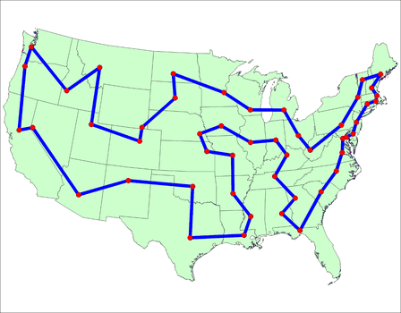
The TSP problem
Source: support.sas.com
Given n cities, find shortest tour.

Slide 3
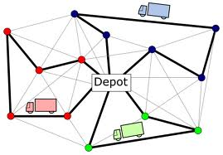
mTSP problem
Source: rcasts.com
M – agents, 1 depot

Slide 4
Solving the TSP
General TSP problem is NP-Hard
Exact solution is not necessary, good solution is enough
Use of evolutionary algorithms to solve difficult optimization problems

Slide 5
Problem representation
Solution is represented as a sequence – bounds pair:
seq : [2,5,1,6,2,8,4,3,10,12,7,11,9]
bounds: [4,8]
For n = 12 cities and m = 3 agents.
The above means that agent 1 starts at the depo, goes through cities [2,5,1,6] and goes back to depot. Agent 2 starts at the depot,
goes through cities [2,8,4,3] and then goes back to the depot, etc..
Fitness: Length of longest tour from all the agents.

Slide 6
Local search
Simple swapping of two cities n times. After n iterations the best swap is kept.
Easy implementation, stuck at local minimum.

Slide 7
Evolutionary algorithm
One point crossover (with slight modification to get valid sequence).
Boundary mutation
Roulette selection of p parents, new offspring always replaces parents if better, replace with a small chance if worse.

Slide 8
Memetic search
Same crossover as in the evolutionary algorithm
Addition of 2-opt after creation of new individuals.
Gives chance to weak individuals to locally improve themselves and have higher chance to be selected in the next round.

Slide 9
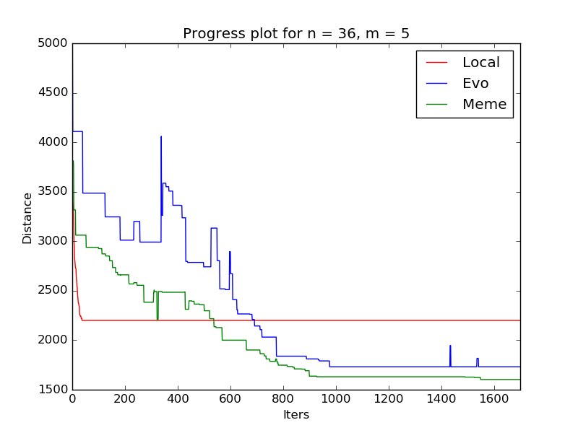
Progress plot

Slide 10
Average results
 | Local | Evo | Meme
Longest tour | 2281 | 1825 | 1718

Slide 11
Conclusion
As expected memetic algorithm outperformed the other two and converged faster.
Works out of the box on small problems.
Very slow, inefficient for large problems, requires hyperparameter tuning and population analysis to prevent stagnation and other bad effects.

