Slide 1
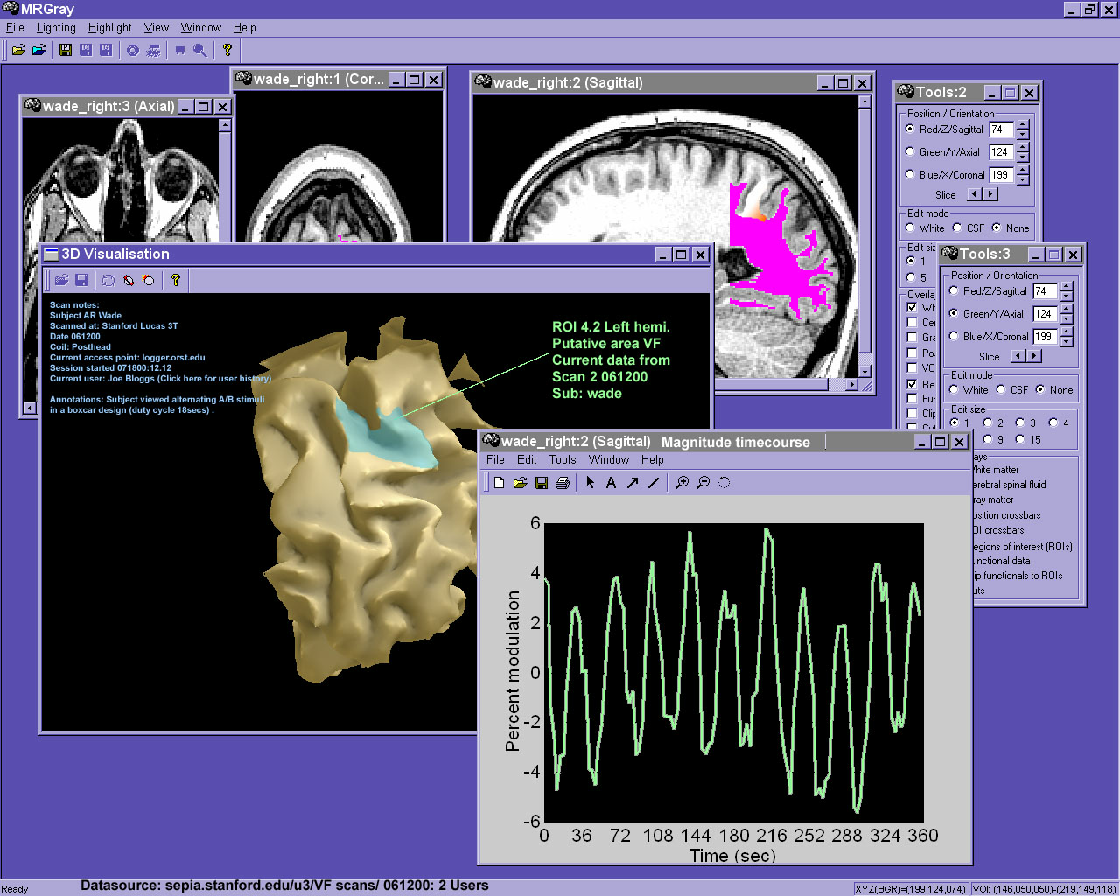
Integrating Database & Analysis

Slide 2
MrData
Central database
  Semi-automated data logging integrated with analysis tools (matlab)
  Web interface for browsing & data entry from scanner

Slide 3
MrData
Database records and organizes:
  Scans: grant, session, subject, operator, etc.
  ROIs
  Large data files (only path info stored in DB)
  3d mesh data?

Slide 4
MrData Advantages
SQL-based database engine
  Centralized, structured queries, efficient data structure, scalable
  Coerces us to do careful data logging (mostly automated)
Data maintained from Matlab and/or web interface
Notes:
Structured queries:
select * where subject=‘wade’ and experiment=‘retinotopy’ or experiment=‘mt reference’
select * where experiment=‘retinotopy’ and scanDate>’1999-05-28’
Efficient data structure- eg. Each person is only entered once, in the ‘people’ table.
Scalable- these databases can search hundreds of thousands of entries in a couple seconds

Slide 5
Basic Database Structure
1
n
Scans:
-display used
-stimulus type
-notes
-scan params
Users
reserves
n
n
scan operator
n
n
1
generates
subject
Subjects
creator
1
1
1
n
subject
n
ROIs
raw data
data source
Sessions
n
n
1
1
analyzer
n
DataFiles:
-location
-backup
-owner
n
lead experimenter
funds
1
n
Analyses:
-notes
-log
-figures?
Grants
n
n
n
data
Studies
derived data
n

Slide 6
To Do
Finish integration with mrLoadRet
Polish web interface
Fine-tune DB structure
Security & backups
Track data relocation
  Spider file structure to find lost datasets?

Slide 7
To Do
Manage unfolds and segments
  Each dataset (raw or derived) may be linked to other datasets via coordinate transform functions (T)- eg:
    Within subjects using coregistration-derived transforms
    Across subjects using functionally-defined ROIs and Talairach coordinates

