Slide 1
TripPlanner
Laura Lilleste, Silver Pajumäe, Rando Tõnisson

Slide 2
Problem
Trip planning
End users: everyday public transport users

Slide 3
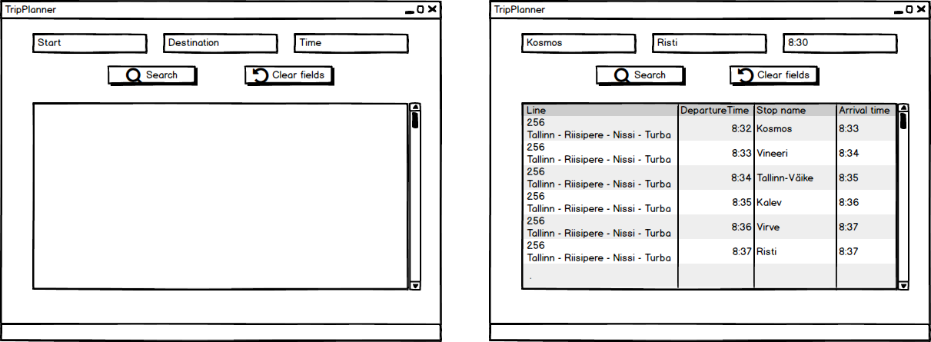
GUI mock-up

Slide 4
Demo

Slide 5
Thanks you for listening!

