Slide 1

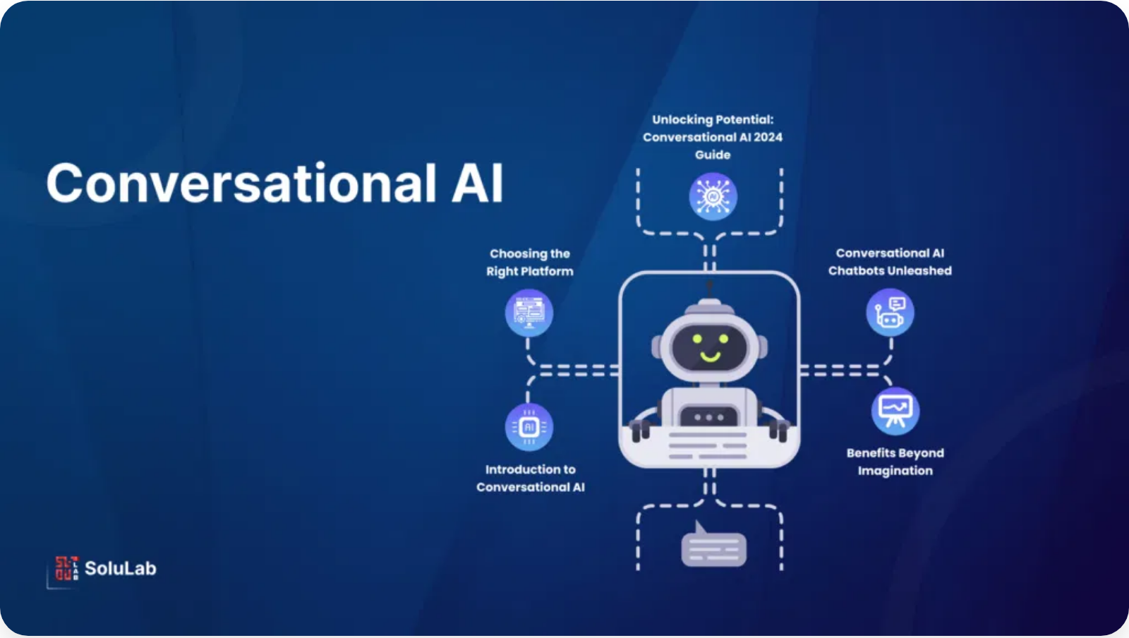
Conversational AI Assistant with RAG
A Multi-Persona Chatbot with Document Understanding
Team Members:
Rijul • Jayraj Choudhary • Siddhant Kankaria • Jitesh Sidhani

Slide 2

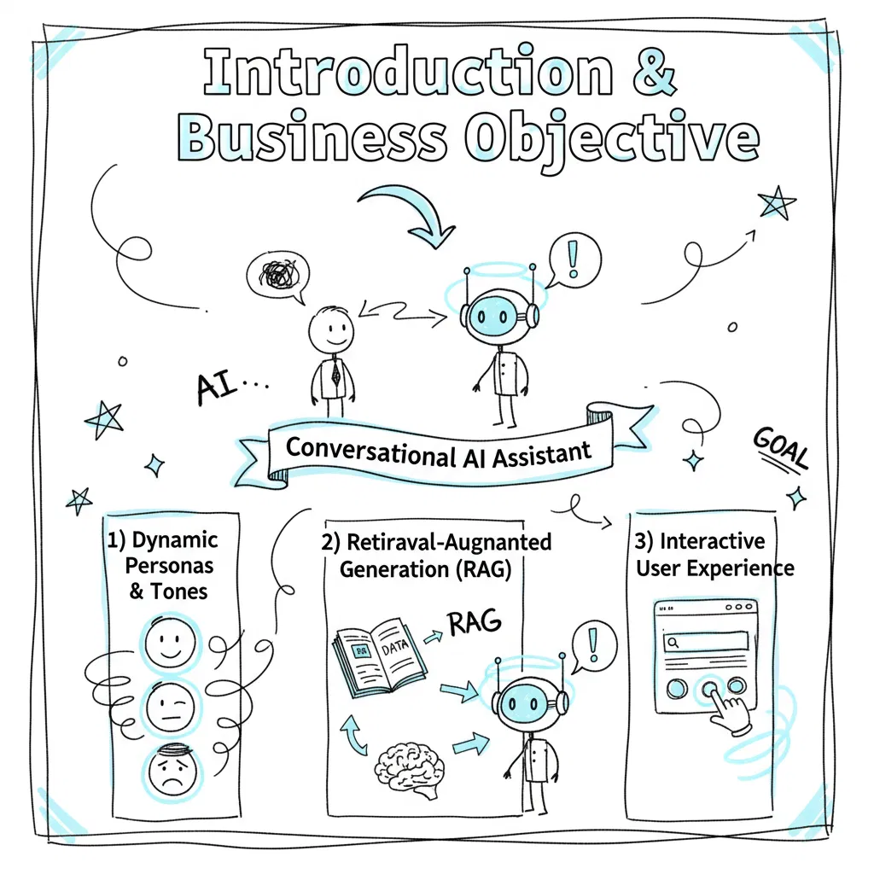

Introduction & Business Objective
Project Purpose
Creating a highly versatile and customizable Conversational AI Assistant that adapts to diverse user needs
Primary Business Objective
Develop an intelligent chatbot that engages in natural conversations while adapting its communication style based on user preferences
Core Pillars of Functionality
Dynamic Personas and Tones:
Allowing users to select the AI's
personality and tone
Retrieval-Augmented Generation (RAG):
Enabling the assistant to
answer questions based on uploaded documents
Interactive User Experience:
Intuitive web interface that encourages
experimentation

Slide 3
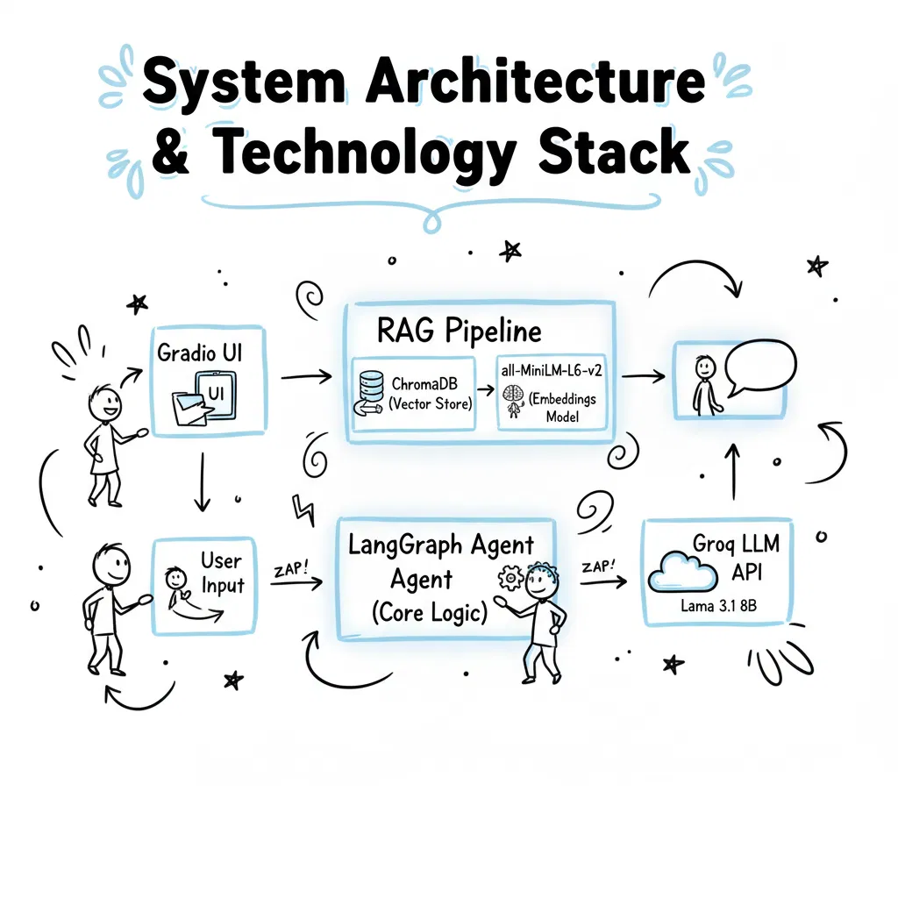





System Architecture & Technology Stack
User Input → Gradio UI → RAG Pipeline → LangGraph Agent → Groq LLM API → Response → Gradio UI → User
Core Logic: LangGraph
- Creates stateful, cyclic graphs to manage conversational
memory using AgentState dictionary
User Interface: Gradio
- Quickly builds feature-rich web interface with interactive
components like file uploads and sliders
LLM: Groq API with Llama 3.1 8B
- Selected for low latency and strong conversational
abilities, essential for real-time chat
Vector Store: ChromaDB (In-Memory)
- Runs in-memory to solve file-locking issues and
ensure clean processing for each document
Embeddings: all-MiniLM-L6-v2
- Open-source model from Hugging Face that runs
locally, ensuring privacy and removing dependency on paid services

Slide 4

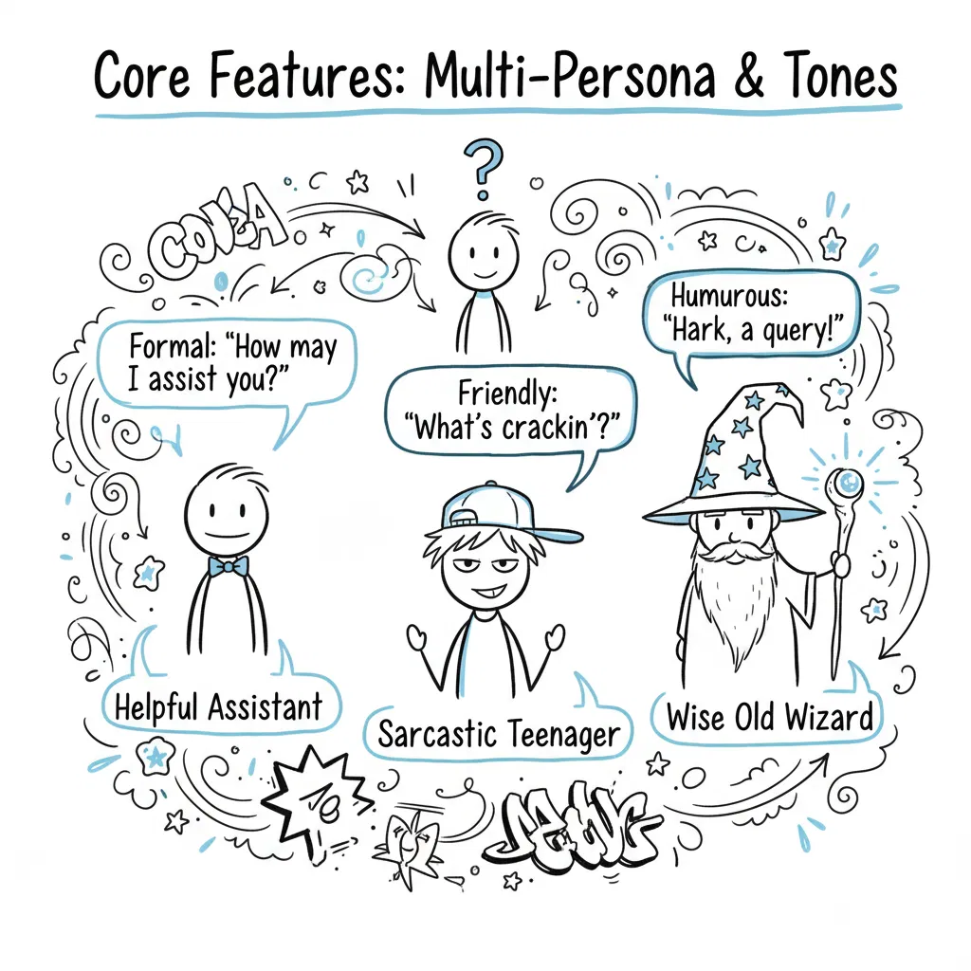






Core Features: Multi-Persona & Tones
Multi-Persona Chat
Engage with different AI personalities, each with unique communication styles and characteristics.
Helpful Assistant:
Professional, informative, and focused on providing accurate
information
Sarcastic Teenager:
Witty, humorous, with a touch of playful sarcasm
Wise Old Wizard:
Speaks with wisdom, metaphors, and a touch of mysticism
Dynamic Tone Control
Further refine the AI's responses by selecting a specific tone, adding another layer of customization.
Formal:
Professional language with proper structure and minimal colloquialisms
Friendly:
Warm, approachable language with conversational elements
Humorous:
Light-hearted language with jokes and playful expressions

Slide 5



Challenges Faced & Solutions
Challenge 1: Dependency and Visualization Issues
Solution:
Used LangGraph's built-in function to generate a Mermaid diagram, avoiding complex installations and visualizing the graph directly in the notebook
Challenge 2: RAG State Management Bug
Solution:
Re-architected the RAG pipeline to use an in-memory ChromaDB instance, ensuring the vector store was completely wiped clean between sessions
Challenge 3: LLM Behavior with Structured Output
Solution:
Simplified the approach by requesting direct, plain-text responses from the LLM instead of using Pydantic models for structured output
Challenge 4: Windows File Locking PermissionError
Solution:
Moved to a fully in-memory vector store, eliminating file locking issues by removing disk-based storage entirely

Slide 6

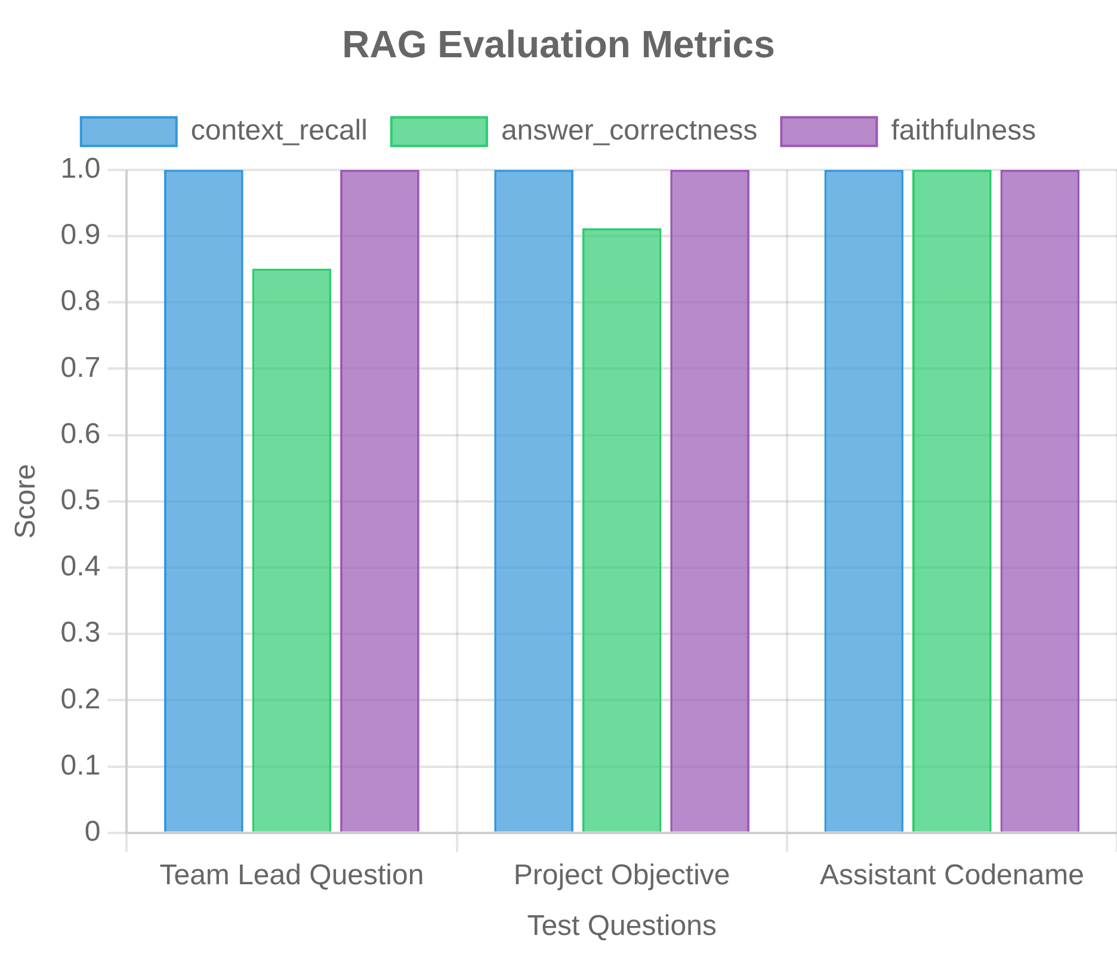



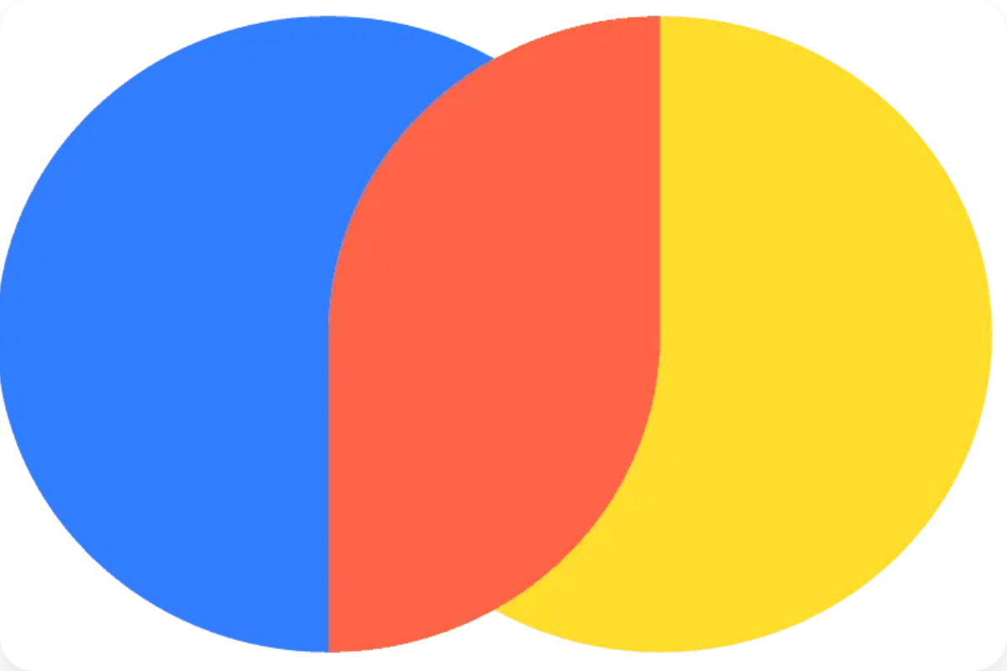
RAG Pipeline Evaluation
We evaluated our RAG system using the
Ragas framework
with a test
document (project_apollo_overview.pdf) and specific question-answer
pairs.
context_recall:
Measures if the retriever found all relevant information. Our system
scored a perfect 1.0, proving highly effective retrieval.
answer_correctness:
Measures factual accuracy of generated answers. Our scores
were consistently high (0.85-1.0).
faithfulness:
Checks if answers are strictly based on provided context. Our model
scored a perfect 1.0, indicating no hallucinations.
Question
context_recall
answer_correctness
faithfulness
Who is the team lead for Project Apollo?
1.0
0.851
1.0
What is the primary objective of the project?
1.0
0.912
1.0
What is the codename of the assistant?
1.0
1.000
1.0

Slide 7



Conclusion & Future Work
We successfully created a comprehensive Conversational AI Assistant that meets all our initial objectives, featuring customizable personas, context awareness, and document expertise through RAG.
Built a polished, well-documented application showcasing modern LLM concepts
Overcame technical challenges in dependency management and stateful design
Quantitatively evaluated the RAG pipeline with strong performance metrics
Future Work
Support for More File Types:
Extend the RAG pipeline to handle images, audio, or even
URLs
Integration of Agentic Tools:
Equip the assistant with tools like web search or calculator
to answer a wider range of questions
More Complex Agentic Workflows:
Expand the LangGraph agent to have multiple steps
or nodes for complex tasks
Deployment:
Package the application and deploy it to a cloud service like Hugging Face
Spaces for wider accessibility

