Slide 1
Predicting the Popularity of Online News:
How to identify and modify important article attributes to increase social media shares
Ryan Miller
Capstone 1 Project Presentation

Slide 2
The Data
Mashable news articles:
Target variable: number of shares across social media
57 features
Word attributes (count, length, uniqueness, etc.)
Media content (images, videos, links)
Assigned category (e.g. business, entertainment)
Latent Dirichlet Analysis (latent topics)
Keywords (e.g. average # shares for keyword)
Day of week published
Article subjectivity and polarity

Slide 3
Overview of Methods
Data Wrangling
EDA
Model data using Gradient Boosting
Hyperparameter optimization
Identify and remove weakly predictive features
Possible data reduction via PCA
Assess final accuracy of model
Improve article shares
Identify representative articles through Kprototype clustering
Use model obtained in gradient boosting step to tweak important features and assess changes in predicted shares

Slide 4
Data Wrangling
Stripped white space from feature names
Convert shares (target) to log(shares)
Parse dates in URL and added month as feature
Used sine and cosine to represent month as geometric variable across two features
Dropped unimportant features (e.g. URL) and rows with impossible values

Slide 5
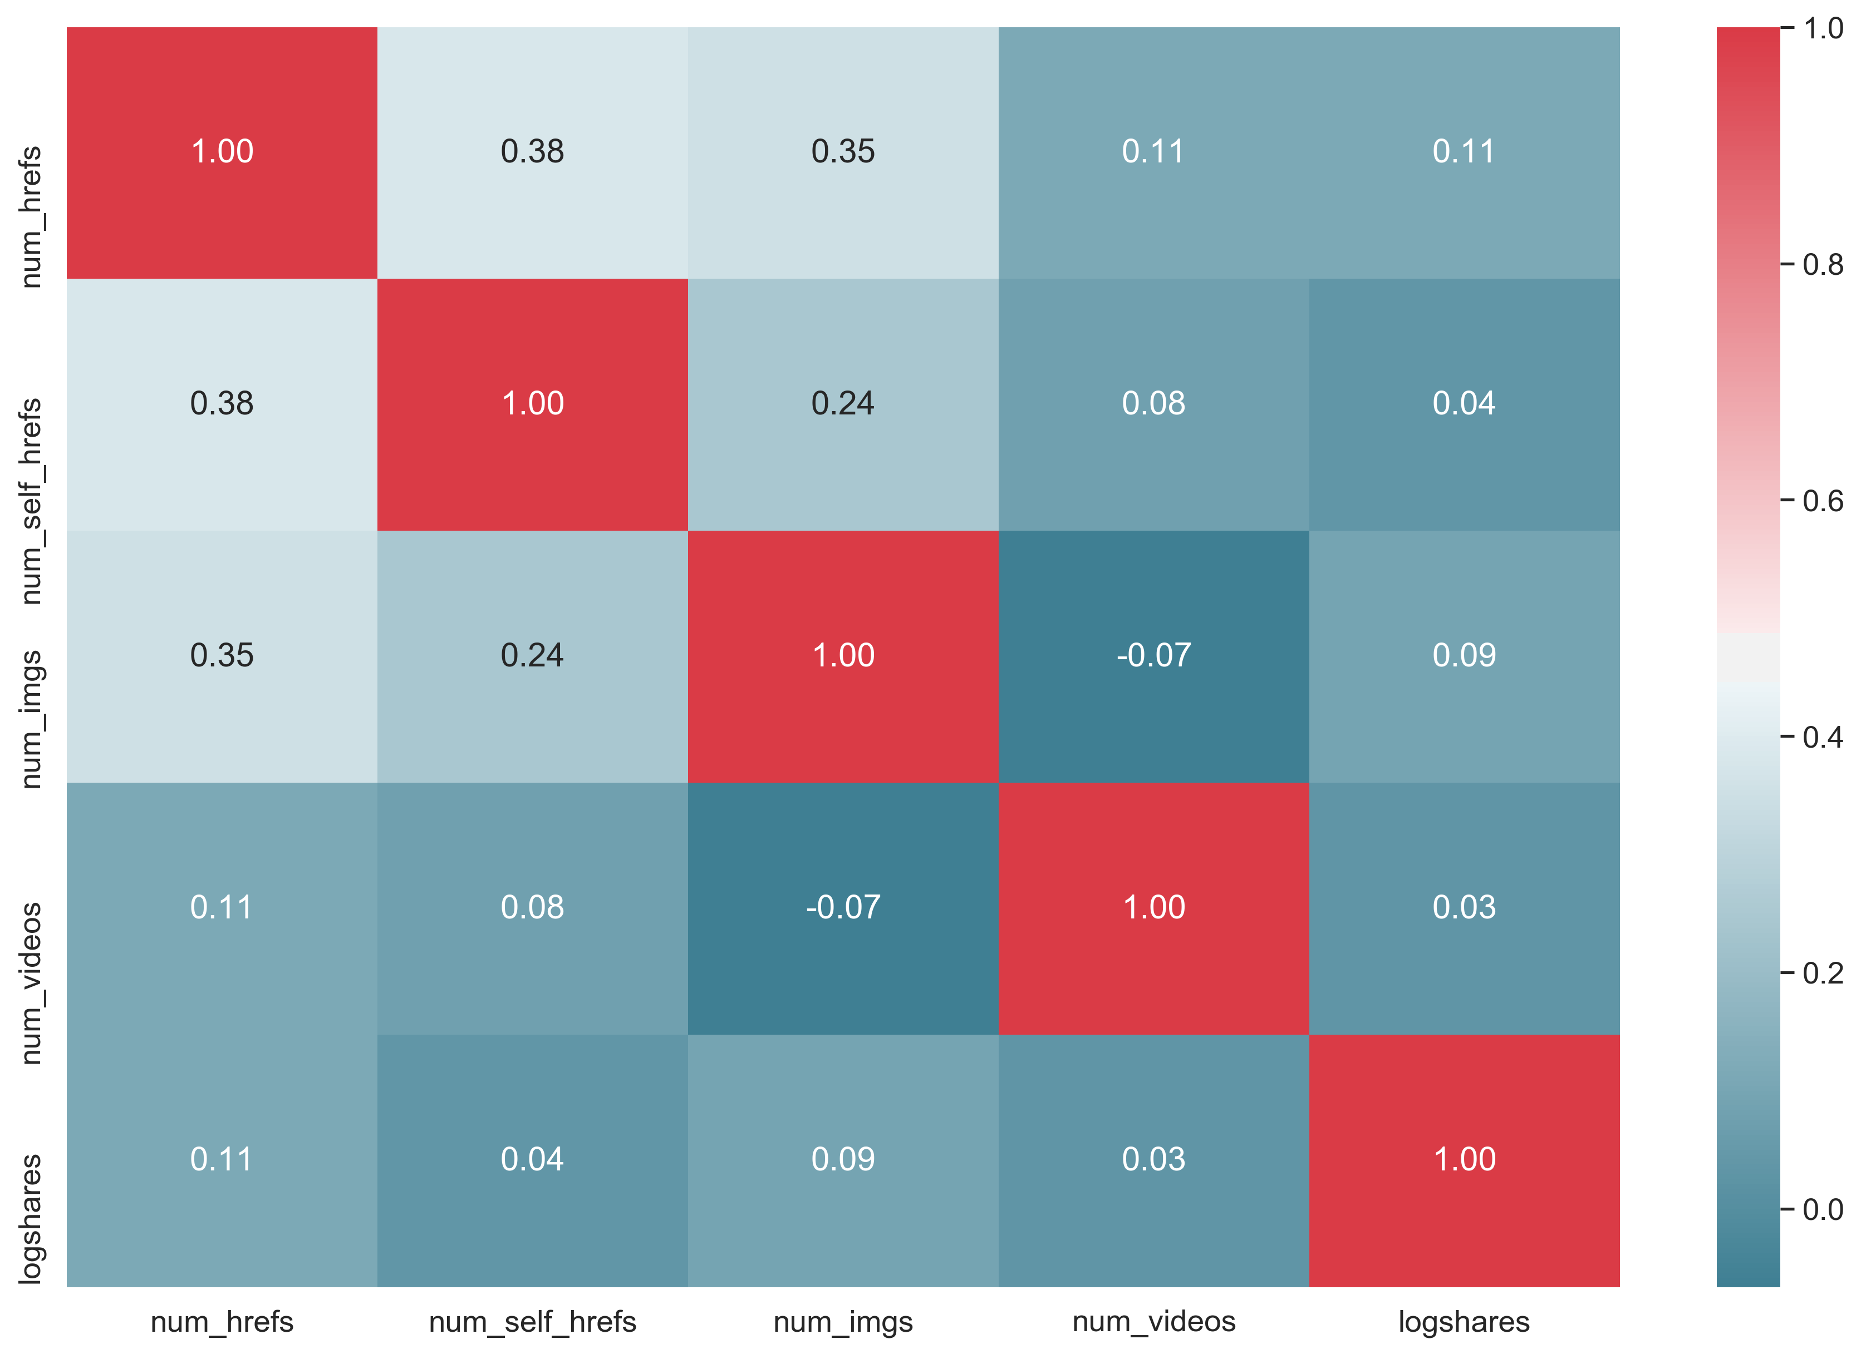
EDA: media content

Slide 6
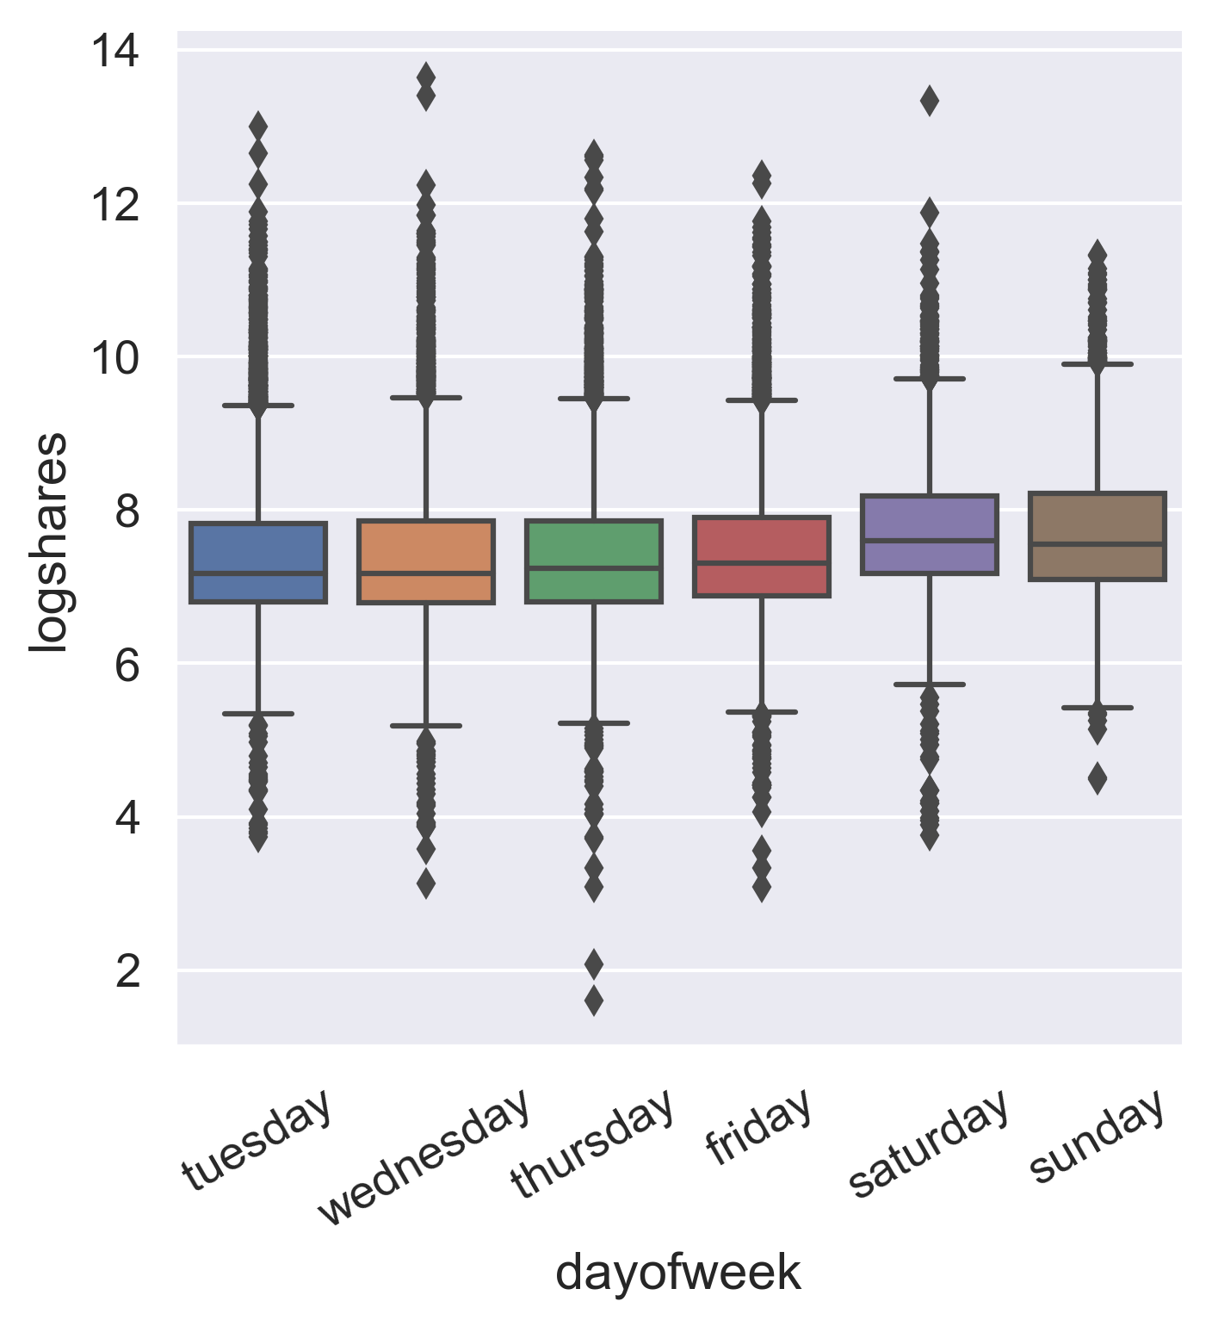
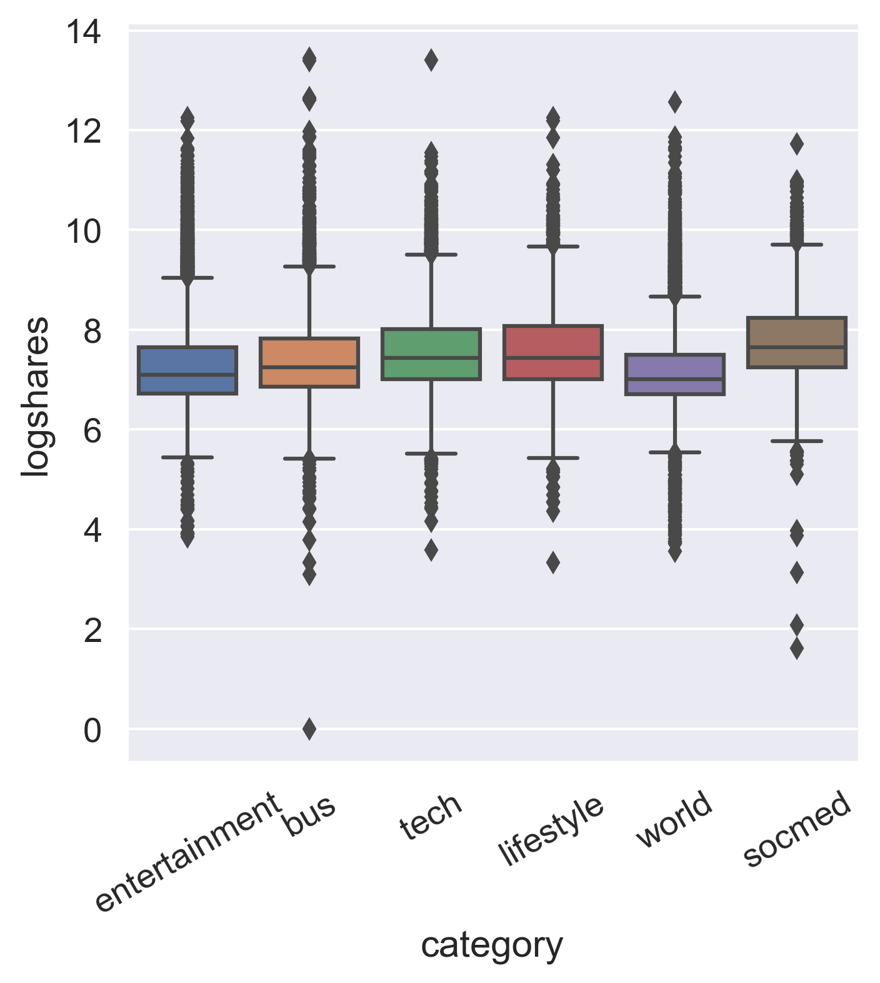
EDA: day of week, category

Slide 7
EDA: summary
Popular articles will generally:
Contain more links, images, videos
Contain keywords referenced in highly shared articles
Discuss social media, lifestyle, or tech-related topics
Be published on the weekend
Contain more positive content
Be more subjective in nature

Slide 8
Gradient Boosting
Separate data into training and test sets
Training set
Validation
Test
20% of train,
used to assess
individual feature
importance and
refine accuracy of
model
10%, Hold out
until very end

Slide 9
Gradient Boosting
Light GBM, LGBMRegressor() with L1 (MAE) objective
Hyperparameter optimization
Ran RandomizedSearchCV() with 5-fold CV 1000 times to identify best parameter values
Narrowed search based on output and reran 100 times.
Final values:
Number of estimators: 2425
Learning rate: 0.012
Max depth: 8
Number of leaves: 34
Feature sampling by tree: 0.23
Subsampling: 0.70
Alpha (L1 regularization): 1.17
Lambda (L2 regularization): 0.21
Mean absolute error (MAE) for CV = .598
Compare to MAE using simplest model using mean of target: 0.70
MAE for validation data subset = .604

Slide 10
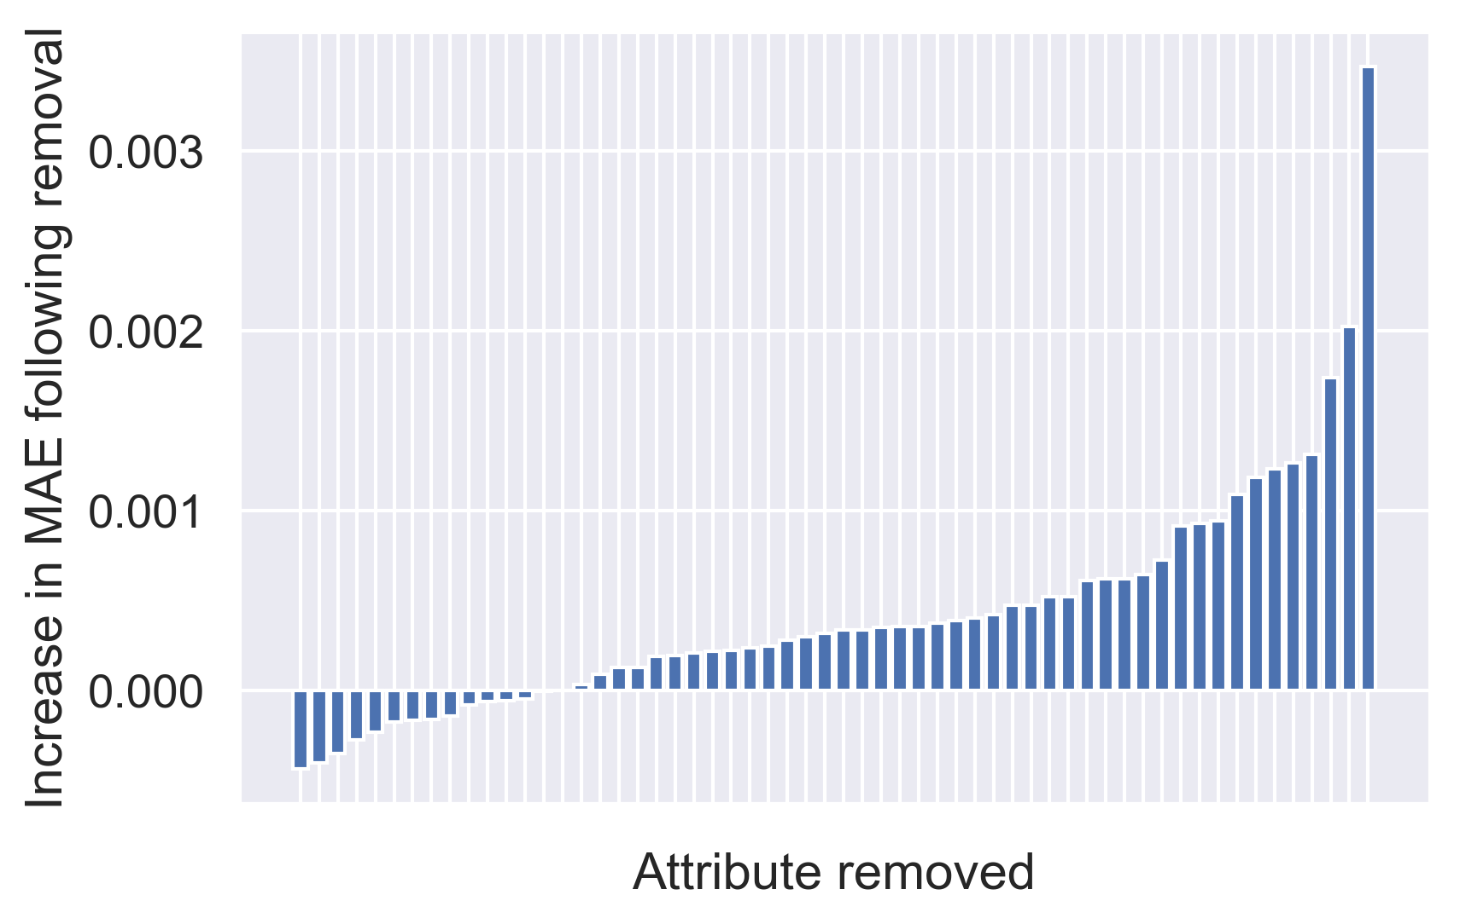
Removing one attribute at a time…
MAE when removing all 15 attributes <= 0: 0.603
MAE when including attributes: 0.604

Slide 11
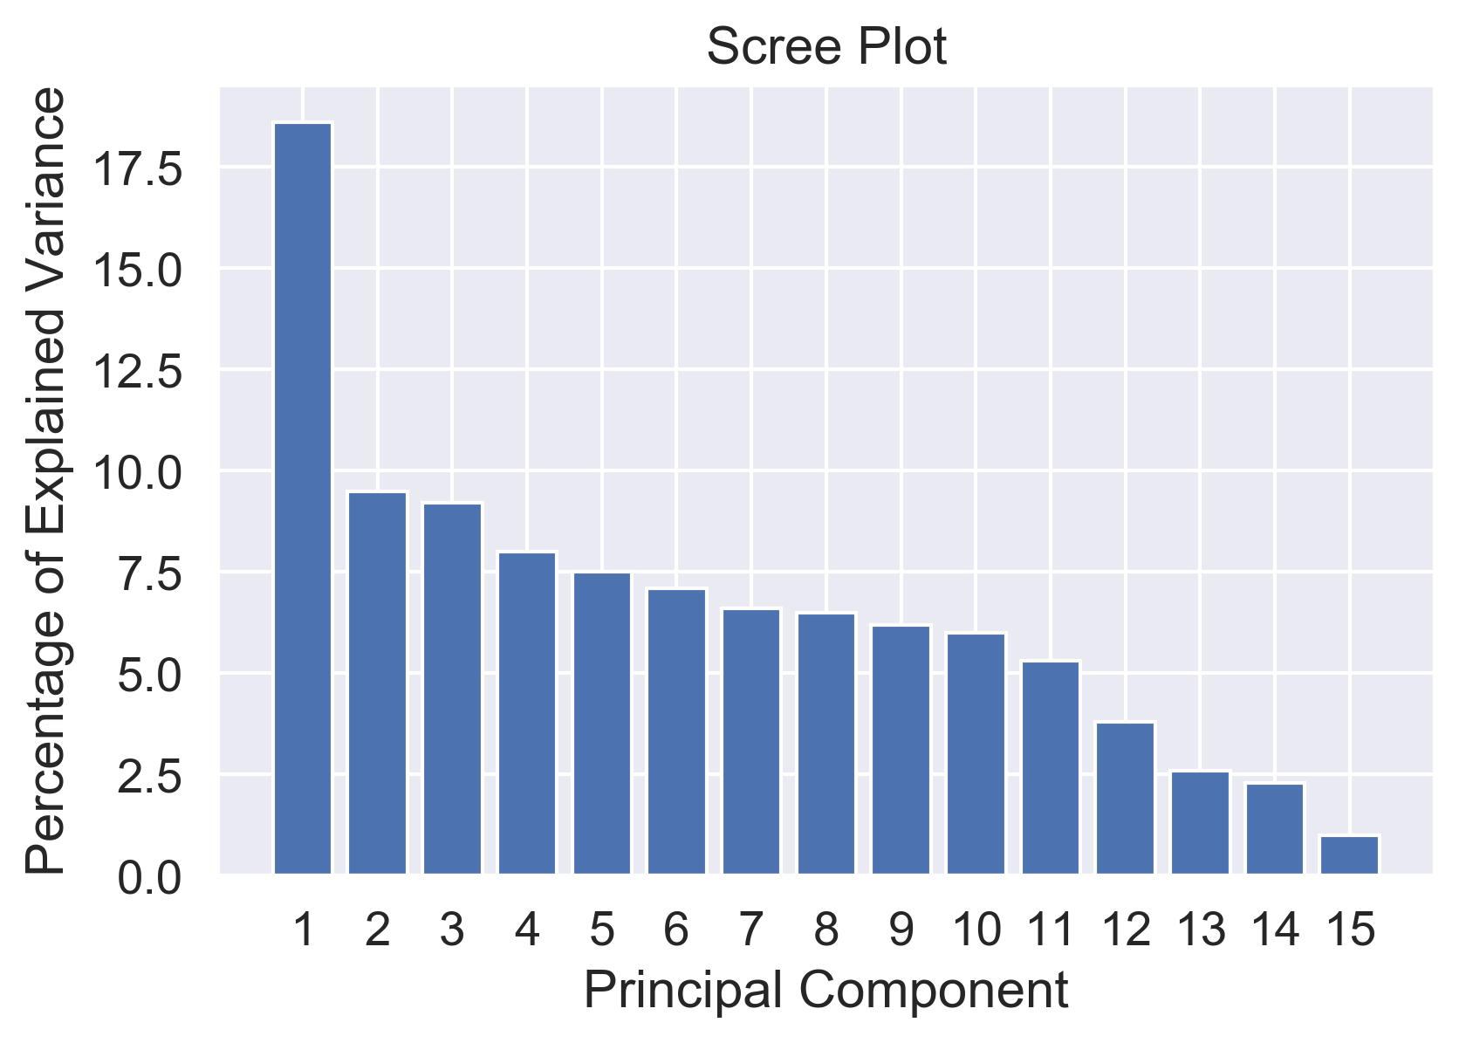
PCA on weak attributes
Adding even the first PC back to dataset increased MAE for
validation set, so all PCs and the weak features from which they were
derived were discarded.

Slide 12
Finalizing model
Reran RandomizedSearchCV() 200 times to re-optimize parameters for new dataset
Marginal improvement:
MAE dropped from 0.598 to 0.597
Accuracy of final model on untouched test set
MAE = 0.579
Compare to simplest mean model: 0.690

Slide 13
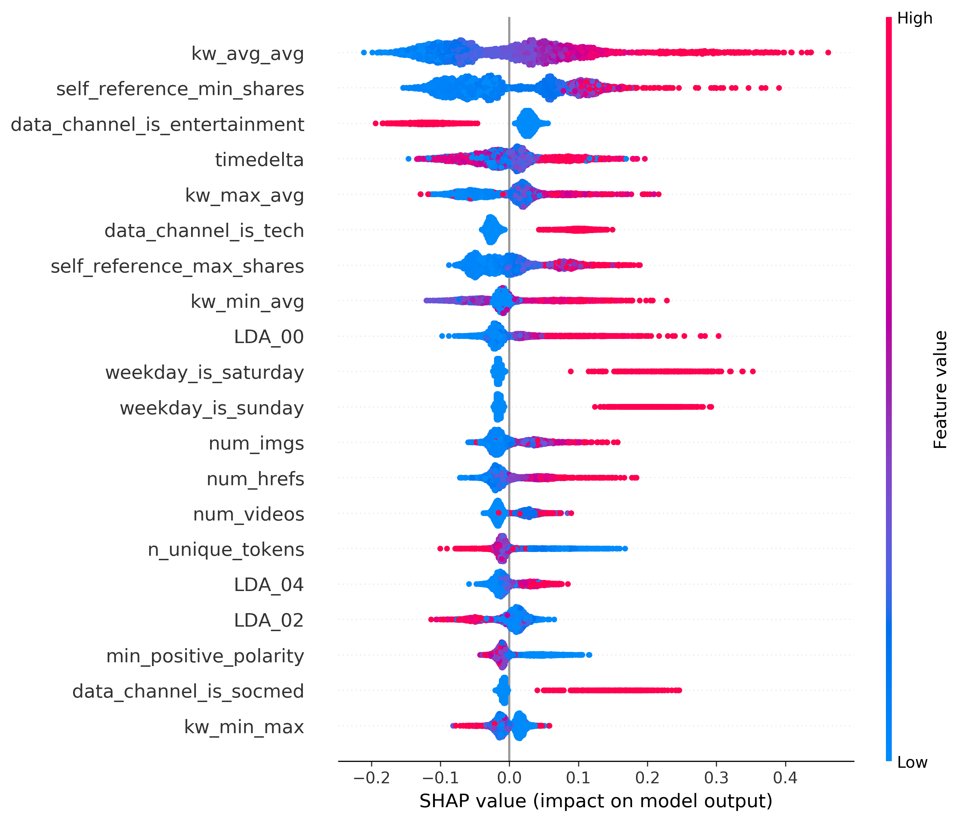
SHAP values (feature importance)

Slide 14
Identifying articles for improvement
Used Kprototypes to cluster data into k clusters and identify representative articles at the center of each cluster
Similar to Kmeans but works with mixed data types
The optimal number for k was assessed for the range 1:10 using elbow plot

Slide 15
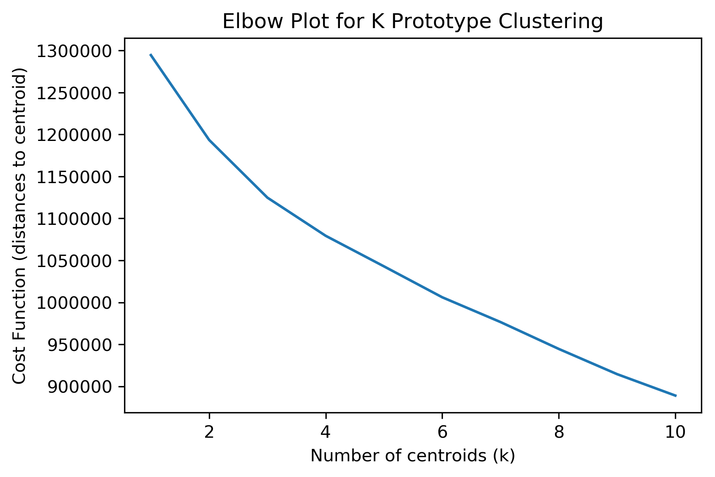
Kprototype Elbow Plot
Because no elbow is apparent, it may be that there are no discernible clusters in the data, or there are significantly more than 10. With no clear choice, k=10 was used for simplicity to identify 10 representative articles.

Slide 16
Improving article shares
For each of the 10 articles, tweaked top 10 features (by SHAP value) that could be reasonably changed
Continuous features were modified by -10 to 10% of median value for that feature in full dataset
Images, hrefs, and videos were simply modified -5 to 5

Slide 17
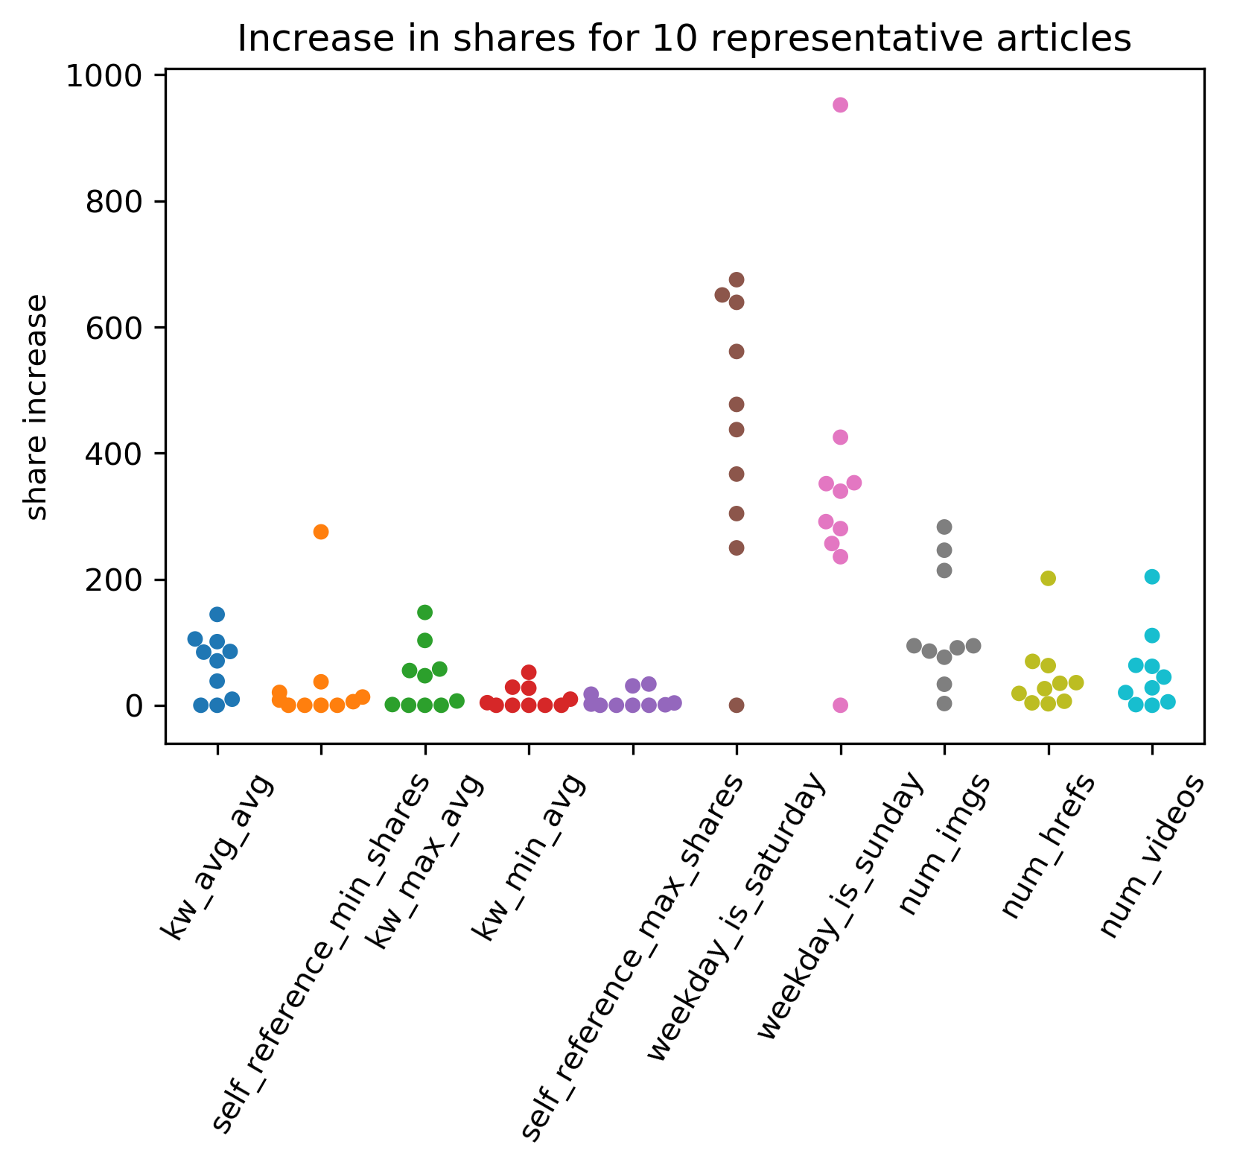

Slide 18
Conclusion
We were able to increase accuracy in the prediction of log(shares) for our test set from 0.690 (using mean) to 0.579
For reference, if an article was shared 1000 times and was predicted as 1992 shares, it would now be predicted as 1782 shares.
Across ten variables we were able to increase shares by an average of 117 using modest modifications.
Of course, whether these modifications would be useful would ultimately depend on the ease of implementation and the value of shares to the company.

