Slide 1


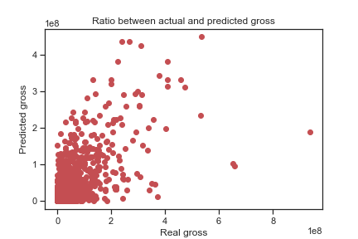
PREDICTING A MOVIE’S BOX OFFICE AND ANALYZING IT’S KEY FEATURES
Silver Spitsõn, Karen Saksakulm
INTRODUCTION
The aim of this project was to find the key features affecting the box office the most and analyzing the results.
DATA
We used data from Kaggle. We analyzed 6820 movies from 1986-2016. Some of the movies were missing the budget value, what we got from Wikipedia API.
PREDICTING AND DATA ANALYSIS
For predicting we used the Random Forrest Classifier. For analyzing we compared the values given and the predicted ones. Also looked up for the features affecting box office the most.
RESULTS
We found that the key features of movie’s box office are budget and the number of votes. We also found that what bigger the movie gross is, the bigger error between real and predicted gross was.

