Slide 1
TOPIC MODELING USING BIG DATA ANALYTICS
SESSION 2015-1016 (Minor project)
PRESENTED BY:
Farheen Nilofer (12-CSS-21)
Sarah Masud(12-CSS-57)

Slide 2
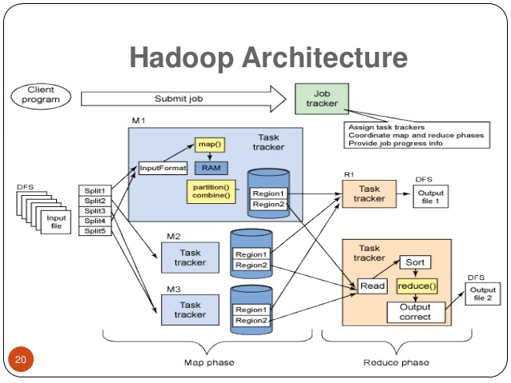
BACKGROUND:
Hadoop:Hadoop is a framework that allows for the distributed processing of large datasets across cluster of computers using computing paradigm like MapReduce.
MapReduce:MapREduce is a programming model processing and generating large datasets with parallel and distributed algorithm on a cluster.
HDFS:A distributed Java-based filesystem for storing large volumes of data.
FEATURES:
Highly Fault tolerant
Deployed on low cost hardware
High throughput for application having large data sets

Slide 3
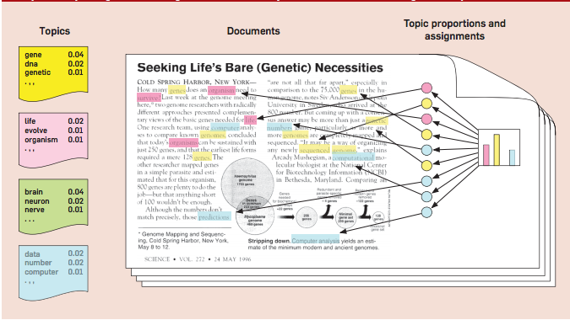
TOPIC MODELING AND IMPLEMENTATION:
Topic Modeling:
Topic models are a suite of algorithms that uncover the hidden thematic structure in document collections.
IN LAYMAN TERMS
A method of text mining to identify patterns in a corpus. Topic modeling helps us develop new ways to search, browse and summarize large archives of texts.

Slide 4
FIRST PHASE: Hadoop configuration (outline)
INSTALL JAVA
sudo apt-get install sun-java-8-jdk
CONFIGURE SSH
ssh-keygen -t rsa -P “ “
ssh localhost
ssh slave
HADOOP INSTALL
Download Hadoop
cd /usr/local
sudo tar hadoop
sudo chown -R hduser:hadoop hadoop
ADD THE FOLLOWING PROPERTIES IN conf/core-site.xml
hadoop.tmp.dir
fs.default.name
ADD THE FOLLOWING PROPERTIES IN conf/mapred-site.xml
mapred.job.tracker
ADD THE FOLLOWING PROPERTY IN hdfs-site.xml
dfs.replication
CONFIGURE /etc/hosts
COMMANDS TO RUN HADOOP:
/usr/local/hadoop/bin/hadoop namenode-format
/usr/local/hadoop/bin/hadoop/bin/start-all.sh
/usr/local/hadoop/bin/hadoop dfs -copyFromLocal <source> <destination>
/usr/local/hadoop/bin/hadoop/bin/stop-all.sh

Slide 5
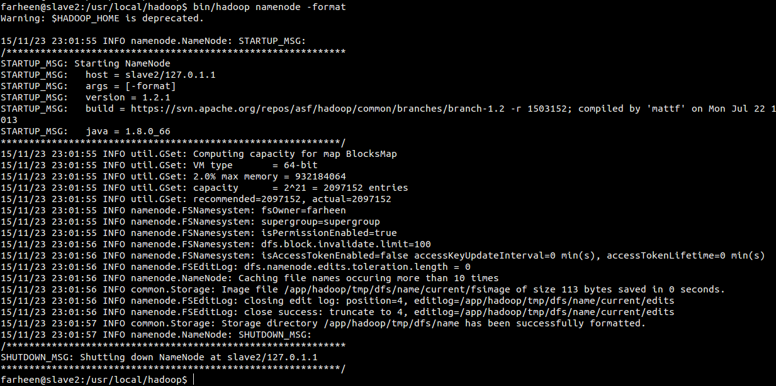
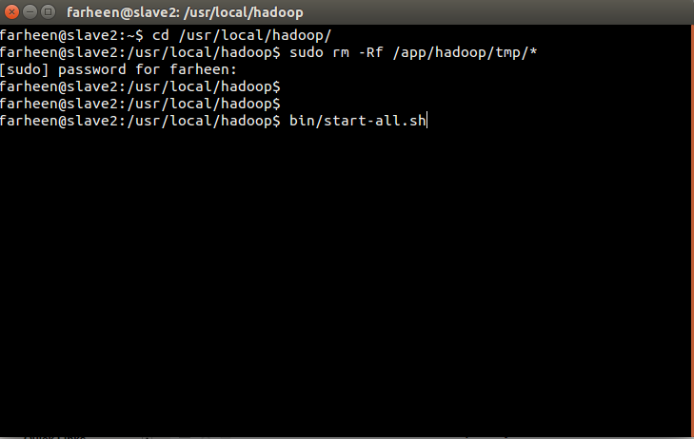
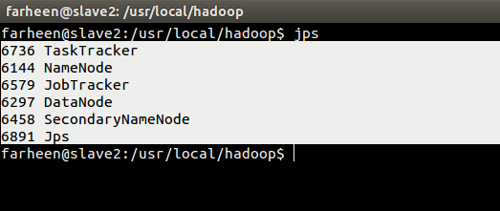
Word Frequency Program : Processing
Namenode Formatted
Starting Hadoop
All Process Running
Copy Files From Local To HDFS

Slide 6
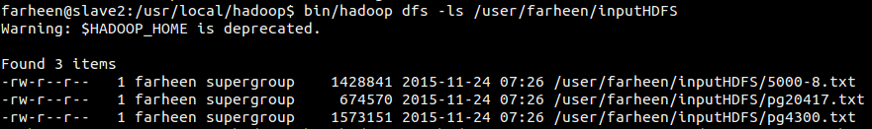
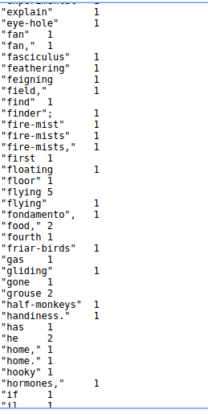
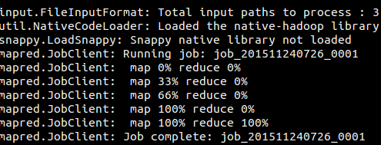
running jar of wordcount on data
list copied files
mapReduce Complete
Wordcount output

Slide 7
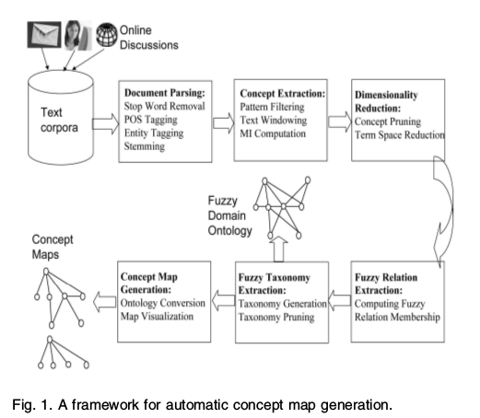
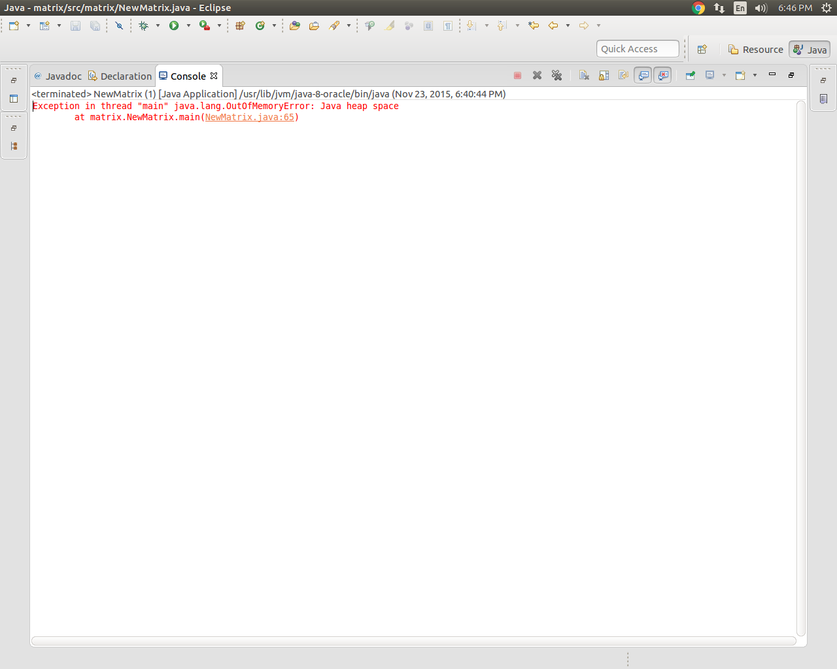
SECOND PHASE:
Implementation of Fuzzy Domain Ontology Extraction Algorithm
WHY WE NEED HADOOP FOR THIS PHASE ?

Slide 8
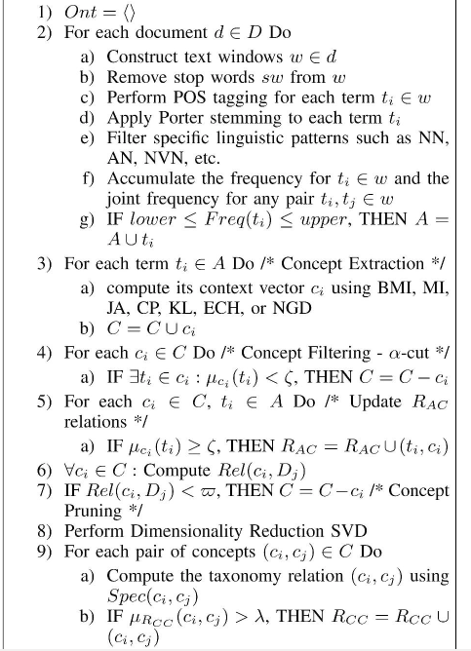
ALGORITHM:
Standard Preprocessing
Stop Word Removal
Cleaning using Reg Ex
Porter Stemming
Tagging
Noun Extraction
Text Windowing
Context vector formation
Mutual Information probability
Concept Filtering
Formation of Attribute-Concept Matrix
Fuzzy Relation Extraction
Concept Pruning
Fuzzy Taxonomy Extraction

Slide 9



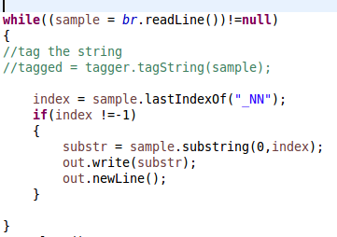
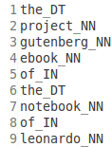


STEP 0: Standard Preprocessing:

Slide 10
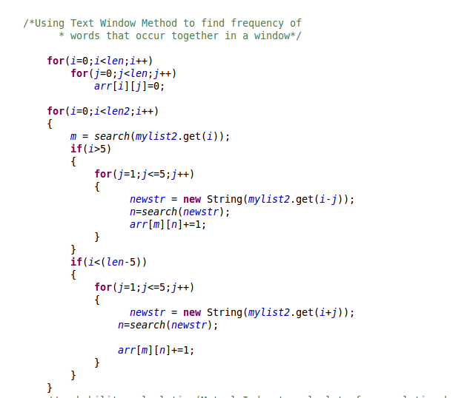
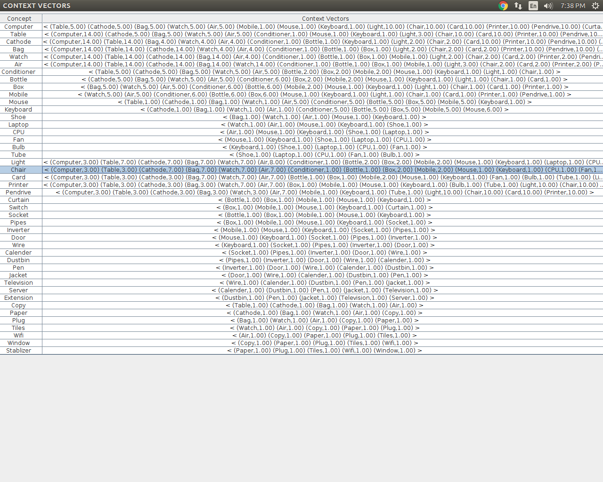
STEP 1: TEXT WINDOWING
STEP 2: CONTEXT VECTOR

Slide 11

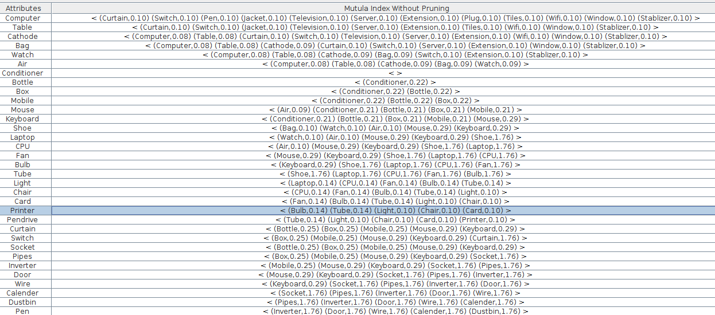
MUTUAL INFORMATION:

Slide 12
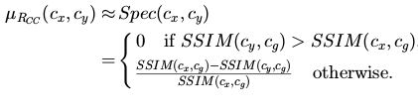
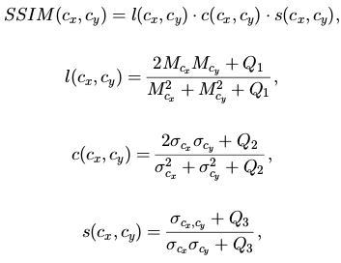
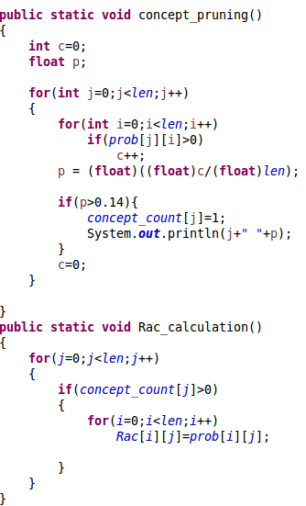
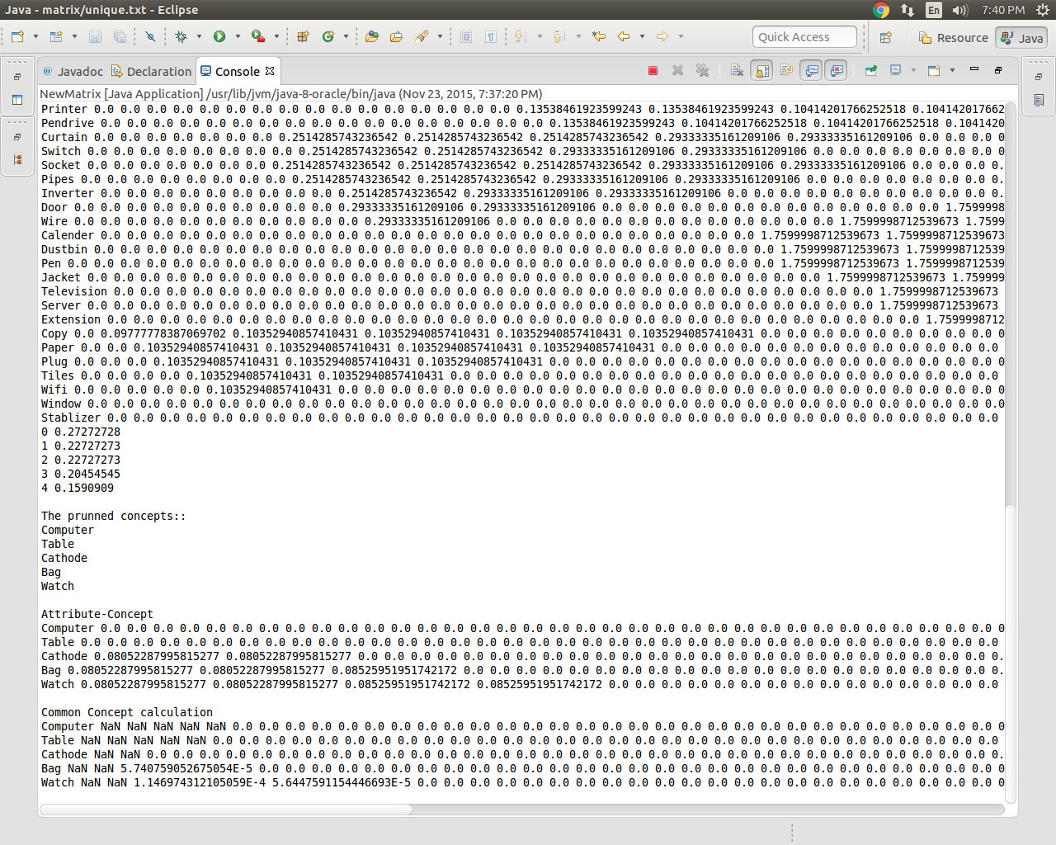

Slide 13
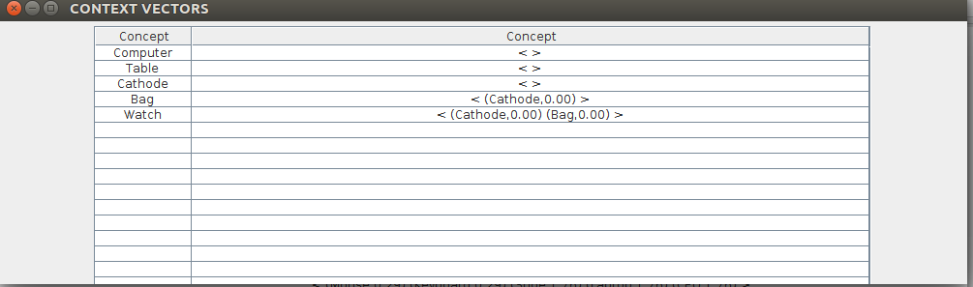
RESULT:
COMPUTER
TABLE
CATHODE
INTERPRETATION:
The attributes Computer, table and, cathode emerged as major independent concepts.
The attribute is subconcept of cathode, while watch is a subconcept of both. A pruning can be employed.
BAG
WATCH

Slide 14
WORK ACCOMPLISHED:
WORK TO BE DONE:
Configuration of hadoop on single system.
Configuration of hadoop on multi cluster system (3 systems currently).
Development and implementation of Fuzzy ontology extraction algorithm.
Graphical display of concept vectors.
Complete and convert the algorithm in Map-Reduce form.
Application of algorithm on big data set.
Construction of Concept graph.

Slide 15
REFERENCES:
ACKNOWLEDGEMENTS:
Toward a Fuzzy Domain Ontology Extraction Method for Adaptive e-Learning
Probabilistic Topic Models for Learning Terminological Ontologies
The Role of Domain Knowledge in a Large Scale Data Mining Project
A Short Fuzzy Logic Tutorial
Dr Tanvir Ahmad
Rafeeq Ahmed
Michel Noll
Sujee Maniyam
Petri Kainulainen

Slide 16
THANK YOU

