Slide 1

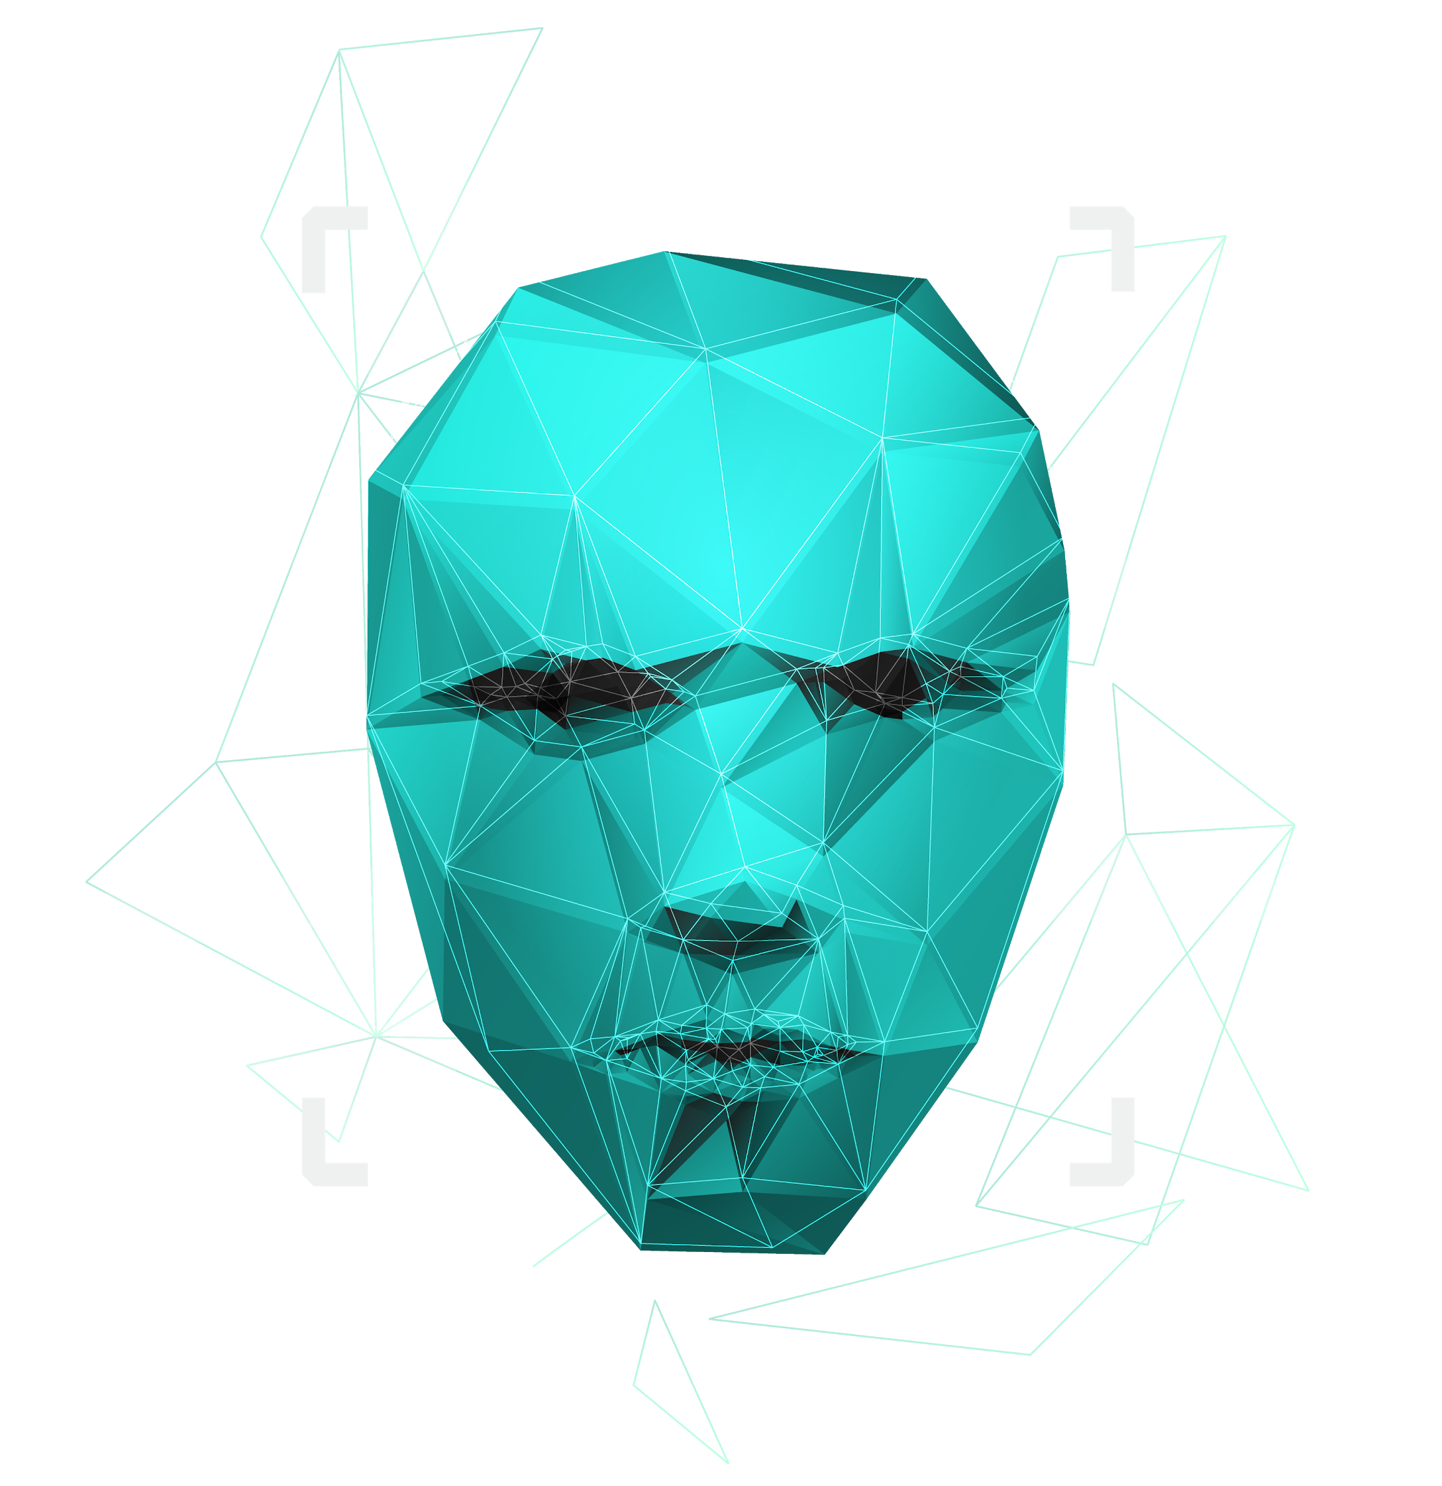
Term Project
Machine Intelligence and Expert Systems

Slide 2

Group 14
17EC35025 SK IZAJUR RAHAMAN
17EC10065 AADI SWADIPTO MONDAL
17EC35012 KANISHKA HALDER
17EC10034 NISCHAY RAJ
17EC10046 RISHAV SHARMA

Slide 3

INTRODUCTION
Passwords are one of the critical problems of cyber security today. In shard accounts authentication using password is not safe as it is easy to get password shared among un-authenticated users.
In contrast, behavioral biometric continuously monitors user activity, which can be used to verify authenticity of the user.
This security based on biometrics can thus easily differentiate an unauthorized user from an authorized user.
Biometrics based security can also distinguish between human and non-human interaction. This helps in bot detection and can limit exploitation by bot-net programs.

Slide 4
INTRODUCTION
Biometrics based validation can continually screen the conduct of a user without blocking any work. It can continually follow user data and make a computerized unique mark of that user.
A Biometrics based authentication system would work in the following way. Once the model is trained on a user's data it can be used to generate a confidence score for that user. Depending on thresholding a user may be provided access or might be barred from further use.
Behavioral biometrics checks for patterns of behavior that are characteristic and variable over time. That’s the motivation behind using behavioral biometrics.

Slide 5

Problem Statement
Mouse Dynamics is another behavioral biometric which is used to authenticate a user. A mouse stroke is defined to be the set of points traversed from one click to the next and a set of one or more strokes are used in order to verify a user. The mood of a person affects these two behavioral biometrics. So, analysis of mood of a person may prove to be very crucial while authentication using keystroke or mouse dynamics.
The project can be divided in 3 parts:
Data acquisition for Mouse Dynamics
Feature extraction of acquired data
Training a KNN Classifier for user prediction

Slide 6
DATA ACQUISITION:
We have taken continuous data of Mouse Log, Keylogger, in additional we have taken data of both mouse log and keylogger for emotion classification using GUI as instructed.
The mouse log file for each session contains data in the following format –
X and Y coordinates of the mouse position and time taken to perform the following tasks: MM: Mouse Movement
MD: Mouse Drag
MP: Mouse Press
MC: Mouse Click
FEATURE EXTRACTION:
The following features are taken into consideration for training the classifier
Whether it is a left click or a right click. Position of mouse click or mouse press while scrolling. Whether it is a single click or a double click. Time elapsed in each click or press. Average speed of the drag while scrolling in x and y directions. Average acceleration of the drag while scrolling in x and y directions.

Slide 7
Machine Learning Model
Mouse Dynamics is another behavioral biometric which is used to authenticate a user. A mouse stroke is defined to be the set of points traversed from one click to the next and a set of one or more strokes are used in order to verify a user. The mood of a person affects these two behavioral biometrics. So, analysis of mood of a person may prove to be very crucial while authentication using keystroke or mouse dynamics.
The project can be divided in 3 parts:
Data acquisition for Mouse Dynamics
Feature extraction of acquired data
Training a KNN Classifier for user prediction

Slide 8
Results and Discussion
The accuracy we got on training the data using 5-fold validation is 41.1%
The accuracy can be increased further if we train the model by more and more data.
Since this is a high dimension data KNN classification might not be the best approach to classify such data​.

Slide 9
THANK YOU

