Slide 1
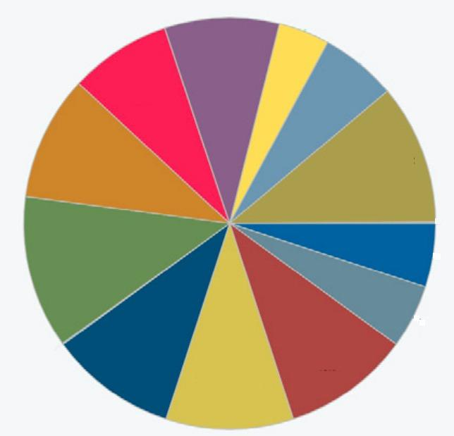
DNS
ARP
SMTP
IMAP
IP
HTTP
SSH
TCP
TELNET
HTTPS
FTP
UDP

