Slide 1

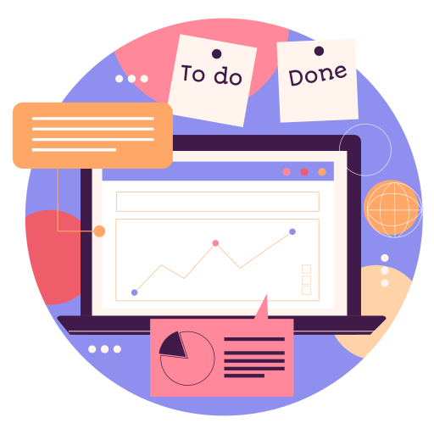
Creating a To-Do List App with Reminders and Notiﬁcations
Team 5
Rumour

Slide 2
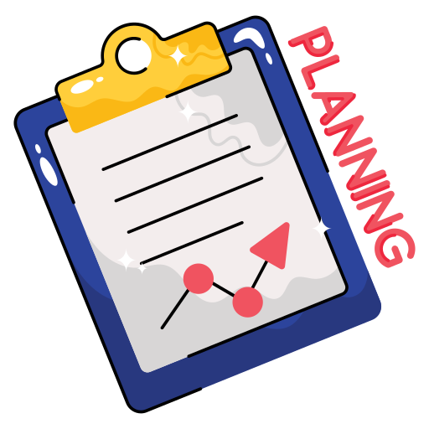

Ultimate to-do list Tracker
TaskTrack! Stay organized and on top of your tasks with ease.
Effortlessly create and manage your to-do list, set priorities, due dates, and receive timely notifications to keep you focused and productive.
Never miss a task again – download TaskTrack now and streamline your daily tasks like never before!

Slide 3
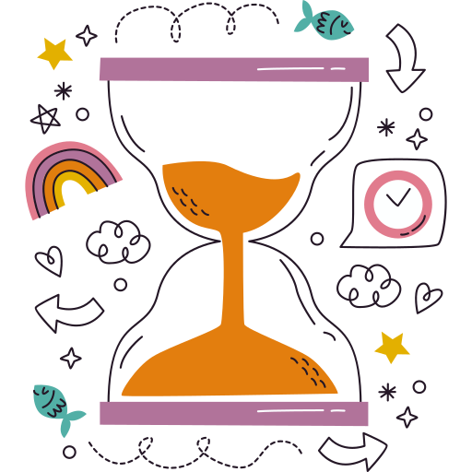
Introduction to the Application
Its a to-do list app that has a voice memo feature that is very efficient to use for everyone.
Its time efficient , don't you think typing takes too much time , just speak it out .
It has a time capsule that works as a description tool during pop-up notification .

Slide 4
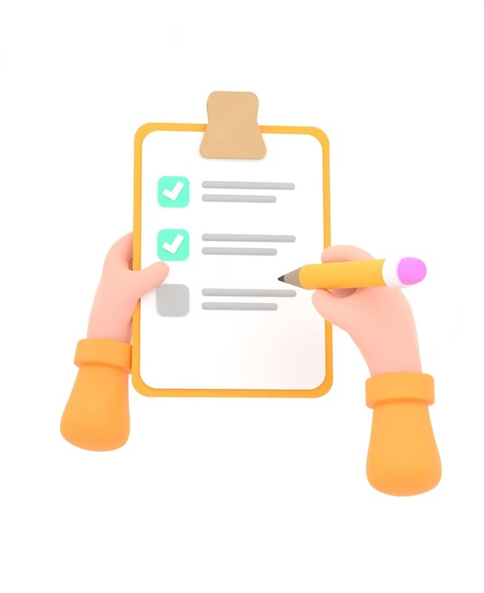

Client Task Management
This presentation will cover the development of a To-Do List App with customizable reminders and notiﬁcations. The app aims to increase productivity and efﬁciency in task management.

Slide 5
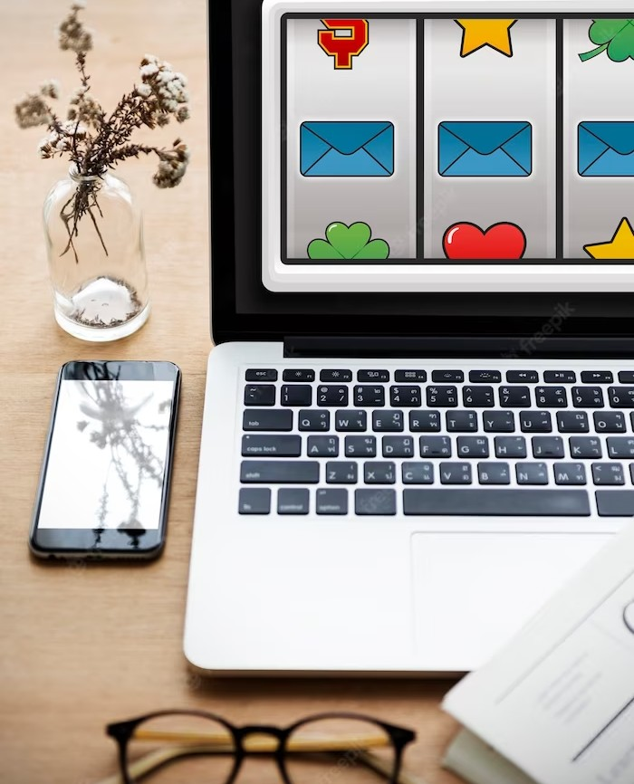
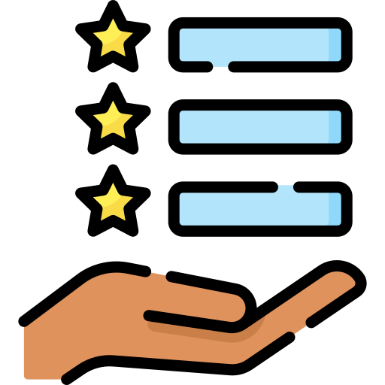
Features
The app will have features such as creating tasks, setting priorities, adding notes, and customizing reminders and notiﬁcations. Users can also categorize tasks and view them by date, priority, or category.

Slide 6
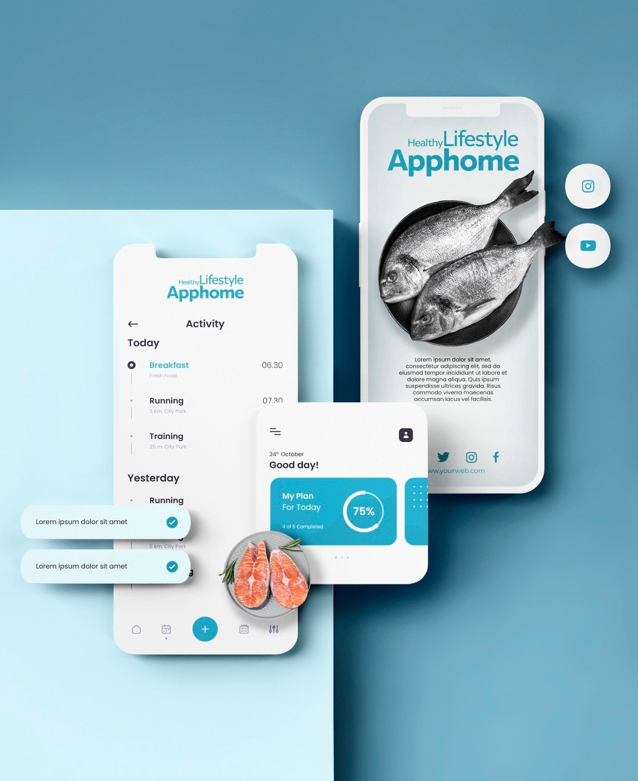
User Interface
The user interface of the app will be simple and easy to navigate. The design will be minimalistic with a focus on functionality. Users can choose from different themes and color schemes to personalize the app.

Slide 7

Development Process
The development process will involve agile methodology with regular feedback from users. The app will be developed for both iOS and Android platforms using flutter. The app will be tested rigorously before launch.

Slide 8
Conclusion
In conclusion, the To-Do List App with customizable reminders and notiﬁcations is a solution for efﬁcient task management. The app's features and user interface are designed to meet the needs of the target audience. The app will be available for download soon.

Slide 9
Thanks!
Do you have any questions?
Feel free to ask Silvi! :)

