Slide 1
POLECON 156
Silicon Valley and the Global Economy
Discussion Section · Week 2 — History of Silicon Valley (Part I): Review
Silvia Díaz de Rada · Section GSI · Fall 2026
DIS 101 Fri 10:00 · 106 Dwinelle DIS 102 Fri 11:00 · 333 UAB
Notes:
Week 2 review section, ~35 min of discussion + the 10-min written reflection.

Slide 2
POLECON 156 · DISCUSSION SECTION — WEEK 2
What we covered this week
We traced how the region emerged — from orchards to a federally funded research-and-defense economy.
We put names to the story — the people who built the region and the institutions behind them.
We mapped the unique factors that shaped Silicon Valley and why it’s difficult to find these somewhere else
We examined Silicon Valley's less flattering side — structural inequality, the lack of diversity, self-reinforcing advantage, and the gap between the Valley's founding myths and its history.
We connected the 1960s Bay Area counterculture to the birth of the personal computer.
2
Notes:
Formal phrasing for the 'dark side': structural inequality / lack of diversity / self-reinforcing (vicious-cycle) advantage / myths and their paradoxes.

Slide 3
POLECON 156 · DISCUSSION SECTION — WEEK 2
Today
• 01 · The five pillars that made Silicon Valley — and keep it competitive
• 02 · How the Valley emerged, and what made Stanford different
• 03 · Written reflection
• 04 · Who is this? — Poll Everywhere activity
• 05 · Venture capital: why it mattered, and why it stayed closed
• 06 · The counterculture thread · immigrants and the legal system · Janet Yellen
3

Slide 4
POLECON 156 · WEEK 2 REVIEW
What are the five pillars we identified in class that shaped Silicon Valley — and keep it competitive over the long term?
Take 30 seconds. Then we build the list together.
4

Slide 5
POLECON 156 · DISCUSSION SECTION — WEEK 2
The five pillars
1 · The state / government policy War and great-power competition have driven US innovation for 80 years. Federal and military money — WWII, the Cold War, Vannevar Bush's push for permanent research funding, Sputnik → NASA / ARPA / NDEA — built the foundation. In 1958, ~80% of Fairchild's business was government contracts.
2 · Research universities They supply the people. Stanford above all — Terman's applied-engineering culture, the Research Park, the faculty–student–industry loop — plus Berkeley, San José State, UCSF (biotech), Santa Clara (law).
3 · Venture capital Funding for ventures banks would never touch. Georges Doriot (1946), then the federal SBIC program (1958) that leveraged private risk capital, then the Valley's own firms from 1959. Decisive — but an insular network.
4 · Immigrants ~25% of US high-tech firms had an immigrant founder; ~40% of Valley firms by the internet era; ~44% of Bay Area residents are foreign-born. Berkeley and Stanford are the main pipelines.
5 · The legal system Valley law firms took equity instead of fees and built the scaffolding — incorporation, term sheets, M&A, IPOs. California's refusal to enforce non-competes keeps talent moving.
Running through all five: a transversal counterculture / anti-establishment ethos (see later).
4
Notes:
Cold-call students to name a pillar before revealing each. Live parallel for pillar 1: the war in Ukraine is now a defense-tech proving ground driving global drone investment.

Slide 6
POLECON 156 · DISCUSSION SECTION — WEEK 2
How Silicon Valley emerged
• Before the war it was orchards — the “Valley of Heart's Delight” — with a small radio-and-electronics cluster (Federal Telegraph; Hewlett-Packard, 1939).
• World War II changed the scale. Vannevar Bush's Office of Scientific Research and Development poured federal money into university labs; Stanford's Fred Terman ran a wartime research lab and returned determined to tie Stanford to defense work.
• The Cold War kept the money flowing — microwave, electronics, missiles. Lockheed Missiles & Space moved to Sunnyvale in 1956 and was the Valley's largest employer for decades.
• Semiconductors spun out of that ecosystem: Shockley (1956) → Fairchild (1957) → Intel (1968). In 1958, ~80% of Fairchild's revenue came from government contracts.
• Sputnik (1957) triggered another surge — NASA, ARPA, and the National Defense Education Act (1958): money for space, and for universities.
• It was never insulated from politics or the business cycle. Defense budgets and the tech stock market rise and fall together — Washington shifts or a recession hits, the Valley lays off and grants dry up, then it booms on the next wave (chips → PCs → internet → AI). O'Mara calls this “boom and bust.”
5
Notes:
Macro origin story = federal military money channeled through research universities into private firms; not a spontaneous free-market miracle. The Stanford slide next is the institutional *mechanism*. Boom-and-bust (Ch. 6): post-Korea drawdown, early-70s aerospace bust hit Santa Clara County hard.

Slide 7
POLECON 156 · WEEK 2 REVIEW
What did Stanford do that an ordinary research university would not?
One answer each — then we'll piece it together.
6

Slide 8
POLECON 156 · DISCUSSION SECTION — WEEK 2
What made Stanford different
• Land it could not sell. Stanford held a large endowment of land it was barred from selling; Fred Terman's answer was to lease it — creating Stanford Research Park (1951), the first university-owned industrial park.
• Proximity became collaboration. Putting technology firms next to campus created a working loop: companies recruited students, hired faculty as consultants, funded research, and spun out of Stanford labs. Terman had already done this in miniature with Hewlett and Packard.
• A deliberate tilt toward industry and the military. Terman moved the university's resources into science and engineering and built an applied-engineering culture explicitly to serve the military-industrial complex — where most universities kept industry at arm's length.
7
Notes:
One cold call: 'What did Stanford do that a normal research university would not?' Answer: it fused the university with industry and the military on purpose.

Slide 9
POLECON 156 · DISCUSSION SECTION — WEEK 2
Written reflection
TODAY'S PROMPT
Why was the venture capital industry so critical to Silicon Valley's rise?
And, according to the first three chapters of The Code, what was the first “venture capitalist” entity in Silicon Valley?
Instructions
• 7 minutes (+2 to upload)
• Handwritten in your spiral notebook — no devices, open-book.
• One short paragraph per question — BOTH answers on the SAME single page.
• When you're done, take a photo and upload it to bCourses under this week's reflection.
8
Notes:
Reflection is graded randomly — students don't know which weeks. 4 pts (2 quality of answers, 2 thoughtfulness). Reinforce verbally: ONE page, both answers. The 'entity' wording nudges them past just naming a person.

Slide 10
POLECON 156 · DISCUSSION SECTION — WEEK 2
Open Poll Everywhere
On your phone or laptop, go to:
PollEv.com/pe156silviaddr
Your response = today's attendance
Notice a discrepancy in your Poll Everywhere points? Flag it with me within 48 hours.
Today's poll is an identification round — “Who is this?” — coming up next.
9
Notes:
Same attendance mechanism as every week. Keep it to ~1 minute, then move to the identification poll.

Slide 11
POLECON 156 · DISCUSSION SECTION — WEEK 2
Who is this?
EARLY FIGURES & THE MONEY
1 · Vannevar Bush
2 · Georges Doriot
3 · Fred Terman
4 · Bill Hewlett & Dave Packard
5 · Ann Hardy
6 · William Shockley
7 · The “Traitorous Eight”
8 · Arthur Rock
9 · Andy Grove
BERKELEY & THE COUNTERCULTURE
10 · Lee Felsenstein
11 · Pam Hardt-English
12 · Mario Savio
13 · Clark Kerr
PollEv.com/pe156silviaddr · multiple-choice: “[name] was known for…” · 7 of these run live
10
Notes:
Drop Crystal's 'Notable Figures' composite (unlabeled) + the Ch. 8 Berkeley photos on this slide. The 7 live MC questions: Bush, Terman, Shockley, Rock, Ann Hardy, Felsenstein, Savio. Answer key: 1-B Bush=ran WWII federal R&D; 2-C Terman=Stanford Research Park; 3-D Shockley=first silicon lab 1956; 4-A Rock=financed the Eight, chaired Intel; 5-B Hardy=time-sharing at Tymshare; 6-C Felsenstein=Homebrew + Osborne 1; 7-B Savio=Free Speech Movement 1964.

Slide 12
POLECON 156 · DISCUSSION SECTION — WEEK 2
Who's who
Vannevar Bush — Ran WWII federal R&D; “Science, the Endless Frontier” (1945) → permanent federal science funding.
Georges Doriot — The first venture capitalist — Harvard Business School professor; ARDC (1946); funded DEC.
Fred Terman — “Father of Silicon Valley”; brought the MIT military/industry model to Stanford; built the Research Park.
Hewlett & Packard — Terman's students; founded HP in a Palo Alto garage (1939).
Ann Hardy — Built commercial nationwide time-sharing at Tymshare; underpaid and overlooked.
William Shockley — Co-invented the transistor (Nobel 1956); Shockley Semiconductor (1956) brought silicon to the Valley.
The “Traitorous Eight” — Quit Shockley in 1957 → Fairchild. Incl. Noyce, Moore, Kleiner. “Fairchildren” seeded the Valley.
Arthur Rock — Financed the Eight's move; made “venture capitalist” a job title; funded and chaired Intel.
Andy Grove — Hungarian refugee; Intel #3, later CEO; chips as “high-tech jelly beans.”
Lee Felsenstein — Cal EECS; MC of the Homebrew Computer Club; designed the Osborne 1, the first mass-produced portable.
Pam Hardt-English — Cal CS dropout; led Community Memory — a public computer terminal in a Berkeley record store.
Mario Savio — Leader of the Berkeley Free Speech Movement (1964); the “bodies upon the gears” speech.
Clark Kerr — UC President; 1960 California Master Plan; fired by the Regents in 1967 after Reagan's election.
11
Notes:
Call out Bush + Terman as the evidence that the Valley was never 'self-made' or libertarian.

Slide 13
POLECON 156 · DISCUSSION SECTION — WEEK 2
Venture capital — why it mattered, and why it stayed closed
• It financed the un-financeable. A bank wants collateral and steady repayment; a startup has neither. Venture capital put in equity, took a board seat, and absorbed the loss when a company failed — which made funding high-risk ventures possible at all.
• The government primed the pump — the SBIC. The 1958 Small Business Investment Act created the Small Business Investment Company program: the federal government licensed private investment funds and leveraged them, lending roughly $2–$3 of low-cost government money for every $1 of private capital. It multiplied the early risk-capital pool and seeded the Valley's first firms (Draper, Gaither & Anderson, 1959).
• But it became a closed circle. Venture capital is still an insular “old-boys network.” Many partners are former founders who back people like themselves; talent is evenly distributed, opportunity is not. Some rise in East and South Asian representation — very few Latino or Black investors. Who hears about a deal, and who gets the introduction, still favors insiders.
John Doerr, on “pattern recognition” (O'Mara, p. 75): backing “white male nerds who dropped out of Harvard or Stanford and have no social life.”
12
Notes:
Fund structure and the 'good VC' checklist are deliberately left out. Focus: why VC exists, the SBIC as government scaffolding, the diversity problem.

Slide 14
POLECON 156 · DISCUSSION SECTION — WEEK 2
The counterculture thread
• The setting. In the 1960s the Bay Area was the center of the American counterculture — the Berkeley Free Speech Movement (1964), anti-Vietnam protest, Haight-Ashbury, communes, a deep distrust of big institutions: government, the military, and corporations like IBM.
• The fusion. That looks opposed to a Valley living on defense contracts — but the two merged. A generation of engineers and dropouts applied the counterculture's “power to the people” politics to computing: take the machine out of the institution and hand it to the individual, and it becomes a tool of personal liberation. Engelbart's 1968 demo (augmenting human intellect); Felsenstein and Hardt-English's Community Memory (a public terminal in a record store); the Homebrew Computer Club trading schematics for free; Atari's irreverent workplace; Steve Jobs on LSD, India and Zen.
• The political legacy. Reagan ran for governor in 1966 against “the mess at Berkeley,” won, and ended tuition-free UC — fees, then tuition (now ~$17K plus fees).
• The paradox. That rebel, anti-establishment ethos became the self-image and the marketing of what is now one of the most powerful, concentrated industries on earth. The “disruptor” story survived the companies becoming giants — which is why it runs through every era, from Homebrew to “move fast and break things” to Burning Man.
13
Notes:
The 'explain it as a story' slide — four beats: setting → fusion → political legacy → paradox. Extra color: Stewart Brand's Whole Earth Catalog ('access to tools'; 'stay hungry, stay foolish'); Google hiring Eric Schmidt partly because he was a 'Burner.'

Slide 15
POLECON 156 · DISCUSSION SECTION — WEEK 2
Immigrants and the legal system
THE LEGAL SYSTEM
• Valley firms took equity instead of fees from cash-poor startups — the same risk mindset as a VC, and skin in the founder's game.
• They built the scaffolding: incorporation, bylaws, hiring contracts, term sheets, M&A, IPOs. Wall Street firms couldn't adapt; Valley-native firms (Wilson Sonsini — Larry Sonsini, Cal grad) still dominate.
• Conflict of interest is built in — the same firm may draft the term sheet for the investors across the table. “If there's no conflict, there's no interest.”
• California won't enforce non-competes (full ban since 2024; still enforceable in New York) → engineers job-hop → ideas and talent cross-pollinate → more dynamic than Boston's Route 128.
IMMIGRANTS
• ~25% of US high-tech firms had an immigrant founder; ~40% of Valley firms by the internet era.
• ~44% of Bay Area residents are foreign-born; ~38% of AI engineers are Chinese-born.
• Berkeley and Stanford are the main talent pipelines; fully-funded STEM PhDs draw top talent on merit.
• The vulnerability: tightening student visas and work authorization directly benefits China's AI sector.
Closing question: does the Valley's reliance on immigrant founders make it stronger, or more vulnerable, as a global tech leader?
14
Notes:
Kept per your note; legal half now carries the equity/conflict-of-interest detail and the non-compete → job-hopping chain from class.

Slide 16
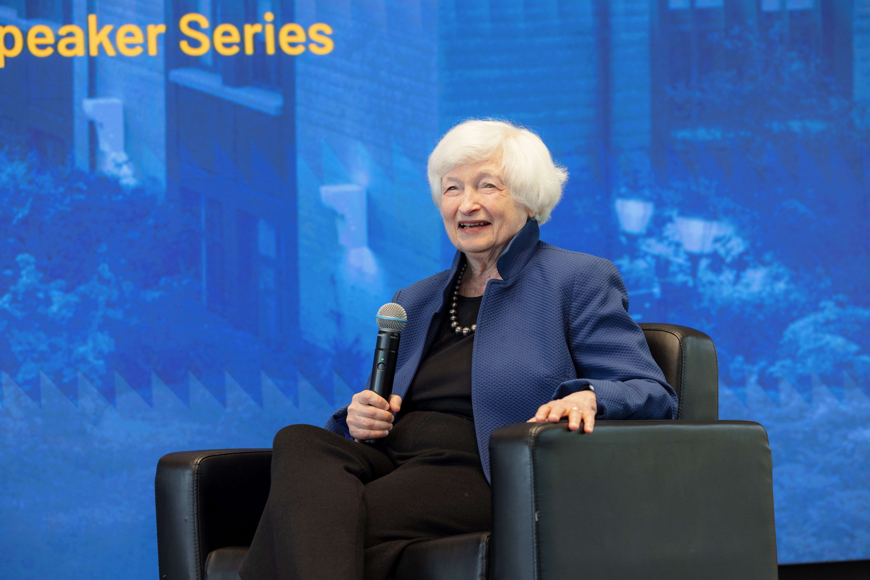
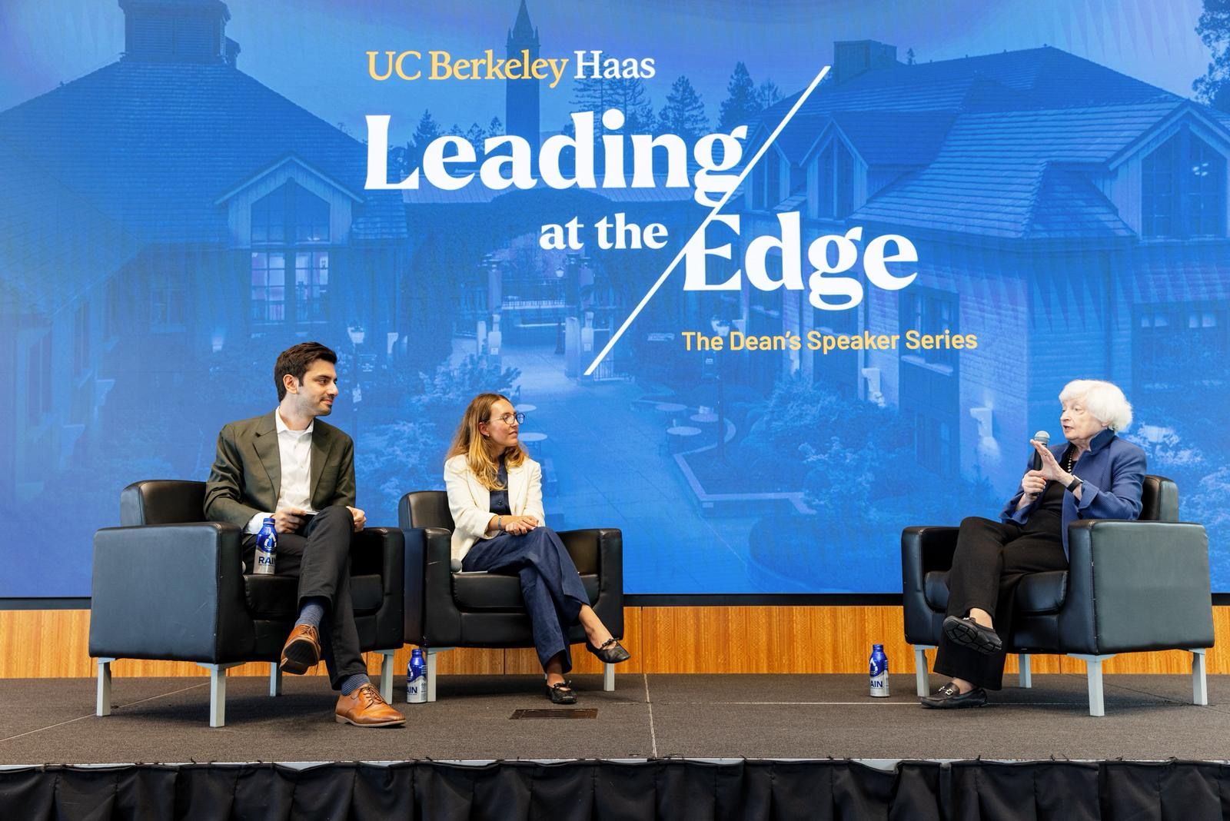
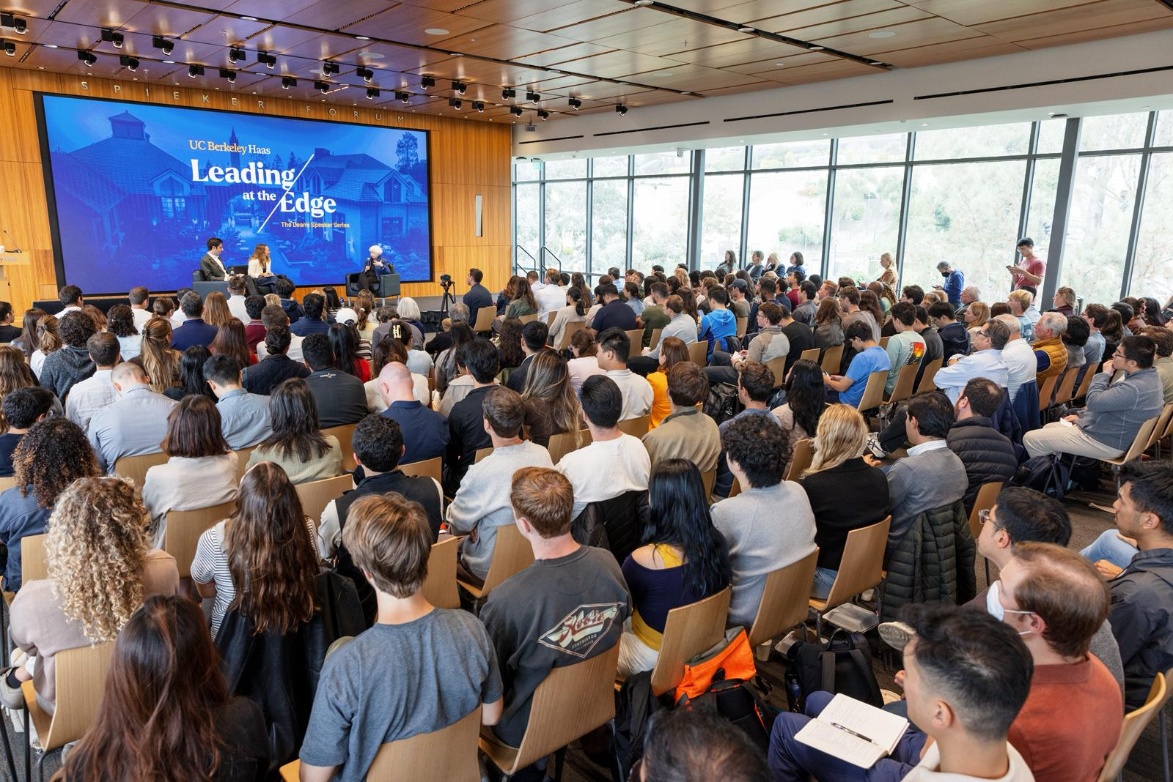
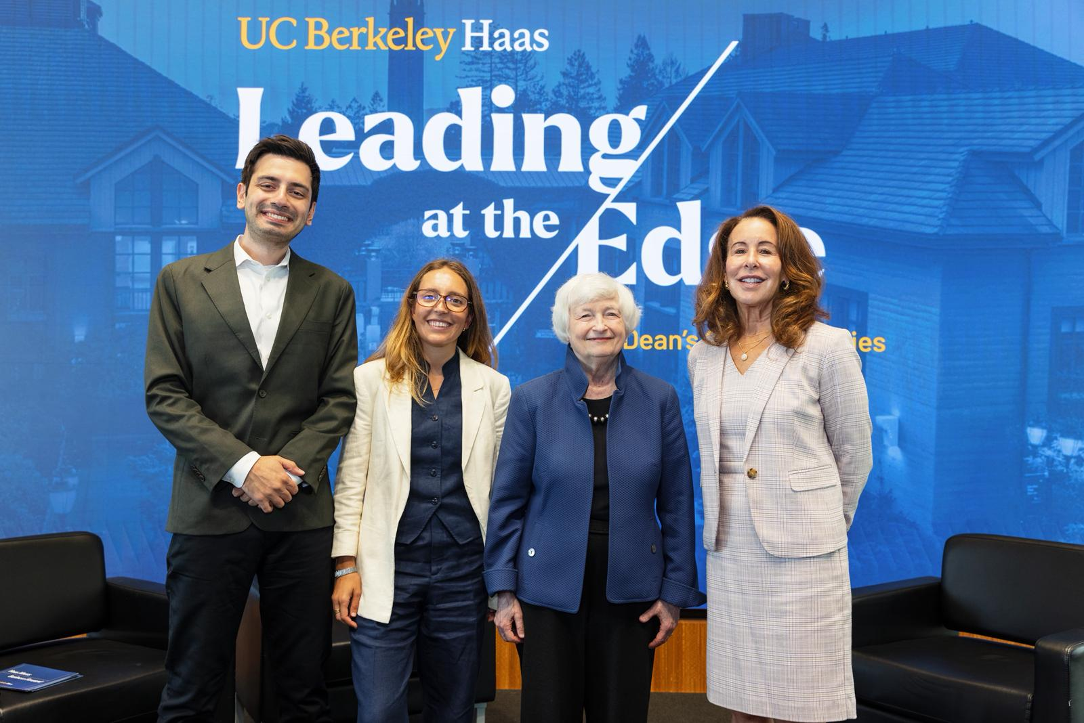
JANET YELLEN AT BERKELEY · “LEADING AT THE EDGE” · SEPT 2, 2026
Berkeley Haas professor emerita (1980–94); Chair of the Federal Reserve, then U.S. Treasury Secretary. Her whole career is about the state's role in the economy
“A job isn't just a paycheck — it's self-respect. My aim has always been an economy where people feel secure that they can find work and keep it.”
“Put tariffs on our allies and it makes little sense — but if the US and Europe act together, we have real leverage against China.”
Notes:
3 photo slots. Context line ties her to pillar 1. Gloss #1: employment as dignity, rooted in her father's Depression-era patients; AI already cutting entry-level hiring. Gloss #2: wary of tariffs (raise prices, hit allies); prefers US+Europe coordination + industrial policy.

Slide 17
POLECON 156 · DISCUSSION SECTION — WEEK 2
Summary
THE FIVE PILLARS
• The state — military and federal money seeded it
• Universities — Stanford's model supplied the people
• Venture capital — financed the un-financeable, then closed ranks
• Immigrants — a growing share of every founding cohort
• The legal system — equity-taking firms, no non-competes
…and a counterculture ethos running through all five.
BEFORE YOU GO
• Upload your reflection to bCourses — one single page
• Attendance = your Poll Everywhere response
• One free discretionary absence — email in advance
• Devices away unless told otherwise
• Next week: Apple, Microsoft, Steve Jobs
15

