Slide 1
Digitalising and Automating Domain-Specific AI Model Cards for Radiotherapy
Silvia María, Herranz Hernández
BrainRain - 25th July 2025

Slide 2
Slide

Slide 3
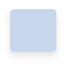

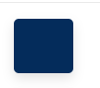
Colors of MIRO logo
HEX: #c7d6ea
RGB: rgb(199,214,234)
HEX: #042c5b
RGB: rgb(4,44,91)

