Slide 1

Analysis of the Italian energy mix evolution under various constraints
Models and Scenarios for Energy Planning A.Y. 2021/2022
Students: Silvia Laera, s288011 Alessandro Montaldo, s288009 Liselotte Nesme, s294148

Slide 2
Scenario definition: Assumed policies
Business as Usual (BAU) Scenario
Our Scenario
No GHGs emission limits
No expectations to reach NECP targets by 2030 → see MaxCapacity or MaxGenGroupLimit
NECP targets reached by 2030 and further increased (solar and wind)
Introduction of H₂ technologies
Emission limits on CO₂
H₂ blending in the natural gas grid with a maximum of 5% by 2030

Slide 3
Scenario definition: Technical constraints
Target set by means of MinGenGroupTarget on solar, wind and electrolysers groups
Applied on Activity (PJ)
Solar: 52 GW by 2030 and 71 GW by 2050
Wind: 18.1 GW onshore and 0.9 GW offshore by 2030 - Remove MaxCapacity on technologies - Set a value for MaxGenGroupLimit of 14 PJ for offshore group
Calibration for the electrolysers:
2022
100 MW
2025
1 GW
2030 5 GW
Notes:
Activity → to be sure that the plants are installed and used Wind → Since at the beginning the target set on the group entered in conflict with MaxCapacity set on techs, we removed it and set a value for MaxGenGroupLimit to be sure that a reliable capacity is installed (considering environemntal limitations especially for offshore plants)
Electrolyzers → calibration performed to avoid too sudden changes in the first future years

Slide 4
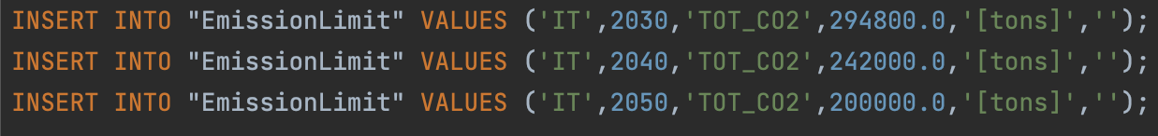
Scenario definition: Emission limits
Focus on CO₂ emissions:
Cut of 33%(*) by 2030
Cut of 80%(*) by 2050
Implementation:
New commodity for total emissions «TOT_CO2»
EmissionLimit parameter used
No linear interpolation in database_preprocessing.py
For 2050 no solution was found and a cut of 55% was chosen
(*) with respect to 1990’s level of 440 Mtons
Notes:
Italy follows the European targets (from the 2020/2030/2050 packages, the Paris Agreement...) with two scenario: the reference scenario and the decarbonization scenario. In our scenario, we mainly focused on CO2 emissions, imposing a target for 2030 of 33% reduction and 80% for 2050. Considering that no solution was found for 2050, we changed for a more reliable value of 55% of reduction (around 200 Mtons), that corresponds to the reference scenario and the Integrated national energy and climate plan. Constraints were applied on the overall emissions duplicating the rows of the tables CommodityEmissionFactor and EmissionActivity referred to sectorial commodities. EmissionLimit parameter was used for 2030, 2050 and also 2040 as no linear interpolation is performed for it in pre-processing phase.

Slide 5
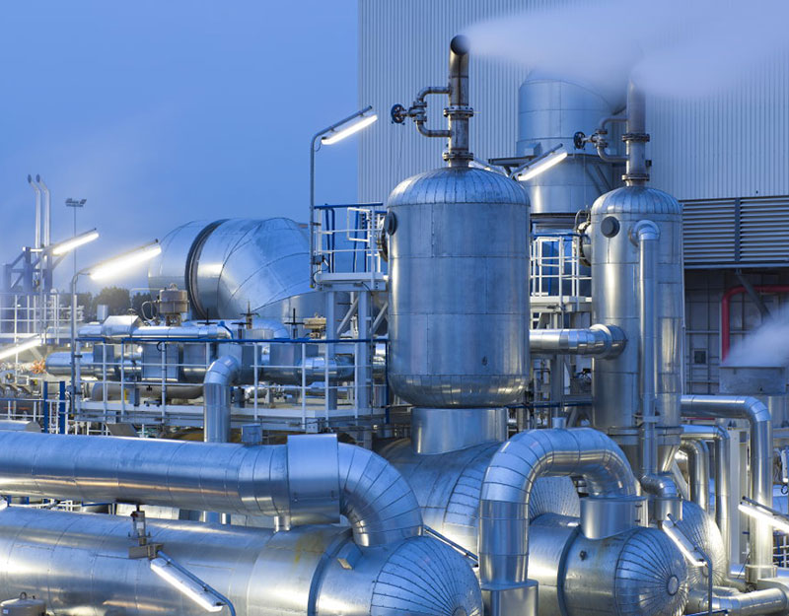
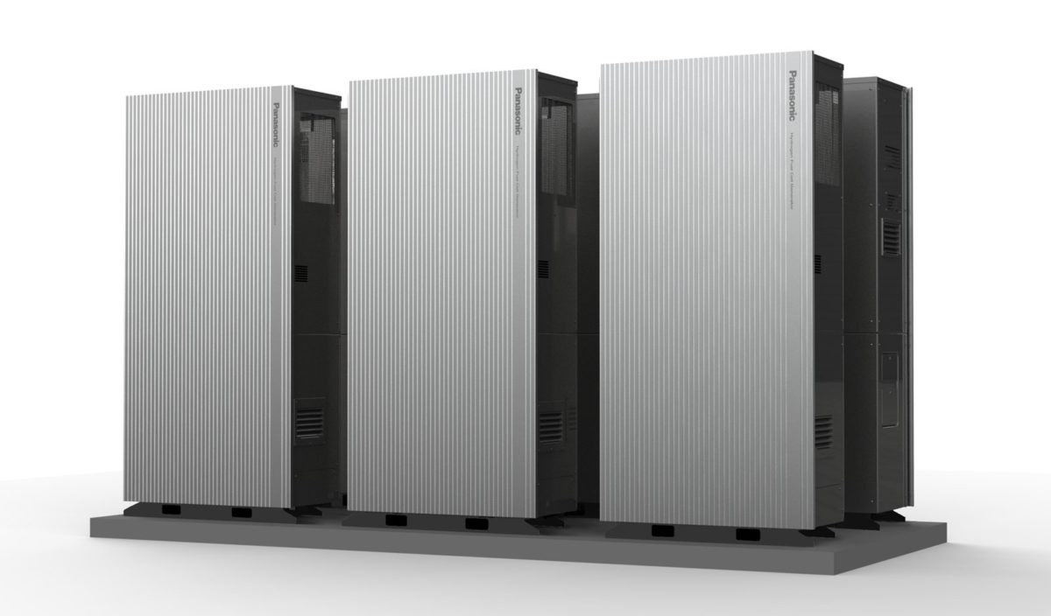
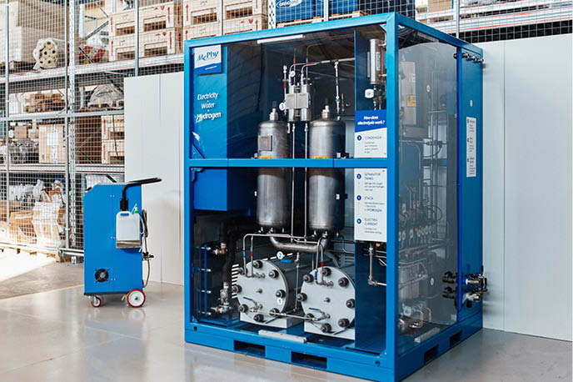
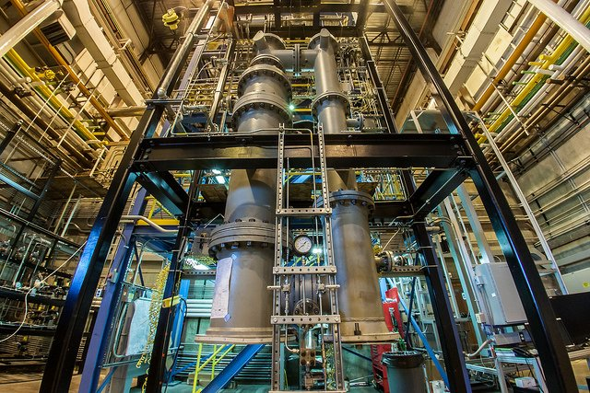
New implemented technologies: Hydrogen technologies (I)
Hydrogen production technologies
Energy production technologies
Grey hydrogen
Fuel cells
Electrolyzers
Chemical looping
Notes:
Hydrogen production technologies :
Set in the power sector
Grey hydrogen:
Main actual way to produce hydrogen
CO2 emissions coupled
Electrolyzers:
Clean way to produce H2
Three modelled types to allow model to choose with the imposed targets
Energy production
Fuel cells:
Three types
Modelled as CHP plants
Chemical looping
Hydrogen inside
From sun energy to heat and power

Slide 6
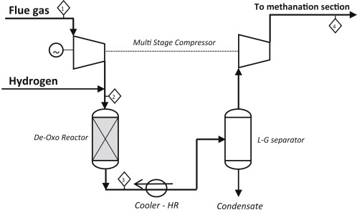
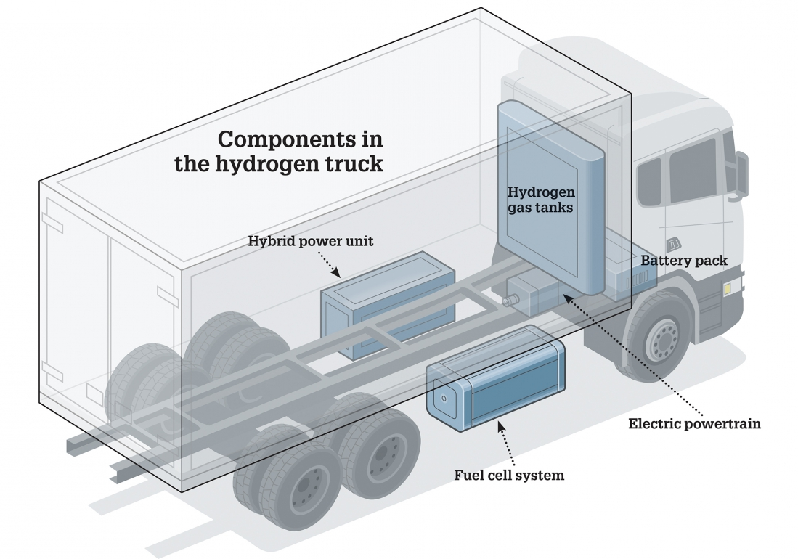
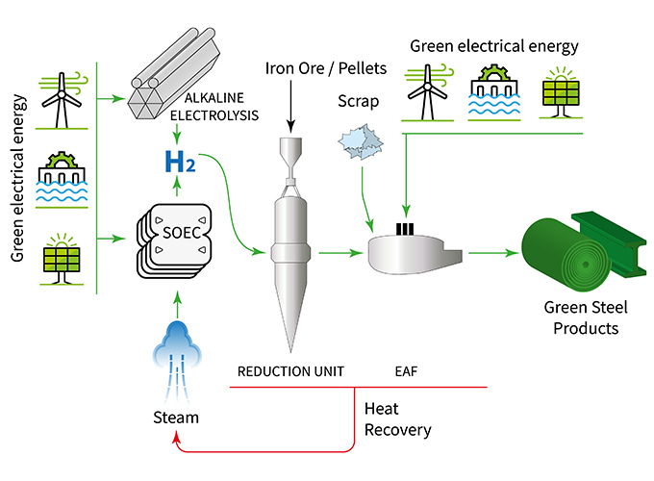
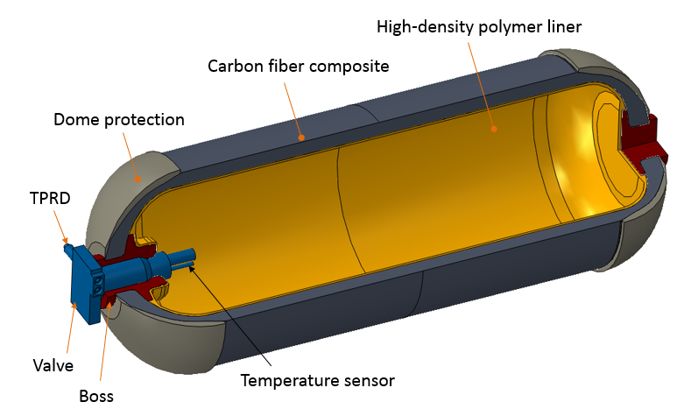
New implemented technologies: Hydrogen technologies (II)
Non power technologies
Methanation
Hydrogen trucks
Green steel
Hydrogen storage
Notes:
Methanation:
From electricity to NGA (electrolyzer in the plant)
New technology in upstream sector
Green steel
From electricity to steel (elec within the plant)
Hard to abate sector
Hydrogen trucks
Transport sector, only tech using H2 explicitely
Hydrogen storage
Only compressed hydro, to allow the use of hydrogen as electricity carrier

Slide 7
New implemented technologies: Hydrogen Blending
Commodity
Technology
COM_BLEND_GRP
MaxInputGroup
Negative Emission Factor
Notes:
Requires a deeper analysis:
Necessitate a new fictitious FT tech, to generate the commodity for Blending since the H2_tra already exist for example
This new commodity is then mixed in the already existing FT_NGA_N, as a choice only in the new FT
Requires a limit on the maximum share allowed, for physiscal reasons, and so it is required to use the MaxInputGroup available for groups only, ew group
Acconuting of the emission savings through a negative commodityEmissionFactor associated to belnding commodity, equal to the one of the UPS_NGA

Slide 8
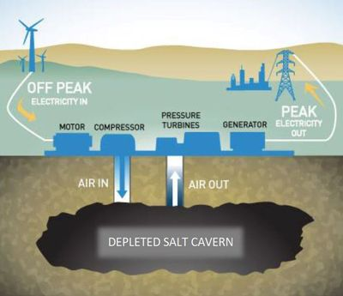
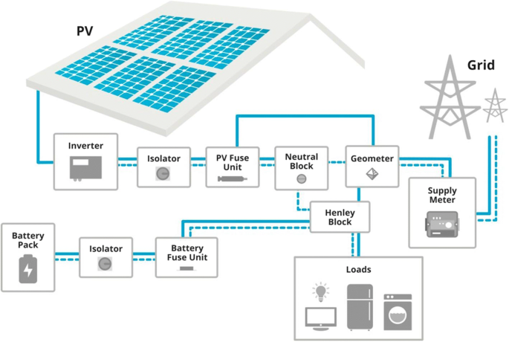
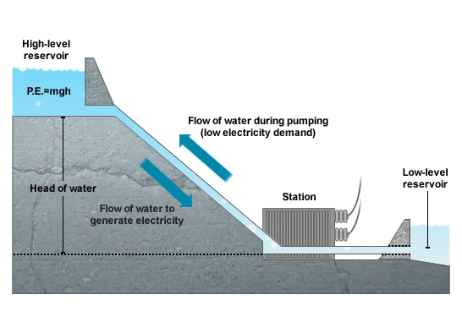
New implemented technologies: Energy storage technologies
Electrochemical Batteries
Compressed Air Energy Storage
Pumped Hydro Energy Storage
Notes:
New type of described technologies, not yet implemted in the code
Batteries: Li-ion and Lead-acid, cause main types of rechargable ones
Pumped Hydro and CAES: two alternatives for the storage of electricity in large size

Slide 9
New implemented technologies: Storage technologies
Modelling steps
Definition of the technologies as «ps»
Creation of the table TechStorage
Definition of the parameter StorageDuration
Try on a smaller database (Transport)
Test forcing the code
Implementation in the TEMOA.Italy database
Never installed
Notes:
Modelling of a new type of technology, required passages listed.
StorageDuration defines the required time to completely discharge the stored energy at full power starting from full charge.
Are enough to make the model run.
Analyzed steps in figure, used to test the script.

Slide 10
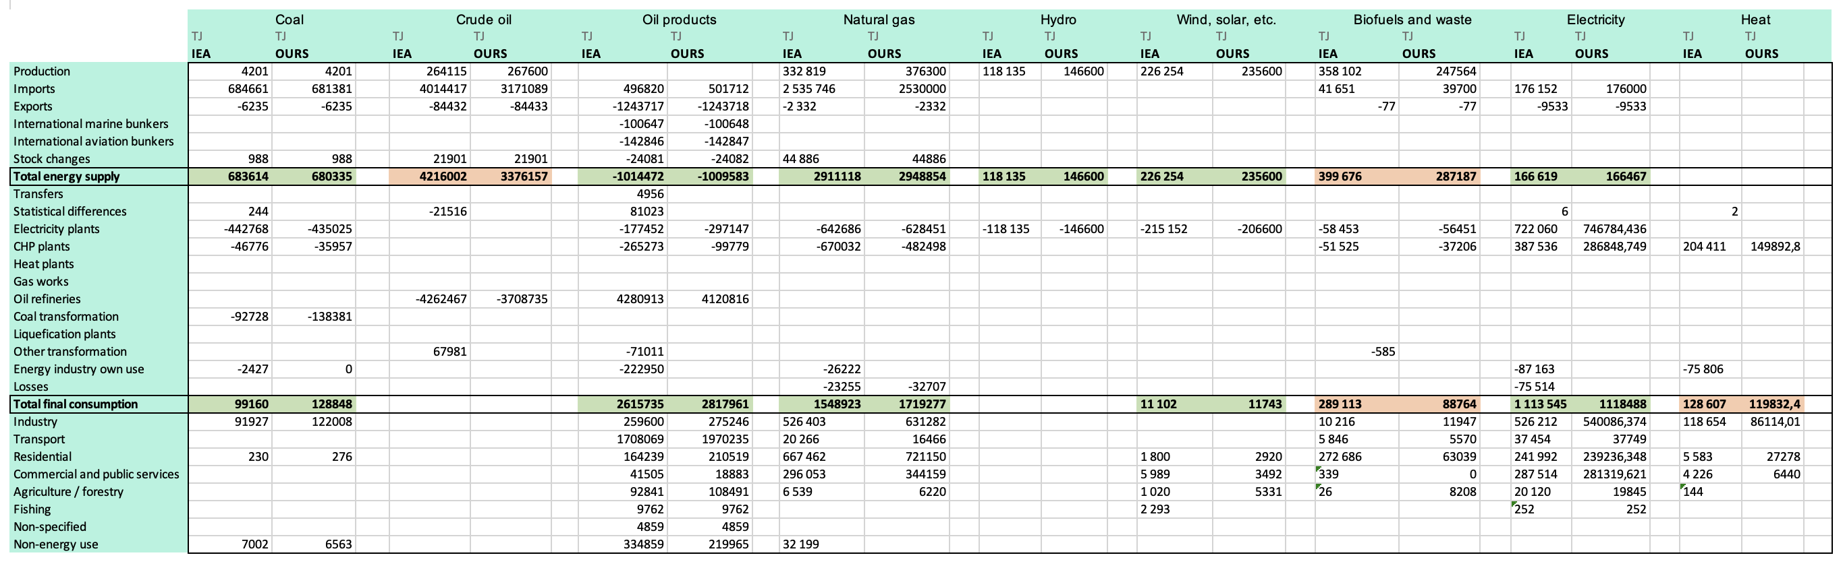
Results: Validation of the model
Comparison with energy balances (TJ) data from International Energy Agency IEA (and MAHTEP outcomes)
Similar results except for biofuels and waste (still in preliminary modelling)
No additional calibration
BY
2007
Today
2010
2014
2018
Notes:
Validate the model comparing past years results with IEA We got similar results (at least in order of magnitude) except for biofuels and waste which are in TEMOA-Italy still in preliminary modeling phase. However, anytime we got very different results with respect to the IEA ones, we always make a comparison with the one achived with TEMOA-Italy.sql file uploaded in Portale della Didattica in order to assess the nature of this uncertainty.

Slide 11

Results: Electricity sector
RES (solar, wind, hydro) production by 2030:
55%
EU target
60%
BAU scenario
66%
Our scenario
2050 projections:
Solar: 49 GW and 126 TWh in both scenarios
Wind: in BAU 1.6 GW and in our scenario 40 GW
Is it too high for ELC_WIN_TYPEA_N ? Yes, but actually not …
Notes:
Mainly focus on electricity sector since most of new technologies were implemented there 40 GW (even if no constraints were imposed for 2050!) Yes, but actually not… As said previously, we had removed the technical constraint on MaxCapacity on wind technology WIN_TYPEA_N, corresponding to roughly 20 GW. So even if 40 GW double this value, even with 20 GW, it would be significantly higher wrt BAU.

Slide 12
Results: Emissions
Sectorial emissions in our scenario:
 | 2007 | 2008 | 2010 | 2012 | 2014 | 2016 | 2018 | 2020 | 2022 | 2025 | 2030 | 2040 | 2050
Tot CO2 | 473588 | 460955 | 438211 | 415417 | 391787 | 379594 | 362813 | 351507 | 343549 | 324642 | 294800 | 247000 | 200000
UPS CO2 | 155 | 128 | 114 | 101 | 90 | 74 | 65 | 49 | 54 | 55 | 36 | 46 | 45
TRA CO2 | 143800 | 142162 | 136328 | 131840 | 128248 | 129131 | 129976 | 129854 | 130369 | 131208 | 126467 | 113320 | 91255
RES CO2 | 55204 | 54395 | 51559 | 50384 | 50924 | 50162 | 49454 | 48057 | 47142 | 41698 | 41617 | 26225 | 2852
IND CO2 | 78425 | 68603 | 61753 | 56462 | 55704 | 57307 | 55080 | 52715 | 52461 | 52140 | 50979 | 54777 | 57065
IND CO2 P | 25280 | 21680 | 19557 | 17362 | 16865 | 16955 | 16034 | 14251 | 14001 | 13140 | 11845 | 10467 | 0
ELC CO2 | 142164 | 146007 | 138500 | 131033 | 114106 | 102307 | 90094 | 86734 | 81876 | 71605 | 51364 | 30528 | 37906
COM CO2 | 20211 | 20581 | 22723 | 20919 | 18793 | 16684 | 15216 | 13026 | 10779 | 7859 | 5359 | 4430 | 3602
AGR CO2 | 8348 | 7399 | 7676 | 7315 | 7057 | 6974 | 6895 | 6821 | 6866 | 6939 | 7133 | 7208 | 7274
Notes:
Looking at CO2 emission trends, it comes out that, even without introducing new policies and technologies, in 2030 Italy will reduce its emissions by 33% with respect to 1990’s level. However, in BAU scenario, after 2030, emissions are going to increase again, wasting the effort done up to 2030. As for sectorial emissions, the trends demonstrate that transport and industry sectors are the most hard-to-abate ones. As expected, power sector experiences a steep reduction in emissions, due to the high penetration of RES, but still much effort is needed to decarbonize it.

Slide 13
Results: Hydrogen blending
Industrial and residential receive the higher amounts of H₂
Decreasing trend from 2030 to 2050
Notes:
Power sector instead, is expected to have an increase in NG consumption as it is widely used in CHP plants which are allowing to phase out coal in electriicty and heating production

Slide 14
Conclusions & Future Perspectives
Natural gas still in the game in both scenarios → Diversity imports in the short-term, invest in H2 (and biofuels) in the long-term.
Without storage, RES will not be able to lead in the electricity sector → Investment and incentive schemes.
Net-zero emissions not reached at all → Efficiency improvements smart infrastructures, full circular economy.
Electrolysers' pathway is very ambitious ≠ the italian governement aims at reaching an installed capacity between 1 MW and 5 MW by 2026.
Notes:
Just to conclude, As for natural gas, it will still be in the game in both scenarios, and this represents a problem for both emission and security targets. To address this issue, In the very short-term, a feasible solution can be diversifying imports, while in the long-term only investmenting in hydrogen and biofuels In addition, without electricity storage, Renewables will not be able to lead in the electricity sector, therefore further investments and incentives schemes are needed for them as they very costly As for emissions, net-zero emission target wont’ be reached at all. For sure, efficiency improvements (example on building sector), smart infrastructure and adopting a full circular economy can help in reaching this target To conclude, the electrolysers’ pathway proposed already looks very ambitious if compared with the Italian government plans. At this stage, 5 GW by 2030 are not likely to be achieved…

Slide 15
Thank you for the attention!

