Slide 1
ST0249 -
AI & MACHINE LEARNING
CA2
P1939213
Silviana
DIT2A14

Slide 2
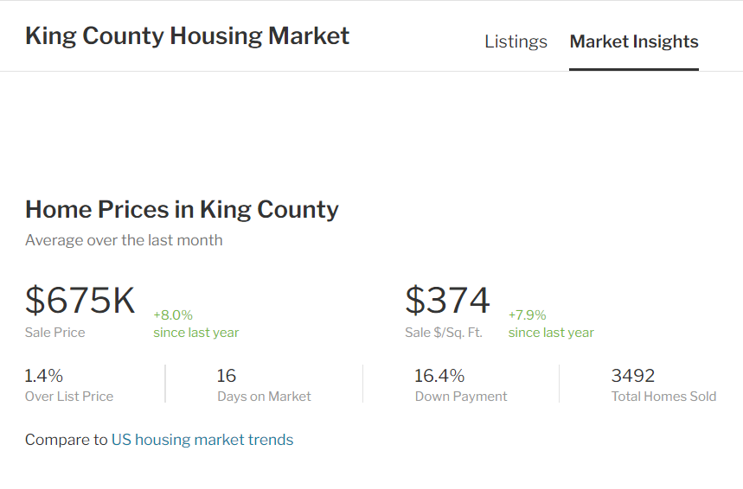
King County House Price
(Regression)
King County
King County is a county located in the U.S. state of Washington. The population was 2,252,782 in the 2019 census estimate, making it the most populous county in Washington, and the 12th-most populous in the United States. The county seat is Seattle, also the state's most populous city.
Goal
To build a machine learning model that predicts the price of a house based on the given house features.
The output variable is the housing price (USD).
Notes:
https://www.redfin.com/county/118/WA/King-County/housing-market

Slide 3
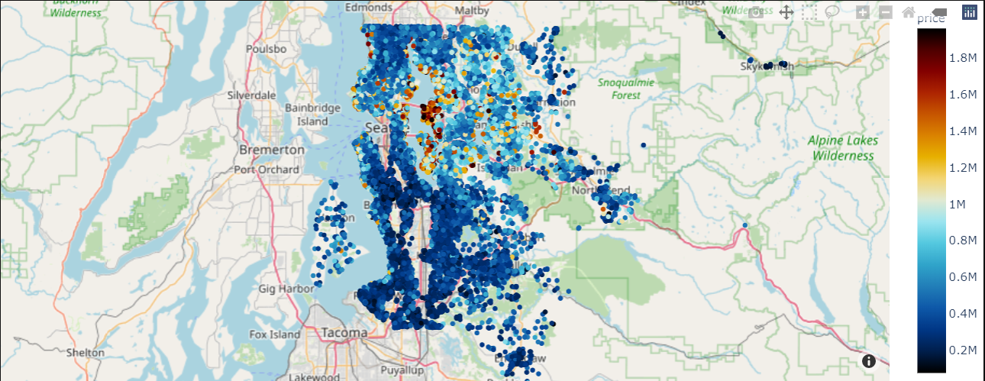
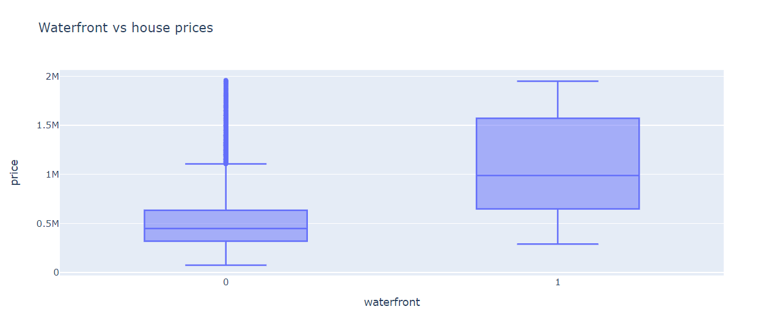
EDA
Houses in the waterfront are more expensive

Slide 4
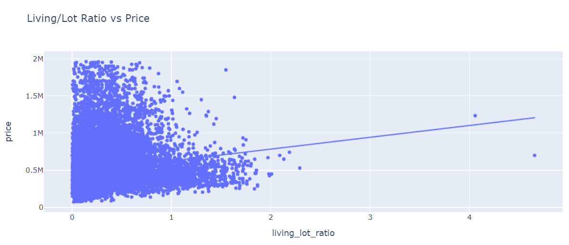
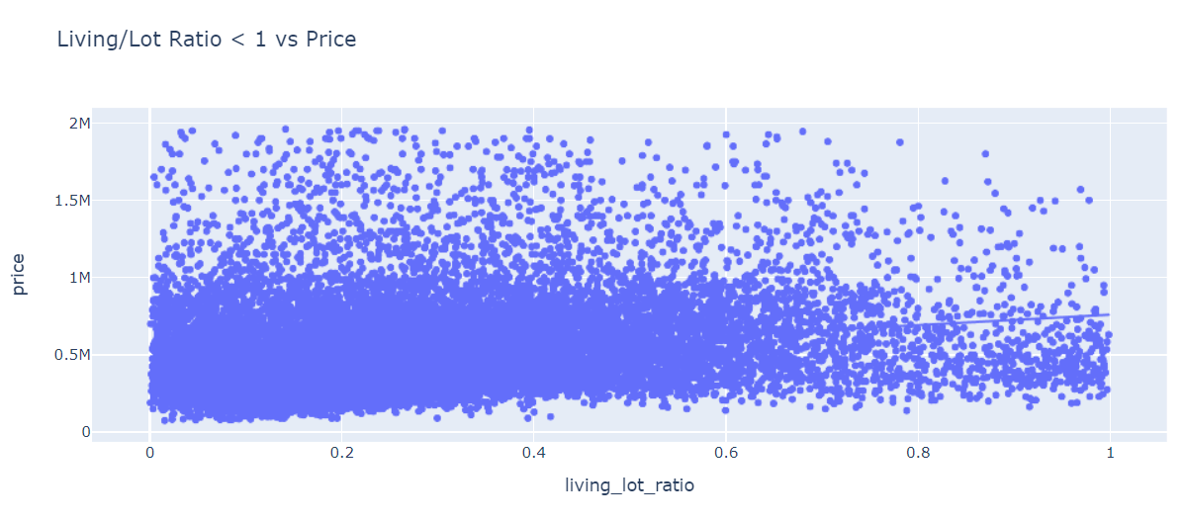
EDA
There seem to be a weak positive correlation between the living/lot ratio and price, with several outliers.
This graph shows that there is little to no correlation between having a large lot and the price.

Slide 5
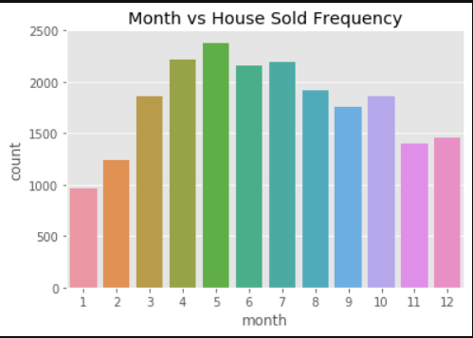
EDA
There are more houses being sold around the middle of the year compared to the start/end of the year.

Slide 6
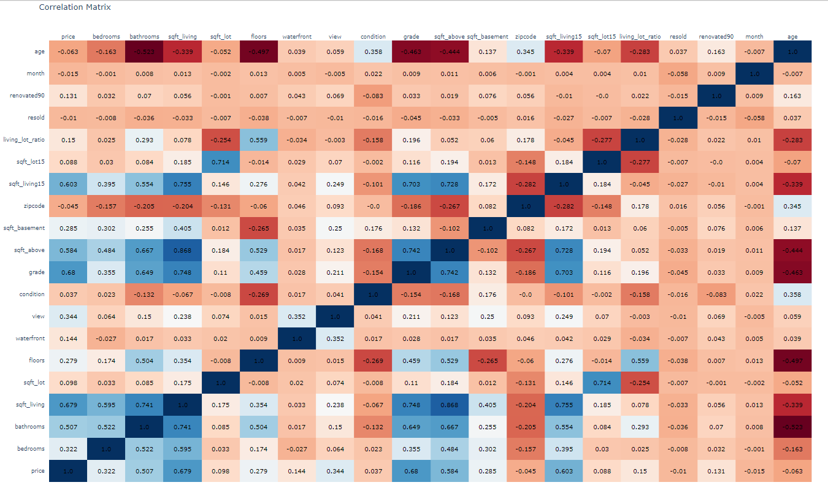
Correlation Matrix

Slide 7
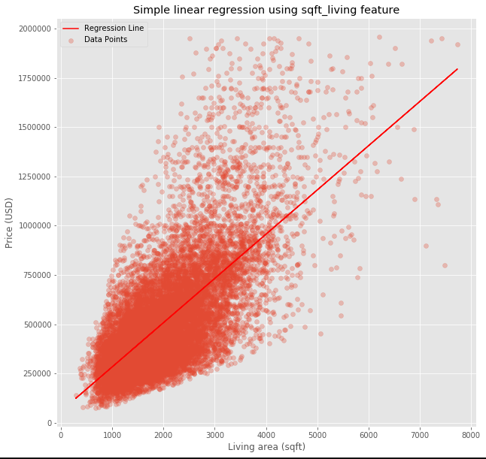
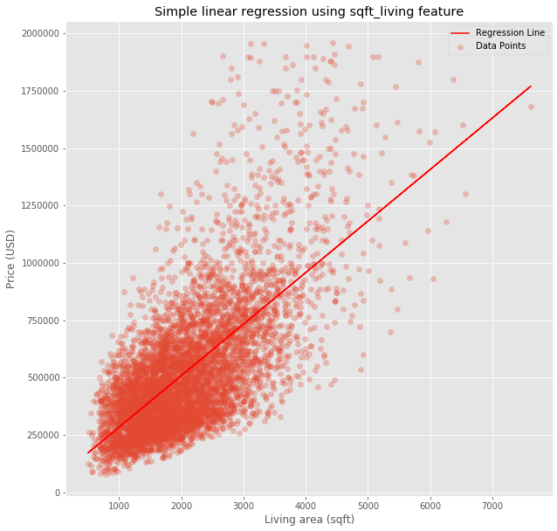
Simple Linear Regression
Train
Test

Slide 8
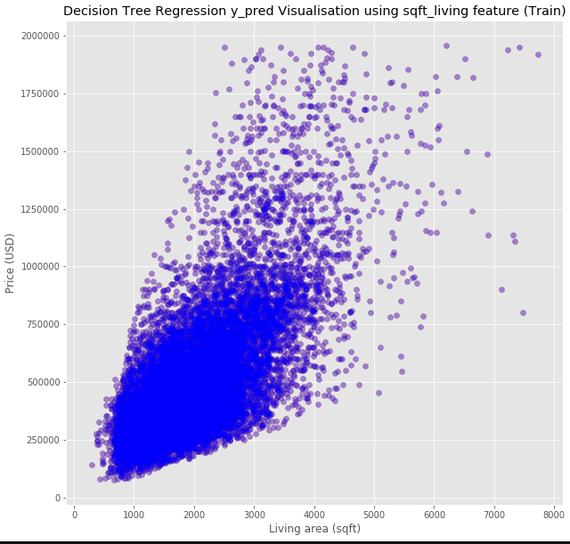
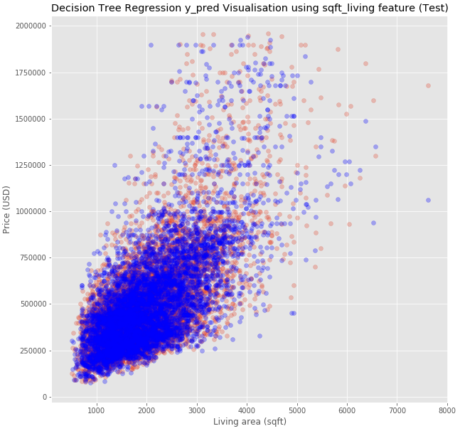
Decision Tree Regression

Slide 9


Slide 10
How is your prediction task defined? And what is the meaning of the output variable?
The prediction task is to predict the house prices based on house features.
Features Engineering
Living/Lot Ratio feature -> sqft_living/sqft_lot
resold -> If the house has been resold within the dataset (boolean)
renovated90 -> renovated after 1990
month -> the month where the house was sold
age -> date(year) - yr_built
encoded discrete values
Did you bring any additional sources of data?
According to an article from www.realtor.com, a full bathroom is made up of four parts: a sink, a shower, a bathtub, and a toilet. Hence, the bathrooms column refers to the number of bathrooms where the decimal points means that there are bathrooms without one/some of the four parts.
How did you select which learning algorithms to use?
Simple linear regression is the most widely used only considers 1 feature.
The next step to improve is to consider more features. We can use multivariable linear regression. However, it is susceptible to boolean values (one hot encoded). Hence, the mean square error is also higher.
To overcome the one hot encoded variables, decision tree regression is preferred as it evaluates left/right value.
How do you evaluate the quality of your system?
I am using root mean square error as a metric to evaluate my systems.
How well does your system compare to a stupid baseline?
It has higher R2 value than the stupid baseline. 0.640 - 0.464 = 0.176 increase.

Slide 11
Can you say anything about the errors that the system makes?
There is still a lot of noise in the data because I did not drop many of the outliers since I thought I could keep them.
I did not standardize the data.
There might be a more suitable model.
The data might not be linear.
Is it possible to say something about which features the model considers important?
The sqft_living feature is important because it has high correlation with the price from the beginning.

Slide 12
Iris Dataset
(Clustering)

Slide 13
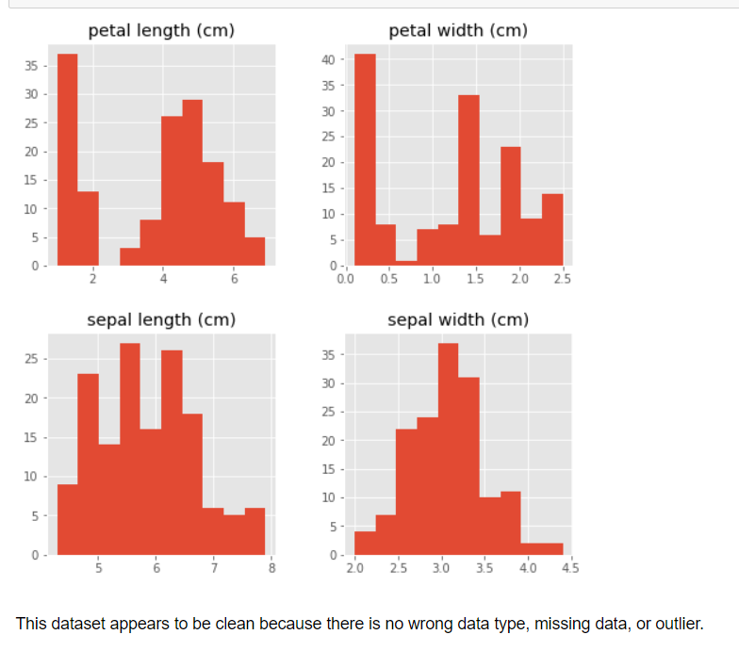
EDA

Slide 14
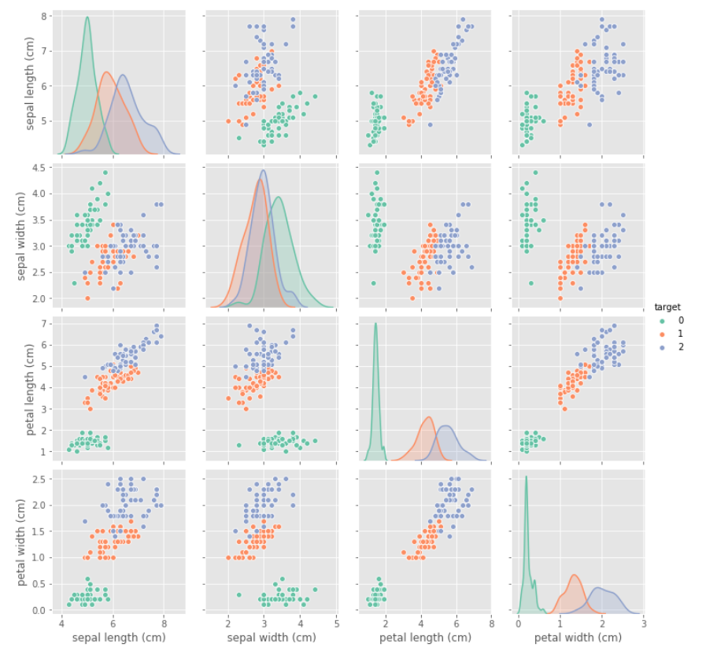
EDA
Target 0 is easily separable from the target 1 and 2

Slide 15
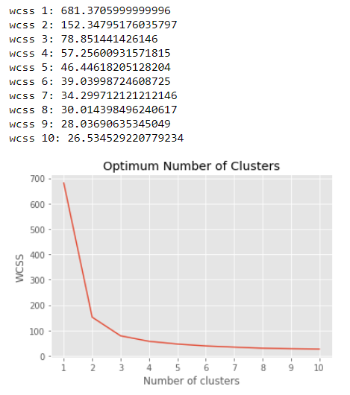
K MEANS
Let's first evaluate the optimum number of clusters by looking at the WCSS (within cluster sum of squares).
The optimum number of clusters in this case is between 2 and 3. Let's try both!

Slide 16
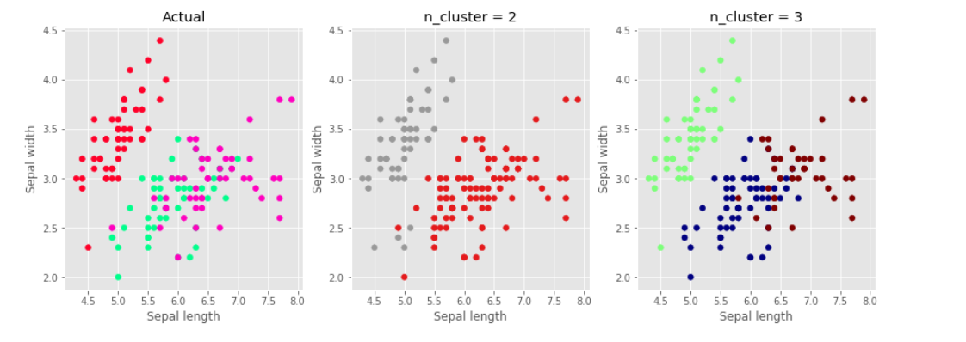
K MEANS Result

Slide 17
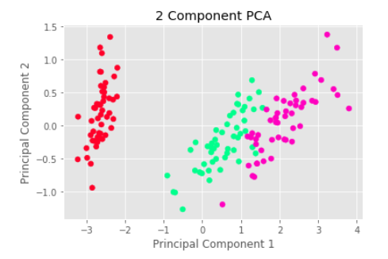
PCA Result

Slide 18
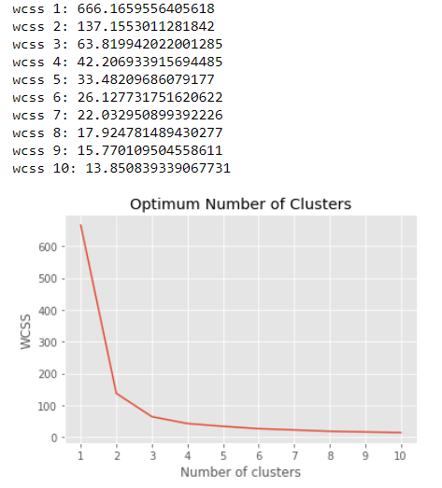
PCA + K MEANS

Slide 19
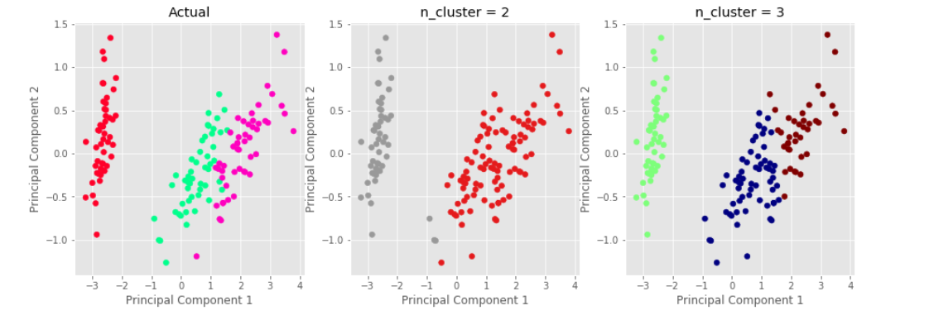
PCA +K MEANS Result

Slide 20
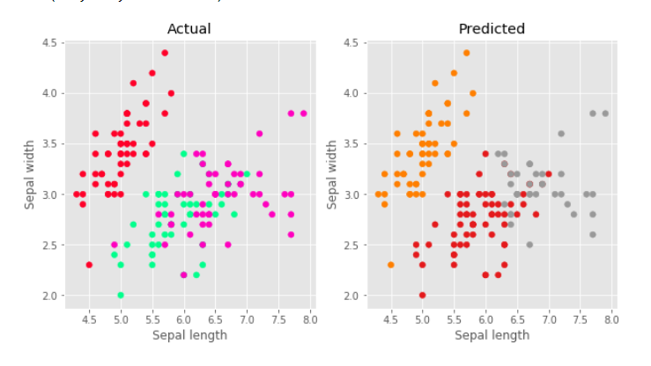
Hierarchial Clustering Result

Slide 21
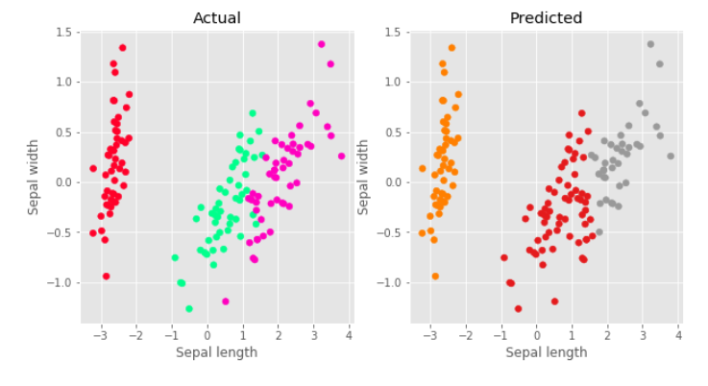
PCA + Hierarchial Clustering Result

Slide 22
Thank you!
And sorry

