Slide 1
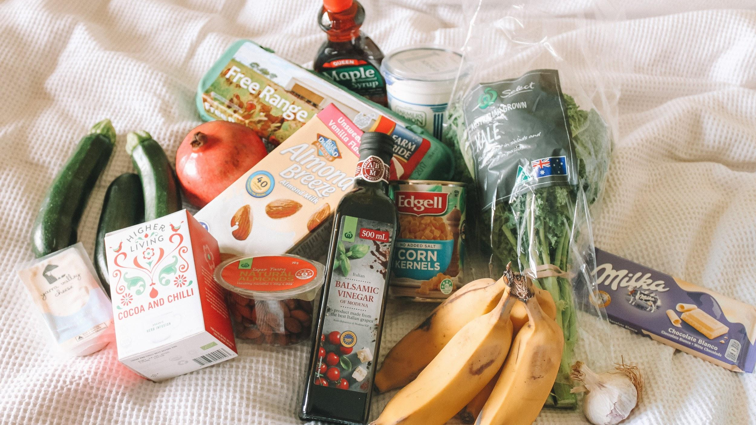
Grocery Store Database Design
Name : SILVIANA
Class : DIT/FT/2A/14
Student ID : 1939213
Module : ST1501 - Data Engineering
Photo by Maddi Bazzocco on Unsplash

Slide 2
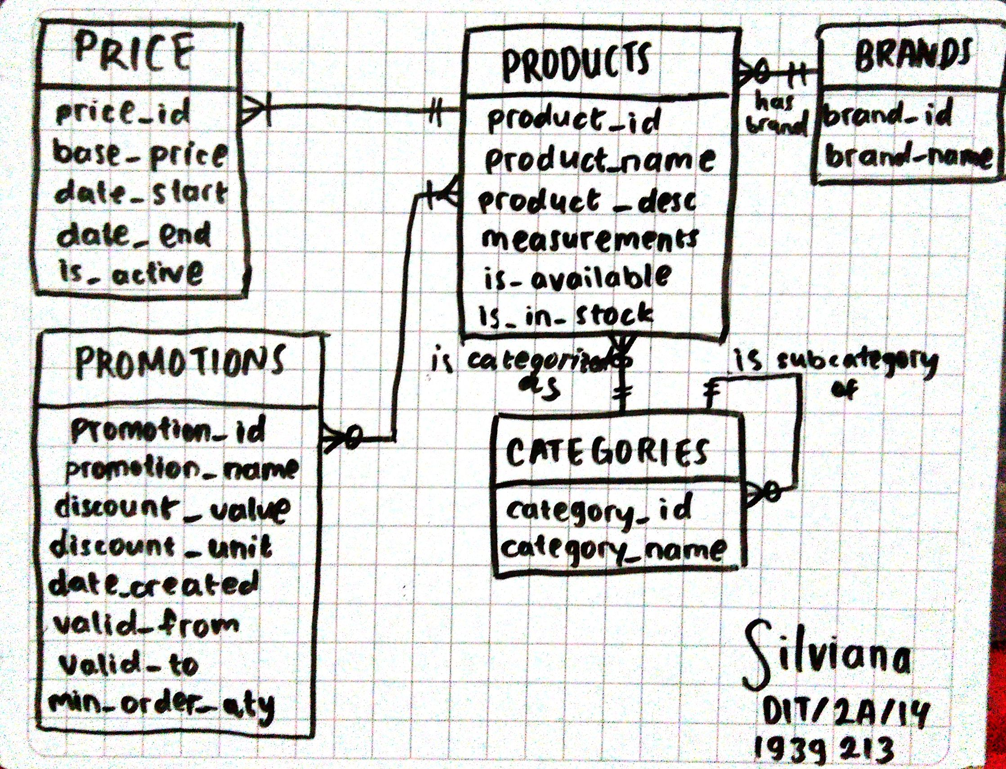
Entity Relationship Diagram

Slide 3
ERD ENTITIES
1.1 Products
Column Name | Data Type | Allow Null? | Description
product_id (PK) | INT | NO | Identity number
product_name | VARCHAR(255) | NO | Product name
product_desc | VARCHAR(255) | NO | Short description
measurements | VARCHAR(255) | NO | Weight/Size/Pieces
is_available | BIT | NO | Availability 1: yes, 0: no
is_in_stock | BIT | NO | In stock 1: yes, 0:no
Table purpose: to store product information
Fields purpose:
product_id: identifier
product_name: to store the product name
product_desc: short description of product
measurements: to store the weight/volume/size information
is_available: to check if item is still available (or not); unavailable (discontinued) items are not shown while out of stock items are still shown.
is_in_stock : to store the item’s out of stock status.

Slide 4
ERD ENTITIES
1.2 Category
Table purpose: to store category id, name, and hierarchy
Column Name | Data Type | Allow Null? | Description
category_id (PK) | INT | NO | Identity number
category_name | VARCHAR(255) | NO | Category name
Fields purpose:
category_id: identifier for category, sub-category, and sub-sub-category. The sub-sub-category id points to sub-category id and sub-category id points to category id.
category_name: to store the category name
1.3 Brands
Column Name | Data Type | Allow Null? | Description
brand_id (PK) | INT | NO | Identity number
brand_name | VARCHAR(255) | NO | Brand name
Table purpose: to store brand identity number and brand name
Fields purpose:
brand_id: brand identifier
brand_name: to store the brand name

Slide 5
ERD ENTITIES
1.4 Price
Column Name | Data Type | Allow Null? | Description
price_id (PK) | INT | NO | Identity number
base_price | DECIMAL (10, 2) | NO | The price without discount
date_start | DATETIME | NO | The start of this price implementation
date_end | DATETIME | NO | The end of this price implementation
is_active | BIT | NO | In stock 1: yes, 0:no
Table purpose: to capture pricing data
Fields purpose:
price_id: identifier
base_price: to store the basic price, without addition or subtraction.
date_start: to store the start of this price implementation
date_end: to store the end datetime of this price implementation
is_active: there is only one and active record at a time.

Slide 6
ERD ENTITIES
1.5 Promotions
Column Name | Data Type | Allow Null? | Description
promotion_id (PK) | INT | NO | Identity number
promotion_name | VARCHAR (255) | NO | Promotion name
discount_value | DECIMAL (10, 2) | NO | Discount value
discount_unit | VARCHAR (10) | NO | Discount Units
date_created | TIMESTAMP | NO
valid_from | DATETIME | NO | Start of promotion
valid_to | DATETIME | NO | End of promotion
min_order_qty | INT | NO | Minimum order quantity
Table purpose: to store promotion information
Fields purpose:
promotion_id: identifier
promotion_name: to store the promotion name
discount_value: the amount or percentage of discount (50, 10, 2.05, etc.)
discount_unit: type of discount. ‘$’ = flat, ‘%’ = percentage
date_created: to record when this promotion was created.
valid_from: to record the start of promotion
Valid_to: to record the end of promotion
Min_order_qty: minimum order quantity to quality for the discount (1 for direct discount, more than one for quantity based discount)

Slide 7
ERD RELATIONSHIP
1.6 Relationships
Products — Brands 1:M relationship. A brand can have many products while a product would belong to one and only one brand.
Products — Categories 1:M relationship. A category can have many products while a product would belong to one and only one category.
Categories — Categories 1:M relationship. A category can have many sub-categories but a category can only have 1 parent category.
Products — Categories 1:M relationship. A product can have many prices (past, present, or future prices) while a price would belong to one and only one product.
Products — Promotions M:N relationship. A product can have one or many concurrent promotions and a promotion can be applied to many products.

Slide 8
ERD RELATIONSHIP
1.6 Converting ERD to Database Relational Diagram - Identifying Keys
Products Candidate Key(s): product_id Primary Key: product_id Foreign Key(s): brand_id, category_id, promotion_id
Brands Candidate Key(s): brand_id, brand_name Primary Key: brand_id Foreign Key(s): n/a
Categories Candidate Key(s): category_id Primary Key: category_id Foreign Key(s): parent_id (this is a self referencing table)
Price Candidate Key(s): price_id Primary Key: price_id Foreign Key(s): product_id
Promotions Candidate Key(s): promotion_id Primary Key: promotion_id Foreign Key(s): product_id

Slide 9
ERD RELATIONSHIP
1.6 Converting into Database Relational Diagram - Adding Keys
products (product_id, product_name, product_desc, measurements, is_available, is_in_stock, brand_id, category_id, promotion_id)
product_brand (brand_id, brand_name)
product_category (category_id, category_name)
product_pricing (price_id, base_price, date_start, date_end, is_active, product_id)
promotion (promotion_id, promotion_name, discount_value, discount_unit, date_created, valid_from, valid_to, min_order_qty, product_id)
M:N relationship!
Separate them into two 1:M relationships

Slide 10
ERD RELATIONSHIP
1.6 Converting into Database Relational Diagram - Handling M:N Relationship
products (product_id, product_name, product_desc, measurements, is_available, is_in_stock, brand_id, category_id)
product_brand (brand_id, brand_name)
product_category (category_id, category_name)
product_pricing (price_id, base_price, date_start, date_end, is_active, product_id)
promotion (promotion_id, promotion_name, discount_value, discount_unit, date_created, valid_from, valid_to, min_order_qty)
product_promotion(product_id, promotion_id)

Slide 11
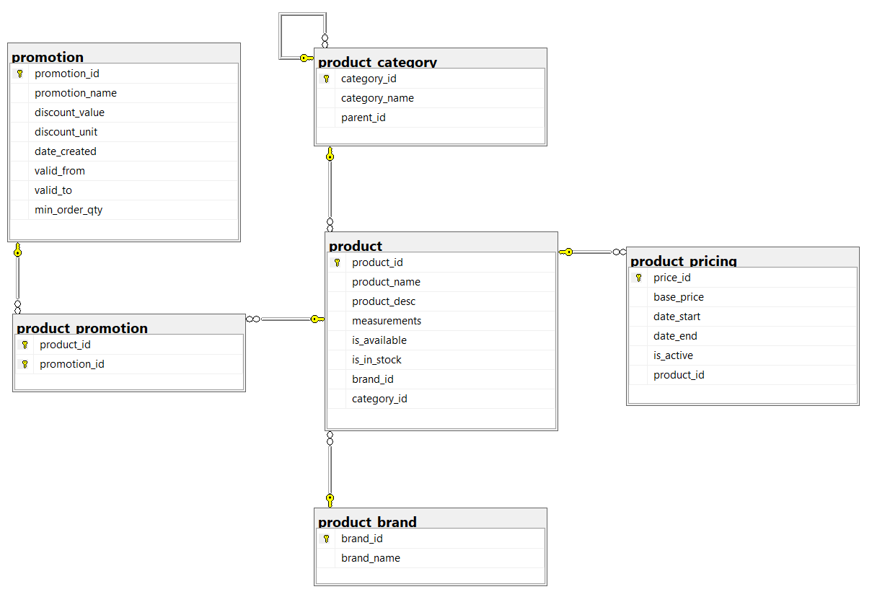
DATABASE RELATIONSHIP DIAGRAM
1.7 Database Relationship Diagram

Slide 12

Thanks!
Photo by okeykat on Unsplash

