Slide 1
Gabriel Manthi
Eugin Wangila
Valerie Susan
GROUP 3 MODULE III PROJECT
Movie Industry Data Analysis
GROUP MEMBERS
Silvia Ogero
Yahya Osman
Ainoham Jeptoo
PROJECT DEFENSE

Slide 2
1. Business Problem & Objectives
Turning historical movie data into practical decision support.
Movie studios must balance release timing, genre selection and production investment.
The project combines financial movie data with IMDb information to identify performance patterns.
Objective: support better decisions about release windows, genre prioritization and production budgets.
Key measures: worldwide gross, production budget, ROI, release month, genre and audience rating.
Group 3 • Movie Industry Data Analysis | 2

Slide 3
2. Data Sources & Project Structure
Financial files + IMDb SQLite data + documented project workflow.
Movie Budget Data
Production budget, domestic gross,
worldwide gross, release date and
movie title.
IMDb Database
Movie titles, genres, average ratings
and vote counts. IMDb tables are
connected through movie_id.
Project Assets
zippedData/, im.db, ERD image,
Jupyter notebook, README
and supporting documentation.
Group 3 • Movie Industry Data Analysis | 3

Slide 4
3. Data Preparation & Feature Engineering
Preparing raw data for reliable analysis.
Removed '$' and commas from monetary fields and converted them to numeric values.
Converted release_date to datetime and extracted release_month.
Calculated net_profit = worldwide_gross − production_budget.
Calculated ROI = (net_profit / production_budget) × 100.
Created loss_or_profit to classify movies as Profit or Loss.
Split multi-genre strings and used explode() to analyze individual genres.
Group 3 • Movie Industry Data Analysis | 4

Slide 5
4. Analytical Workflow
From raw data to business recommendations.
Load
CSV + SQLite
Clean
Types + formats
Transform
Profit + ROI
Merge
Budget + IMDb
Analyze
Group + aggregate
Visualize
Charts
Recommend
Actions
Group 3 • Movie Industry Data Analysis | 5

Slide 6
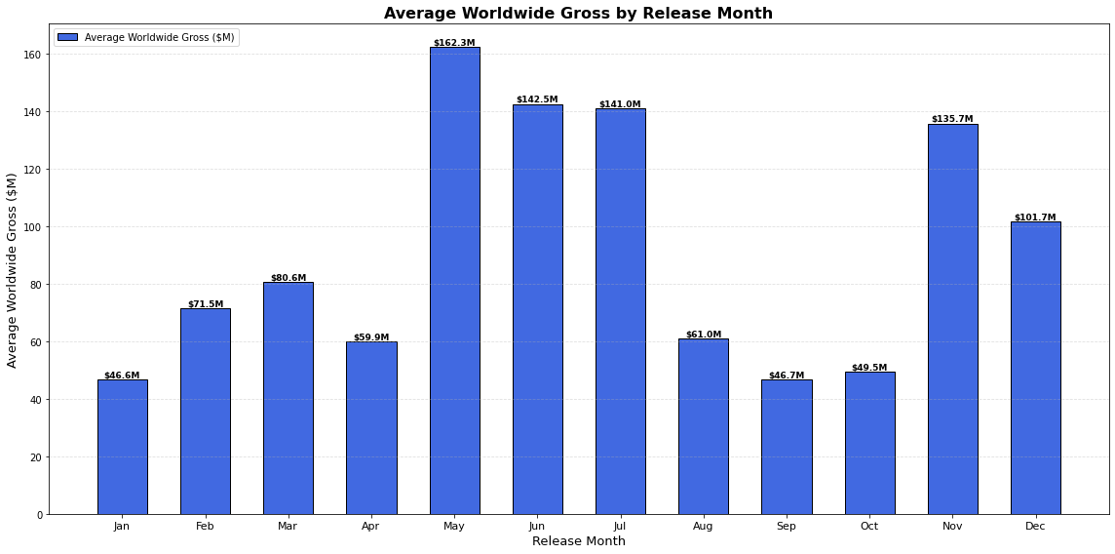
Business Question 1: Which Release Months Perform Best?
Two y-axes compare financial performance with release volume.
Prime windows: May–July and November–December.
May has the highest average worldwide gross at about $162.3M.
June and July follow at about $142.5M and $141.0M.
December has the highest release volume (745), showing that volume and gross performance are different measures.

Slide 7
Business Question 1: Conclusion & Recommendation
Conclusion
May–July and November–December emerge as
prime release windows. May is the strongest individual month
by average worldwide gross.
Recommendation
Prioritize commercially strong releases in these windows
while considering competition, genre, marketing, audience
behavior and release volume.
Group 3 • Movie Industry Data Analysis | 7

Slide 8
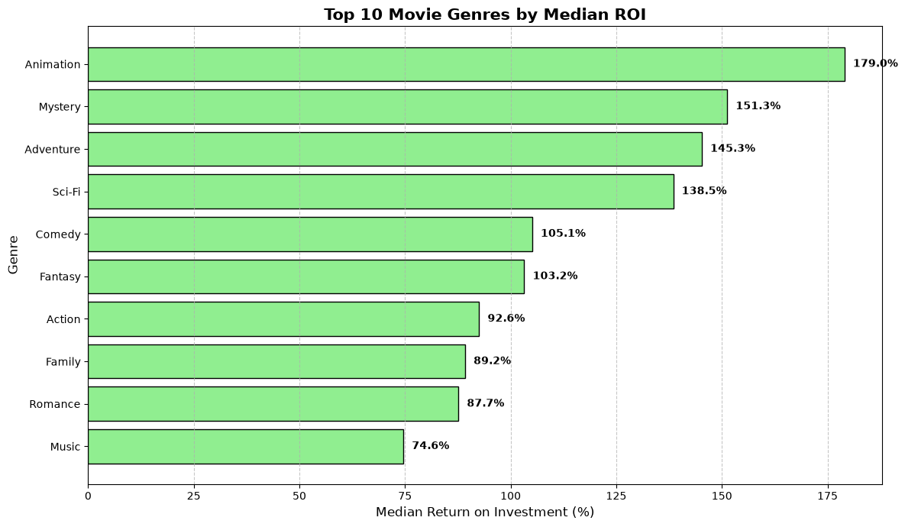
Business Question 2: Which Genres Have the Highest ROI?
Top 10 genres ranked by median ROI.
Group 3 • Movie Industry Data Analysis | 8

Slide 9
Business Question 2: Conclusion & Recommendation
Conclusion
Animation leads with a 179.0% median ROI, followed by
Mystery (151.3%), Adventure (145.3%) and Sci‑Fi (138.5%).
Recommendation
Give greater consideration to high-ROI genres, but combine
genre with budget, target audience, competition, release timing
and marketing strategy.
Group 3 • Movie Industry Data Analysis | 9

Slide 10
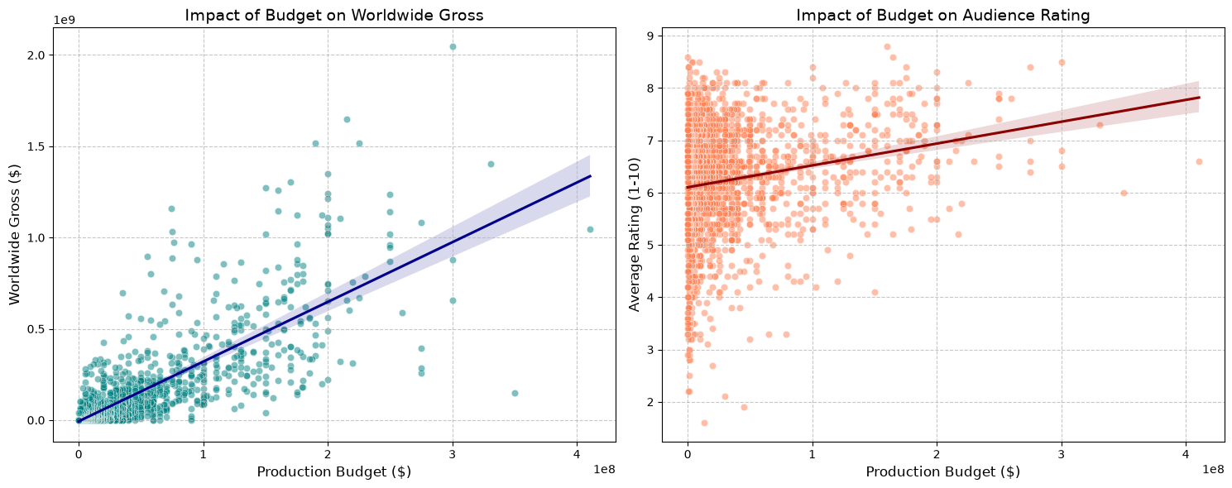
Business Question 3: How Does Production Budget Affect Performance?
Budget is compared with worldwide gross and audience rating.
Higher production budgets generally correspond with higher worldwide gross.
The relationship is not perfect: similar budgets can produce very different revenues.
Production budget shows a relatively weak relationship with audience rating.
Group 3 • Movie Industry Data Analysis | 10

Slide 11
Business Question 3: Conclusion & Recommendation
Conclusion
Higher budgets are generally associated with
higher worldwide gross, but budget size alone
does not guarantee commercial success or higher audience ratings.
Recommendation
Optimize production budgets using expected revenue,
historical ROI, genre performance, release timing,
target audience, competition and marketing requirements.
Group 3 • Movie Industry Data Analysis | 11

Slide 12
Overall Findings
The three business questions form one decision framework.
WHEN?
May–July and November–December
are the prime release windows identified by
historical average worldwide gross.
WHAT?
Animation, Mystery, Adventure and Sci‑Fi
show the strongest median ROI
among the top 10 genres.
HOW MUCH?
Optimize production budgets based on
expected return and risk rather than
assuming bigger is always better.
Genre → Budget → Expected ROI → Release Window → Marketing Strategy → Investment Decision
Group 3 • Movie Industry Data Analysis | 12

Slide 13
Limitations & Future Work
What the analysis can—and cannot—tell us.
Historical relationships do not guarantee future box-office outcomes.
ROI is based on worldwide gross and production budget; additional costs such as marketing are not included.
Multi-genre movies can contribute to more than one genre after explode().
Future work could incorporate marketing spend, competition, franchise strength, distribution strategy and audience demographics.
Predictive modeling could estimate expected gross or probability of profitability for future releases.
Group 3 • Movie Industry Data Analysis | 13

Slide 14
Final Takeaway
Movie profitability is influenced by a combination of
RELEASE TIMING • GENRE • BUDGET
Data-driven analysis can turn these factors into more informed investment and release decisions.
Thank You | Questions & Discussion

