Slide 1
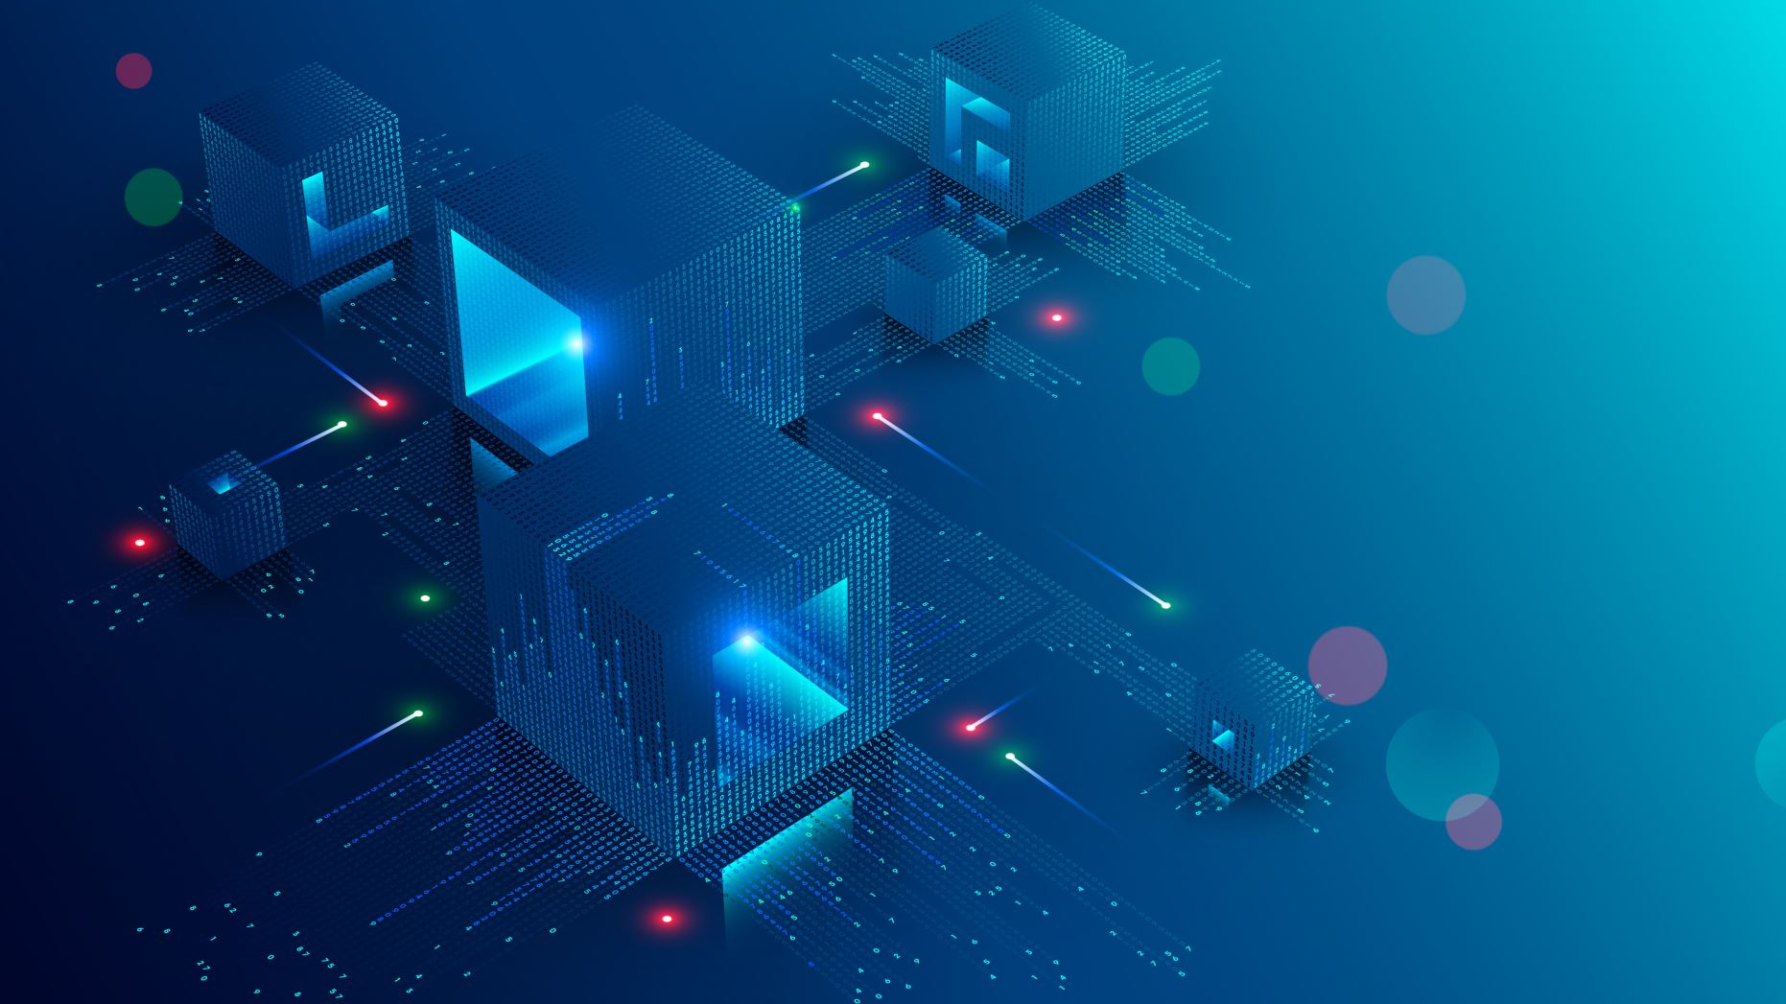
TCO over 5 years

Slide 2
Description of the environment UC
Credit Card (CC) Transaction for a Bank
Every CC transaction requires:
Checking the CC is valid
Checking the POS is valid
Checking the money amount is valid:
* That the specific CC is within single transaction limits, daily limits and monthly limits
* If the CC is pre-loaded CC, that there is sufficient money in the basket
Check if the transaction is suspect:
* Run AI to warn or stop suspect transactions
If the POS requires a second identification step, perform that step and check complete successfully
At the end of the transaction, issue OK or abort
Store all the information about the transaction whatever is the exit status

Slide 3
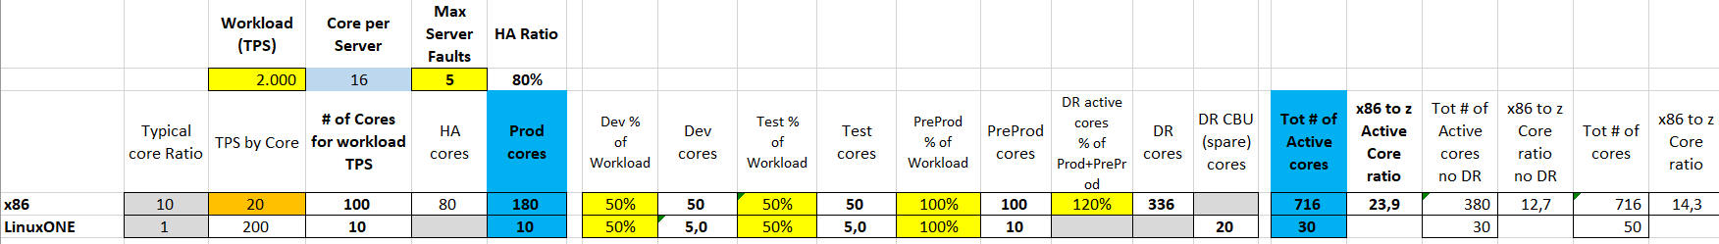
Sizing
The input provided is that the systems must support up to 2000 TPS.
Our input is that a x86 core is able to process 20 TPS;
based on literature, a LinuxONE core (aka IFL) is able to perform 10x TPS, therefore 200 TPS.

Slide 4
Technical Architectures
x86
LinuxONE
Prod: 12 server
180 cores
PreProd: 7 server
100 cores
Dev: 4 server
50 cores
Test: 4 server
50 cores
DR: 19 server
336 cores
Prod: 10 cores
Dev: 5 cores
Spare: 10 CBU
PreProd: 10 cores
Test: 5 cores
Spare: 10 CBU
LinuxONE server
2 server
30 cores (IFL)
20 spares (CBU)
x86 server: Rack server w Xeon Gold 6244 8C 3.60GHz (2 Chips, 16 Cores)
46 servers
716 cores

Slide 5
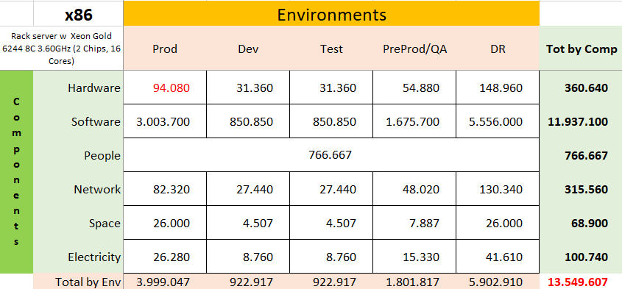
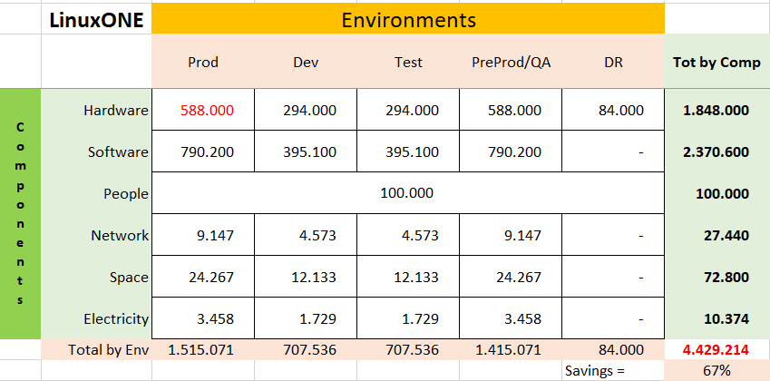
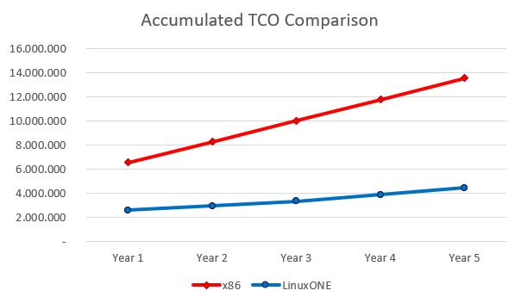
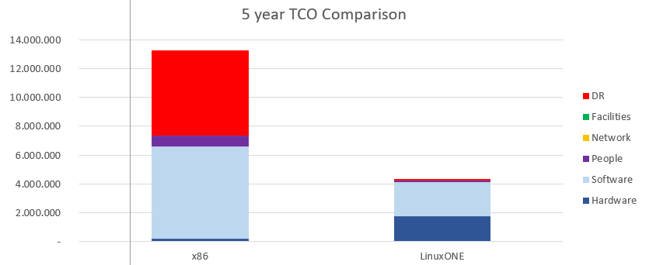
TCO Comparison on 5 years
Above schemas summarize the TCO for the different environments on 5 years, for each cost component.
The savings with the LinuxONE platform is 67% vs the x86 equivalent platform.
Below diagrams highlights the component contribution to total cost and cost per year that make the accumulated TCO.

Slide 6
x86 TCO Assumptions
Hardware:
Rack server w Xeon Gold 6244 8C 3.60GHz (2 Chips, 16 Cores)
Acquisition cost: 10K€ - 30% discount
including 3 years Support
Support for following years is 20% of purchase price
Network:
7000€ per Server - 30% disc
Maint @ 10% of PP from y2
People:
One FTE covers 30 servers
Average yearly fully loaded costs=100K€
Space:
Fully loaded cost of Sq. meter=2.800€
Electricity:
Cost per kWh=0,10€
Software:
OS: subscription 2000€/year - 20% disc per socket
VM: license @5000€/socket - 20% disc
maint @ 20% of purchase price from y2
Application Server: license @100€/PVU
- 75% disc (70 PVU per core)
maint @ 20% of purchase price from y2
DB: license @40.000€ for 2 cores - 75% disc
maint @ 20% of purchase price from y2
Data Replication Tools: subscription
3000€/year - 75% disc per core
Monitoring Tools: license @5.000€/server - 40% disc. Maint @ 20% of PP from y2
Security Tools: license @5.000€/server - 40% disc. Maint @ 20% of from y2

Slide 7
LinuxONE TCO Assumptions
Hardware:
LinuxONE servers @ 725K€ for 3 years - 30% disc
Maint @ 10% PP from y4
Network:
14000€ per LinuxONE Server - 30% disc
Maint @ 10% of PP from y2
People:
One FTE covers 10 servers
Average yearly fully loaded costs= 120K
Space:
Fully loaded cost of Sq. meter=2.600€
Electricity:
Cost per kWh=0,10€
Software:
OS: subscription 6000€/year - 20% disc per socket
VM: included in HW
Application Server: license @100€/PVU - 50% disc
(120 PVU per core)
maint @ 20% of purchase price from y2
DB: license @40.000€ per cores - 50% disc
maint @ 20% of purchase price from y2
Data Replication Tools: subscription 3000€/year - 50% disc per core
Monitoring Tools: license @5.000€/server - 40% disc. Maint @ 20% of PP from y2
Security Tools: license @5.000€/server - 40% disc. Maint @ 20% of from y2

Slide 8
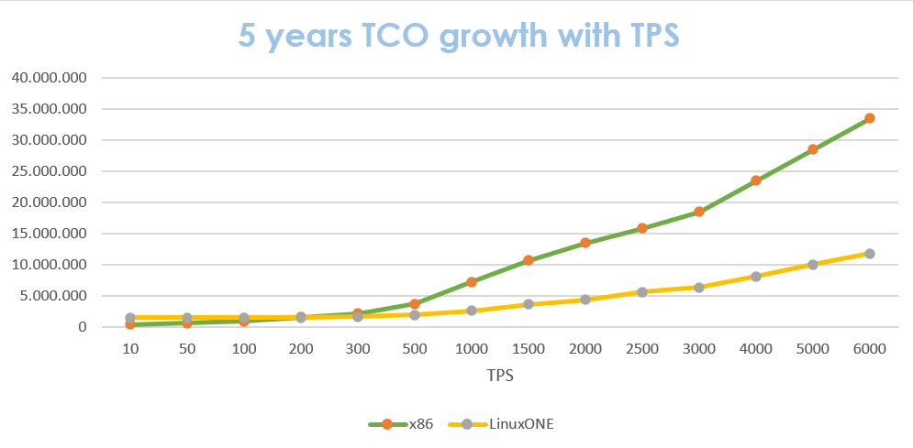
Considerations (1)
As it’s shown by the chart the LinuxONE and the x86 architectures have similar costs when TPS’ values are small.
Instead, when TPS’ values gradually increase the LinuxONE architecture is much more convenient than x86 one.
Indeed, in the previous slide «TCO comparison on 5 years» it’s shown that the savings it’is 67% vs the x86 equivalent platform. This because the capital expenditure costs are
amortized over the years!

Slide 9
Considerations (2)
Active-active sites
In both cases this «organization» of the two sites enable to have not only pre-production, production, development and test environments, but also a DR environment which permits to restore all system functionalities;
Workload TPS and HA
With the 2000 TPS input workload and the additional server (which provide high avalibility) the system is able to manage TPS peaks.

