Slide 1





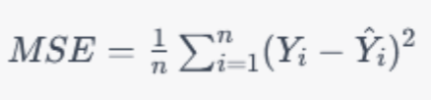



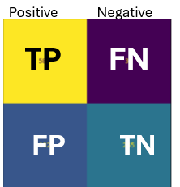


Linear regression
Logistic regression
The Gini index measures node purity in decision trees, guiding splits that create the most homogeneous groups
Log loss
measures how far predicted probabilities are from the actual class labels using a logarithmic scale.
Predicts numerical values by modeling how explanatory variables relate to a response variable using the equation y = ax + b. The slope shows whether the relationship is positive, negative, or absent, and the model is stronger when data points lie close to the regression line.
Predicts binary outcomes by estimating class probabilities using odds and log-odds. It assumes independent predictors, a linear relationship with the log-odds, and works best with large datasets, but unlike linear regression, it does not require linearity, normal residuals, or constant variance.
Log Loss
GINI
Regression
Gauges:
Residuals
MSE (Mean squared error)
R-squared R2
The correlation coefficient
Decision Tree
Main models
Is a supervised learning classification method that visually represents the decision-making process. It classifies new observations based on previously known categories and shows how different conditions influence outcomes. The model can also be used for prediction, relying on patterns learned from past observations.
Supervised Machine
learning
Is a machine learning approach where a model is trained on data that includes correct answers. By learning from these labeled examples, the model can predict new outcomes—either binary, categorical, or continuous values—and is especially common in classification
tasks.
Evaluation metrics
Classification
The model becomes too complex for the amount or quality of data it has.
It memorizes the training examples instead of learning general rules. As a result, it performs very well on the training data, but poorly on new, unseen data.
Matrix of confusion
Accuracy
Precision
Recall
Overfitting

Slide 2
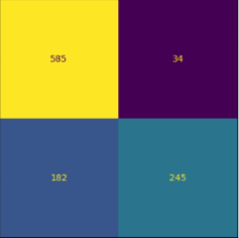
Positive Negative
TP FN
FP TN

