Slide 1
Uber Reviews Analysis
Subject: 47451 Data Visualization
Name: Silvina Yosa 藍水晶
Student ID: 10890525
Date: 31/12/2024

Slide 2
Data Visualization Problem 1:
What is the problem you want to solve in data analysis?
Displaying key insights on business performance. Identifying trend and potential issues. Highlighting relationship between user ratings and application version across the time.

Slide 3
Data Visualization Problem 1:
What is the dataset for data analysis?
Dataset Title: Uber Customer Reviews Dataset (2024)
Subtitle: Sentiment Analysis and Insights from 12,000+ Google Play Store Reviews.

Slide 4
Data Visualization Problem 1:
What is the dataset for data analysis?
Dataset Column:
Column Name | Description
userName | Anonymized username of the reviewer.
userImage | URL of the reviewer's profile image (if available).
content | Text content of the review describing the user's experience.
score |Numerical rating given by the user (1–5).
thumbsUpCount | Number of likes received by the review.
reviewCreatedVersion | App version at the time of review creation (if available).
at | Timestamp indicating when the review was posted.
replyContent | Developer's response to the review (if any).
repliedAt | Timestamp indicating when the developer replied (if any).
appVersion | App version string associated with the review (if available).

Slide 5
Data Visualization Problem 1:
What is the download link URL? (Please clearly marked the download URL link of your dataset)
https://www.kaggle.com/datasets/kanchana1990/uber-customer-reviews-dataset-2024/data
Other References:
Ethically Mined Data - This dataset was collected in compliance with ethical web scraping practices:
Data was sourced from publicly available Google Play Store reviews.
Personally identifiable information (PII) such as email addresses, images or phone numbers has been removed.
Acknowledgements:
Google Play Store: For providing access to publicly available app reviews.DALL·E 3: For generating a visually appealing dataset image.

Slide 6
Data Visualization Problem 1:
Which tool do you use to visualize the results of your data analysis?
Python and Tableau

Slide 7
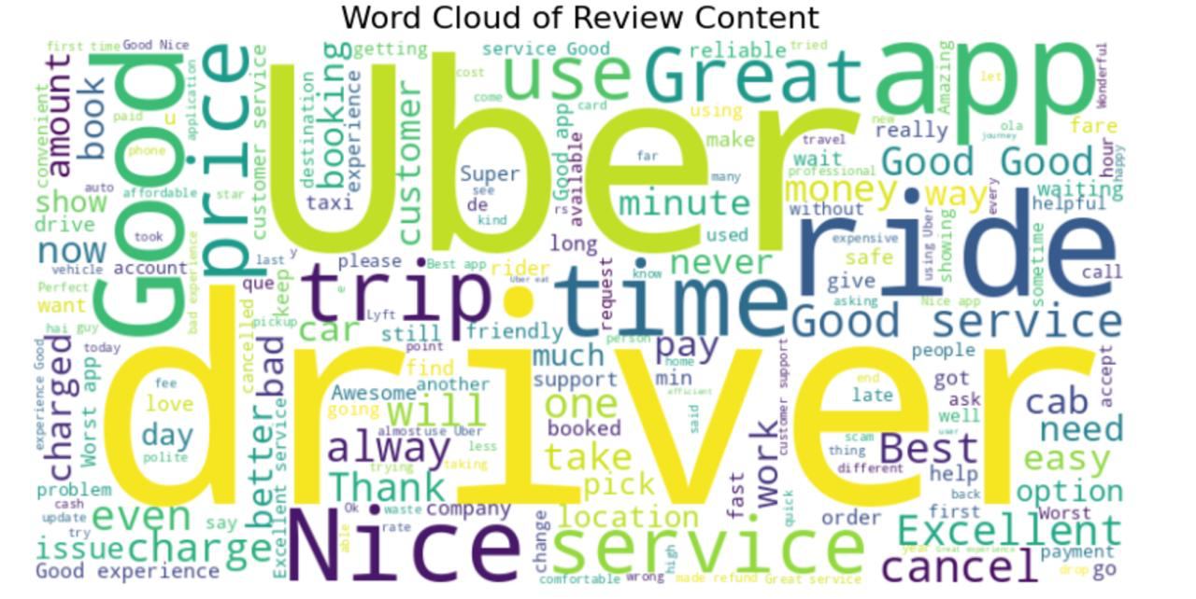
The visual analysis result of problem 1
1. World Cloud of Review Content

Slide 8
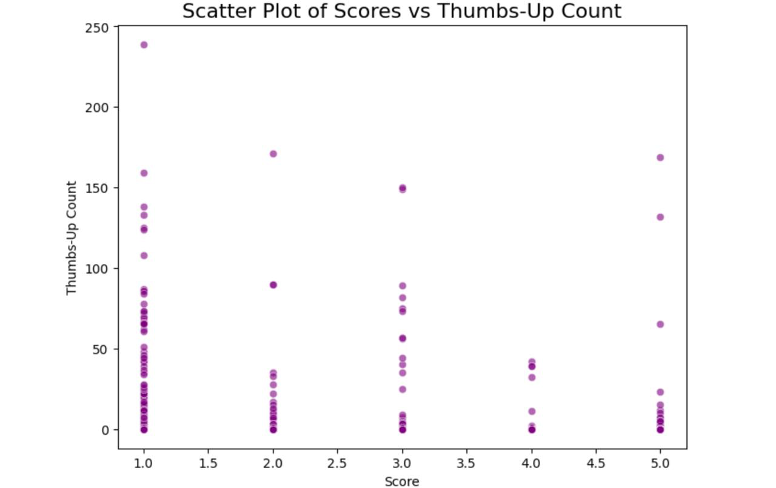
The visual analysis result of problem 1
2. Scatter Plot of Score vs Thumbs-up

Slide 9
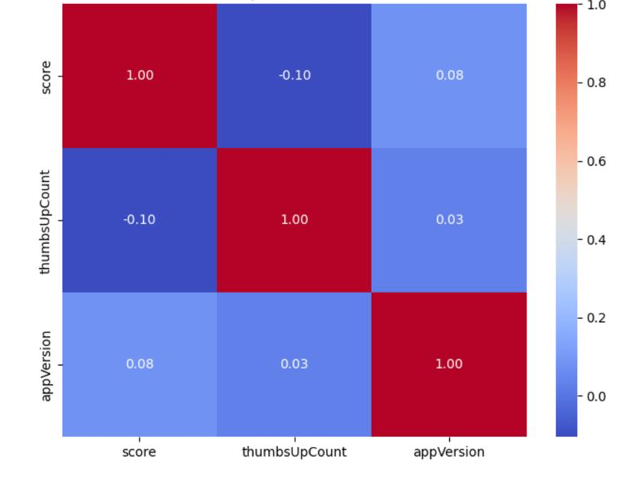
The visual analysis result of problem 1
3. Heatmap of Correlations

Slide 10
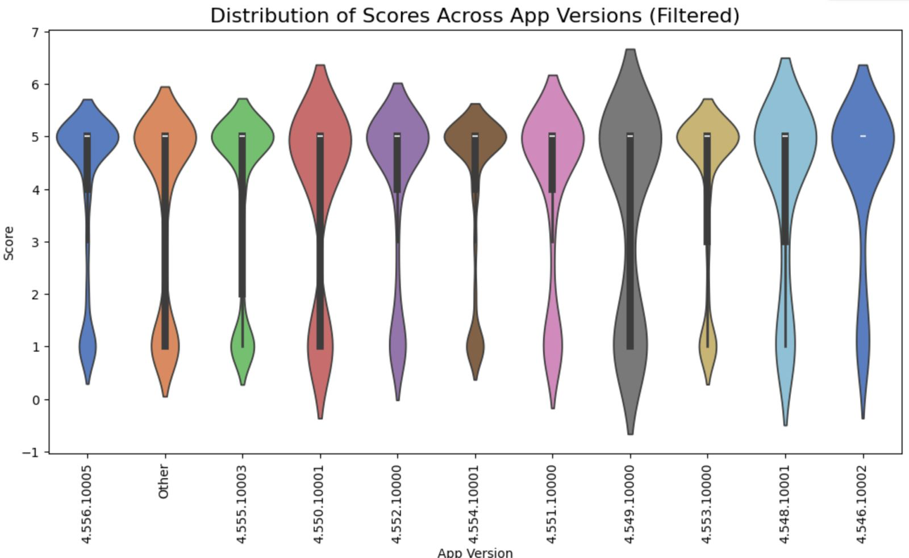
The visual analysis result of problem 1
4. Distributions of Score Across App Versions

Slide 11
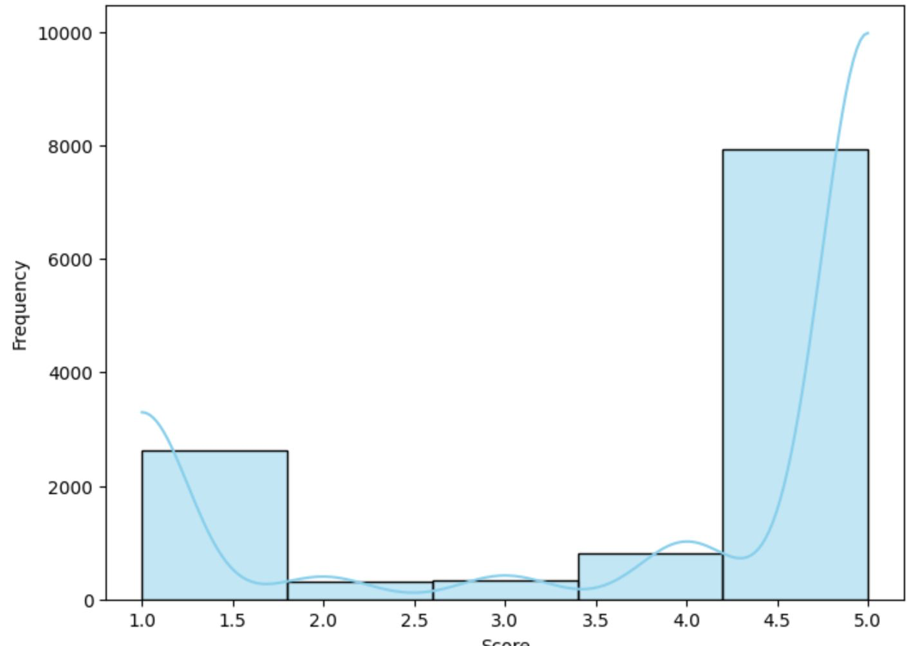
The visual analysis result of problem 1
5. Histogram of Score Distribution

Slide 12
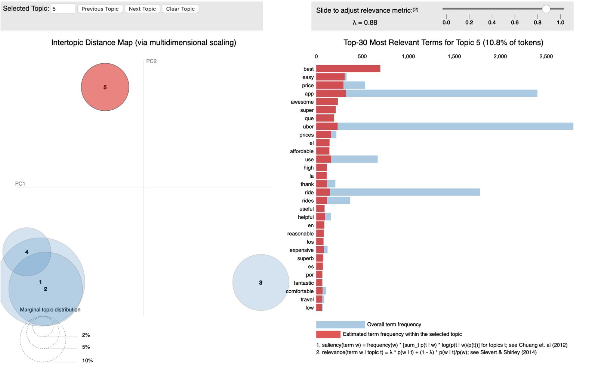
The visual analysis result of problem 1
6. Intertopic Distance Map

Slide 13
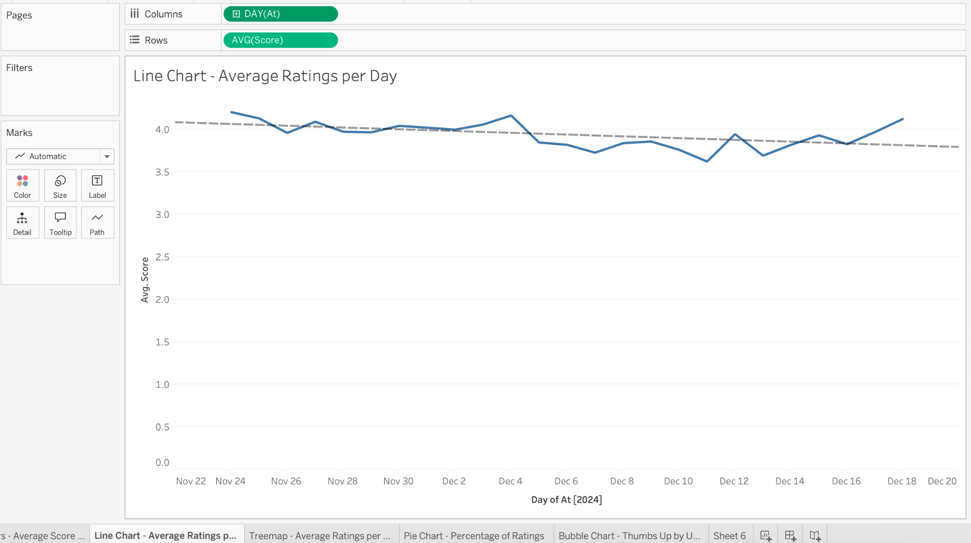
The visual analysis result of problem 1
1. Line Chart

Slide 14
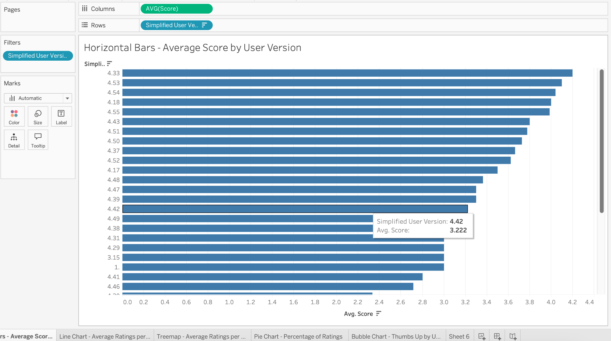
The visual analysis result of problem 1
2. Horizontal Bar Charts

Slide 15
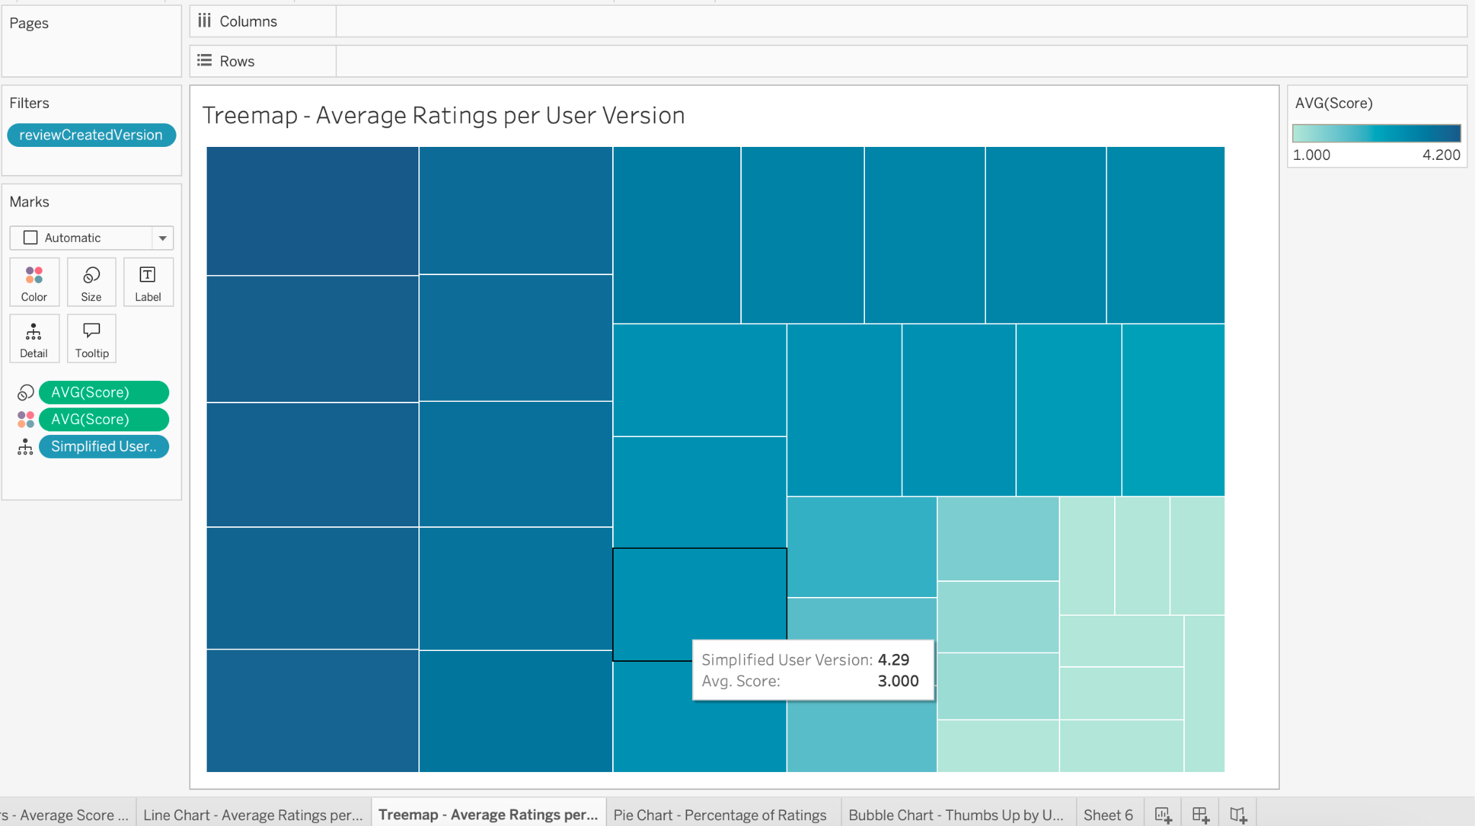
The visual analysis result of problem 1
3. Treemap

Slide 16
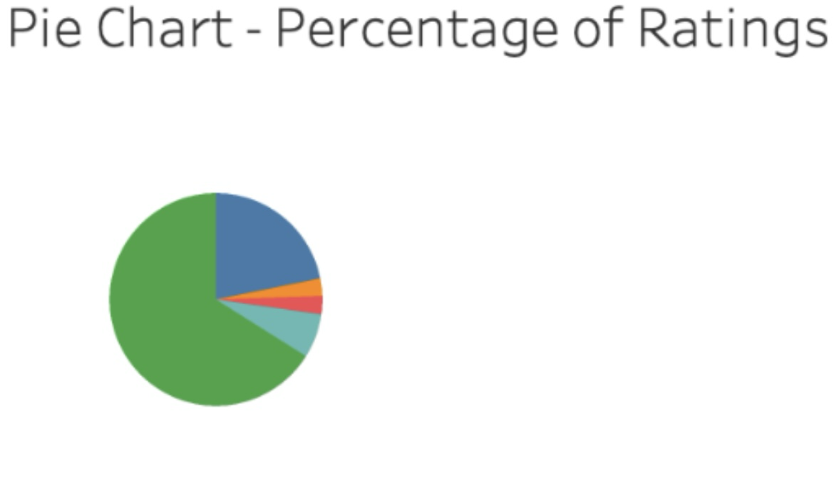
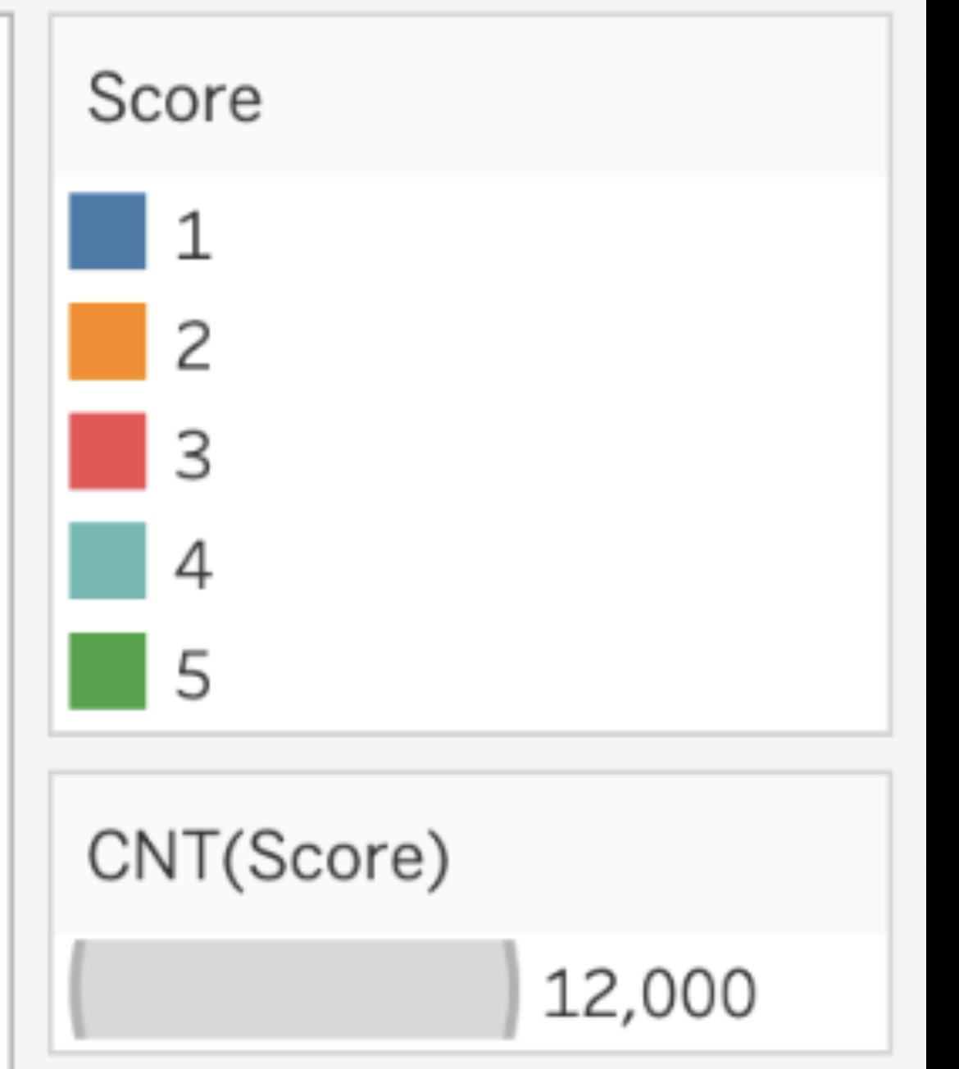
The visual analysis result of problem 1
4. Pie Chart

Slide 17
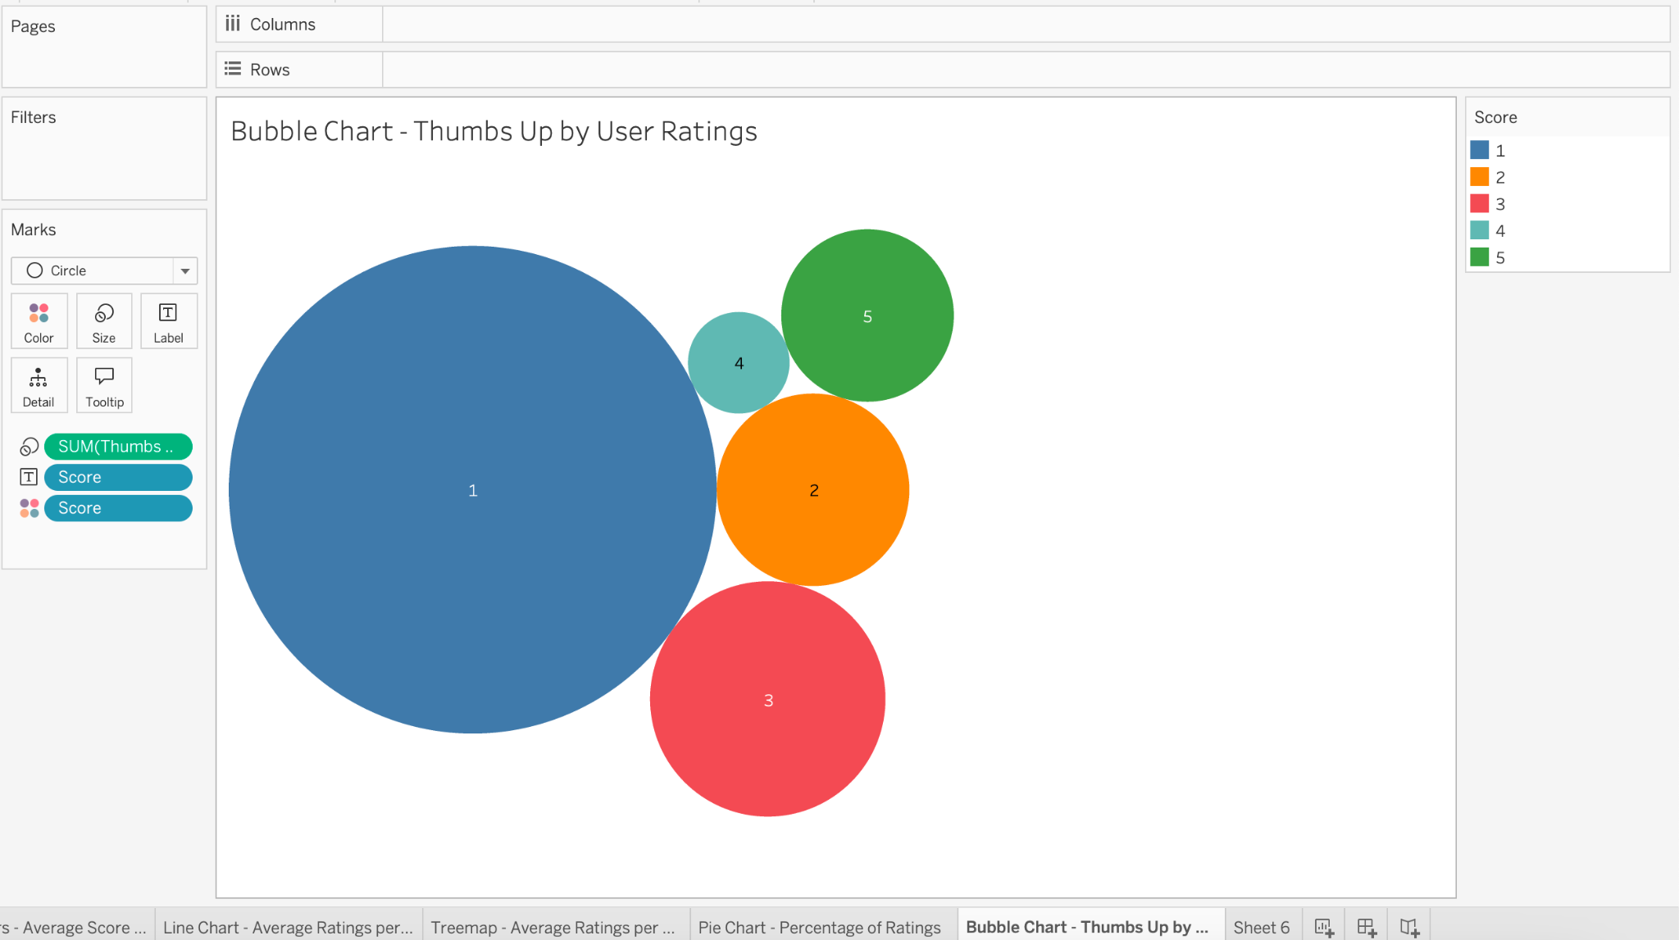
The visual analysis result of problem 1
5. Bubble Chart

Slide 18
The visual analysis result of problem 1
What is the conclusion of data analysis insights obtained through visual charts?
This project successfully described the insights of … Dataset. Key points include:
Trends in Ratings: Line Chart shows slight-decreasing trend of user ratings.
User Version & Ratings: Several graphs (violin chart, horizontal bar chart, and treemap) show the correlation between these variables. Some versions have higher ratings than others.
Distribution of Ratings: Histogram and Pie chart show that most ratings are still around 4-5 stars.
Engagement: Bubble chart highlight users’ response on other different ratings. Most 5-star-ratings received higher thumbs up.

