Slide 1

JPEG AI as a Threat to
Deepfake Detection
Computer Vision | Sapienza University of Rome
Presented by:
Enrico Bosco (1956727) • Gabriel Di Fazio (1941485)
01 / 13

Slide 2
Outline
01
02
03
04
Problem Statement
Forensic Analysis
Proposed Methodology
Experimental Evaluation
The emergence of learned neural image codecs
(JPEG AI)
How JPEG AI compression modifies the low-level statistical fingerprints that deepfake detectors exploit.
Mitigation strategies that make detector more robust to deepfake.
Degradation curves and mitigation strategy benchmarks.
02 / 13

Slide 3
Problem Statement
Key Context
Deepfake detectors rely on subtle, low-level statistical fingerprints left in high-frequency content during generation.
Any operations that smooth or overwrite these pixel-level traces can completely erase the evidence detectors depend on.
JPEG AI Standard: The first international standard for end-to-end learned compression driven by deep neural networks.
Core Hypothesis: Unlike traditional JPEG, JPEG AI neural encoding completely overwrites native artifacts with its own network signature, neutralizing forensic models.
GAN Model
Generates deepfake content with high-frequency artifacts
Micro-Fingerprints
Subtle, low-level statistical forensic traces
JPEG AI Neural Codec
Wipes forensic traces & overwrites with network signature
03 / 13

Slide 4
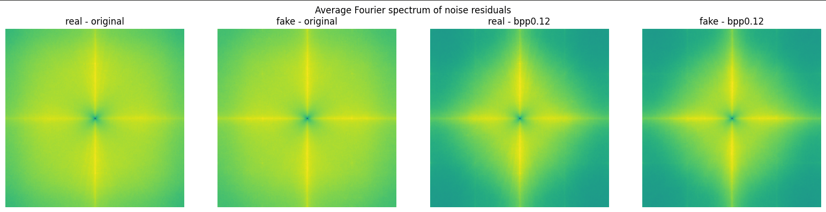
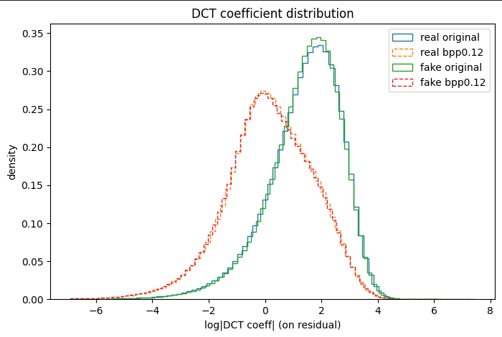
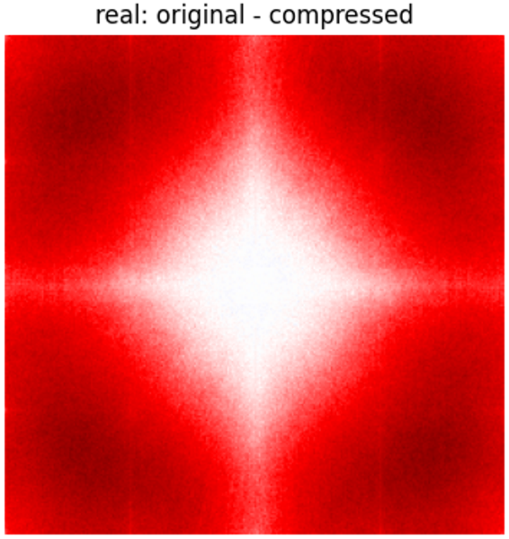
Problem Statement: Forensic Analysis
High-Frequency Tracking: Analysis is performed on high-pass noise residuals to expose hidden, low-level generative fingerprints.
2D Fourier Star Pattern: Neural compression forces a distinct, highly directional "bright cross" onto the pixel spectrum, signaling a codec stamp.
DCT Magnitude Suppression: Codecs aggressively eliminate fine details, crushing the statistical distribution of DCT coefficients toward zero.
Fingerprint Erasure: The difference map (original − compressed) isolates the exact high-frequency energy that JPEG AI strips away — the bright central core marks the fingerprint the codec removes.
04 / 13

Slide 5
State of the Art
CNNDetection Detector (Wang et al., CVPR 2020)
A ResNet50-based model built on the premise that CNN-generated images share common architectural artifacts.
Evaluated via two training configurations with an augmentation of Gaussian blurring and standard JPEG compression:
prob0.1: highly vulnerable baseline with light augmentation.
prob0.5: robust baseline featuring heavy augmentation.
The Core Research Gap
The forensic vulnerabilities induced by the newly established neural standard JPEG AI remain almost entirely unmapped in active literature.
Our project reproduces the severe degradation challenges introduced by Cannas et al. (ICCVW 2025) while constructing ad-hoc mitigation strategies.
Input Image
224 × 224 pixels
ResNet50 Backbone
Feature Extraction & Artifact Mapping
Binary Logit Output
Classification (Real vs. Fake)
[1] Wang, S.-Y., Wang, O., Zhang, R., Owens, A., & Efros, A. A. (2020). CNN-generated images are surprisingly easy to spot... In Proceedings of the IEEE/CVF CVPR.
[2] E. D. Cannas, P. Bestagini, S. Tubaro, et al., "Is JPEG AI Going to Change Image Forensics?", IEEE/CVF International Conference on Computer Vision Workshops (ICCVW), 2025.
05 / 13

Slide 6
Proposed Method
01
02
03
Fine-Tuning: Augmentation
Fine-Tuning: Consistency
Test-Time Sharpening
Retrains the detector on a 50/50 mix of original and JPEG-AI-compressed images.
Creates two bitrate-specialized experts: low (0.12–0.25 bpp) and high (0.50–0.75 bpp) to combat codec loss.
Adds an invariance loss on original-compressed pairs, forcing matching scores:
BCE(orig) + BCE(comp) + λ·MSE(σ(orig), σ(comp))
Test-time preprocessing only, requiring no neural network retraining.
Applies an unsharp mask before detection to restore high-frequency traces smoothed away by the JPEG AI codec.
JPEG AI Compression
↓
50/50 Dataset (Orig + Comp)
↓
Fine-Tune & Experts
JPEG AI Compression
↓
Paired Dataset (Orig ↔ Comp)
↓
Consistency Loss Fine-Tune
JPEG AI Compression
↓
At Inference: Sharpen Image
↓
Standard Detector
Trade-off: Strategies 01 and 02 shift computational cost to a one-time offline training (zero run-time overhead). Strategy 03 avoids training entirely but increases inference latency and degrades detection accuracy.
06 / 13

Slide 7
Dataset
Sources & Format
Core Benchmark: ProGAN dataset (extracted from the official CNNDetection testing splits).
Image Sources: Real photographs from LSUN alongside synthetic images generated via ProGAN.
Resolution: Uniformized at a native resolution of 256×256 pixels.
Data Isolation
Strict isolation designed to prevent leakage across experimental subsets.
Evaluation Split: 150 images/class (300 total) per target bitrate.
Fine-Tuning Split: 100 images/class, carved from a disjoint index range separate from test data.
Infrastructure
Storage & Sync: Handled dynamically via cloud integration.
Google Drive Mounts: Enable seamless execution and consistent environment synchronization across processing nodes.
07 / 13

Slide 8
Experimental Setup
01
Neural Codec Configuration
Executed using the official JPEG AI reference software under standard profiles (base.json) with secondary tools deactivated (tools_off.json).
Used 4 bpp: (0.12, 0.25, 0.50, 0.75)
02
Crucial Preprocessing
Enforced strict deterministic CenterCrop(224) with no resizing. This preserves the raw spatial layout and micro-pixel structures required for artifact verification.
03
Optimization Settings
Retrained across 8 full epochs, utilizing a conservative Learning Rate of 5e-5 paired with the Adam optimizer.
04
Multi-Expert Architecture
Formulated two specialized models: a Low-Bitrate Expert (optimized for bpp 0.12–0.25) and a High-Bitrate Expert (optimized for bpp 0.50–0.75).
08 / 13

Slide 9
Baseline Evaluation
prob0.1
Key Observations
Perfect Baseline: On uncompressed original images, the detector achieves perfect classification with AUC = 1.000 and Accuracy = 1.000.
Severe Degradation: Increasing neural compression strength causes a monotonic, severe performance drop across all metrics.
Critical Failure Point: At maximum compression (bpp 0.12), performance drops sharply: AUC falls to 0.781 and Accuracy plummets to 68.3%.
Forensic Failure: The False Positive Rate leaps to 0.480, misclassifying nearly half of the genuine images as fakes due to neural artifacts.
CONDITION | AUC | AP | Acc | FPR | FNR | F1 | n
original | 1.000 | 1.000 | 1.000 | 0.000 | 0.000 | 1.000 | 300
bpp 0.12 | 0.707 | 0.667 | 0.577 | 0.787 | 0.060 | 0.689 | 300
bpp 0.25 | 0.873 | 0.851 | 0.683 | 0.607 | 0.027 | 0.755 | 300
bpp 0.50 | 0.976 | 0.980 | 0.853 | 0.267 | 0.027 | 0.869 | 300
bpp 0.75 | 0.991 | 0.992 | 0.940 | 0.093 | 0.027 | 0.942 | 300
prob0.5
CONDITION | AUC | AP | Acc | FPR | FNR | F1 | n
original | 1.000 | 1.000 | 1.000 | 0.000 | 0.000 | 1.000 | 300
bpp 0.12 | 0.781 | 0.753 | 0.683 | 0.480 | 0.153 | 0.728 | 300
bpp 0.25 | 0.944 | 0.944 | 0.860 | 0.233 | 0.047 | 0.872 | 300
bpp 0.50 | 0.996 | 0.997 | 0.960 | 0.060 | 0.020 | 0.961 | 300
bpp 0.75 | 0.999 | 0.999 | 0.977 | 0.020 | 0.027 | 0.977 | 300
09 / 13

Slide 10
Evaluation: Mitigation Benchmarks
Fine-Tuning: Augmentation
Effectively reclaims robustness at the critical bpp 0.12 boundary, boosting AUC back to 0.875 and Accuracy to 76.3% while forcing FPR down to 0.340.
Fine-Tuning:
Consistency
Delivers solid, balanced recovery (AUC = 0.864, Acc = 76.0%) while achieving the lowest overall false alarm rate with an FPR of 0.320.
Test-Time Sharpening
Preprocessing images via Unsharp Masking actively worsens detection, reducing AUC further down to 0.742. Naive high-frequency contrast enhancement cannot restore structural features deleted by neural models.
High-Bitrate Convergence: At high bitrates (bpp ≥ 0.50), where the original baseline is already strong, both training frameworks smoothly converge to near-perfection (AUC ≥ 0.999).
10 / 13

Slide 11
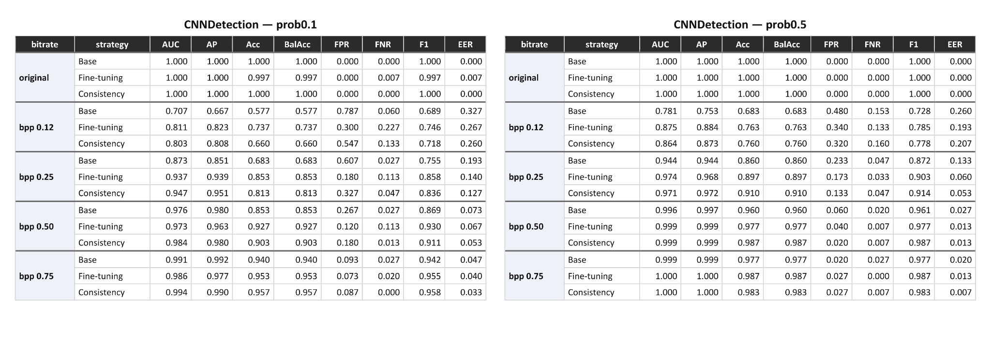
Evaluation: Mitigation Benchmarks B
Notice that for fine-tuning detectors we reported only results of “low” type (Augmentation: [0.12, 0.25]), that are more effective than “high” (Augmentation: [0.50, 0.75]).
11 / 13

Slide 12
Conclusions & Future Work
Conclusions
JPEG AI Threat: Compression poses a severe, quantifiable threat to modern multimedia forensics by wiping low-level GAN high-frequency fingerprints.
Naive Failures: Post-processing solutions at test-time (e.g. Sharpening) fail entirely since they cannot hallucinate destroyed statistics.
Robust Recovery: Retraining models via balanced augmentation (Fine-Tuning) and output-level probability mapping recovers a major portion of the forensic gap.
Future Work
Limitations & Next Steps: Current evaluations are restricted to In-Distribution scenarios where ProGAN is used for both training and testing.
Cross-Generator Datasets: Future iterations require validation against completely disjoint cross-generator datasets to confirm generalization.
DANN Deployment: Implement Domain-Adversarial Neural Networks (DANN) to achieve complete, compression-invariant detection.
12 / 13

Slide 13
References
[1] E. D. Cannas, P. Bestagini, S. Tubaro, et al., "Is JPEG AI Going to Change Image Forensics?", IEEE/CVF International Conference on Computer Vision Workshops (ICCVW), 2025.
[2] P. Wang, O. Wang, R. Zhang, A. Owens, A. A. Efros, "CNN-generated images are surprisingly easy to spot... for now", IEEE/CVF Conference on Computer Vision and Pattern Recognition (CVPR), 2020.
[3] JPEG AI Reference Software Official Codebase, ISO/IEC JTC 1/SC 29/WG 1.
13 / 13

