Slide 1

Statistical learning applied to graduate admission dataset
Silviu Filote 1059252, Jonathan Bommarito 1068755

Slide 2
Introduction
Apply some approaches described in “An Introduction to Statistical Learning” to the chosen dataset
Select the best model which can explain better our response with the lowest complexity
Focus on the interpretability rather than optimal model

Slide 3
Dataset
Dataset: Graduate Admission 2 (available on Kaggle)
500 rows without missing values
In the dataset there are 8 variables, 4 continuous and 4 discrete

Slide 4
Continuous variables
Graduate Record Examinations Scores (GRE): test that measures abstract thinking in areas such as reading comprehension, writing, and mathematics
Test Of English as a Foreign Language (TOEFL): it’s the score of English language test;
Cumulative Grade Point Average (CGPA): is based on all coursework completed for bachelor’s degree, representing overall average;
Chance of Admit (Admit): percentages that indicates the probability of being admitted.

Slide 5
Discrete variables
University Rating (UniRatings): It refers to the applicant’s undergraduate university. It would be fair to say that not all universities carry the same repute around the world;
Statement of purpose (SOP): is a short essay that highlights the educational background, achievements, and goals;
Common Letter of Recommendation (LOR): score from 1 to 5 assigned to the letter of recommendation;
Research Experience (Research): boolean that indicates any professional or academic research activity acquired in any research field in the public or private sector.

Slide 6
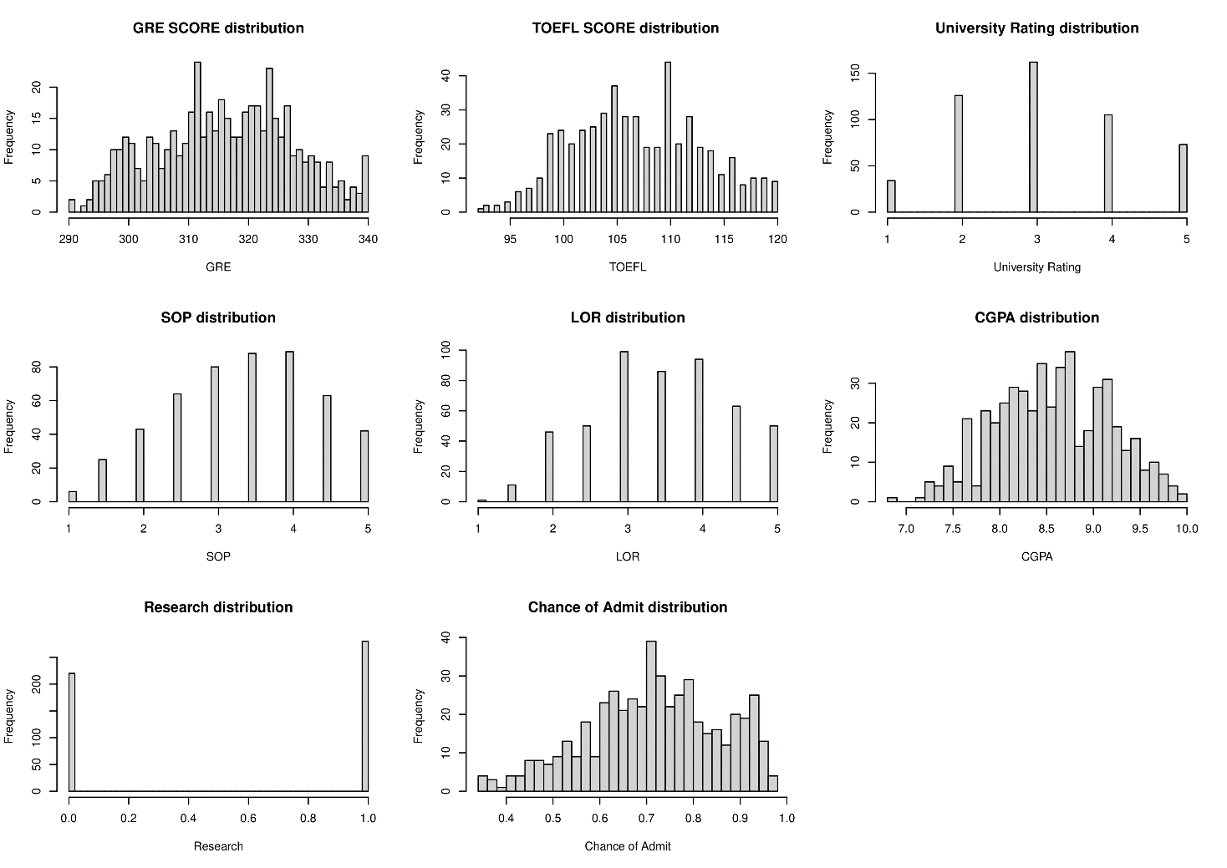
Empirical variables distribution
Figure 1: Empirical distribution of all the variables inside the dataset

Slide 7
Approaches implemented
Linear regression: Estimated manually, Stepwise, Lasso, Model improvements
Generalized Additive Models (GAMs)
Regression trees: Pruned tree, Bagging, Random forest, Boosting
For each approach we will:
Split dataset into: 70% training set 30% validation set of the dataset
Perform residual analysis: Shapiro-Wilk and Breusch-Pagan tests

Slide 8
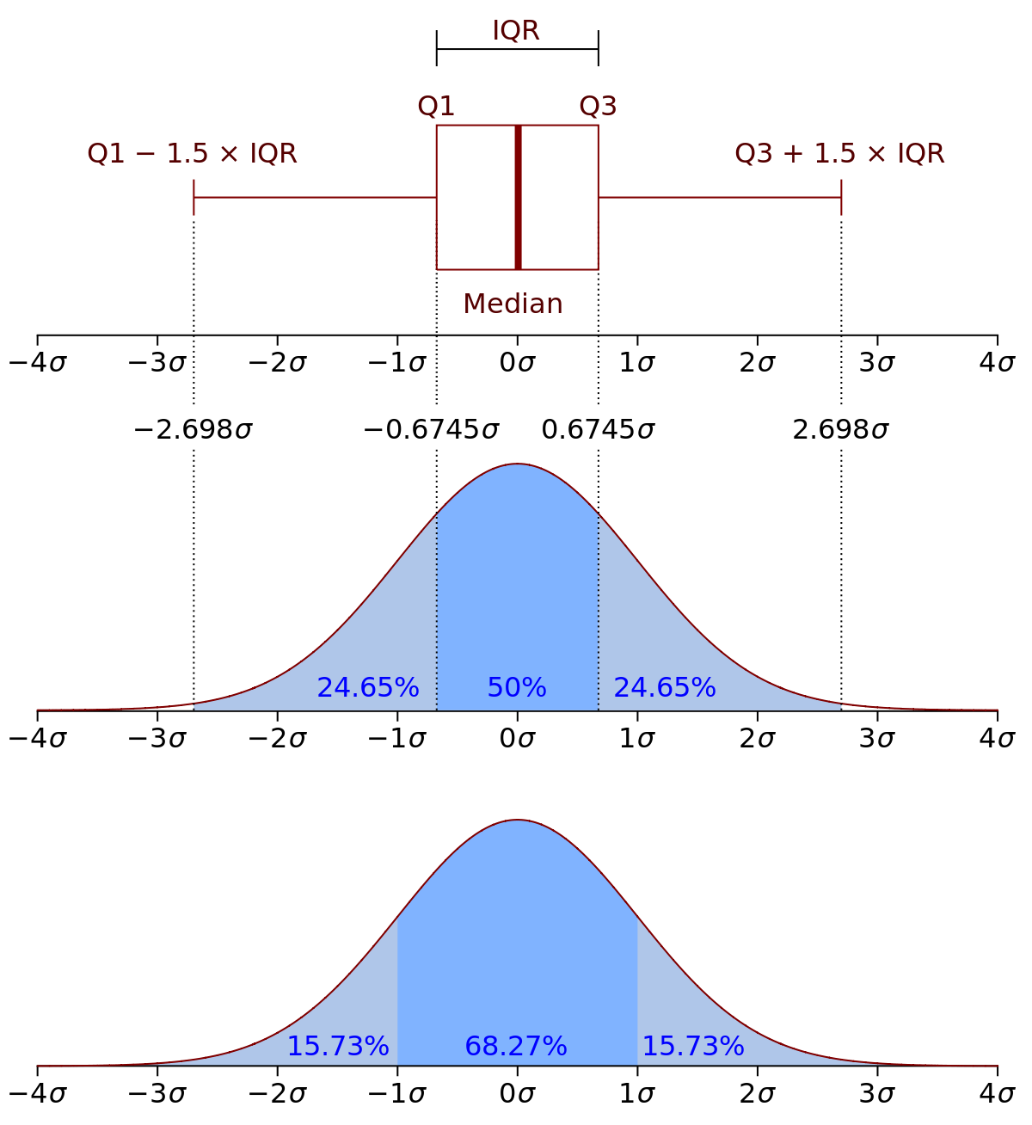
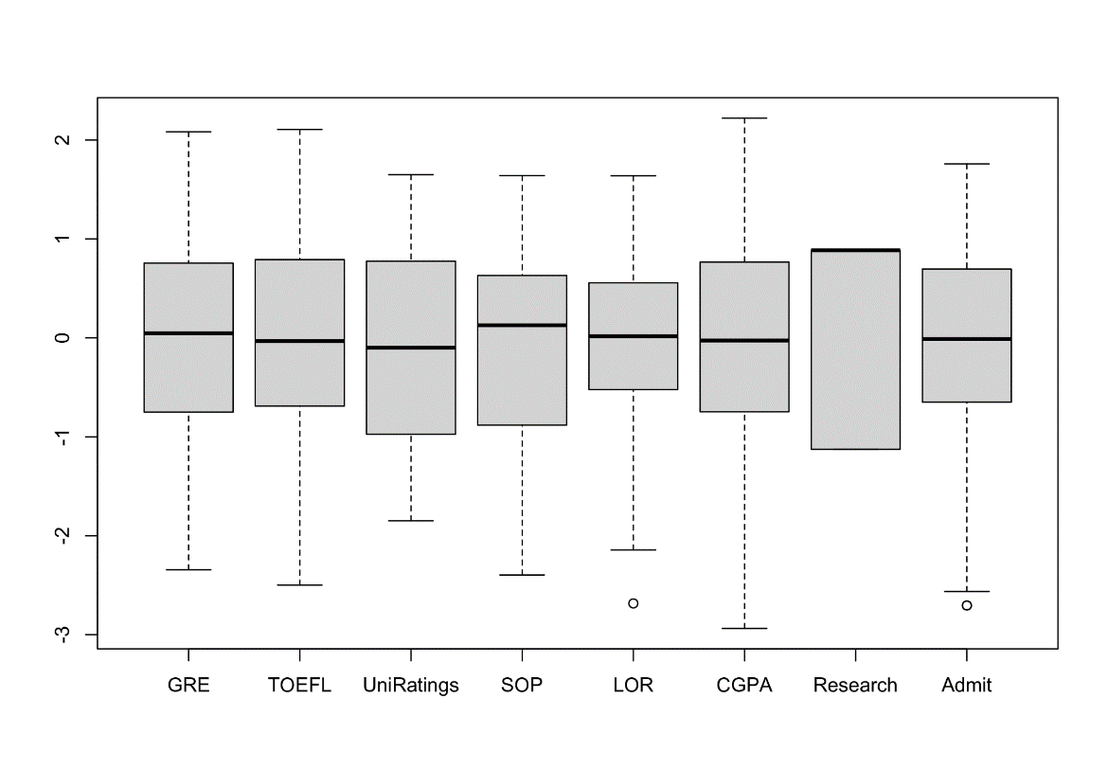
Outliers
Figure 3: How IQR method works
The outliers are going to be removed from the dataset using IQR method.
Figure 2: Detecting possible outliers in the regressors’ distribution using boxplot

Slide 9
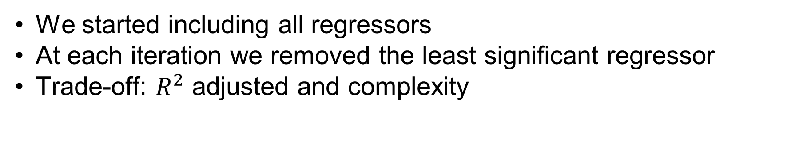
Linear regression: Estimated manually
We started including all regressors
At each iteration we removed the least significant regressor
Trade-off: $R^{2}$ adjusted and complexity

Slide 10
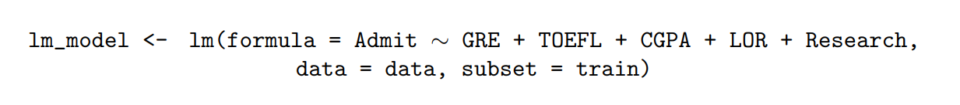
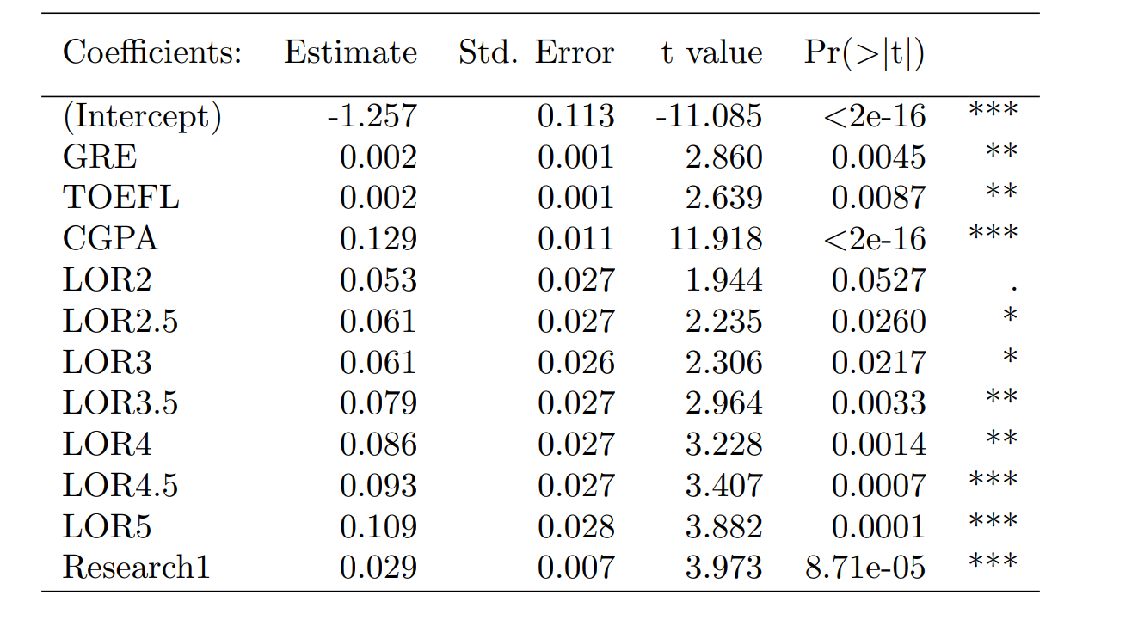
Linear regression: Estimated manually
Table 1: Result of applying the linear model in order to explain the response variable using the most important regressors.

Slide 11
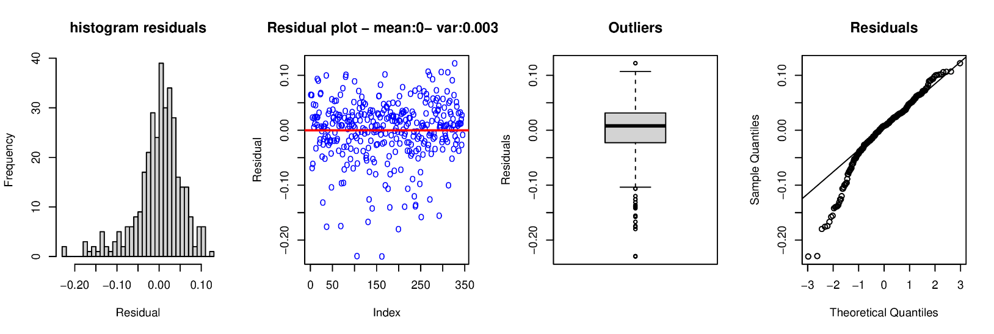
Linear regression: Estimated manually
Figure 4: Residuals plotting made by the linear model

Slide 12
Linear regression: Estimated manually
The Shapiro-Wilk test that the distribution of the residuals is non-normal
Studentized Breusch-Pagan test confirms that the distribution of the residuals is heteroscedastic

Slide 13
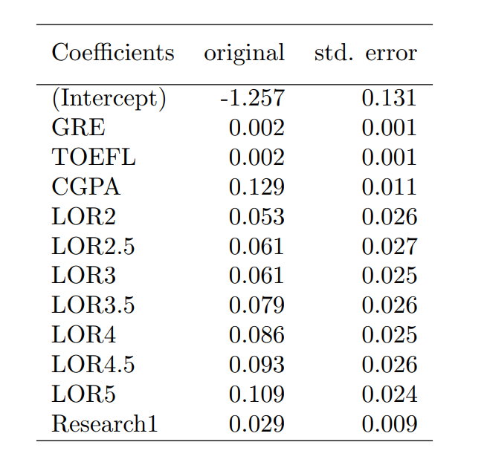
Linear regression: Estimated manually
We can’t trust the coefficients estimated by the model
We implement boostrap to compare the coefficients values
Table 2: Boostrap test applied on the training dataset in order to estimate the coefficients of the linear model
Table 3: most important statistics of the linear model estimated before

Slide 14

Linear regression: Stepwise
We include all the regressors and also: log, exponential, squared and cubic of all the continuous regressors
Selection criterion: AIC
Started with 42 coefficients and the algorithm selected only 20
Only 10 regressors selected
Residuals tests confirm again heteroscedasticity and non-normal distribution;

Slide 15
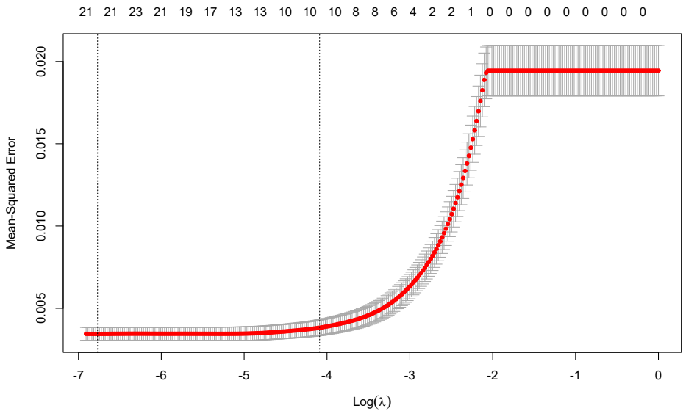
Linear regression: Lasso
Reduce complexity of the model
Cross-validation on the penalization λ
Using “lambda.1se” instead of “lambda.min”
Figure 5: Cross-validation method applied on the training dataset for the purpose of choosing the best penalization (lambda) that reduces the model complexity. The two vertical lines highlight two possible values for lambda

Slide 16
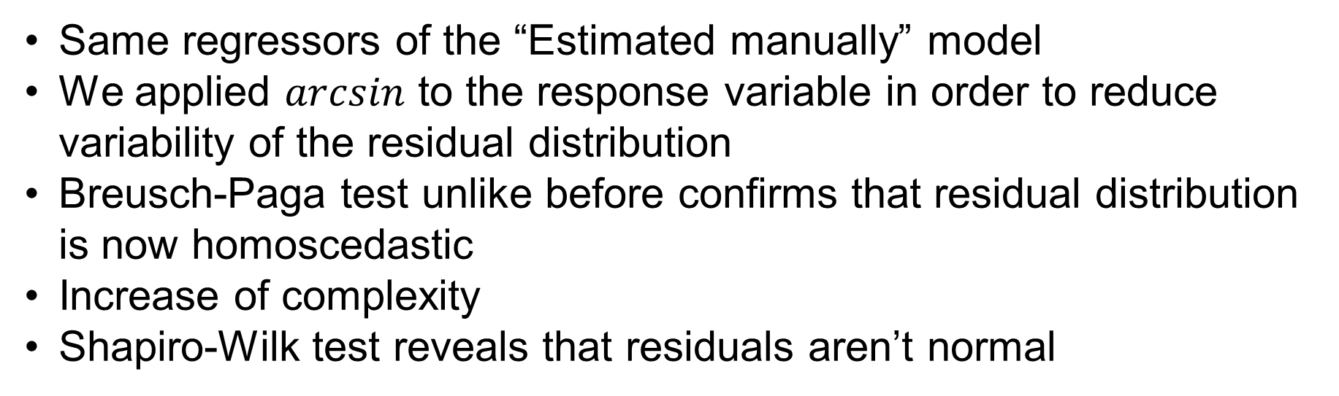
Linear regression: Model improvements
Same regressors of the “Estimated manually” model
We applied $arcsin$ to the response variable in order to reduce variability of the residual distribution
Breusch-Paga test unlike before confirms that residual distribution is now homoscedastic
Increase of complexity
Shapiro-Wilk test reveals that residuals aren’t normal

Slide 17
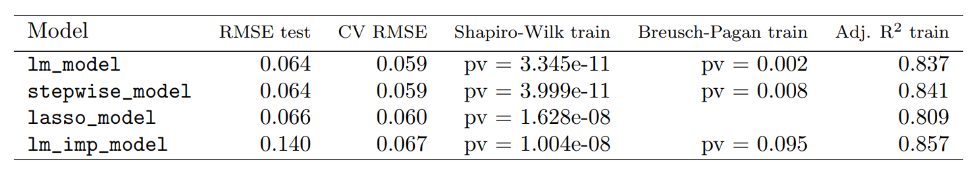
Final considerations about linear models
The “lm_model” is the most interpretable model and the less complex one
We will use this one to do other comparisons with other models
Table 4: All the linear regression models implemented during this section with the most important statistics

Slide 18
Generalized Additive Models
GAM with all regressors
GAM with only significant regressors
GAM with the most performing degrees of freedom

Slide 19
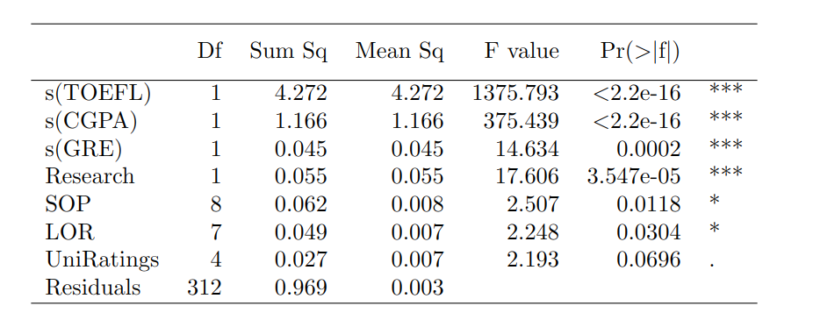
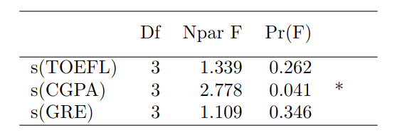
GAM with all regressors
Table 5: GAM with all regressors
Table 6: non-linear splines component in GAM with all regressors

Slide 20
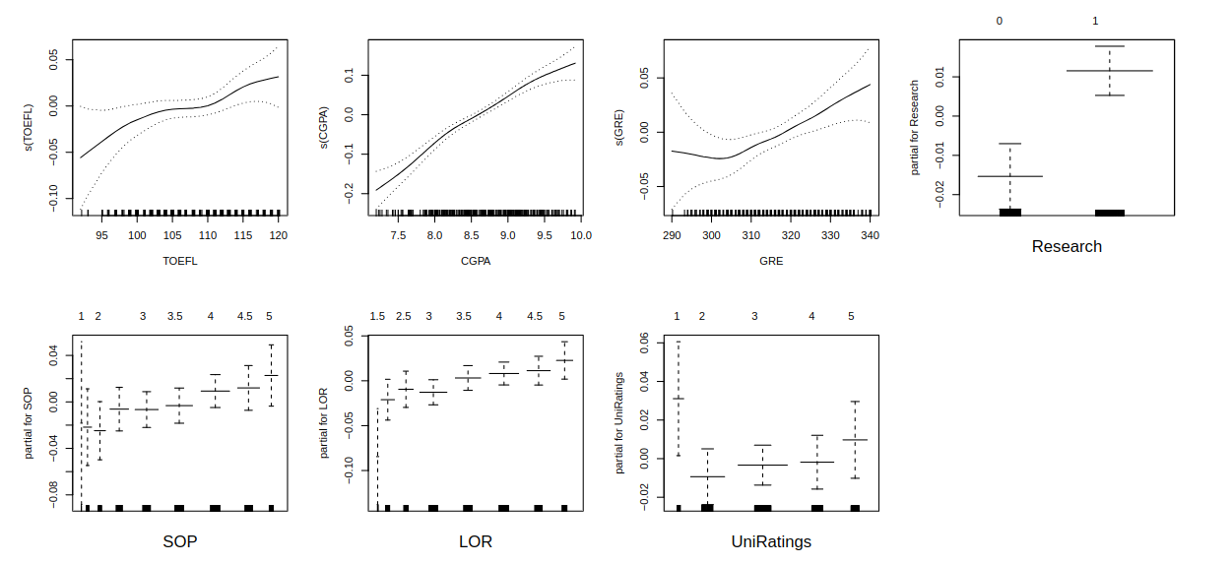
GAM with all regressors
Figure 6: GAM with all regressors

Slide 21
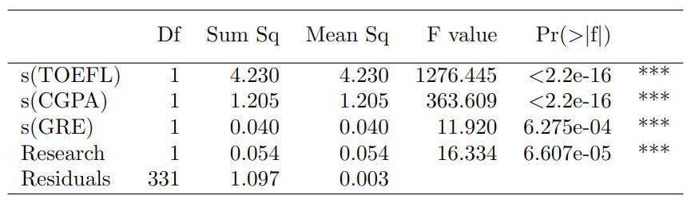
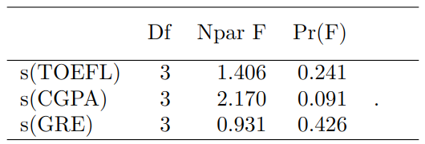
GAM with only significant regressors
Table 7: GAM with only significant regressors
Table 8: non-linear splines component in GAM with only significant regressors

Slide 22
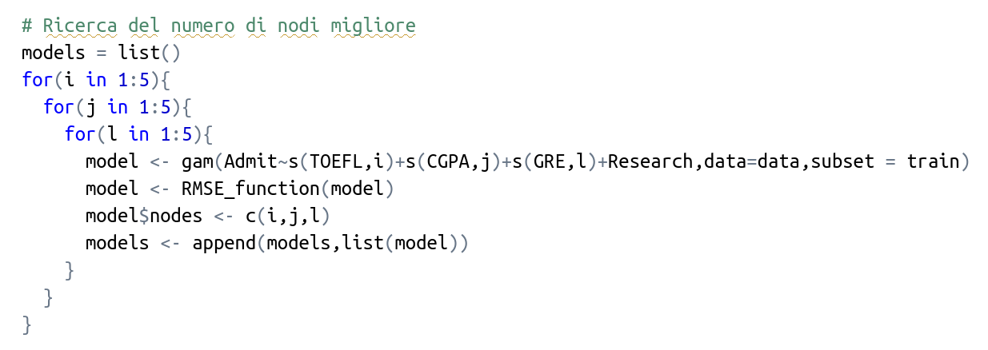
GAM with the most performing degrees of freedom

Slide 23
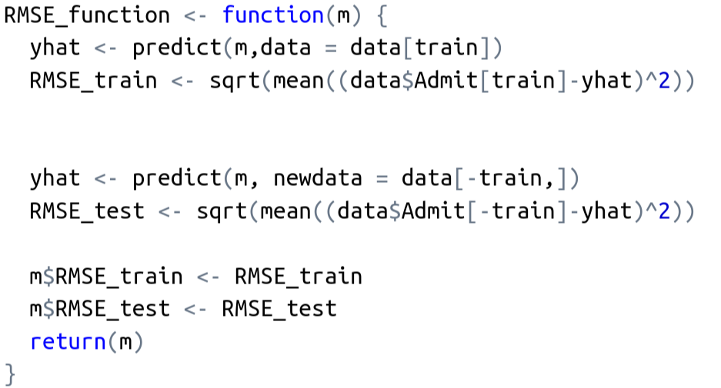
GAM with the most performing degrees of freedom

Slide 24
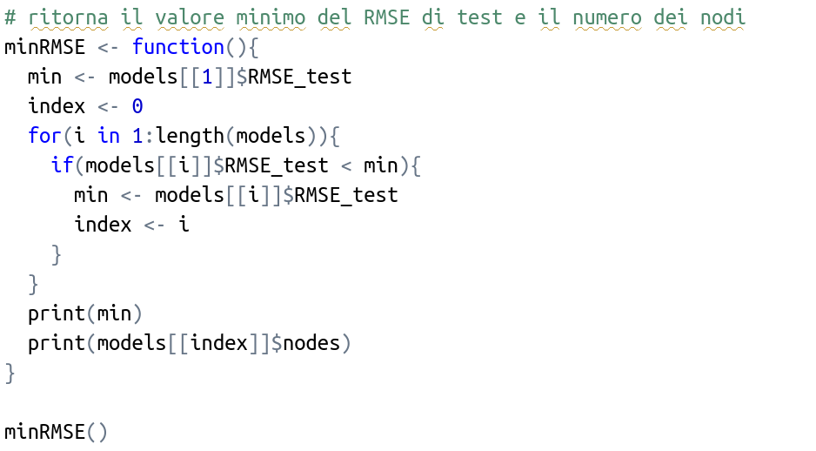
GAM with the most performing degrees of freedom

Slide 25
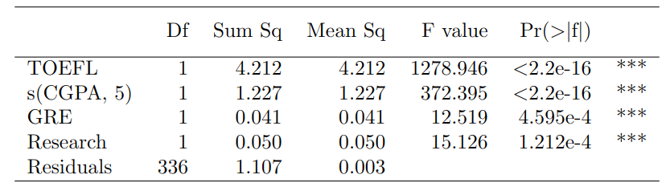
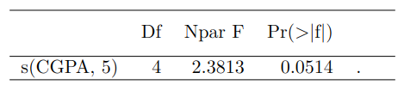
GAM with the most performing degrees of freedom
Table 9: GAM suggested by the algorithm
Table 10: non-linear splines component in GAM suggested by the algorithm

Slide 26
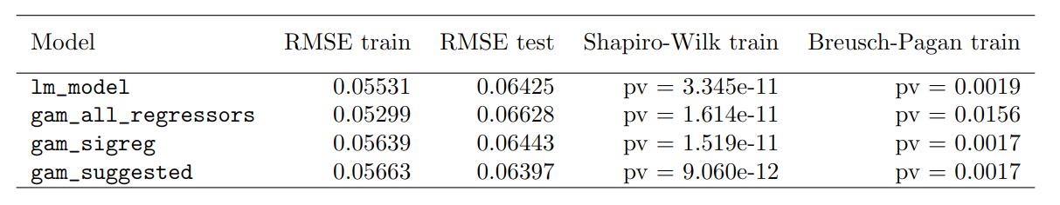
Final considerations about GAMs
Each model fails the Breusch-Paga and Shapiro-Wilk
All the models have similar RMSE test value
Linear model suits better our goals than the GAM models
Table 11: Comparing all estimated models

Slide 27
Regression trees
In this section we are going to apply trees to our dataset
Also, most complex algorithms based on trees: Bagging, Random forest and Boosting
Apply optimization approaches where possible
Compare all the tree-based models and choose the best one that suits our goals

Slide 28
Regression trees: Pruned tree
First regression tree to complex to read
We applied the pruning method
The penalization factor that involves pruning is chosen using a cross-validation approach

Slide 29
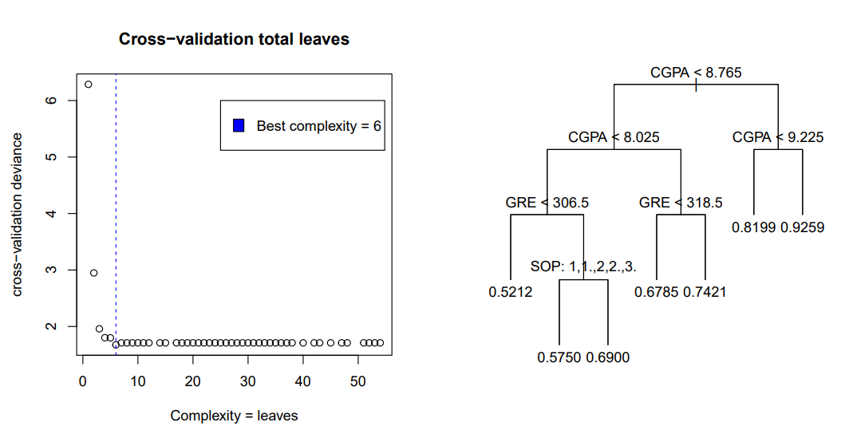
Regression trees: Pruned tree
Figure 7: Left: The cross-validation chooses the number of total leaves of the tree, that indicate the complexity of the tree and where to stop the splitting - Right: Tree pruned model using the best complexity parameter discovered in cross-validation

Slide 30
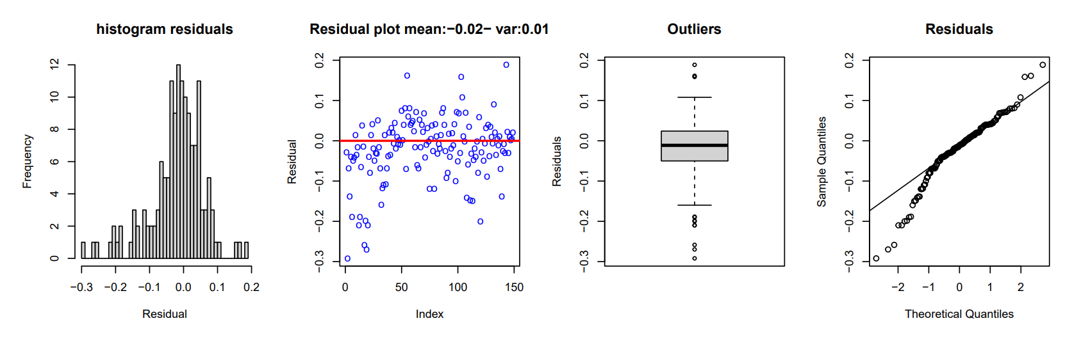
Regression trees: Pruned tree
Figure 8: Residuals obtained in the validation/prediction phase from tree model after pruning

Slide 31
Regression trees: Bagging
Bagging, also known as Bootstrap aggregating, is an ensemble learning technique
Bagging models performs the splits of each tree considering all the regressors in the dataset
It’s important to carefully choose the right number of trees we want to build in the training phase to not achieve any overfit
Optimization: optimal number of trees

Slide 32
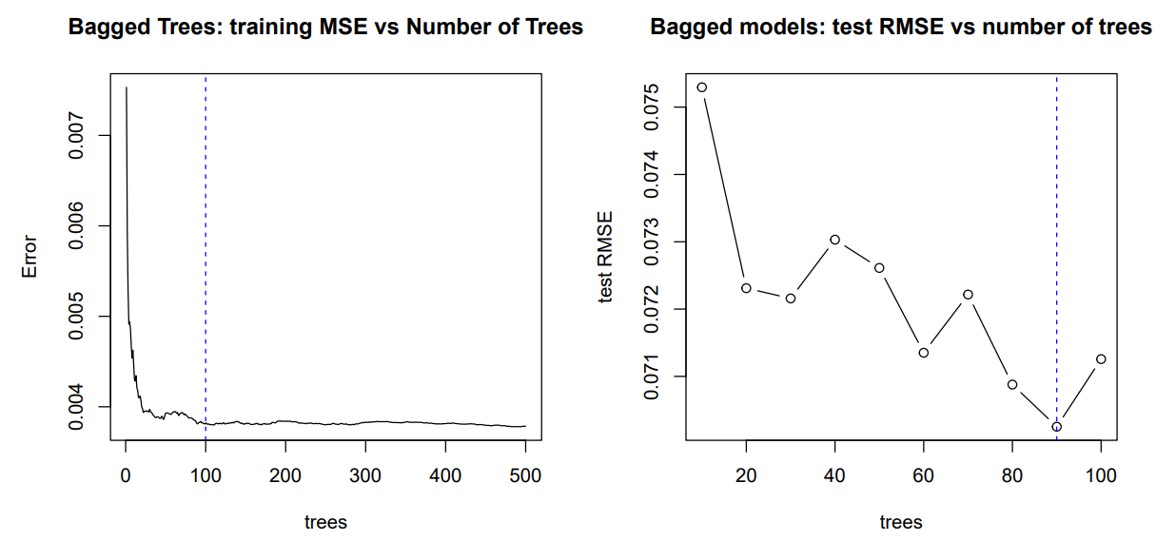
Regression trees: Bagging
Figure 9: Left: The behavior of a bagging model using a high number of trees compared to the training MSE. - Right: We fitted 10 different bagging models changing ntree parameter from 10 to 100 with a span of 10 and then calculating for each iteration the test RMSE.

Slide 33
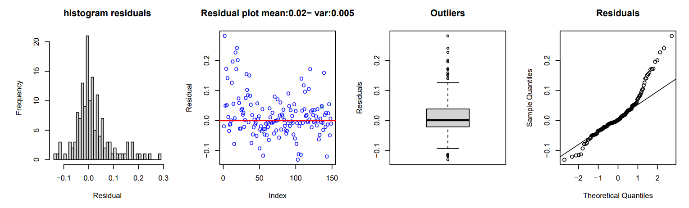
Regression trees: Bagging
Figure 10: Residuals obtained in the validation/prediction phase from the optimized bagging model

Slide 34
Regression trees: Random forest
Work in the same way as the bagging, but splits are constrained to a subset of the total regressors in the dataset
Has lower learning rate compared to Bagging
RMSE stabilizes after 100/150 trees
Optimization: optimal number of trees
Optimization: regressors used at each split

Slide 35
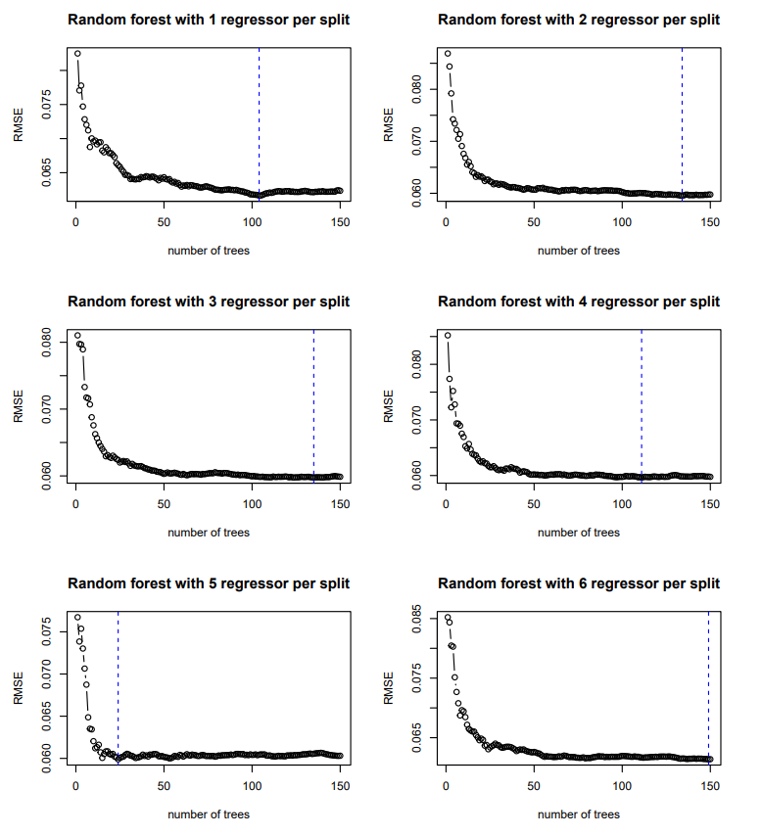
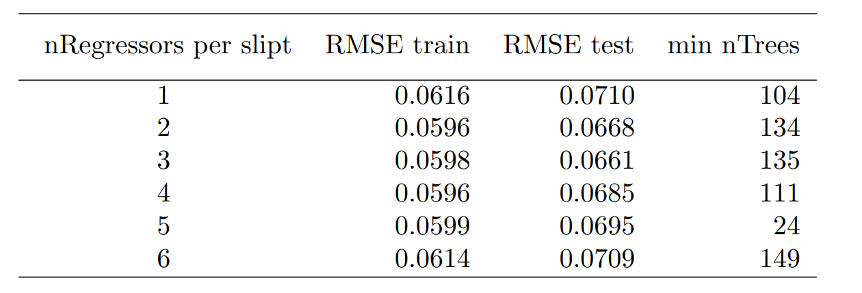
Regression trees: Random forest
Table 12: Number of regressors used per each split in the random forest approach followed by the lowest RMSE (training and validation) and the number of tree associated

Slide 36
Regression trees: Boosting
The most complex tree-based approach
The learning rate, also called shrinkage parameter λ
We fixed the shrinkage parameter to λ = 0.001
The maximum number of trees which overfitting starts is 6000 trees
Optimization: different numbers of depths

Slide 37
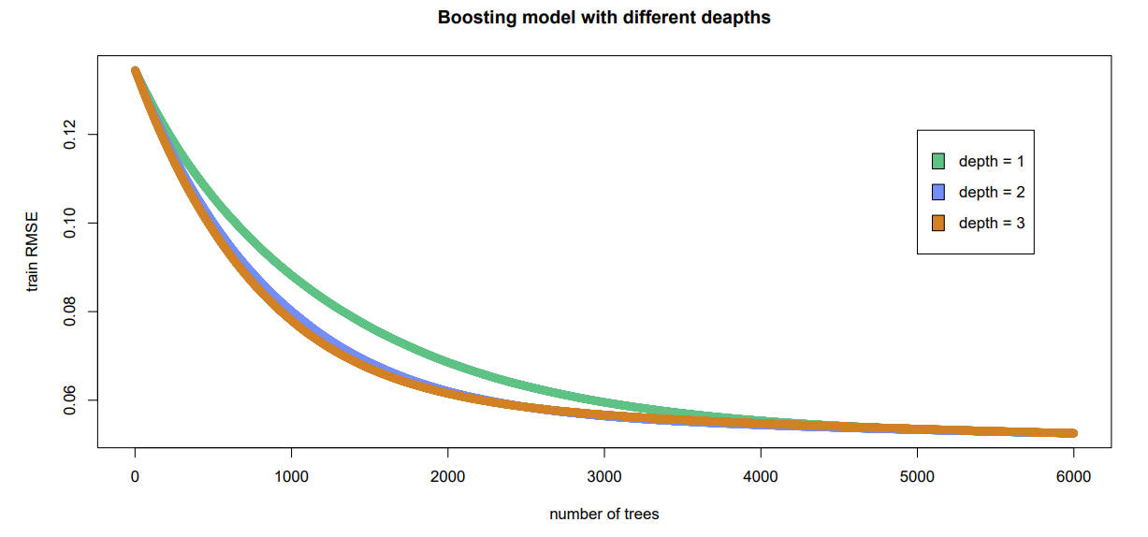
Regression trees: Boosting
Figure 11: Training 3 boosting models with different depths but fixed number of trees

Slide 38
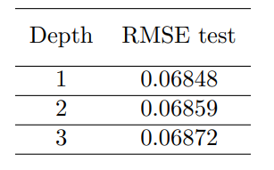
Regression trees: Boosting
Table 13: Boosting models with different depths using 6000 trees to train the models

Slide 39
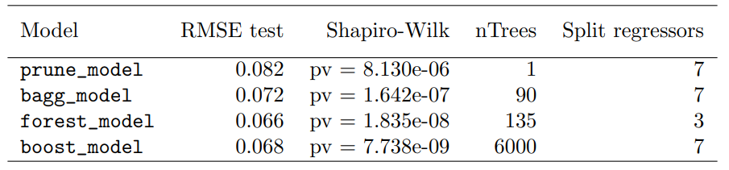
Final considerations about trees
The best performing model in validation is the forest_model instead the worst one is prune_model
The normality distribution of the prune_model is the best one
boost_model which is the most complex model and the most time expensive is the worst in terms of residual behavior
Table 14: All the best models analyzed and their most important statistics after the optimization

Slide 40
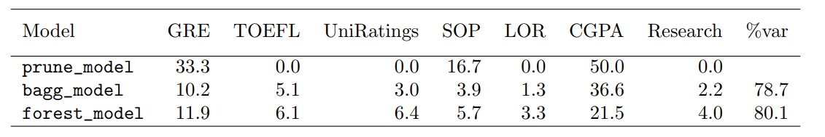
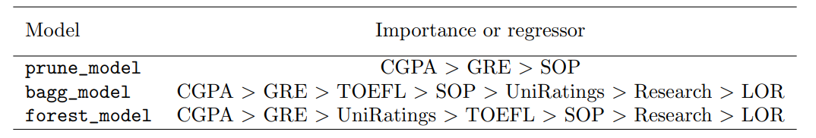
Final considerations about trees
Table 15: Percentage of importance of each regressor and the total percentage of variability of the model in explaining the dataset
Table 16: Ordering the regressors per model starting from the most important one

Slide 41
Final considerations about trees
Using ensemble methods we lose interpretability
Trees are non robust methods
The model that suits better our purposes is the prune_model

Slide 42
Conclusions
The models that reflect our goals are lm_model and prune_model
The residuals of both models act in the same way
Probably there is/are missing variable/s inside the dataset
In validation the lm_model performs better than the prune_model
lm_model keeps being the model which better explains our dataset.

