Slide 1
Dependency Injection and Test Driven Development
Silvano Luciani

Slide 2
Dependency Injection and TDD
DI = Design pattern or principle
TDD = Programming practice
Using DI we write code easier to test
Writing tests we are driven to use DI to make our code easier to test

Slide 3
Content
Small bits of theory
  Different forms of Dependency Injection
  Basic model of TDD
  Common types of tests
Case study inspection
  Code analysis of a sample application

Slide 4
What is Dependency Injection?
An application of Inversion of Control principle.

Slide 5
What is Inversion of Control?
An abstract principle
Software designed so that reusable generic code controls the execution of problem-specific code.
Reusable generic code and problem-specific code can be developed independently.

Slide 6
No IoC
package main;
sub extractRecords {
my $self = shift;
# db handlers
my $dbhMy = DBI->connect(
'DBI:mysql:database=EXTERNAL_SOURCE',
'root',
''
);
my $dbhLite = DBI->connect(
'DBI:SQLite:database=EXTERNAL_SOURCE',
'root',
''
);
# code to get the data from a MySQL db
my $sth = $dbhMy->prepare("SELECT foo, bar FROM table WHERE baz=?");
$sth->execute( $baz );
$results = $sth->fetchall_hashref();
foreach my $record (@$results) {
# code to adapt the format
$record->{source} = 'external';
$record->{created_at} = time();
##
# code to save the record to my db ( SQLite )
##
}
}

Slide 7
Template Method
package main;
sub templateRecords {
my $self = shift;
my @records = $self->queryRecords();
foreach my $record (@records) {
my $output = $self->templateRecord($record);
$self->saveRecord($output);
}
}
sub queryRecords {
# abstract
}
sub templateRecord {
# abstract
}
sub saveRecord {
# abstract
}

Slide 8
Delegation
package main;
sub importRecords {
my $self = shift;
my $externalCollection = ExternalCollection->new();
my $recordFormatter = RecordFormatter->new();
my $recordCollection = RecordCollection->new();
my @records = $externalCollection->queryRecords();
foreach my $record (@records) {
my $output = $recordFormatter->formatRecord($record);
$recordCollection->saveRecord($output);
}
}

Slide 9
What is a Dependency
With Delegation come dependencies
Our class now needs instances of the following three classes to perform its tasks:
  ExternalCollection
  RecordFormatter
  RecordCollection

Slide 10
What is Dependency Injection?
Object Dependencies are problem-specific code.
We 'Invert The Control' creating the dependencies outside the class that is consuming the dependencies.

Slide 11
Constructor vs Setter Injection
# Constructor Injection
my $instance = main->new(
externalCollection => $externalCollection,
recordFormatter => $recordFormatter,
recordCollection => $recordCollection,
);
# Setter Injection
my $instance = main->new();
$instance->setExternalCollection($externalCollection);
$instance->setRecordFormatter($recordFormatter);
$instance->setRecordCollection($recordCollection);

Slide 12


2nd Round
Constructor:
After the constructor method, the object is usable
Better for required dependencies
Circular dependencies
Setter:
No circular dependencies
Better for optional or dynamic dependencies
Can be hard to determine when the object is ready to use
Remember to set the dependencies

Slide 13
Block Injection
We Inject a block of code ( subroutine ) that returns an object
Not famous because in Java it's not possible
More versatile, handy for handling complex initialisation code

Slide 14
Container
Control of objects creation
Include satisfaction of dependencies
When we need an instance of a class, we ask the Container to create the instance and wire the dependencies
Using Environments we can easily change the behaviour of the system ( very useful for integration and functional tests )

Slide 15
What is TDD?

Slide 16

What is TDD?

Slide 17
What is TDD?
Red
Refactor
Green

Slide 18
What is TDD?
Write the test for a functionality and execute the test to check that it is failing
Write the amount of code needed for the test to pass
Refactor code:
  Remove duplications
  Improve the design with tests as a safety net ( never modify test and code at the same time! )

Slide 19
Example: 1st iteration
sub test_add {
is(add(5,5), 10, "Correct result for addition");
}
sub add {
return 10;
}

Slide 20
Example: 1st iteration
sub test_add {
is(add(5,5), 10, "Correct result for addition");
}
sub add {
return 10;
}

Slide 21
Example: 2nd iteration
sub test_add {
is(add(5,5), 10, "Correct result for addition");
is(add(3,8), 11, "Correct result for addition");
}
sub add {
my ($a,$b) = @_;
return $a + $b;
}

Slide 22
Why TDD?
Drive us towards 'good' design principles:
  Loose coupling
  Program to an interface, not an implementation
  Composition over Inheritance
  Delegation
  You ain't gonna need it

Slide 23
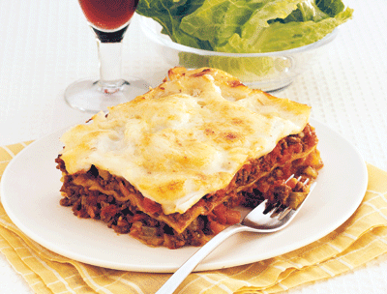
Testing Layers
Functional
Integration
Unit

Slide 24
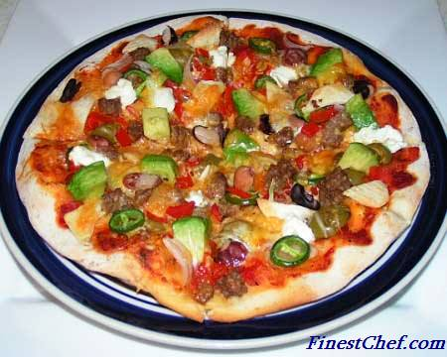
Usually
Functional
Integration
Unit
“A piece of this, a piece of that”
K-Hos from Bethnal Green™

Slide 25
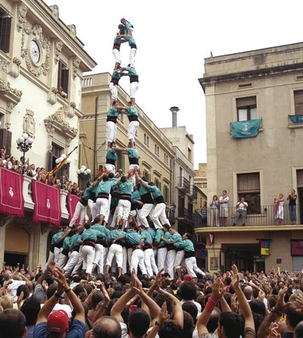
Testing Layers again
Functional
Integration
Unit

Slide 26
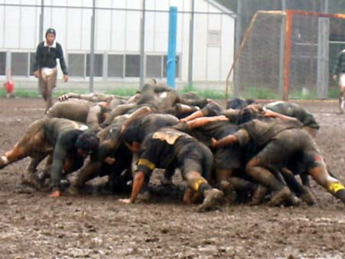
Usually again
Functional
Integration
Unit

Slide 27
Unit Test
Individual units of source code tested
A unit is the smallest testable part
White Box test
All the dependencies are mocked
Written by developers

Slide 28
Unit Test
Input

Slide 29
Unit Test
mock
Output
Input
mock

Slide 30
Integration Test
Individual software modules are combined and tested as a group ( subsystem )
Partially White Box, partially Black Box
We can mock some objects to position ourself in a certain starting condition
Written by developers, but with the right tools QA can help

Slide 31
Integration Test
System
Sub System
Input
Output

Slide 32
Functional Test
Specifications of the software are tested
Black Box
We can use testing environments ( i.e. db ), but we should not mock anything
QA, with help from the developers

Slide 33
Functional Test
Application
Input
Output

Slide 34
Sample Application
A command line perl application to help an Estate Agency for students to determine the days in which the tenants must pay the rent and the bills
The rent is due the 1st day of the month if it is a weekday, otherwise the next monday.
The bills are due the 15th day of the month if it is a weekday, otherwise the previous friday.

Slide 35
Input
Student Name and Expiration ( index 1 – 12 )
Csv Input: a line for each student, first value is the name, second value is the expiration
MySql Input: a table named 'Students' with two columns, name and expiration

Slide 36
Output
Name of the student and for every month until the expiration month ( included ) :
  Month name ( January, February … December )
  Rent Payment Day
  Bills Payment Day
Csv Output: a line with the name of the student and then one line for each of the month
Yaml Output: array of arrays
The user can specify the name of the output file

Slide 37
Some of the modules
Moose
Test::Class and Test::More
Test::Cukes
Class::MOP and Moose::Meta::*
Bread::Board

