Slide 1

Human Resource Analysis of AIC
By Arash Aghagol

Slide 2
Company Overview
This company has 10 different departments(IT, Sales, Marketing, …)
For each person there is a record in the HR department, and they track various data about employees

Slide 3
What HR Department Track
Satisfaction (0 to1)
Evaluation (0 to1)
Number of project currently involved (2 to 7)
Average monthly hours (96 to 310 hours)
Work experience in the company (2 to 10 years)
Salary level
Whether they have work accident and promotion
Whether they have left the company or not

Slide 4
Questions
Why people leave the company?
Quantity
Distribution
Pattern
A model to predict the employee who is going to leave the firm

Slide 5
Some General Stats
Some medians:
Satisfaction (0.64)
Evaluation (0.72)
Number of project currently involved (4)
Average monthly hours (200)
Work experience in the company (3)
Total employee records: 14999
11428 stay (76%)
3571 left (24%)

Slide 6
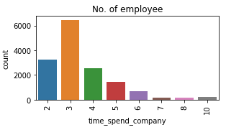
Distributions

Slide 7
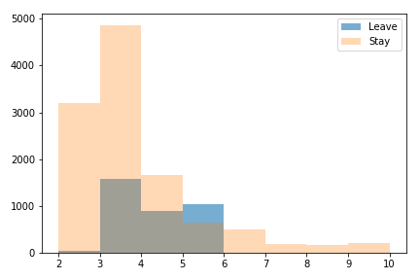
Distributions Comparison

Slide 8
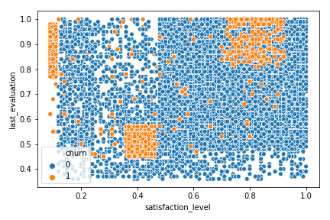
Can we find patterns in leavers?
III
I
II

Slide 9
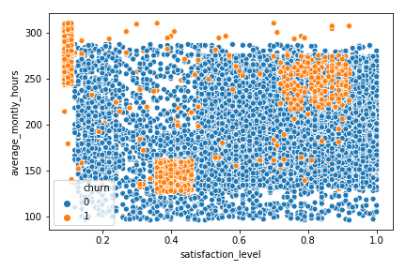
Can we find patterns in leavers?
I
III
II

Slide 10
Why Group I Leaves?
Approximately 192 People
Long Working Hours (Median: 275 Vs 200 and Max>300)
Work-Life was imbalance
Overloaded (6 projects Vs 4)
Low Salaries
57% Low Salary
40% Medium Salary
Result: Headhunted by rivals

Slide 11
Why Group II Leaves?
Approximately 670 People
Their working hours as well as number of projects were not extreme
Probably wanted to gain experience not interested to stay
Use firm reputation to find another job

Slide 12
Why Group III Leaves?
Approximately 789 People
Long Working Hours (Median: 245 Vs 200 and Max=300)
Work-Life was imbalance
Low Salaries
60% Low Salary
38% Medium Salary
Result: Headhunted by rivals

Slide 13
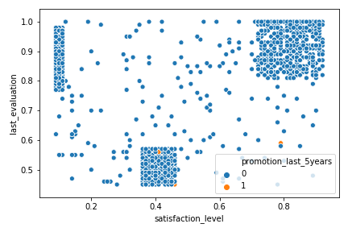
Do these group got promotion?

Slide 14
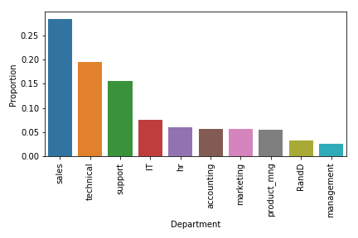
Dept Leaving Proportions

Slide 15
Prediction
Committing which error in prediction is more severe:
Predicting some people are going to leave while they don’t want
Predicting some people will stay while they actually leave
Because finding competent employees and training them are costly, the second is more severe

Slide 16
Final model metrics
Modelling was done with 20 features
Variables reduction examined, no improvement

Slide 17
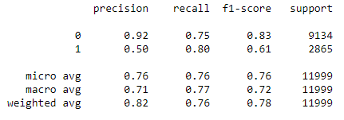
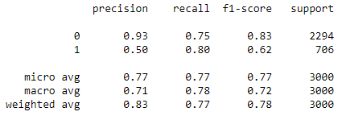
Final model metrics

Slide 18
Summary
People have left the company for following reasons:
Sheer majority no promotion
Low salary
High work load
Long working hours
A model has been developed for prediction with good reliability

Slide 19
THANK YOU!
Questions?

Slide 20
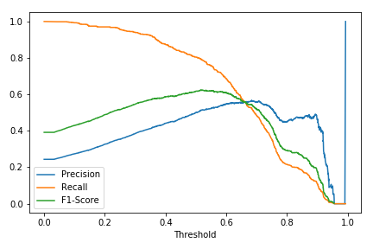
Appendix

Slide 21
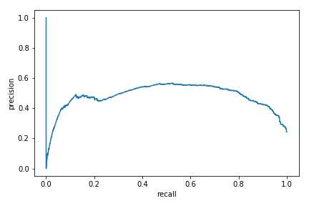
Appendix

