Slide 1
Scales
&
types
Kingdoms
Ecosystems
Fungi
Plants
Across
Animal
Species
Functions
Chromista
Protozoa
Genetic
Bacteria

Slide 2
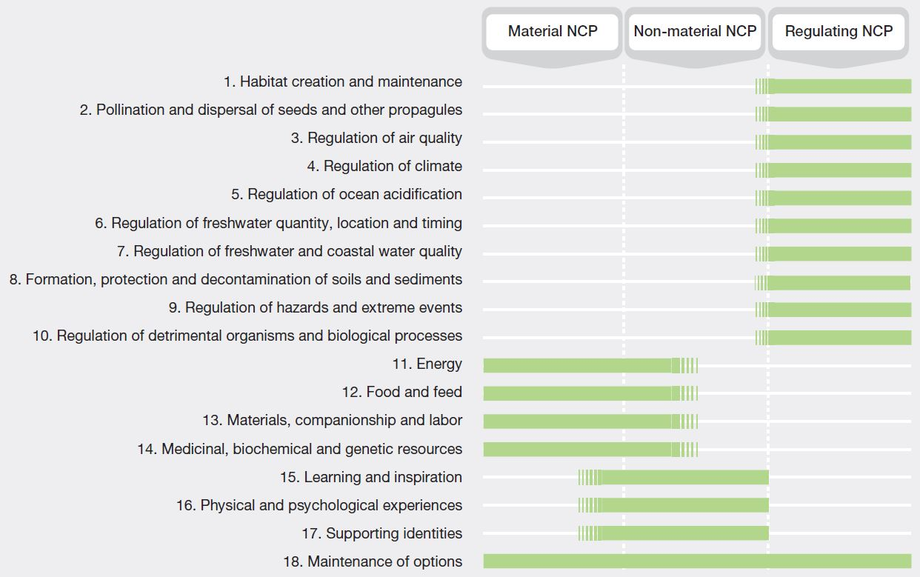
Human
Wellbeing
Ecosystem services
Ecosystems
Provisioning
Cultural
Regulating
Supporting
Good quality of life
Nature
Living in harmony with nature
Nature Contributions to People
Biodiversity and ecosystems
Human wellbeing
Mother Earth etc…

Slide 3

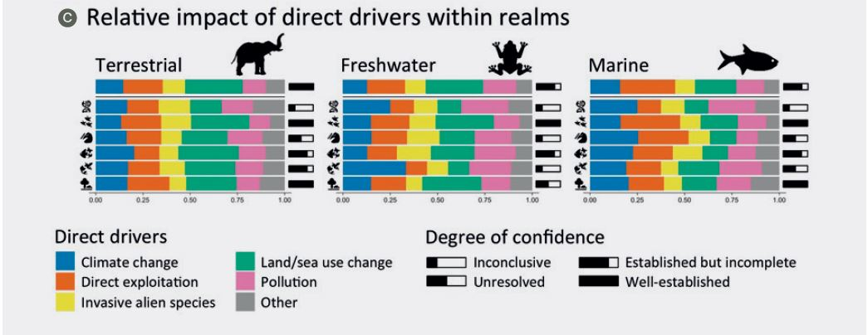

Slide 4
Realms
A
Boreal forests
Kelp forest
Temperate forests
Forests
Marine shelf
Coral reefs
Freshwater
Terrestrial
Marine
Biomes
Functional groups
Intensive land-use
Subterranean
Pelagic ocean water
Cropland
Epipelagic
Urban and industrial
Mesopelagic
Scales
&
types
Ecosystems
Plants
Kingdoms
Protista
Animal
Pollination
Species
Functions
Predation
Photosynthesis
Seed dispersal
Nutrient cycle
Bacteria
Fungi
Genetic
Individuals
Populations
Regions
« Across » relationship

Slide 5
A
B
Patch
Landscape
Habitat amount
C
4
D
1
2
3
Habitat fragmentation per se

