Slide 1
Is there a future for hybrid EAERE Conferences?
Reflections on the basis of 2023 evaluation questionnaire
Alessio D’Amato

Slide 2
Premise
I am a «newcomer» in the Sustainability Committee
I am of course grateful for the great job already done by existing members
This reflections are based on «descriptive» evidence and a few «naive» quantitative attempts

Slide 3
Data
2023 questionnaire in Cyprus (Conference Evaluation Report)
217 respondents out of 730 participants
I could not make it to be there, so I am in a «suitable» position to try and drive some reflections

Slide 4
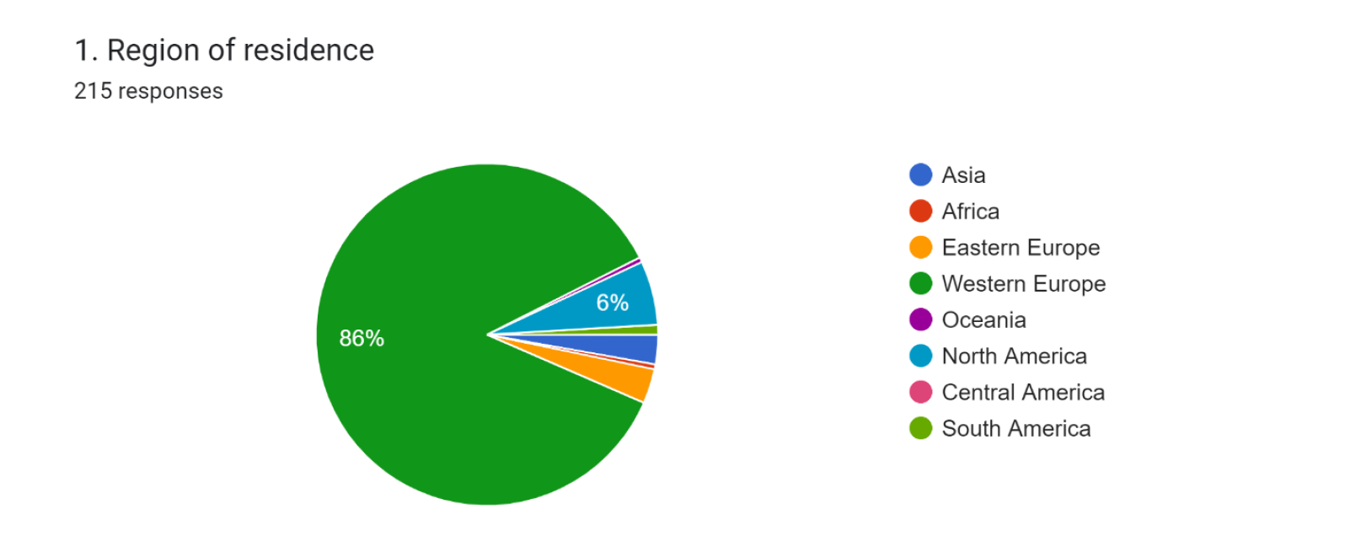
Most of the participants come from Western Europe

Slide 5
Gender balance

Slide 6
Accomodation and trips (1)
Almost one third is «long term participant» (5+ years)
Almost 98% of respondents participated in person
Around 73% stayed in hotel (50% in high budget hotel)
Only 20% mentioned sustainability as a relevant criterion in choosing accomodation, and only around 16% stayed in a «recognizable» sustainable venue
85% visited Limassol mostly or only for the Conference
Small fraction bundled with other Conferences

Slide 7
Accomodation and trips (2)
Most respondents flying from Europe
Highly heterogeneous transportation means (train minor role overall but with more respondents than plane for the main leg)
Most trips with an estimated distance between 1000 and 5000 Kms
Around 38% used a car, around 34% does not know the fuel.
Only in around 17% of the cases the cars were «full» (4 or more than 4)

Slide 8
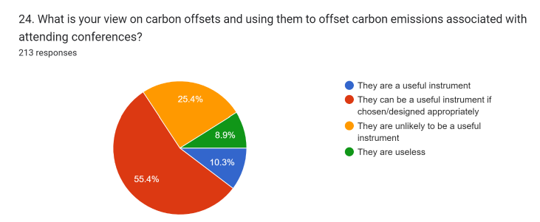
Carbon offset and food

Slide 9
Satisfaction with the online package

Slide 10
Attitudes towards the future (1)

Slide 11
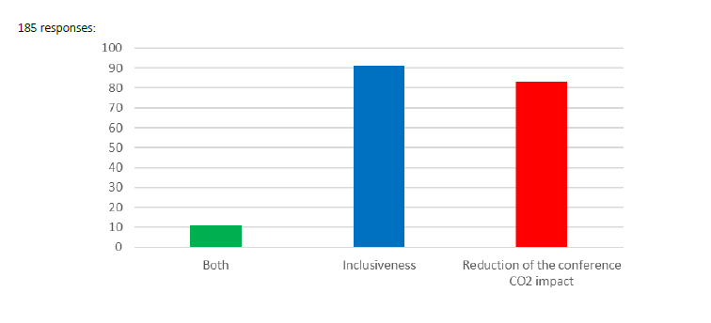
Attitudes towards the future (2): why a hybrid conference

Slide 12
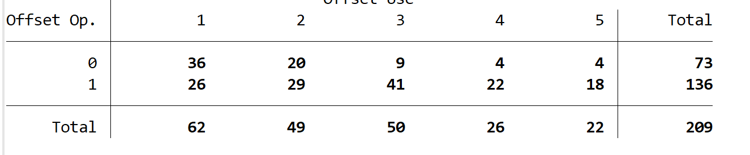
Offset opinion vs. Offset use
A two-sample Wilcoxon rank-sum (Mann–Whitney) test confirms that «treated» (good opinion) answer by stating that they use offsets more often – larger median answer - (Prob > |z| = 0.0000)
Offset opinion: 1 if useful or likely useful; 0 otherwise; Offset use: from Never (1) to Always (5).

Slide 13
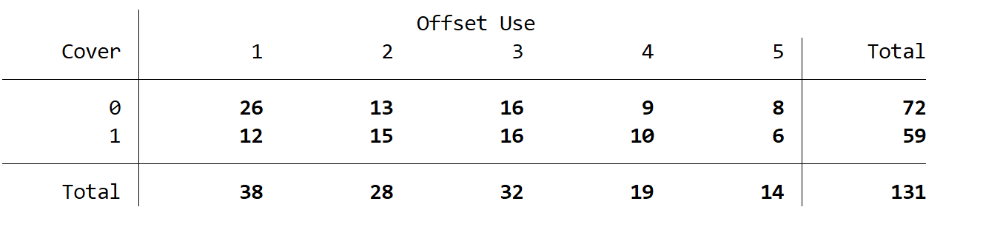
Offset use vs. (Covered) fee
No evidence of a difference - two-sample Wilcoxon rank-sum (Mann–Whitney) test - (Prob > |z| = 0.1919)
Also, very small correlation between offset use and satisfaction with fee (less than 0.1)
Cover: 1 if the fee is covered for non presenters; 0 otherwise; Offset use: from Never (1) to Always (5).

Slide 14
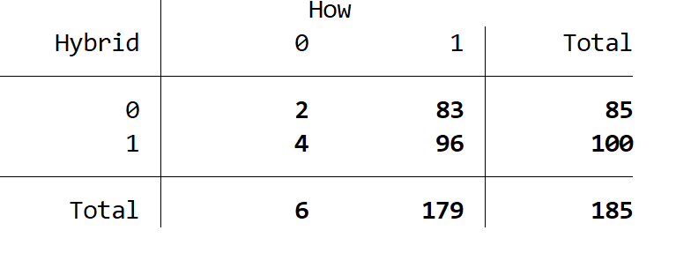
Hybrid vs in person participation
Surprisingly (?) A majority of respondents suggest «hybridization» of the Conference, but among those that would go for hybrid, a huge majority also states to be willing to participate in person

