Slide 1
Instruction fusion opportunities in Manticore
Bachelor semester project
Simon A. Marti, Spring 2022
Supervised by Sahand Kashani & Mahyar Emami
Notes:
design an algorithm and implement it

Slide 2
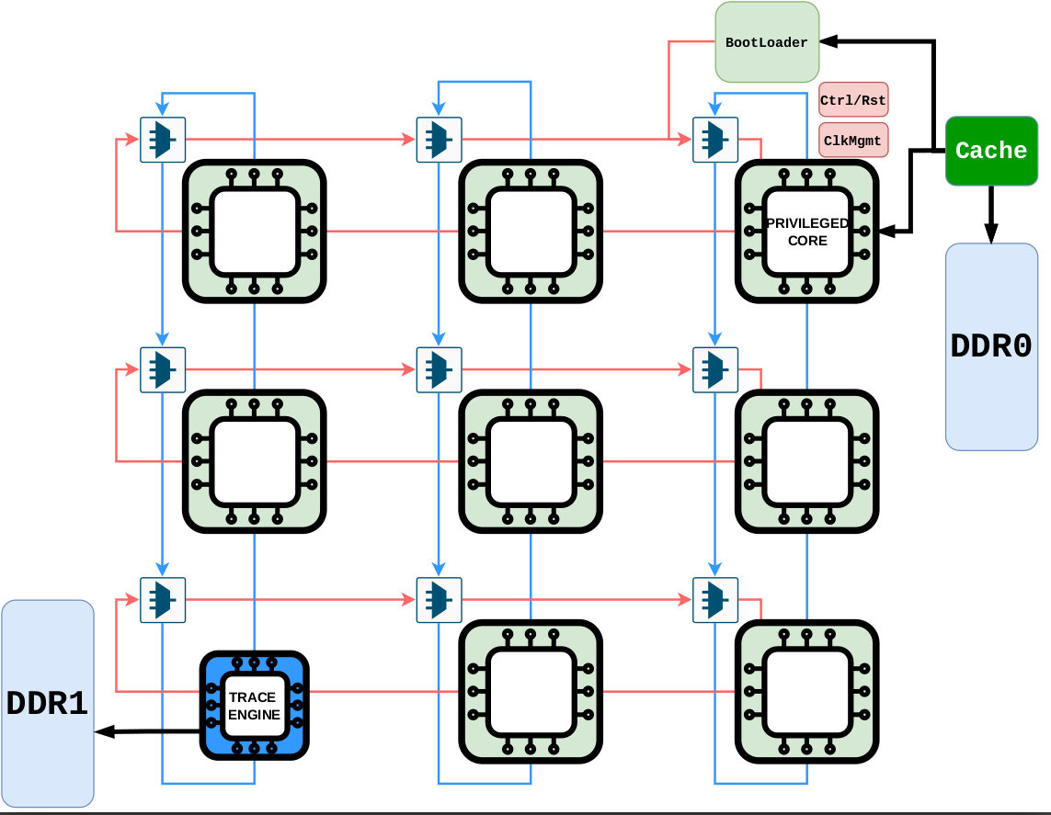
Manticore
Goal : Accelerate RTL simulation with parallelization
Run on FPGAs
Array of custom CPUs
Wimpy cores with a static schedule
Notes:
Quick recap of Sahand & Mahyar’s work
parallel architecture for cycle-accurate RTL simulation on FPGAs.
FPGAs work with LUT=lookup table. Extract parallelism from circuits to run faster on fpgas

Slide 3
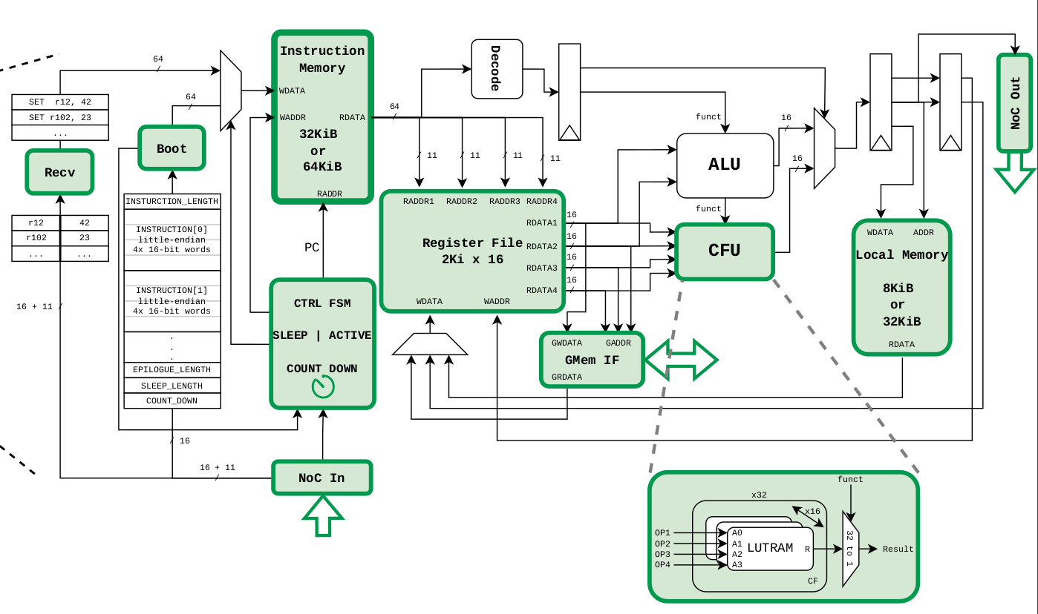
Notes:
support for binary arithmetic operations like `ADD`,... + CFU

Slide 4

Manticore compiler
Verilog executable / Netlist
Standard optimizations
  Dead code elimination
  Constant folding
  Extract parallelism
Notes:
(Manticore emulates parallel circuits with sequential insts.)
placed = all 16 bits and knows on which core to run, passes.
unconstrained=closer to machine code
IR=Intermediate representation.
inputs(immutable),outputs,constants,wires

Slide 5
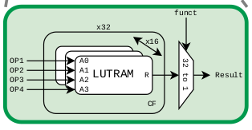
Custom Instructions
HW has support for up to 32 custom LUT
0 ≤ arity ≤ 4
Replace logic instructions (AND, OR, XOR)
Save simple instructions
Notes:
Leverage FPGA resources. => CFU
(expensive op : selecting bits and logic ops on them)
arity = how many inputs a function takes
"Manticore emulates parallel circuits with sequential insts. "

Slide 6
Goal
Program with only normal instructions
=> Program with normal & custom instructions
Find most profitable instructions to fuse
Constraint : up to 32 different custom functions
Notes:
PLACED.
insertion/replacement .
Note : A custom FUNCTION can be used in many custom INSTRUCTIONs
_____4__________

Slide 7
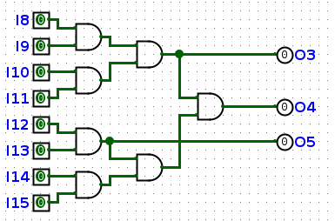
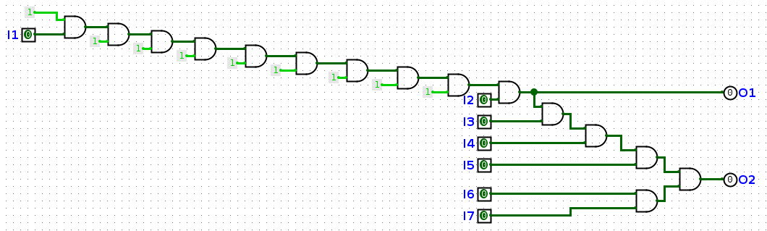
4-inputs fusion examples
“A-fusion”
AND w1, i1, i2;
AND w2, i3, i4;
AND w3, w1, w2;
“B-fusion”
AND w1, i1, i2;
AND w2, w1, i3;
AND w3, w2, i4;
Notes:
FUSION=pattern replaceable by custom function.
name arbitrary.
drawing on logisim.
which wire is which.
Let's focus on 4-inputs fusion, we will cover 0-1-2-3-inputs fusions later

Slide 8
Fusion search
Notes:
still a program, represented graphically for simplicit
Wires represent a 16-bit register.
4 partially overlapping fusions

Slide 9
Fusion profitability
Some fusion save more instructions than other
Gain = 1
Gain = 2
Needs to be replicated
Notes:
(in any case, E-fusion can be made (bottom))

Slide 10
Fusion conflicts
Before : 6
After : 4
Gain = 2
Before : 6
After : 3
Gain = 3
Notes:
Left : Here the 2 bottom nodes are not yet fusable. Right : Top node still needed

Slide 11
Algorithm : fixed-point approach
0. build graph
do {
  1. find and select fusions to apply
  2. merge reused operands
  3. reduce arity
  4. merge arity-0 instructions
  5. collapse chains of arity-1 instructions
} 6. repeat until no more change in graph
Notes:
graph will be used to our pattern matching, and used to determine when it will finish
_____7_______

Slide 12
0. Graph building
Candidates for fusion : AND, OR, XOR
Not considered : ADD, SLL, MUX, MOV, …
Three types of nodes :
  Logic
  Const
  Name

Slide 13
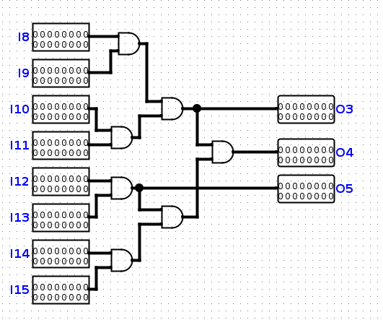
AND w5, i8, i9;
AND w6, i10, i11;
AND w7, w5, w6;
MOV o3, w7;
AND w8, i12, i13;
SLL o5, w8, c1;
AND w9, i14, i15;
AND w10, w8, w9;
AND o4, w7, w10;
...
Pattern for fusion
w7 is reused
w8 is reused
Notes:
16 bits wire

Slide 14
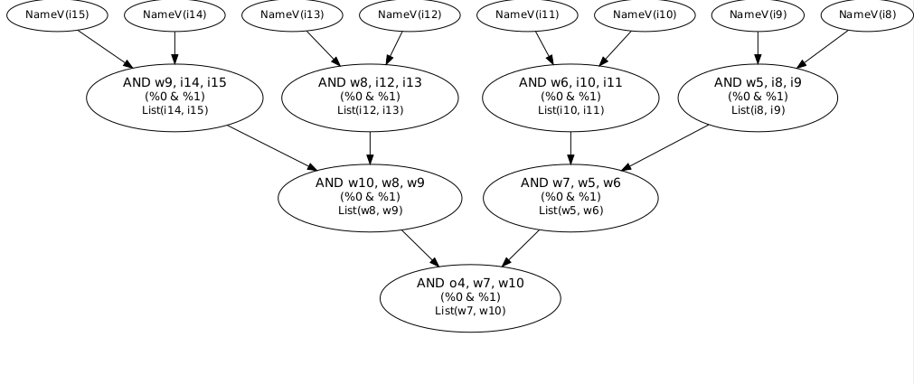
AND w5, i8, i9;
AND w6, i10, i11;
AND w7, w5, w6;
MOV o3, w7;
AND w8, i12, i13;
SLL o5, w8, c1;
AND w9, i14, i15;
AND w10, w8, w9;
AND o4, w7, w10;
...

Slide 15
1.1 Fusion pattern-based enumeration
Pattern matching approach
for i in body.arity2Instructions :
  for j in i.inputs :
    for k in j.inputs :
      if (i, j, k) forms a fusion pattern :
        record (i, j, k)
Notes:
iterate thru body, look into parents and grandparents in graph

Slide 16
1.2 Collisions and collision zones
Each fusion exclude some others
“Collision zone” = isolated portion of the program where some fusions overlap
Typical size : 1 - 300
Notes:
UNION-FIND,
much bigger with new types of fusion to come, will make the selection cumbersome.

Slide 17
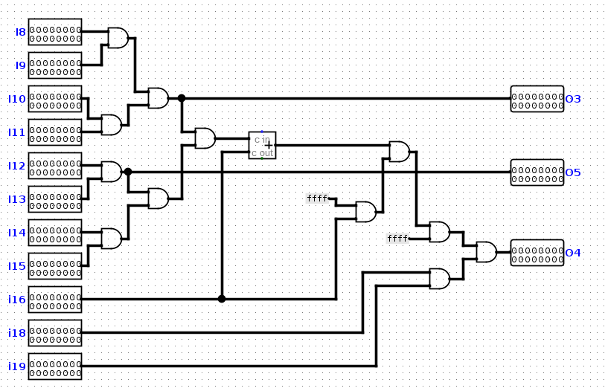
7 fusions
3 fusions
Notes:
adder

Slide 18
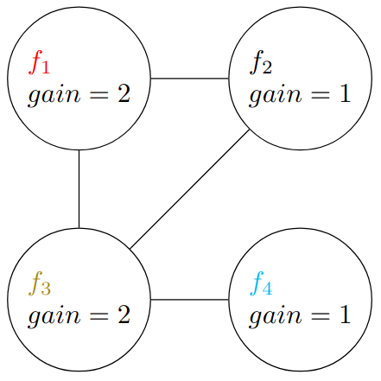
1.3 Fusion selection
gain = 1
gain = 2
AND w0, w22, i2;
AND w1, w0, i3;
AND w2, w1, i4;
AND w3, w2, i5;
AND w4, i6, i7;
AND o2, w3, w4;
gain = 2
gain = 2
Maximum Independent Set
problem !

Slide 19
1.3 Fusion selection : Heuristic
Given a collision zone :
sort it (by degree ascending, gain descending)
while(zone.isNotEmpty):
  f = zone.pop()
  selection.add(f)
  selection.addAll(fusions excluded by f)
Notes:
multilevel sorting (excel). first level : Degree. If 2 fusions have same degree, look at gain
_____11_______

Slide 20
1.3 Fusion selection
gain = 1
gain = 2
AND w0, w22, i2;
AND w1, w0, i3;
AND w2, w1, i4;
AND w3, w2, i5;
AND w4, i6, i7;
AND o2, w3, w4;
gain = 2
gain = 2
Notes:
same example

Slide 21
f4 (gain=1) ; f1 (gain=2) ; f2 (gain=1) ; f3 (gain=2)
degree = 1
degree = 2
degree = 3
Notes:
sorting; taking; removing

Slide 22
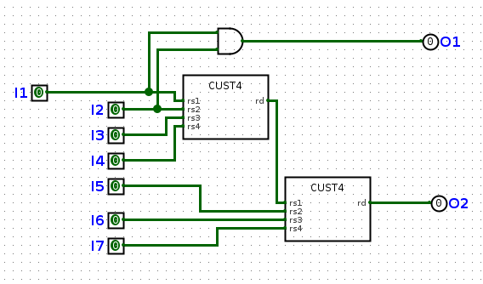
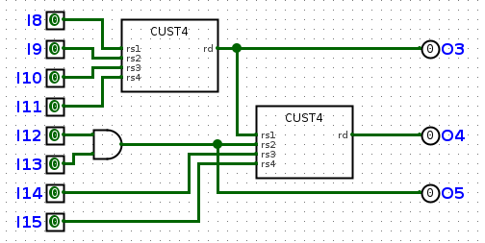

Slide 23
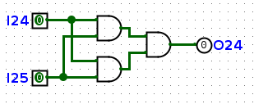
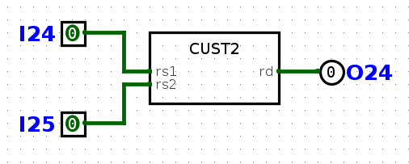
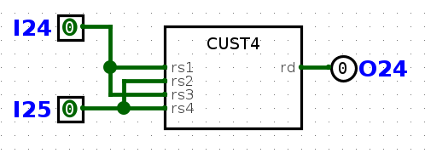
2. Merging reused operands
AND w20, i24, i25;
AND w21, i14, i25;
AND o24, w20, w21;
Towards more flexibility...
Notes:
16 bits. TOWARDS MORE FLEXIBILITY
_____13________

Slide 24
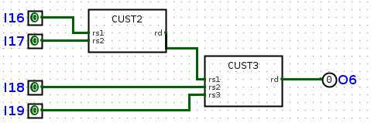
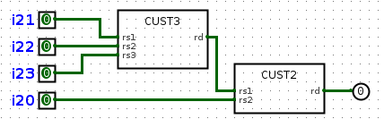
4-inputs fusion examples (2)
“C-fusion”
“D-fusion”
CUST w13, [CUST2], i16, i17;
CUST o6, [CUST3], w13, i18, i19;
CUST w17, [CUST3], i21, i22, i23;
CUST o20, [CUST2], w17, i20;
Notes:
Can occur only after 1 iteration

Slide 25
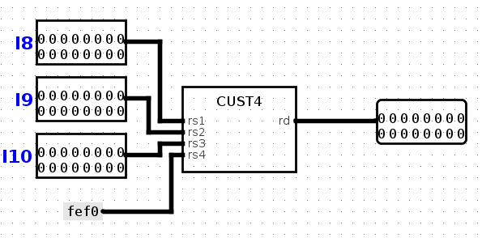
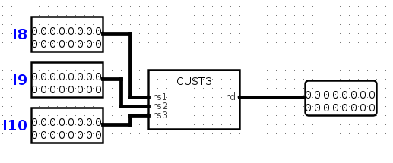
3. Arity reduction : Constant folding
Notes:
absorbion

Slide 26
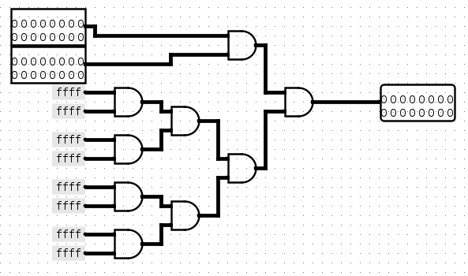
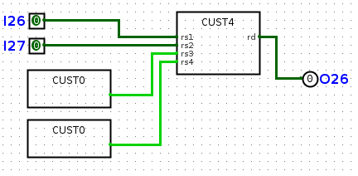
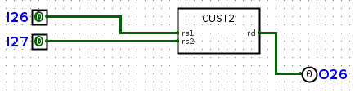
4. Merging nodes of arity 0
Notes:
Won't happen if we run constant folding pass

Slide 27
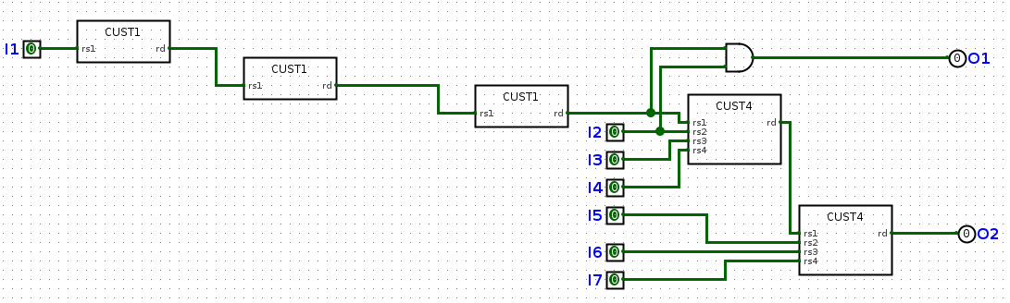
5. Collapsing chains of arity-1 nodes
collapsing
Notes:
after constant absorbsion.
understand '1' as Constant

Slide 28
Notes:
input i1 is included in cust4

Slide 29
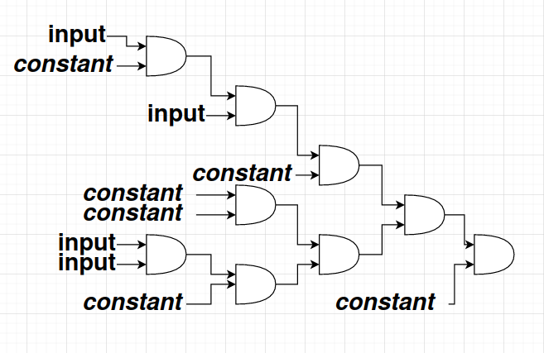

Slide 30
6. Repeat
At start, only arity-2 nodes
Now we have all kind of different nodes
Rerun to find new fusions
Notes:
new possibilities
_____15__________

Slide 31
Limit the number of fusions
In HW, bounded to 32 distinct custom functions
One function can correspond to many fusions
Notes:
basic description of ExprTreeToFusion

Slide 32
Problems (1)
Best fusions at an iteration may not be the best over iterations
Useless constant merging
Performance : Exponential runtime for optimal choice of fusions

Slide 33
Problems (2)
Function equality
(((a & b) & c) & d) == ((a & b) & (c & d))
((a & b) & (a & b)) == (a & b)
((a | b) ^ (c & d)) == ((c & d) ^ (a | b))

Slide 34
Benchmarks
Mips32 : a 32 bits MIPS processor
PicoRV32 : small 32 bits RISC-V processor
Swizzle : inversion of a simple bit vector
XorReduce : XOR bit reduction of bit vector
Xormix32 : pseudorandom number generator
Bitcoin : a bitcoin mining simulation
Notes:
Bitcoin : bunch of parallel SHA units to find a nonce
___18__________

Slide 35
Benchmarks : additional information
 | #collision zones | largest collision zone
Mips32 | 4 | 15
PicoRV32 | 72 | 48
Swizzle | 1 | 17
XorReduce | 1 | 37
Xormix32 | 36 | 291
Bitcoin | 12 | 11
Notes:
Process => biggest, without E-fusions to have smaller numbers

Slide 36
Benchmark results
Random choice
 | #Cycles before | #Cycles after | Speedup | Custom Functions | Fusions | Loop iterations
MIPS32 | 335 | 315 | 5.97% | 13 | 23 | 3
PicoRV32 | 2028 | 1767 | 12.87% | 32 | 216 | 2
Swizzle | 57 | 46 | 19.30% | 4 | 4 | 3
XorReduce | 107 | 87 | 18.69% | 4 | 14 | 3
Xormix32 | 1808 | 1269 | 29.81% | 32 | 431 | 2
Bitcoin | 266 | 225 | 15.41% | 14 | 141 | 4
Notes:
Custom functions = max/process, Fusions = per program, Loop iter=max/process
PicoRV & Xormix hit maximum !!

Slide 37
Benchmark results
Smarter choice
 | #Cycles before | #Cycles after | Speedup | Custom Functions | Fusions | Loop iterations
MIPS32 | 335 | 315 | 5.97% | 13 | 23 | 2
PicoRV32 | 2028 | 1770 | 12.72% | 32 | 175 | 2
Swizzle | 57 | 46 | 19.30% | 4 | 4 | 3
XorReduce | 107 | 85 | 20.56% | 2 | 12 | 2
Xormix32 | 1808 | 1092 | 39.60% | 32 | 384 | 2
Bitcoin | 327 | 279 | 14.68% | 13 | 119 | 3
Notes:
Smarter choice = If N>30:heuristic choice, else locally optimal choice
Xormix v.good

Slide 38
Benchmarks : Unbounded functions
HW with support for infinitely many LUTs
Random choice
 | #Cycles before | #Cycles after | Speedup | Custom Functions | Fusions | Loop iterations
MIPS32 | 335 | 315 | 5.97% | 13 | 23 | 2
PicoRV32 | 2028 | 1528 | 21.84% | 64 | 319 | 3
Swizzle | 57 | 46 | 19.30% | 4 | 4 | 3
XorReduce | 107 | 89 | 16.82% | 2 | 10 | 2
Xormix32 | 1808 | 1105 | 38.88% | 44 | 360 | 4
Bitcoin | 219 | 187 | 14.61% | 13 | 117 | 3
Notes:
PicoRV really benefits...

Slide 39
Benchmark results
HW with support for infinitely many LUTs
Smarter choice
 | #Cycles before | #Cycles after | Speedup | Custom Functions | Fusions | Loop iterations
MIPS32 | 335 | 315 | 5.97% | 13 | 23 | 2
PicoRV32 | 2028 | 1578 | 22.19% | 62 | 316 | 3
Swizzle | 57 | 46 | 19.30% | 4 | 4 | 3
XorReduce | 107 | 85 | 20.56% | 2 | 12 | 2
Xormix32 | 1808 | 995 | 44.97% | 32 | 364 | 3
Bitcoin | 211 | 182 | 13.74% | 14 | 120 | 3
Notes:
v.good on Xormix

Slide 40
Benchmarks results

Slide 41
Conclusion
Manticore : Parallelize RTL simulation on FPGAs
Compiler : Pass to find custom functions
Algorithm : Fixed-point based loop
  Pattern matching search
  Selection (random/locally optimal/heuristic)
  Transformation (arity reduction, collapsing)
~20% speedup on some circuits

Slide 42
1.3 Fusion selection : locally optimal
Locally optimal choice
  find best among all Maximum Independent Sets
NP-hard : O(3^{N/3}) *
Recursive implementation with memoization
* J.W. Moon & L. Moser (1965), “On cliques in graphs”, Israel Journal of Mathematics.
Notes:
"Maximum independent set". in weighted nodes
Complementary to maximum clique in complement graph.
If many plans with same gain, choose at random.
typical values of N : 1-300.

Slide 43
3. Arity reduction : Constant folding
Each fusion is represented by an expression tree e.g.
  (%0, %1, %2, %3) => ((%0 & %1) ^ (%2 | %3))
Constants can be absorbed to create new fusions e.g.
  (%0, %1, %2) => ((%0 & 255) ^ (%1 | %2))
Notes:
argument.
A-fusion.
SHIFTing arguments.

Slide 44
Benchmarks : with all fusions
 | #collision zones | largest collision zone
Mips32 | 7 | 27
PicoRV32 | 86 | 81
Swizzle | 1 | 30
XorReduce | 1 | 71
Xormix32 | 37 | 510
Bitcoin | 12 | 20
Notes:
obviously 1 A-fusion => 2 more E-fusions

Slide 45
Recursion hypothesis
Gain achievable with available fusions A, B, C =
  max(
    Gain of fusion A + gain achievable with available fusions B, C minus fusions excluded by A
    Gain of fusion B + gain achievable with available fusions A, C minus fusions excluded by B
    Gain of fusion C + gain achievable with available fusions A, B minus fusions excluded by C
    )

Slide 46
remaining chosen gain
{f1,f2,f3,f4}
f1 -> {f4} 2
f4 -> {} {f1, f4} 3
f2 -> {f4} 2
f4 -> {} {f2, f4} 3
f3 -> {} {f3} 2
f4 -> {f1, f2} 1
f1 -> {} {f1, f4} 3
f2 -> {} {f2, f4} 3

Slide 47
Data structure to hold functions and fusions
class ExprTreeToInstructionSet() extends mutable.AbstractMap[ExprTree, Set[Instruction]]{
  def hasFunction(inst : Instruction) : Boolean //returns true if the instruction is found in one of the sets
  def removeInstruction(inst : Instruction) //removes the instruction from the set, and removes associated ExprTree if set is empty
  ...

